Slide 1
Introduction to the HIV estimates process
UNAIDS, Geneva
October 2022
Notes:
This presentation provides an introduction to the HIV estimates process and is intended for people with very little familiarity with the estimates.

Slide 2
Objectives of presentation
To provide the background around the estimates
Why UNAIDS supports countries to produce estimates?
What indicators are calculated?
How the models are produced, what data are used?
Who develops the country estimates and the models?
When are the estimates due, what are the timelines?
Notes:
After the presentation you will understand the background of why UNAIDS supports countries to produce these estimates, their mandate
What are some of the indicators calculated

Slide 3
Why does UNAIDS support countries to produce estimates?
Since 2001 UNAIDS has been mandated through political declarations to support countries to monitor and report on their HIV epidemics
Sustainable Development Goal 3.3.1: HIV incidence per 1,000 uninfected population
UN Political Declarations on HIV/AIDS 2016: specific targets on HIV incidence and AIDS-related mortality
These indicators are not possible to measure directly over frequent intervals – so we use models to estimate these values

Slide 4
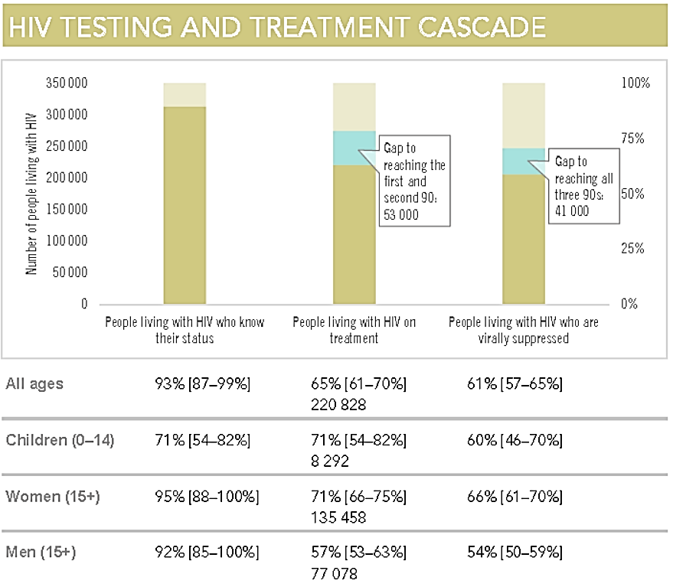
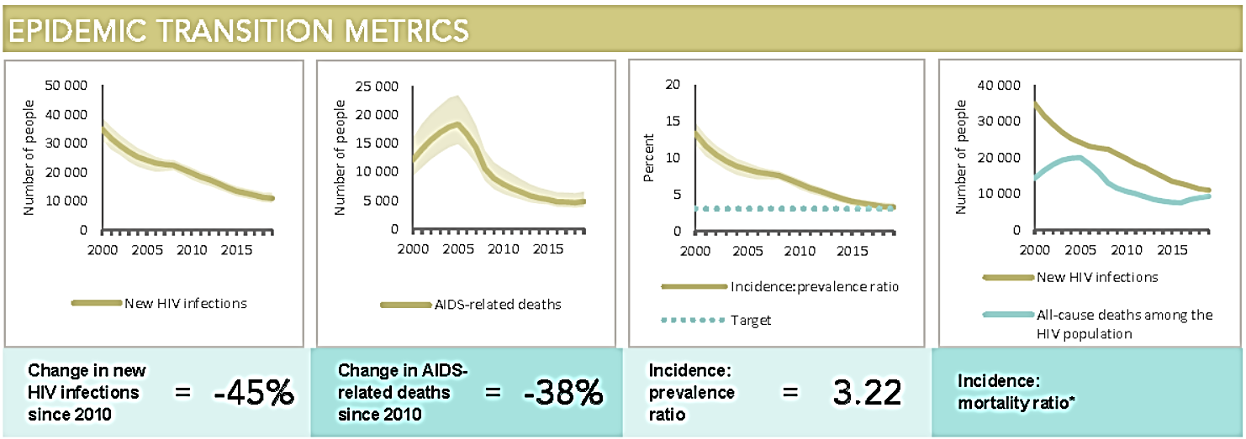
Country uses of the estimates
Source: UNAIDS 2020 Data book
To understand the trajectory of their HIV epidemic
To monitor and improve their HIV response
To inform targets for national strategic frameworks and donor agreements
Triangulates all available, high quality, data to calculate the best estimate

Slide 5
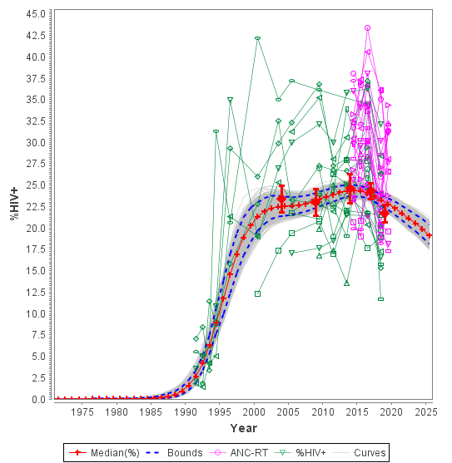
How are the estimates produced?
HIV prevalence over time, multiple data sources
Every year UNAIDS supports 170 countries to develop HIV estimates using Spectrum software
Indicators include historical trends of people living with HIV, new HIV infections and AIDS related deaths, etc
Models incorporate data available in each country and use multiple data sources to create the best estimate to track the epidemic
Examples of data included in the models: prevalence from sentinel surveillance, people receiving ART, prevalence and incidence from household surveys, case surveillance, key population size estimates
In some countries, with robust data, modeled estimates are produced at the district level to better focus HIV responses
Example of data used in a generalized epidemic country
Green lines are ANC sentinel surveillance
Pink lines are routine testing among ANC attendees
Red diamonds are household surveys
Grey lines are the lines that fit those data
Red line is the average of the grey lines
Notes:
UNAIDS supports about 170 countries, representing 99% of the global population, to produce estimates using Spectrum software.
The indicators produced for these estimates include PLHIV, New infections, AIDS deaths, treatment coverage and many more. The models produce historical trends of these indicators.
The data going into the model vary depending on what data sources exist in the country.
The example on the right shows the data used in a generalized epidemic country with robust data from the general population. The green lines are the data available historically from ANC sentinel sites, the pink lines are the routinely collected data from all ANC attendees in the country on prevalence – capturing real time data to inform the latest trends in the country and the red diamonds are household survey data which bring in the data from the population outside of antenatal clinics.

Slide 6
Country teams
In-country teams develop these estimates with support from UNAIDS
Teams usually consist of national M&E focal person, epidemiologists, programme managers, UNAIDS Strategic Information Advisers, multilateral and bilateral partners
By relying on these country teams, this process:
Ensures country ownership of results
Builds capacity to use models
Guarantees that critical country knowledge is used to build the country’s estimates
Also builds collaboration among the team and ensures that all stakeholders are using the same data
Capacity building is ongoing: every other year UNAIDS holds regional workshops to build capacity to use the models, during the off years UNAIDS supports teams through UNAIDS country offices and remotely
Sign off of the results is provided by Minister of Health or Director of National AIDS Commission before being published by UNAIDS
Notes:
So who produces these estimates.
UNAIDS has committed to ensure that countries are able to produce these estimates and so teams exist in each country and are supported by UNAIDS.
These teams typically include national M&E officers, epidemiologists, programme managers from PMTCT or ART, and are supported by UNAIDS country office, and other multilateral and bilateral partners
These teams have a number of advantages to the process:
1. Ensures that the country owns these estimates and uses them for their planning and reporting
2. Builds the capacity of nationals and partners to use the models to help answer questions. What would be the impact on AIDS deaths if ART were scaled up faster, or the impact on infant infections if pregnant women were retained on treatment
3. The people entering data into the models have the best knowledge of those data and systems to collect those data. This ensures that the country knowledge is used to build the estimates.
4. Finally the process builds collaboration in the country and means that all stakeholders are using the same data.
Capacity building is an ongoing process. Every two years UNAIDS holds in person regional trainings on how to use the models. During the intervening years UNAIDS supports countries through country offices and remotely.
Finally UNAIDS requests sign off on the final estimates from country leadership to ensure they recognize and use those estimates in their work.

Slide 7
Reference Group advises on software development
The models are informed by the UNAIDS Reference Group on Estimates, Modeling and Projections
Group of experts from epidemiologists, demographers, statisticians, public health experts and programme managers
Meets twice a year to improve models and incorporate the latest research
Information on this group, the meeting notes and members can be found at www.epidem.org
The actual Spectrum model is developed by Avenir Health, a non-profit organization based in the United States (avenirhealth.org)

Slide 8
Timeline for producing estimates: Updated every year
December: Release of software with any change to assumptions
January – March: countries teams enter updated data, rerun models review results, share with country stakeholders
March – April: UNAIDS reviews results
May: UNAIDS requests Ministers of Health or Heads of NACs to approve the results produced by the country teams
July: results are published on AIDSinfo.unaids.org and in UNAIDS reports (also in UNICEF, WHO and other partners’ reports)
Faster process available for countries on shorter timelines

Slide 9
More information
To see the results go to aidsinfo.unaids.org
To read an overview of the methods see Annex of the latest UNAIDS Global AIDS Update Report which are published every July and can be seen at unaids.org
To learn about the UNAIDS Reference Group on Estimates, Modeling and Projections which advises on the models go to www.epidem.org

