Slide 1
Overview of Models and Tools Used to Generate HIV Estimates
John Stover
UNAIDS 2023 Workshop on
HIV Estimates and Identifying Inequalities

Slide 2
Purpose of HIV Epidemic Modeling Synthesize data to estimate key HIV indicators
Data
Surveys
Surveillance
Program data
Models
Estimated Indicators
PLHIV
Incidence
Mortality
Treatment coverage
Notes:
UNAIDS coordinates an annual process to prepare estimates of key HIV indicators. These estimates are used to understand the burden of HIV across the world, to track progress in combatting the epidemic and to identify priority areas for action. We use various data sources to prepare these estimates. Each contributes to our understanding, but none provides a complete picture. National surveys are good for understanding prevalence and incidence rates at one point in time but are not available for all years and do not tell us about the number of people affected. Program data tells us about the number of people receiving services but may not tell us anything about who is missed. Special research studies help us to understand HIV dynamics but are limited to the populations studies. Therefore, we use models to translate the available data into estimates of trends and levels of the key indicators that are useful to guide program decisions and track progress.

Slide 3
Structure
Data > Model > Results
Demographic Data
Spectrum/AIM Calculations
Adults
Mother-to-child transmission
Children
National Results
Number HIV+
New Infections
AIDS deaths
Need for ART & PMTCT
Coverage of ART & PMTCT
Program Statistics
Epidemic Patterns
Surveillance, Survey and Routine Testing Data
Prevalence & incidence trend
Generalized epidemic: EPP-Gen.
Concentrated epidemics:
EPP / CSAVR / AEM / ECDC
Notes:
The estimates start with data, as shown in the gold boxes on the left. National sources provide demographic data, programs statistics and surveillance, survey and testing data. Epidemic patterns, such as progression and mortality rates, are derived from special studies and reviewed by the UNAIDS Reference Group on Estimates, Models and Projections. These data are used to estimate trends in adult incidence and prevalence over time using one of several models, depending on the type of data available. The incidence trends and other data are used by the Spectrum/AIM model to calculate HIV transmission to children and progression and morality in all PLHIV. The results of these calculations are summarized for the national level in key results such as new infections and AIDS-related deaths by sex, age and time. If surveys are available, the national results can be used in the Naomi model to calculate key indicators at district level. These subnational results can also be transferred to the PEPFAR datapack for detailed PEPFAR planning.

Slide 4
Estimating Incidence Trends – Concentrated epidemics Different models can be used, depending on the data available
Model | Data Required
Estimation and Projection Package (EPP) | Prevalence data for ANC clients and Key Populations from: Sentinel Surveillance and IBBS Routine programmatic testing & Population Group Size Estimates
AIDS Epidemic Model (AEM) | Surveillance prevalence data: ANC clients & Key Populations Population Group Size Estimates Program service coverage
Case Surveillance and Vital Registration (CSAVR) | New HIV diagnoses AIDS-related deaths Optionally, CD4 count at diagnosis
ECDC HIV Model | Case-based or aggregate surveillance data: New HIV diagnoses, AIDS diagnoses, AIDS-related deaths
Notes:
Several different model are available to estimate HIV incidence and prevalence trends. The selection of which model to use depends on the data available.
EPP is designed for countries with robust HIV surveillance data. For generalized epidemics this includes estimates of HIV prevalence from surveillance among ANC attendees, routine testing among ANC attendees and national household surveys. EPP can also use data on ART coverage from national surveys. For concentrated epidemics, EPP uses data from surveillance among key populations as well as ANC attendees.
CSAVR is designed for countries that do not have good surveillance data but do have good case reporting. It requires information on new HIV diagnoses by year and AIDS-related deaths and can also use information on CD4 counts at diagnosis if available.
AEM is used in most Asian with good surveillance data on key populations and information on behaviors and STI trends over time
ECDC is used in European and other High-Income countries with good case-based surveillance for HIV. It fits reported HIV and AIDS case and/or death numbers.

Slide 5
Estimating Incidence Trends – Generalized & Concentrated Epidemics Different models can be used, depending on the data available
Model | Data Required
Estimation and Projection Package (EPP) | Surveillance prevalence data for ANC clients and/or Key Populations Population Group Size Estimates Can also use: Prevalence from routine testing among ANC attendees Prevalence and ART coverage from national household surveys
AIDS Epidemic Model (AEM) | Surveillance prevalence data for, ANC clients and Key Populations Population size estimates Program service coverage
Case Surveillance and Vital Registration (CSAVR) | New HIV diagnoses AIDS-related deaths Optionally, CD4 count at diagnosis
ECDC HIV Model | Case-based or aggregate surveillance data: New HIV diagnoses, AIDS diagnoses, AIDS-related deaths
Notes:
Several different model are available to estimate HIV incidence and prevalence trends. The selection of which model to use depends on the data available.
EPP is designed for countries with robust HIV surveillance data. For generalized epidemics this includes estimates of HIV prevalence from surveillance among ANC attendees, routine testing among ANC attendees and national household surveys. EPP can also use data on ART coverage from national surveys. For concentrated epidemics, EPP uses data from surveillance among key populations as well as ANC attendees.
CSAVR is designed for countries that do not have good surveillance data but do have good case reporting. It requires information on new HIV diagnoses by year and AIDS-related deaths and can also use information on CD4 counts at diagnosis if available.
AEM is used in a number of Asian with good surveillance data on key populations and information on behaviors and STI trends over time
ECDC is used in European countries with good case-based surveillance for HIV. It can also use aggregate data on new diagnoses, AIDS cases and AIDS-related deaths.

Slide 6
Methods and models used to create HIV estimates
Incidence model | Countries | Regions
EPP, Generalized epidemic | 37 | Eastern and southern Africa, Western and central Africa, Caribbean, Asia-Pacific
EPP, Concentrated epidemic | 39 | Middle East and North Africa, Eastern Europe and central Asia, Caribbean, Latin America, Asia and the Pacific
AIDS Epidemic Model | 13 | Asia and the Pacific
CSAVR or ECDC model fitting deaths and/or case reports | 69 | Middle East and North Africa, Eastern Europe and central Asia, Caribbean, Latin America, Western and central Europe and North America, Asia and the Pacific
Other | 14 | Western and central Europe and North America, Asia and the Pacific, Latin America, Eastern and southern Africa

Slide 7
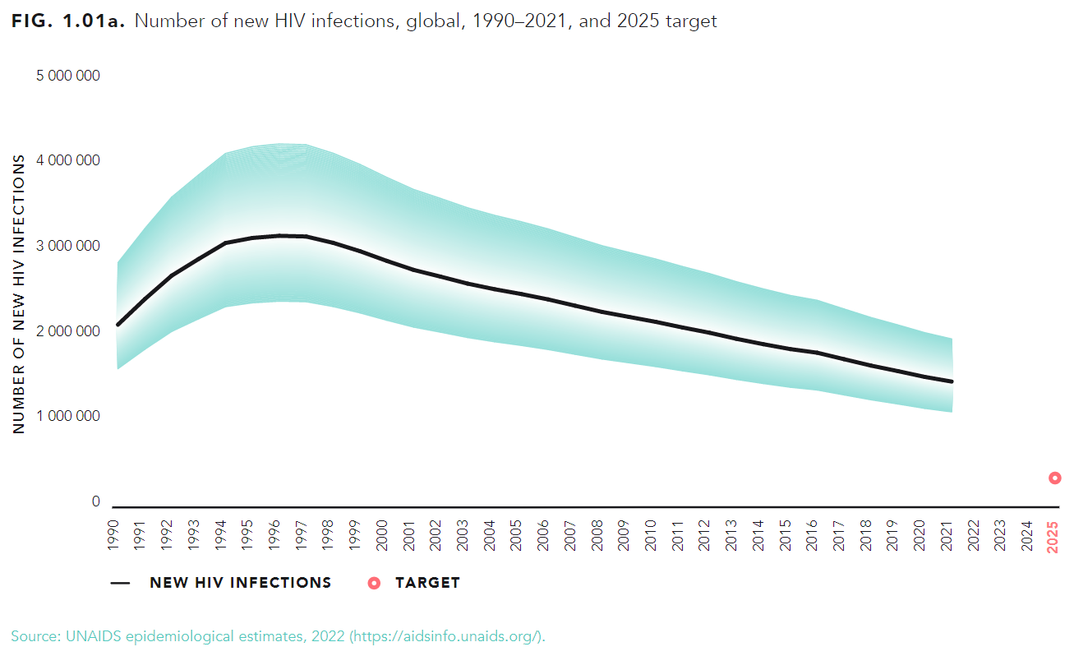
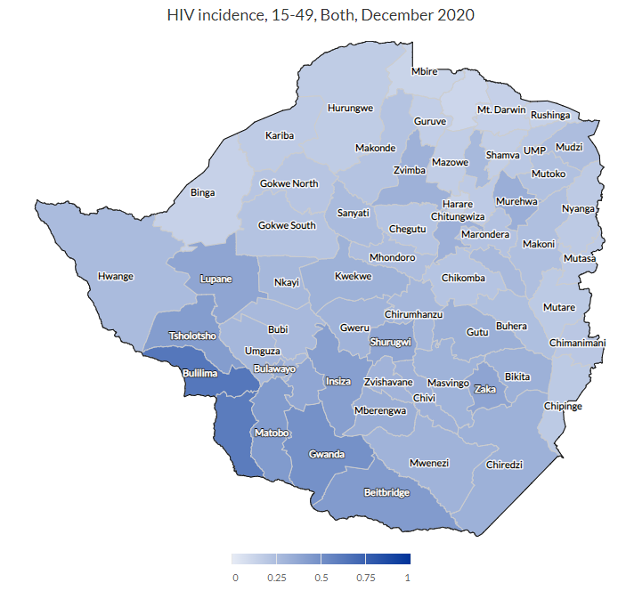
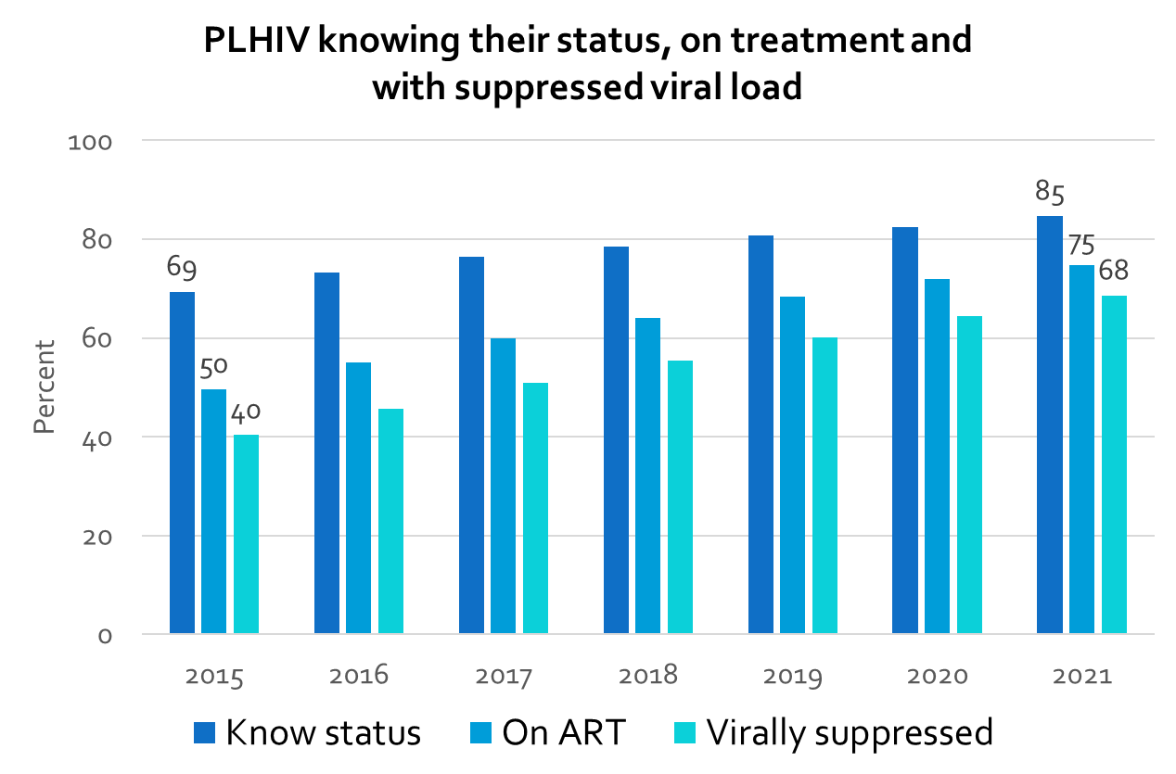
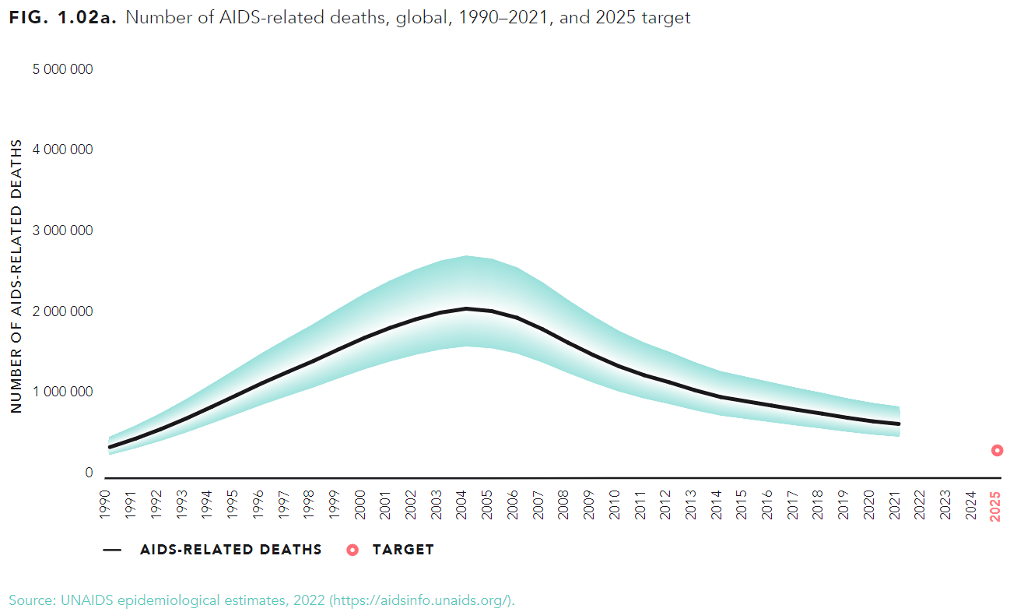
Key Results from HIV Estimates
Notes:
The pay-off from the process is a set of updated estimates using the latest national data that indicate the status of the epidemic and can be used for planning the next steps of the response. Outputs include trends in new infections and AIDS deaths, the treatment cascade showing the remaining gaps and, in come cases, subnational estimates that can be used for detailed planning at subnational levels.

