Slide 1
PMTCT, ANC testing/surveillance and ART program data
Eline Korenromp (UNAIDS)
UNAIDS workshop on HIV Estimates and Identifying Inequalities in the Middle-East and North Africa region
Cairo, 19-23 February 2023

Slide 2
Update program data
PMTCT
ANC testing
ART
HIV testing (NEW)
Knowledge of Status (Day 3)
Viral suppression (Day 3)
Key populations (NEW – Day 1 PM)

Slide 3
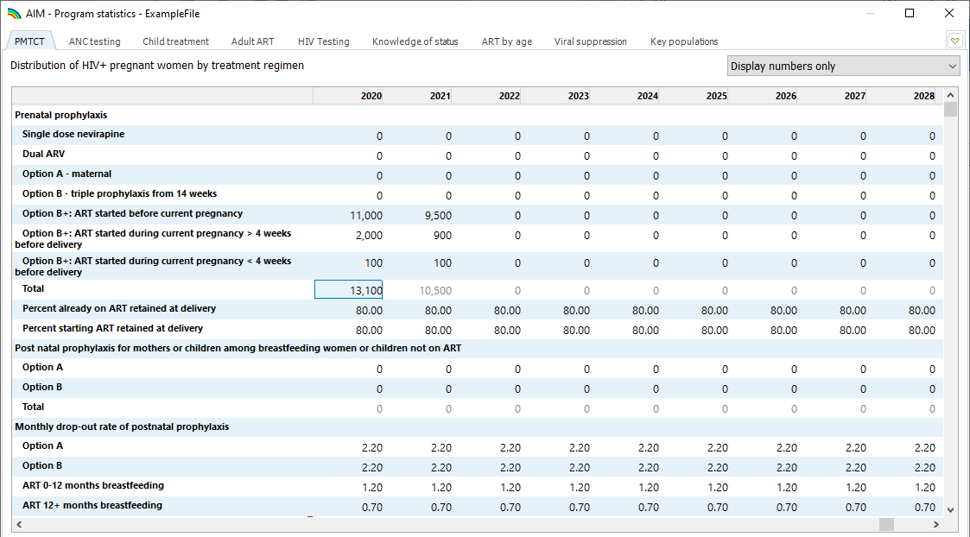
PMTCT
1
2
Display numbers
Add prenatal data for 2022
Check retention at delivery
Check monthly drop-out from ARVs during breastfeeding
Plot values
3
4
5

Slide 4
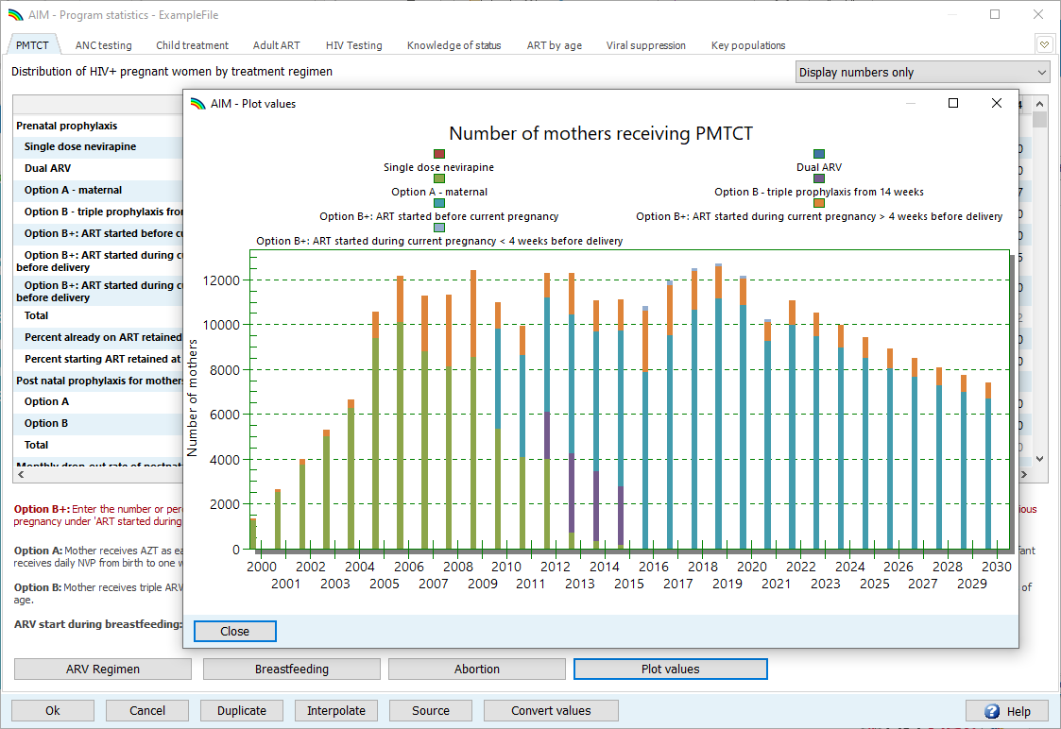
Plot buttons

Slide 5
ANC testing Validation of ANC data
Notes:
Enter data indicated
New row 1: Program reported births (compare to Spectrum calculated births as a starting point for investigating MTCT rate and PMTCT coverage issues)
New row 2: Known HIV- at first ANC (some country’s DHIS capture this. When available these should be counted towards denominator of HIV prevalence at ANC)
Can use the “HIV+ (census-level ANC-RT)” row to check manual calculations against Spectrum calculations. This may be useful for checking understanding before updating subnational inputs in EPP.

Slide 6
Analyze ANC data quality: Used for fertility adjustment and/or EPP fitting
Routine testing data can be challenging, sometimes difficult to discern trends from reporting artifacts
Initial guidance on ANC sentinel surveillance suggested focus on high-HIV sites
During initial scale-up, HIV testing at ANC moved from higher- to lower-prevalence areas → Early years not nationally representative, stabilized later.
Managing individual-level reporting difficult, especially before electronic reporting systems are available
Before using ANC-RT data:
Include women already known to be positive, in numerator (HIV+) and denominator (sample size).
Count all first tests (max. one per pregnancy) – including first tests at labor or delivery
Fit only years of data that are complete, or representative nation-wide.
Watch for sharp increases or decreases; prevalence trends should be stable
Watch for: false positives, changes in testing algorithms, stockouts and their impacts, and rates of refusal.
Review household survey data on the % of women not attending ANC and their characteristics, to understand biases.
Notes:
Many issues can influence the prevalence trends produced by ANC routine testing data including changes in service provision over time, the expansion of coverage of routine testing, and the increasing reach of electronic reporting systems as they expand to more and more places. All of these can affect how timely and complete your data is. They can also influence the epidemiological trends, e.g., as systems expand, they normally move from higher prevalence areas to lower prevalence ones introducing an artifactual decline in HIV prevalence. One way to deal with this might be to not use the trend data from routine testing until the coverage of the system has stabilized.
Accordingly, we recommend that before you use your ANC-RT data you consider some of the issues presented here: how has your routine testing system and its geographic and population coverage been changing over time? Have known positive women been included in the reporting or not? Has only the first test at an ANC visit been included? Are first tests at labour and delivery included? Have you considered changes in the testing over time, including the kits used and false positive rates in low prevalence settings, the algorithms used, refusal rates and the influence of stockouts on completeness of testing? Have you read any available quality assurance reports and compared the prevalence data against other sources such as household surveys?
Given how important the trends produced by EPP will be to determining the trends in your national estimate, it is worth spending some time considering these factors and consulting with experts as necessary to better understand how they influence your data and which data should be used or excluded.

Slide 7
Adult ART, 15+ years
1
Select “Number of percent”
Enter 2022 data
Add Loss to Follow-up, if available*
Enter numbers initiating ART, if available
Plot values.
* important for mortality → distribution of ART by age → prevalence of pregnant women → PMTCT coverage
2
3
4
5

Slide 8
Adjusting ART based on a Data Quality Audit
Check “Enable adjustment” to activate “Enter adjustments” button
Press “Enter adjustments” to open adjustment editor
Example: Morocco in a DQA found that reported numbers had over-counted people on ART by 11% in 2021 → Enter 0.89 as the correction factor
Since reporting issues may go back several years, consider to adjust ART numbers for preceding years too.

Slide 9
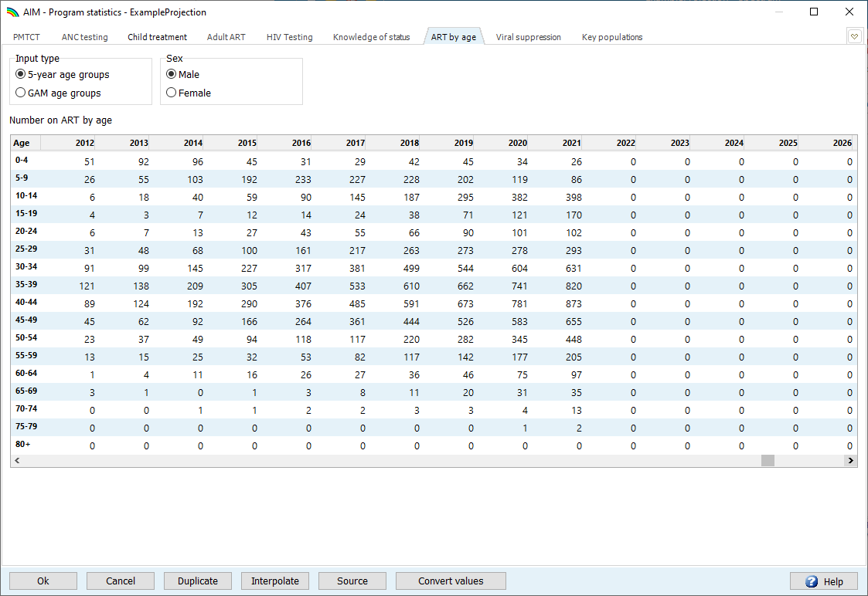
ART by age
Update with 2022 data for each sex
… to estimate the distribution of incidence by age: incidence rate ratios
Disaggregation by 5-year age groups is most informative

Slide 10
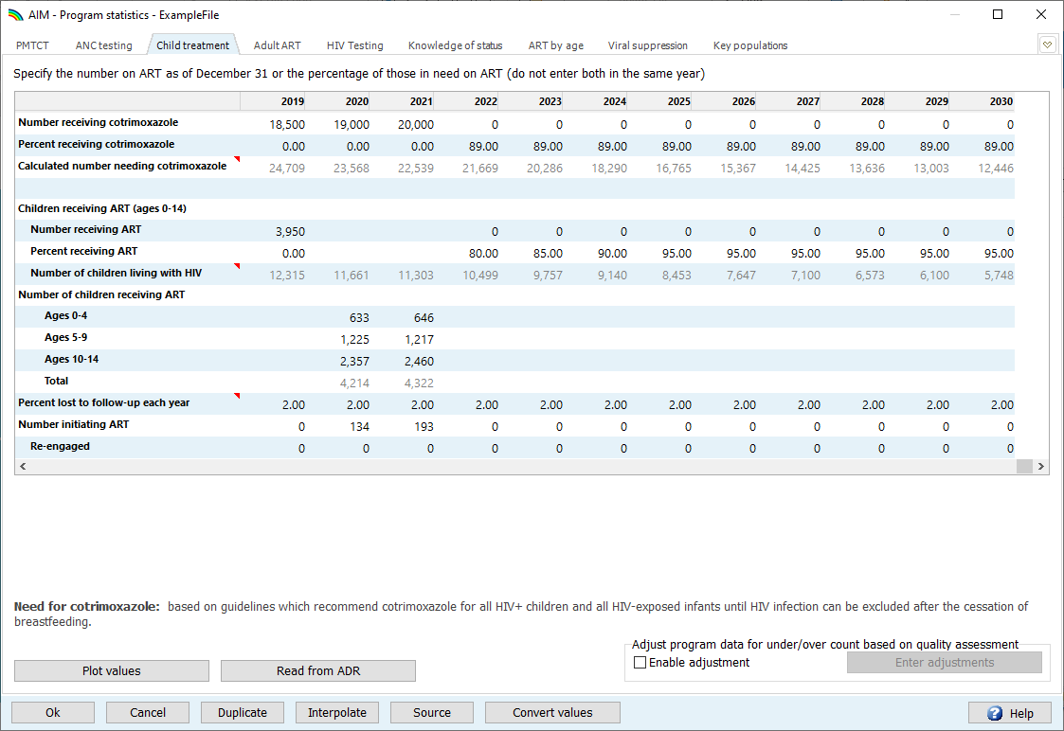
Child Treatment
Ages 0-14 years
1
Update cotrimoxazole for 2022
Update ART for 2022 – overall or by age
Add Loss To Follow Up, if available
Plot values
2
3
4

Slide 11
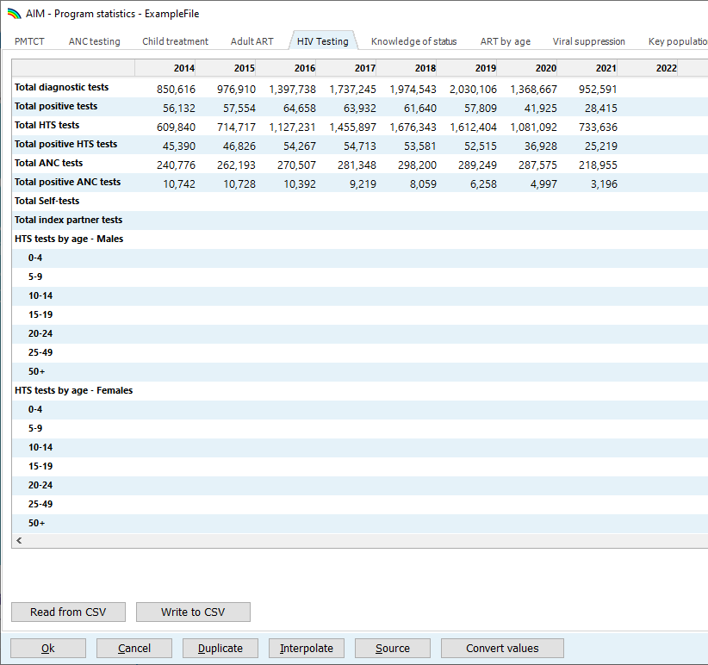
HIV Testing
New editor in Program Statistics, will be blank
Fill all years with data
Does not influence the estimation.
Potential uses:
KOS estimation
Tests drive new diagnoses → context to CSAVR input
Evaluate Tests Program & set targets
Notes:
HTS, ANC, self-test and index-testing are mutually exclusive, their sum may (or not) sum up to the total row.
Do not include blood donors
If possible, record persons tested, not single tests (with duplicate/repeat and confirmatory tests on the same person within 1 year).

Slide 12
What to do if final, full-year 2022 data are still pending?
At time of this workshop, you may not have final program, HIV testing and surveillance data for the full year of 2022 yet.
The ‘final’ 2023 Spectrum estimate will have to wait for those, and then refit (EPP and CSAVR, then AIM).
--> Alert the team back home you are waiting for these data...
You have these options for the Spectrum file:
ART, PMTCT:
Leave or update 2022 as an expected % target, in line with 2021.
As interim placeholder, put 2021 numbers for 2022.
Enter 2022 first part-of-year data
Do NOT leave adult ART blank! Since ART reduces HIV transmission & incidence
Prevalence-type of data (ANC tests & positives, ANC prevalence for EPP):
Enter the data available, e.g. the first 6 of 9 months – and document this in ‘Source’ field, as provisional.
New Cases and deaths, for CSAVR: Leave 2022 values blank.
In the Excel, please enter ALL data types even if only part of the year, for DQA purposes (e.g., test positivity rates corresponding to case counts for CSAVR)
Notes:
Prevalence-type of data: Working with part-of-year data works also for: Viral Load testing & suppression & also CD4 count at diagnoses for CSAVR
& ART by age distribution.
KOS: Leave 2022 blank, until complete.

Slide 13
Copying numbers from Excel to Spectrum, and vice versa
From Excel to Spectrum: Put the cell format in Excel as ‘General’ – any other format (Number, Currency, Accounting…) won’t get saved in Spectrum.
From Spectrum to Excel:
Select cells to copy.
You may increase the decimals shown in Spectrum, and copied to Excel, by right-clicking in (a) cell(s) and ‘Incrementing decimals’
Copy an entire table by right-clicking in the table and selecting ‘Copy All’.

