Slide 1
2024 HIV estimates
Eline Korenromp
Senior adviser Epidemiology and Modelling
UNAIDS, Data for Impact, Geneva
Notes:
Welcome to another round of HIV estimates!
We call this a ‘refresher’ webinar, tailored to those who have been doing HIV estimates for several years, and who attended one or more of the past regional training workshops. So we’ll focus on what’s new and what is especially important this year.
If you are new to this process, you will need a bit more training – please reach out to UNAIDS Strategic Information Advisor in your country or region to help you orient, that is:
Study the training videos and PowerPoint presentations from the 2023 Estimation training workshops,
and go through your country’s Spectrum file from in the last round with its specific history and issues of the input data and results.

Slide 2
Estimates are a cornerstone of the national HIV response
Epidemic estimates are a critical element of the national HIV response
Burden = need for services = denominator for coverage: PMTCT, ART
National Strategic Plans & Performance Frameworks: service coverage & impact targets
Funding requests for Ministry of Health, Global Fund, etc.
Impact evaluation → innovate strategies, adapt priorities
Monitoring and addressing inequalities (age, sex, Key Populations, geography)
Advocacy and global reporting
Sustainable Development Goals: HIV incidence
Monitoring progress towards the 2025 targets set out in the 2021 UN Political Declaration on HIV/AIDS through the annual Global AIDS Monitoring
including inequalities
Inform your senior leadership of the process and the results produced from the Estimates process
Notes:
The HIV estimates produced by the teams are critical for reviews of national strategic plans and setting targets to end AIDS by 2030. The estimates are used for reporting on progress for the global targets through the Global AIDS Monitoring process.
HIV estimates produced by estimates teams are simultaneously becoming more critical to the national response and more complex as they expand to increasingly smaller geographical areas.
These factors, combined with the increasing sophistication of estimates models, place greater pressure on countries to resolve programme data quality challenges.

Slide 3
Thank you
Estimates will inform sustainability roadmaps: for after 2030
‘End of AIDS as a public health treat’ will require ongoing strong AIDS programs!
In 2025 round estimates, we’ll resume program scenario projections
Goals & AEM models project service volumes, coverage targets, cost and health impact – of not only ART and PMTCT but also prevention,
in national program scenarios, to optimize control for your epidemic & keep it sustainable
Good-quality input data on Antiretroviral Treatment:
by Age
New Initiates, interruption, re-initiations, deaths on ART (Electronic Medical Records, Unique IDs)
Data Quality Audits
Validate Spectrum % coverage estimates against program data & surveys
Key Populations:
Population size estimates
HIV prevalence
ART & prevention coverage
AEM, EPP and Goals models
Notes:
Thank you everyone, for all your work on national estimates the last year and years before.
And thank you for the work ahead to update and refine your national estimates in this 2024 round.
We appreciate it, from the UNAIDS global perspective but especially on behalf of those who rely on you, people needing good treatment for their health or prevention services to reduce risk – and people advocating for these needs.
The picture here shows the Global AIDS Update Report that UNAIDS publishes every July, based on your estimates and data. It gives an overview of where countries, regions and the world stands with the AIDS pandemic and the response: progress, successes but also challenges and gaps.
Data: Important all estimation teams examine and ensure data quality, evaluate and explain patterns and adjust data inputs before fitting the Spectrum model to them. For ART, this calls out the importance of Electronic Medical Records with Unique Patient Identifiers.

Slide 4
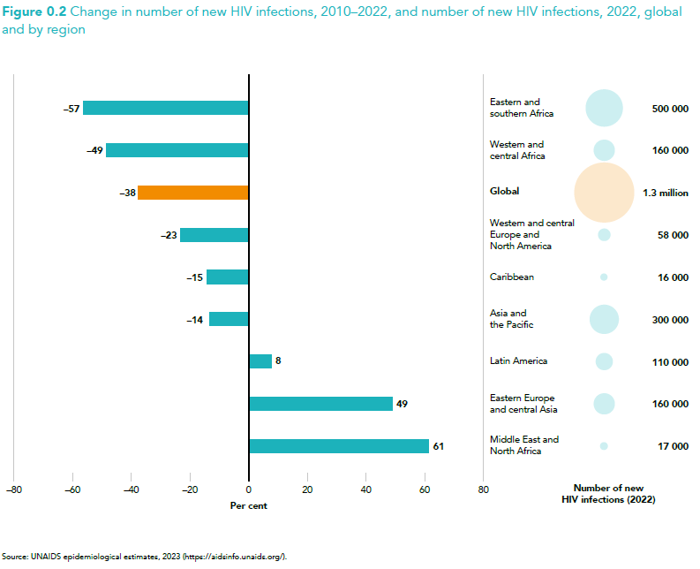
Strong declines in new HIV infections in highest-burden regions (Africa); weaker declines elsewhere – EECA & MENA regions increased
Notes:
The global goal (of the 2021 UN Political Declaration on HIV/AIDS) for reducing annual new infections is a 90% reduction by 2030, relative to 2010 levels.
Based on your estimates, summing them up by region, we see good progress in some regions.
But other regions have much less decline, and some even show increases. Notably the EECA and MENA regions show alarming rises now, after past decades of much slower rates of infections.
Congratulations to all of you who produced the country estimates underlying these regional trends, and especially for making those declines happen! No less, we commend those using estimates of rising epidemics to advocate and strategize for strengthening the AIDS response, adapt a national program, to reverse rising trends.

Slide 5
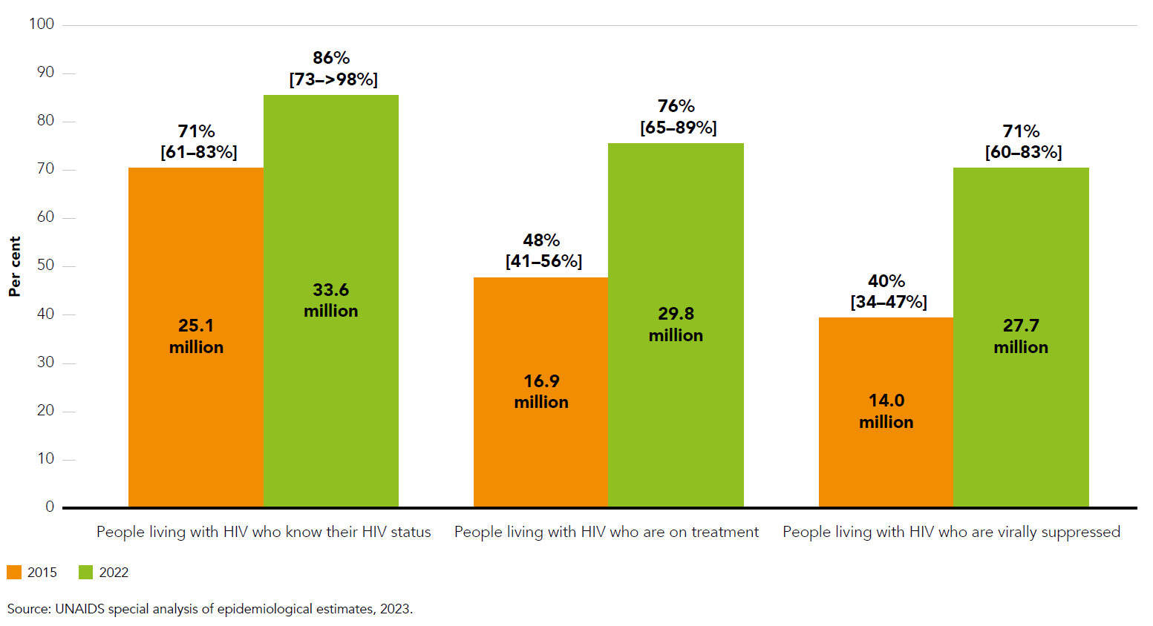
% and number of people living with HIV who know their HIV status, receive antiretroviral therapy and are virally suppressed, globally
Impressive scale-up of HIV testing and treatment since 2015...
but gaps remain
Notes:
Especially in Viral Load Suppression we see a strong increase from 2015 to 2022. This is the combined effect of improved testing and case finding, starting and keeping people on ART and ensuring they get and stay virally suppressed. This is having a huge impact on people’s lives, as well as on the risk of transmission and so on new infections.
Gaps include some countries and regions, but also:
Key Populations – the sparse data available suggest some Key Populations have lower access to key services despite highest need.
Also children lag behind in progress toward all 3 95% targets.

Slide 6
2023 estimates: Most countries could estimate % among PLHIV ART coverage over 2015 to 2021/22 Fewer had high- coverage routine data on Viral Load Suppression
Notes:
Underlying these global estimates, from the 2023 estimates and 2023 Global AIDS Update report, we see that most countries were able to estimate the national ART coverage, as a percentage of all people living with HIV, over the period 2015 to 2021 or to 2022.

Slide 7
Key points for 2024
No in-person regional workshops in 2024 Workshops every other year, next Q1 of 2025
Virtual technical support
UNAIDS (sub-)regional and country Strategic Information Advisors; + consultants for MENA & high-income countries
UNAIDS Data for Impact advisors (Geneva/Nairobi)
AIDS Epidemic Model (Asia): East West Center
Linking (via UNAIDS) to Avenir Health as needed
Spectrum file for UNAIDS review due by 30 March – drafts welcome before!
Key Populations workbook: to review Key Populations data, and initial Goals model representation, preparing for 2025+ national KP estimates, including non-AEM non-EPP countries
Notes:
I will end with 4 slides about the process.
This year today’s refresher class and virtual support, no workshop.

Slide 8
Timeline for 2024 HIV estimates – Concentrated Epidemics
24 January 2024 Updated version of Spectrum released to create 2024 estimates
25 & 30 January 2024 Estimates refresher webinars (Eng/French & Spanish)
Jan.-Feb. 2024 Prepare and quality-review data – countries in MENA, CAR, LA and WCENA filling Excel template
Feb-March 2024 Finalize data and Spectrum fit; share, discuss and refine draft results with UNAIDS advisor
31 March 2024 Submit ‘final’ Spectrum file to UNAIDS for final review. alongside online Global AIDS Monitoring (GAM) report for non-Spectrum indicators
April 2024 Feedback from UNAIDS on Spectrum; GAM validation queries
01 May 2024 Estimates approved by country authority
July 2024 Publication of aggregate regional and global results in Global AIDS Update Report
Approved country indicator results (GAM and estimates) on https://aidsinfo.unaids.org/
All important communication with UNAIDS Estimates Advisors:
Please copy Estimates@unaids.org
Notes:
From 1st of May we will seek county clearance for the estimates.

Slide 9
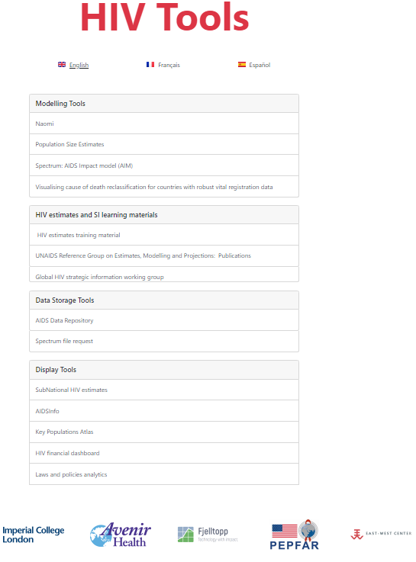
Estimates Training and Guidance materials https://hivtools.unaids.org/hiv-estimates-training-material-en/
Basic Steps to Update Spectrum Eng, Fr, Esp, Arabic, Port
What’s new in Spectrum?
Eng, Fr, Esp, Arabic, Port
Guide for updating Spectrum HIV estimates
Eng, Fr, Esp
All detail, with screenshots
Spectrum user interface
File > Options > Language: Eng, Fr, Esp, Arabic, Port, Chin

Slide 10
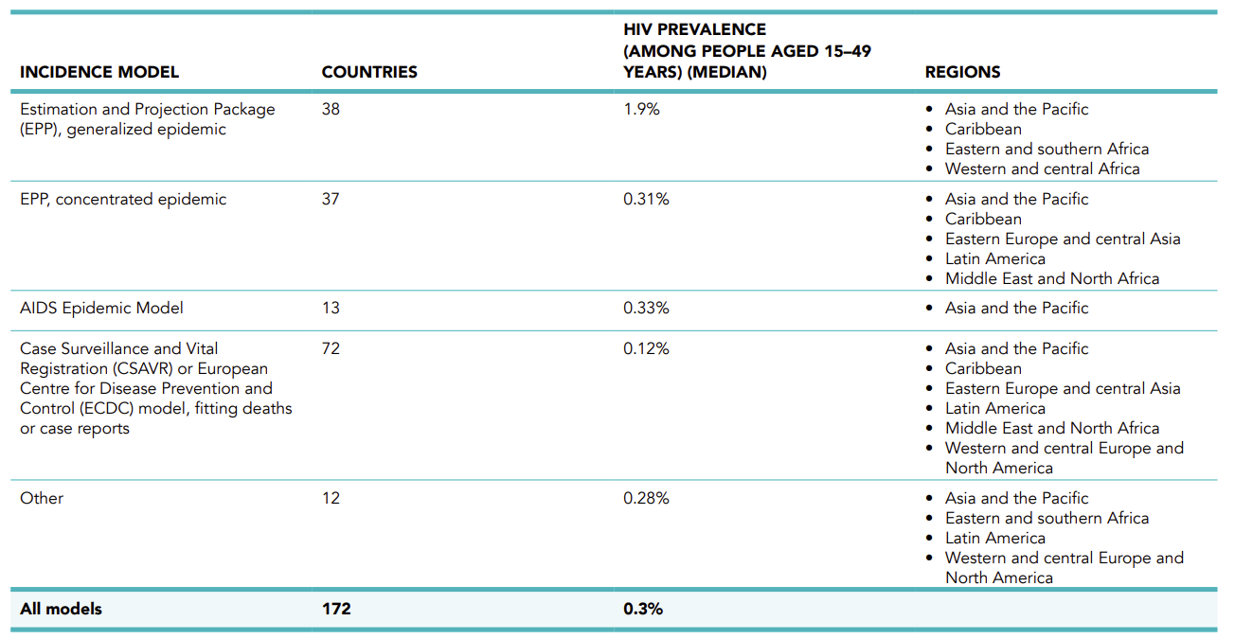
Incidence Model options in Spectrum: Use in 2023 estimation round
Notes:
4
Countries with concentrated HIV epidemics traditionally model their epidemics by generating separate epidemic curves for key subpopulations at higher risk, such as people who inject drugs, men who have sex with men, and female sex workers, alongside the lower-risk general population. EPP and AEM.
However, countries with robust HIV case reporting and vital registration systems opt to utilize case surveillance data rather than serosurvey data, enabling the creation of a unified national set of estimates. Case Surveillance and Vital Registration (CSAVR) or The European Centre for Disease Prevention and Control (ECDC) models are employed in the majority of countries with concentrated epidemics in 2023. These models utilize mortality and case report data to estimate HIV trends.
All models utilize UNAIDS-supported evidence-based assumptions on treatment effectiveness and disease progression, with technical oversight from the UNAIDS convened Reference group on modeling and projections.
Demographic data are sourced from the UN Population Division or recent censuses.

Slide 11
Incidence Model options in Spectrum – used by Latin America countries
Different models can be used, depending on the type(s) of surveillance data available
Model estimating Adult incidence | Input data required | Provides Key Population Estimates? | Countries in 2023 estimates
Estimation & Projection Package (EPP) for Concentrated epidemics | Prevalence data for Key Populations & pregnant women attending Ante-Natal Care from: Sentinel Surveillance and IBBS Routine testing in Ante-Natal Care & Population Group Size Estimates | Yes | 37
AIDS Epidemic Model (AEM) | As EPP + prevention service coverage |  | 13
Case Surveillance and Vital Registration (CSAVR) | New (= First-time) HIV+AIDS case diagnoses AIDS-related deaths optionally CD4 count at initial diagnosis | No | } 72
ECDC model | As CSAVR, + optionally case diagnoses by Mode-of-Transmission for Key Population estimates | Optional

Slide 12
File management: UNAIDS SharePoint country folders
Used by most countries in CAR, LA, MENA & WCENA regions
Excel file to update, review and quality-assure data and consistency
sheets ART, Knowing Status & VL Suppression, PMTCT, ANC tests
EPP countries: sheet EPP prevalence
CSAVR countries: sheets Cases, Deaths, CD4
Sheet ‘Rec(commendation)s’ with county-specific recommendations, pending from last round
Spectrum…PJNZ: Final 2023 file – before editing, resave under new name!
Subfolders 2021 & 2022: 2021 & 2022 final estimation file (for reference)
Subfolder 2023: draft files (PJNZ & XLS) used in 2023 round
Notes:
To facilitate your work on data and Spectrum estimates, and do so with a national team, we have set-up a SharePoint folder for each country, with your archive of past estimations and related working files. You will have received the link to the folder through the UNAIDS Strategic Information Advisor (same, unchanged from the link used in 2023).
As mentioned, data quality is critical for good estimates. To facilitate Data Quality reviews, we recommend you collate and review the input data first in an Excel, and ensure they are quality, and mutually consistent across indicators.
First, please update the XLS, review and ensure the quality and consistency of the data.
Then, copy into the Spectrum file and update the estimation.

Slide 13
Webinar Agenda today
​14.00 Welcome and timeline for the 2024 round of estimates​
14.20 What’s new in Spectrum, CSAVR and EPP​
​14.50 Program and surveillance data collation & quality review, common problems and solutions
15:10 AIDS Epidemic Model (AEM, Asian countries)
15.20 Q&A on Spectrum and Data Quality
15:40 Key Population data and estimation:
2023 global estimates & vision for 2025+ country estimates
Excel workbooks
16.10-17 Open discussion: Progress, challenges, how can we help?​
Notes:
This ends the introduction. I will hand back now to Otilia to introduce the next presenters, and facilitators.

