Slide 1
2024 HIV estimates
Mary Mahy
Director, Data for Impact
UNAIDS, Geneva

Slide 2
Thank you
The importance of your efforts and the estimates in the HIV response
Discussions on sustainability roadmaps to start in 2024
Goals model training in next round of estimates
These provide projections and consideration of what programmes are essential for your epidemic
Good quality input data
Treatment data: survey vs programme data
ANC prevalence: Compare the ANC prevalence calculated for Naomi to the prevalence in the ANC testing tab – why are there differences?

Slide 3
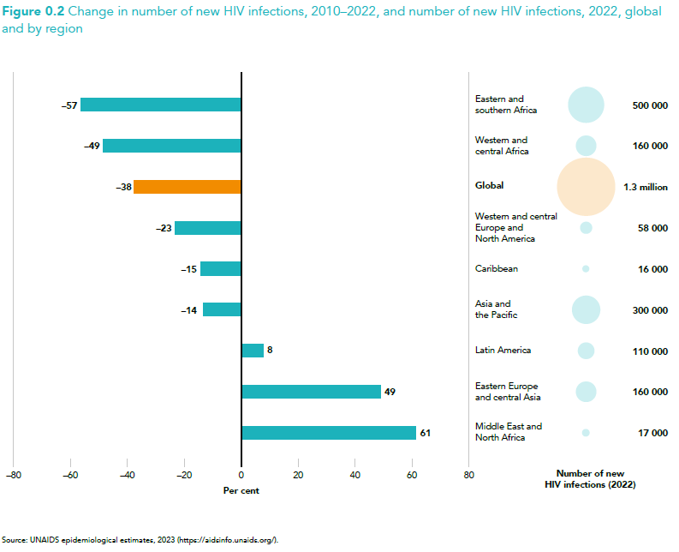
Declines in new HIV infections are strongest in regions with highest HIV burdens

Slide 4
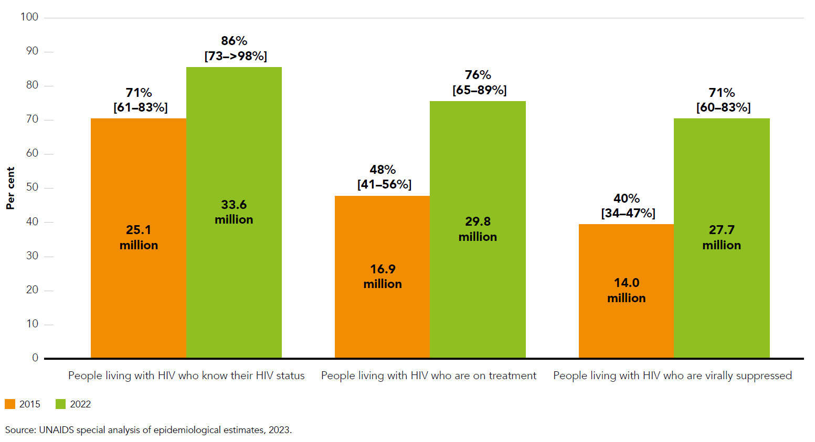
Percentage and number of people living with HIV who know their HIV status, are receiving antiretroviral therapy and are virally suppressed, global, 2015 and 2022
Impressive scale up in cascade since 2015...
But gaps remain

Slide 5
Key points for 2024
No in-person, regional workshops this year
Workshops every other year, so next workshop December 2024- February 2025
Ian Wanyeki taking over support to ESA countries
Estimates due to UNAIDS by 25 January if needed by 5 February
Key Populations workbook can be submitted slightly later, but required for final submission
AIDS Data Repository to be updated with names of team members

Slide 6
Timelines for 2024
1 December 2023: Updated version of Spectrum (and other supporting models/tools) available to create the estimates
11 December 2023: Estimates refresher webinar
30th January 2024: PEPFAR supported countries: Preliminary files (with data up to December 2023) sent to UNAIDS
15th February 2024: UNAIDS feedback sent so countries can use the information for COP planning
1-15 March 2024: Remaining countries: Preliminary files (with data up to December 2023) sent to UNAIDS
31 March 2024: CSV upload with your GAM submission via the GAM online tool (see GAM guidance for full description)
1 May 2024: Estimates approved by senior managers

Slide 7
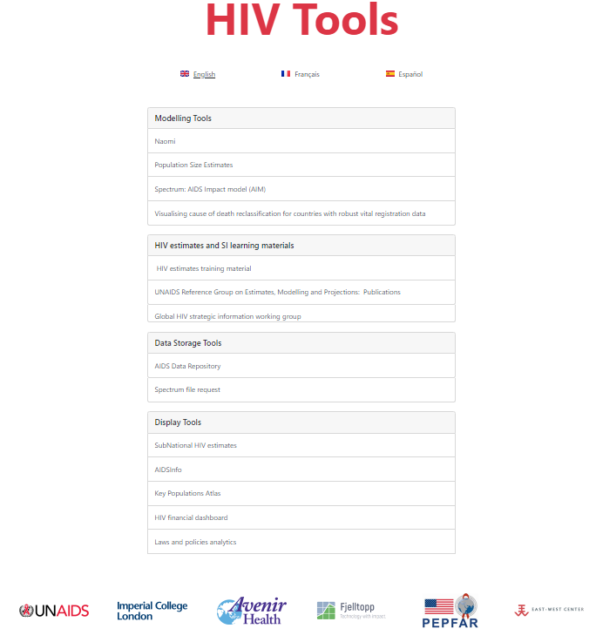
HIVtools.unaids.org is your resource for everything related to the estimates

Slide 8
Today’s agenda
​Welcome and timeline for the 2024 round of estimates​
What’s new?​
Spectrum
Naomi
Child estimates
Key Population workbook
​Available resources and TA​
Feedback from countries on their preparation efforts: Progress, challenges , how can we help?​
Please build your team’s capacity, train new colleagues, and set up roles and responsibilities to ensure successful estimates​

