Slide 1
Key Population data: HIV prevalence, population group sizes, ART
Keith Sabin (UNAIDS)
UNAIDS 2023 Workshop on
HIV Estimates and Identifying Inequalities
Cairo, Egypt, 19-23 February 2023

Slide 2
Key population data – external/internal to models
We must understand impacts of HIV on key population communities & their contributions to national epidemics and responses
… whether or not these are used in the Spectrum incidence estimation model
HIV prevalence in past 10 years (minimum)
Population size estimates (over time)
ART coverage (numbers and/or %) among key populations
HIV testing/new diagnoses by population
To input to: Modes of transmission analyses by country

Slide 3
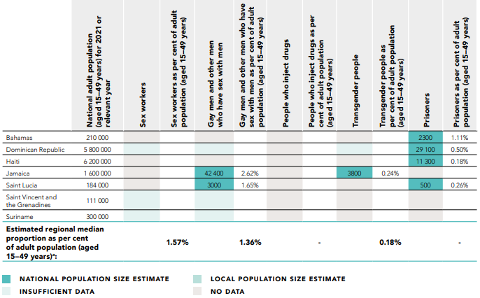
Validity of national HIV estimates for (and from) key populations?
UNAIDS requires “recent” data to publish an EPP-based incidence trends
HIV prevalence estimates for at least one population should be less than 5 years old
2023 round: from 2019 or later
Population size estimates should be nationally adequate
Definition of adequacy: see Sabin et al., 2016
Based on established methods, triangulated & reviewed
Validated against regional estimates

Slide 4
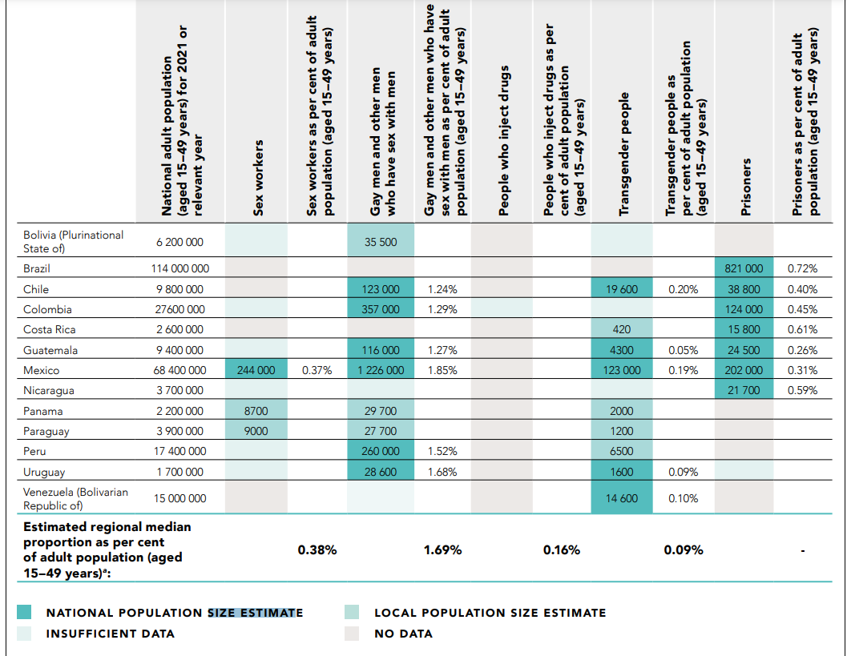
Validity of national HIV estimates for (and from) key populations?
UNAIDS requires “recent” data to publish an EPP-based incidence trends
HIV prevalence estimates for at least one population should be less than 5 years old
2023 round: from 2019 or later
Population size estimates should be nationally adequate
Definition of adequacy: see Sabin et al., 2016
Based on established methods, triangulated & reviewed
Validated against regional estimates

Slide 5
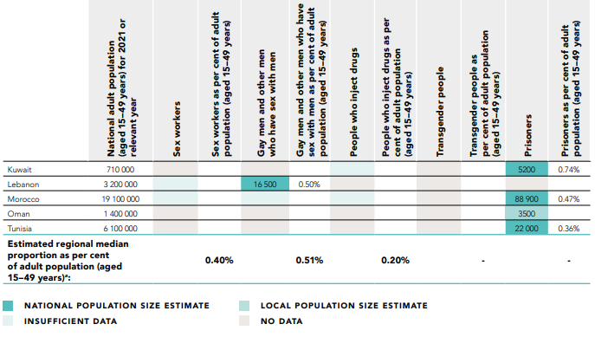
Validity of national HIV estimates for (and from) key populations?
UNAIDS requires “recent” data to publish an EPP-based incidence trends
HIV prevalence estimates for at least one population should be less than 5 years old
2023 round: from 2019 or later
Population size estimates should be nationally adequate
Definition of adequacy: see Sabin et al., 2016
Based on established methods, triangulated & reviewed
Validated against regional estimates

Slide 6
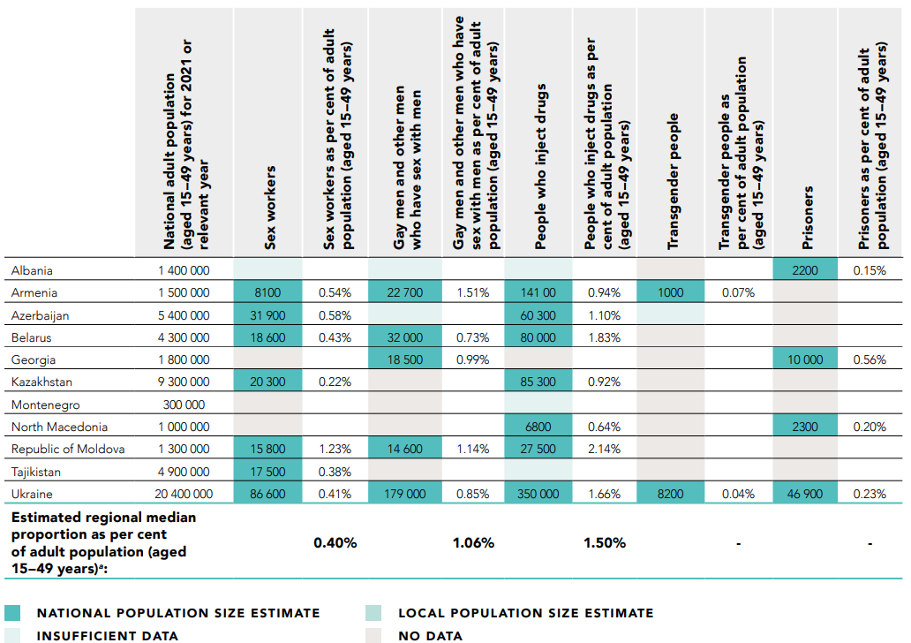
Validity of national HIV estimates for (and from) key populations?
UNAIDS requires “recent” data to publish an EPP-based incidence trends
HIV prevalence estimates for at least one population should be less than 5 years old
2023 round: from 2019 or later
Population size estimates should be nationally adequate
Definition of adequacy: see Sabin et al., 2016
Based on established methods, triangulated & reviewed
Validated against regional estimates

Slide 7
https://www.sciencedirect.com/science/article/pii/S1201971222002648
In almost a third of the countries, there are still few or no HIV data on key populations.
Integrated bio-behavioral surveys were recently (since 2017) done in four countries.
Recent population size estimations of key populations were done in two countries (Afghanistan and Morocco).
HIV prevalence increased among people who inject drugs and female sex workers in Tunisia and among MSM in Lebanon.

Slide 8
HIV estimates for Key Populations, Latin America region
Key Populations continue to have disproportional large HIV burden, relative to their group size
Country that used EPP in 2022 Spectrum estimate | Share in adult new infections, 2021
Country that used EPP in 2022 Spectrum estimate | Female SW | Male SW | MSM | PWID | Trans Gender | Clients and partners of Key P | Remaining M & F
Bolivia | 0.1% | N | 57% | N | 15% |  | 28%
Brazil | 2% | N | 24% | 1% | N
Colombia | 2% | N | 63% | 3% | N |  | 32%
Dominican Republic | 6% | N | 15% | N | N |  | 70%
Ecuador | 7% | N | 39% | N | 9% |  | 44%
Guatemala | 15% | N | 28% | N | 1% |  | 56%
Nicaragua | 10% | N | 54% | N | 14% |  | 22%
Peru | 6% | N | 32% | N | 21% |  | 42%
Uruguay | 1% | 3% | 19% | 6% | N |  | 71%
UNAIDS regional extrapolation** | 5.1% | 0.4% | 45% | 1.2% | 2.4% | 7.1% | 39%
* Brazil: EPP estimation from before switching to Direct Incidence, in or pre-2021.
** Provisional analysis by UNAIDS, October 2022 (unpublished), extrapolating from neighboring or otherwise similar countries or epidemics.
Only 1 country estimated MSW, and 3 estimated PWID.
Other 8 countries (CSAVR model): No HIV estimate for any KP.
Still, x countries did report (through GAM) a Population group Size and/or prevalence data point for some KPs (next slide)

Slide 9
HIV estimates for Key Populations, Caribbean region
Key Populations continue to have disproportional large HIV burden, relative to their group size
 | Share in adult new infections, 2021
Country that used EPP in 2022 Spectrum estimate | Female SW | Male SW | MSM | PWID | Trans Gender | Clients and partners of Key Populations | Remaining M & F
Guyana | 19% | N | 0.2% | N | N |  | Y
Suriname | 30% | N | 51% | N | N |  | Y
Jamaica | 8% | N | 67% | N | 1% |  | Y
Trinidad & Tobago | N | N | N | N | N |  | Y
UNAIDS regional extrapolation* | 9% | 0.3% | 16% | 0.8% | 3% | 9% | 62%
* Provisional analysis by UNAIDS, October 2022 (unpublished), extrapolating from neighboring or otherwise similar countries or epidemics.
No single country in the region had an HIV estimate for PWID or Male Sex Workers.
Other 9 countries (CSAVR model): No HIV estimate for any KP.
Still, 8 countries did report (through GAM) a Population group Size and/or prevalence data point for some KPs (next slide)

Slide 10
HIV estimates for Key Populations, MENA region
Key Populations continue to have disproportional large HIV burden, relative to their group size
Country that used EPP in 2022 Spectrum estimate | Share in adult new infections, 2021
Country that used EPP in 2022 Spectrum estimate | Female SW | Male SW | MSM | PWID | Trans Gender | Clients and partners of Key Population | Remaining M & F
Egypt* | 1% | N | 8% | 72% | N |  | 19%
Morocco | 46% | N | 12% | 2% | N | 29% | 11%
Sudan | 4% | N | 3% | N | N |  | 93%
Tunisia | 37% | N | 25% | 38% | N |  | 1%
Yemen | 13% | N | 31% | N | N |  | 37%
UNAIDS regional extrapolation** | 17% | - | 19% | 1.8% | 0.9% | 5.6% | 56%
* Egypt: EPP estimation from before switching to CSAVR in or pre-2021.
** Provisional analysis by UNAIDS, October 2022 (unpublished), extrapolating from neighboring or otherwise similar countries & epidemics.
KP shares of new infections vary much across countries – suggesting data and/or estimation challenges
No single country in the region had an HIV estimate for Male Sex Workers or Transgender people.
Other 14 countries (CSAVR model): No HIV estimate for any KP.
Still, 12 of those 14 countries did report (through GAM) a Population group Size and/or prevalence data point for some KPs (next slide)

Slide 11
KP prevalence data reported to GAM, 2011-2022 – Middle East & North Africa
Country | HIV prevalence (%) |  |  |  | Population group size
 | FSW | MSM | PWID | TransGender | FSW | MSM | PWID | TransGender
Algeria | 3.5 (2018) | 2.4 (2018) | 0.9 (2018)
Bahrain
Djibouti | 9.3 (2019) | 14.2 (2019)
Egypt | 2.8 (2015) | 6.7 (2017) | 2.5 (2016) |  |  | 900 (2011) | 933 000 (2014)
Iraq |  |  |  |  | 23 000 (2014) | 64 300 (2014)
Jordan | 0.5 (2013) | 0.2 (2013)
Kuwait |  |  | 0.1 (2017) |  |  |  | 2 270 (2018)
Lebanon | 1 (2013) | 12 (2018) | 0.9 (2014) |  | 4 300 (2018) | 16 485 (2018) | 3 100 (2014)
Libya |  | 3.1 (2012)
Morocco | 1.7 (2019) | 4.9 (2020) | 7.1 (2017) |  | 73 000 (2020) | 46 000 (2020) | 1 300 (2020)
Occupied Palestinian Territory
Oman |  |  | 1.1 (2012)
Qatar
Saudi Arabia |  |  | 0 (2018)
Somalia | 3.4 (2017) |  |  |  | 3 720 (2016)
Sudan | 0.5 (2021) | 0.8 (2021) |  |  | 212 000 (2012) | 132 000 (2012)
Syrian Arab Republic |  |  | 0.5 (2011) |  | 25 000 (2011) | 10 000 (2011)
Tunisia | 0.5 (2021) | 8.2 (2021) | 8.8 (2021) |  |  | 28 000 (2011) | 9 000 (2011)
United Arab Emirates
Yemen |  | 5.9 (2011) |  |  | 54 000 (2011) | 44 000 (2011)
Footnote:

Slide 12
KP prevalence data reported to GAM, 2011-2022 – Caribbean
Country | HIV prevalence (%) |  |  |  | Population group size
 | FSW | MSM | PWID | TGW | FSW | MSM | PWID | TG
Guyana | 6.1 (2014) | 4.9 (2011) |  |  | 5300 (2016) | 3300 (2016)
Suriname | 10.3 | 16.6 (2018) |  |  |  | 1300 (2011)
Jamaica | 2.0 | 29.8 |  | 51.0 | 18700 (2014) | 42400 |  | 3800
Trinidad and Tobago |  | 26.6 (2011)
Bahamas |  | 19.6 (2016) |  |  |  | 2800 (2015)
Barbados |  | 2.8 |  |  |  | 2600 (2012)
Belize | 0.9 (2012) | 13.9 (2012)
Antigua and Barbuda | 0.5
Grenada |  | 1.7 |  |  | 1000 | 2400
Saint Lucia |  |  |  |  | 1700 | 3000 |  | 300
Saint Vincent & Grenadines | 0.6 |  |  |  | 200 | 300
Saint Kitts and Nevis |  | 1.3 (2011)
Dominica | 0.4 |  |  |  |  | 500 (2012)
Suriname reported 37.9% HIV prevalence among male sex workers and 60% among trans women sex workers
Other data exist, not reported to GAM.

Slide 13
KP prevalence data reported to GAM, 2011-2022 – Latin America
Country | HIV prevalence (%) |  |  |  | Population group size
 | FSW | MSM | PWID | TGW | FSW | MSM | PWID | TG
Argentina | 5.4% (2011) | 15.7% (2011) |  |  | 74,896 (2011) | 205596 (2014) | 6300 (2013) | 5400 (2013)
Bolivia | 4.3% (2013) | 25.8 (2021) |  | 30.8% (2021) | 13540 (2018) | 35500 (2021) |  | 863 (2018)
Brazil | 5.3% (2016*) | 18.3% (2017) | 5.9% (2011) | 30.0% (2017) | 1401585 (2013) | 2037741 (2013) | 227253 (2013) | 1000000 (2018*)
Chile | 0.0% (2016) | 13.9% (2016) |  |  |  | 122613 (2021) |  | 19588 (2021)
Colombia | 1.2% (2016) | 17.0% (2016) | 2.8% (2015) | 21.4% (2016) | 247772 (2021) | 356687 (2021) | 8756 (2021) | 10223 (2021)
Costa Rica | 1.4% (2017) | 15.4% (2017) |  | 24.6% (2021) | 3032 (2017) | 10127 (2017) |  | 416 (2017)
Ecuador | 1.0% (2021) | 10.2% (2021) |  | 18.2% (2021) | 34420 (2014) | 89350 (2021) |  | 8041 (2021)
El Salvador | 4.5% (2021) | 14.4% (2021) |  | 19.6% (2016) | 44972 (2016) | 54140 (2016) |  | 1835 (2014)
Guatemala | 1.6% (2018) | 9.0% (2018) |  | 22.2% (2019) | 84017 (2019) | 116461 (2020) |  | 4280 (2020)
Honduras | 3.0% (2020) | 10.0% (2020) |  | 6.4% (2019) | 28256 (2019) | 40949 (2016) |  | 2621 (2019)
Mexico | 0.8% (2019) | 11.9% (2019) | 2.9% (2019) | 4.9% (2020) | 244100 (2019) | 1226000 (2019) | 109079 (2016) | 122650 (2019)
Nicaragua | 2.2% (2020) | 8.8% (2020) | 2.3% (2013) | 9.5% (2021) | 15354 (2021) | 35535 (2021) |  | 6722 (2021)
Panama | 1.4% (2021) | 8.3% (2021) |  | 14.7% (2020) | 8711 (2021) | 29660 (2020) |  | 1993 (2020)
Paraguay | 1.5% (2020) | 20.9% (2020) |  | 31.7% (2020) | 8973 (2020) | 27726 (2020) |  | 1181 (2020)
Peru | 2.3% (2021) | 10.0% (2019) |  | 31.8% (2019) | 67824 (2018) | 260303 (2019) |  | 6456 (2019)
Uruguay | 1.0% (2018) | 8.5% (2018) |  |  | 13100 (200) | 28550 (2020) | 1583 (2017) | 1600 (2018)
Venezuela | 3.7% (2019) | 22.3% (2019) |  | 35.8% (2019) |  | 210836 (2018) |  | 14576 (2019)
* = Not reported to GAM

Slide 14
KP prevalence data reported to GAM, 2011-2022 –Eastern Europe & Central Asia
Country | HIV prevalence (%) |  |  |  | Population group size
 | FSW | MSM | PWID | TGW | FSW | MSM | PWID | TG
Albania | 0.7 (2019) | 2 (2019) | 1.4 (2019) |  | 2200 (2019) | 7000 (2019) | 7000 (2019)
Armenia | 0.2 (2021) | 5 (2021) | 2.6 (2021) | 2.5 (2021) | 8140 (2021) | 22700 (2021) | 14100 (2021) | 1000 (2021)
Azerbaijan | 3 (2020) | 2.6 (2020) | 6.1 (2020) | 5.7 (2020) | 31900 (2018) | 23900 (2018) | 60250 (2018) | 1000 (2021)
Belarus | 9.7 (2020) | 5.8 (2020) | 22.7 (2020) |  | 18600 (2020) | 32000 (2020) | 80000 (2020)
Bosnia and Herzegovina | 0 (2016) | 1.1 (2016) | 0 (2016) |  | 4000 ((2012) | 6900 (2012) | 12500 (2012)
Georgia | 0.1 (2021) | 16.2 (2018) | 1.4 (2021) |  | 6525 (2014) | 18500 (2018) | 52500 (2017)
Kazakhstan | 1.3 (2021) | 6.9 (2021) | 8.3 (2020) |  | 20250 (2019) | 62000 (2017) | 85300 (2021)
Kyrgyzstan | 2 (2016) | 6.6 (2017) | 14.3 (2017) |  | 7100 (2013) | 16900 (2016) | 25000 (2013)
Montenegro | 0.9 (2021) | 12.5 (2014) | 0.5 (2020) |  |  |  | 1600 (2021)
Republic of Moldova | 2.7 (2020) | 11.4 (2020) | 11.4 (2020) |  | 15800 (2020) | 14600 (2020) | 27500 (2020)
Russian Federation |  |  | 26 (2018)
Tajikistan | 2.9 (2018) | 2.3 (2017) | 12.1 (2018) |  | 17500 (2018) | 13400 (2015) | 22200 (2018)
North Macedonia | 0 (2018) | 5.4 (2017) | 0 (2017) |  | 3600 (2011) | 11000 (2017) | 6800 (2018)
Turkmenistan
Ukraine | 3.1 (2021) | 3.9 (2021) | 20.9 (2020) | 1.7 (2020) | 86600 (2018) | 179400 (2018) | 350300 (2018) | 8200 (2018)
Uzbekistan | 3.2 (2018) | 3.7 (2018) | 5.1 (2018)2.5 |  | 22000 (2012) |  | 48000 (2012)
Footnote:

Slide 15
2023 Estimates round:
All countries to collate KP data, even if not fitting them in EPP
First step toward:
Refined regional estimates of the share of key populations among New Infections
assessing inequalities in, for example, Knowledge of status & ART coverage
MSM, FSW, TG, PWID + locally relevant KPs (with evidence of their higher risk of acquiring HIV).
Prevalence %
Sample size = Number tested
Population Size estimate – national, or subnational estimates that can be extrapolated to a national group size.
ART coverage – optional, but strongly encouraged if data exist

Slide 16
Data requirements for EPP to fit a prevalence curve
A national population size estimate
An estimate of the % male in each population
An estimate of duration spent in population (e.g., years in sex work)
At least 3 prevalence data points over time
Notes:
See Guide to update Spectrum.doc, Decision tree Figure 1

Slide 17
KP Data eligibility and quality criteria
Quality and comparability of data are critical, to see which can inform valid trend estimates
Basic questions:
Are data collected with same population definitions in same locales over time?
Issue with early MSM data
Are survey methods consistent over time? If they’ve changed, document how, and try understand any potential biases in time trends.
Change from PWUDs to PWIDs, or vice versa
“Indirect” sex workers has many different meanings.
Call the surveillance staff and ask about particular outliers
Has the protocol changed in a particular year?
Was the same population tested each time?
Did age and gender composition of the sample change?
Did emphasis shift to areas with less intensive programs?
Are the data nationally adequate? Two articles provide method to determine adequacy:
Size Estimates: https://journals.plos.org/plosone/article?id=10.1371/journal.pone.0155150
HIV prevalence: https://www.ncbi.nlm.nih.gov/pmc/articles/PMC7708087/

Slide 18
KP data collation, for Spectrum 2023
(Empty) XLS template, provided in Kingston-Share folder.
Enter all data you have, even if you have only 1 data point for a given KP.
If you use EPP with data for some or all KPs, also complete the XLS:
to collate data for additional populations for which there are too little data to fit an independent curve in EPP (e.g., transgender women or male sex workers)
to detail sources, methods & comparability of data over time – for valid trends
to include data on ART in KPs
to visualize all this in Spectrum (next slide).
Please provide full source/citation/reference for each data point. Post the original report (e.g., an IBBS final report, preliminary report, or results slides) in your country SharePoint folder.
 |  | 2010 | 2011 | … | 2020 | 2021 | 2022
Number of men having sex with men (MSM) |  | 100 | 105 |  | 150 | 155 | 160
 | Method
 | Source
Number of female sex workers (FSW) |  | 200 | 300 |  | 1200 | 1300 | 1400
 | Method
 | Source
Number of transgender persons (TG)
 | Method
 |  | MSM | FSW | TG | PWID | Clients
Estimated duration of high risk behaviour
See the Guide for updating a Spectrum HIV estimation, Step 8, on Turnover
Duration is the average number of years a person engages in the behaviors, or expresses the identity, that define this population
Proportion of Key Population that is Male |  | 100% | 0% |  |  | 100%
Notes:
This Excel allows to enter all data, including if for example you have only 1 data point for a given KP, so too little to enter and fit it in EPP.
If you run EPP, and have collated all data for some KPs there, then you don’t need to duplicate these data in the XLS, but the XLS may be used to collate data for additional KPs with still too little data to fit an independent curve in EPP (e.g. TransGender women or Male Sex Workers)

Slide 19
ART data by KP – New! in 2023 Spectrum round
Optional data element, in the Excel; first step toward KP-specific treatment cascades .
Either:
Program data for each key population on ART, divided by an estimate of key population living with HIV
Or a survey/IBBS providing a % coverage self-reported by respondents.
Challenges:
Validity of self-reported ART uptake
Sampling method:
If RDS, were initial seeds drawn from treatment clinics, and were enough recruits/waves brought in to reduce biases associated with the clinic-based primary recruitment?
If another sampling method, was recruitment in any way linked with (so, oversampling persons accessing) ART or related services?
 |  | 2010 | 2011 | 2012 | 2013 | 2014 | 2015 | 2016 | 2017 | 2018 | 2019 | 2020 | 2021
FSW | Number of FSW on ART
 | Source
 | Estimated number of FSW living with HIV
 | Source
 | Estimated ART coverage among HIV-positive FSW
 | Source
Notes:
Keith Sabin (05 Feb. 2022): No consistent pattern that emerges across countries? Varying with enabling (or disabling) environments for KP’s access to services?

Slide 20
KP data: export from XLS to Spectrum (I)
Encouraged but optional, export the KP data from the Excel into
Spectrum > AIM > Program Statistics > Key Populations:
As secondary archive, with full documentation of source and methods
Include any KP with fewer than 3 data points (which are not eligible for EPP’s trend estimation)
To plot the KP data, for 1 (recent) calendar year
Spectrum will calculate and show ‘Other F/M’ alongside, so the full population distribution for population, PLHIV and (if inputted for KP) ART coverage and New Infections.
Won’t impact the HIV estimate, which remains based on CSAVR, or on your EPP with selected KPs with >=3 data points.

Slide 21
KP data: Process & file storing
During workshop:
Download empty XLS template from Workshop_Share folder (or the E-mail from UNAIDS ‘Estimates’)
Resave as: [CountryName]_KPdata_Date.XLS, locally and/or on your Country SharePoint folder
Before or by 31 March
Save the final XLS on your Country SharePoint folder
Import the final XLS into the final Spectrum file
Save the final Spectrum-PJNZ on your Country SharePoint folder
Submit for UNAIDS’ review, via E-mail, the same final XLS and Spectrum.PJNZ
Repeat the Excel-to-Spectrum import every time when:
You update the KP data, at least when you change the latest-year data that you export to Spectrum
The Spectrum national incidence & PLHIV estimate changes.
Notes:
This Excel allows to enter all data, including if for example you have only 1 data point for a given KP, so too little to enter and fit it in EPP.
If you run EPP, and have collated all data for some KPs there, then you don’t need to duplicate these data in the XLS, but the XLS may be used to collate data for additional KPs with still too little data to fit an independent curve in EPP (e.g. TG or MSW)

Slide 22
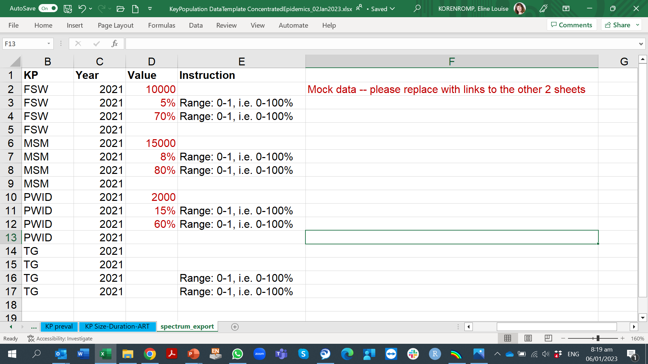
KP data: export from XLS to Spectrum (II)

Slide 23
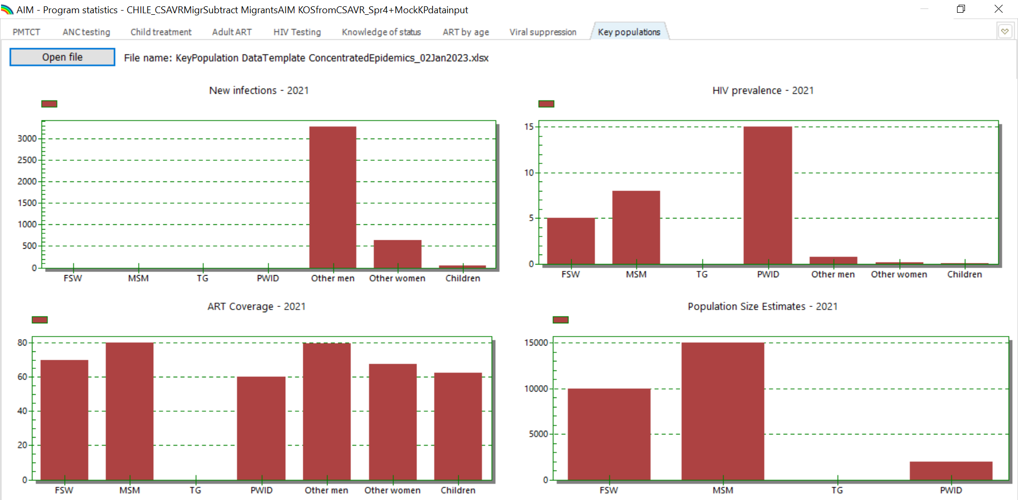
KP data: export from XLS to Spectrum (III)
Notes:
Spectrum calculates ART coverage for ‘Other’ men and ‘Other women’, adjusting for coverage in the key populations.

