Slide 1
AEM: a brief update & issues to watch for
Tim Brown, East-West Center
UNAIDS Estimation Tools Update Webinar
January 25, 2024

Slide 2
AEM Update for 2024
New features in AEM
Single year data entry of behavioral, PSE and program data post 2025
PrEP in both Baseline and Intervention Workbooks
Important things to watch for in finalizing your Spectrum file
Making sure ART inputs and parameters are aligned between AEM and AIM
Make sure AEM is set for end-year populations

Slide 3
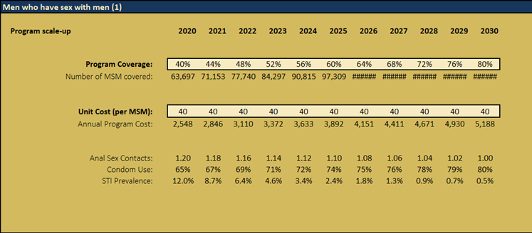
Baseline & Intervention support single years
AEM now allows single year data entry/scenario building after 2025
Previously only had 2025, 2030, 2035, 2040, 2045, 2050
Important for strategic planning post-2025
Importing previous AEM workbook automatically interpolates 2025+

Slide 4
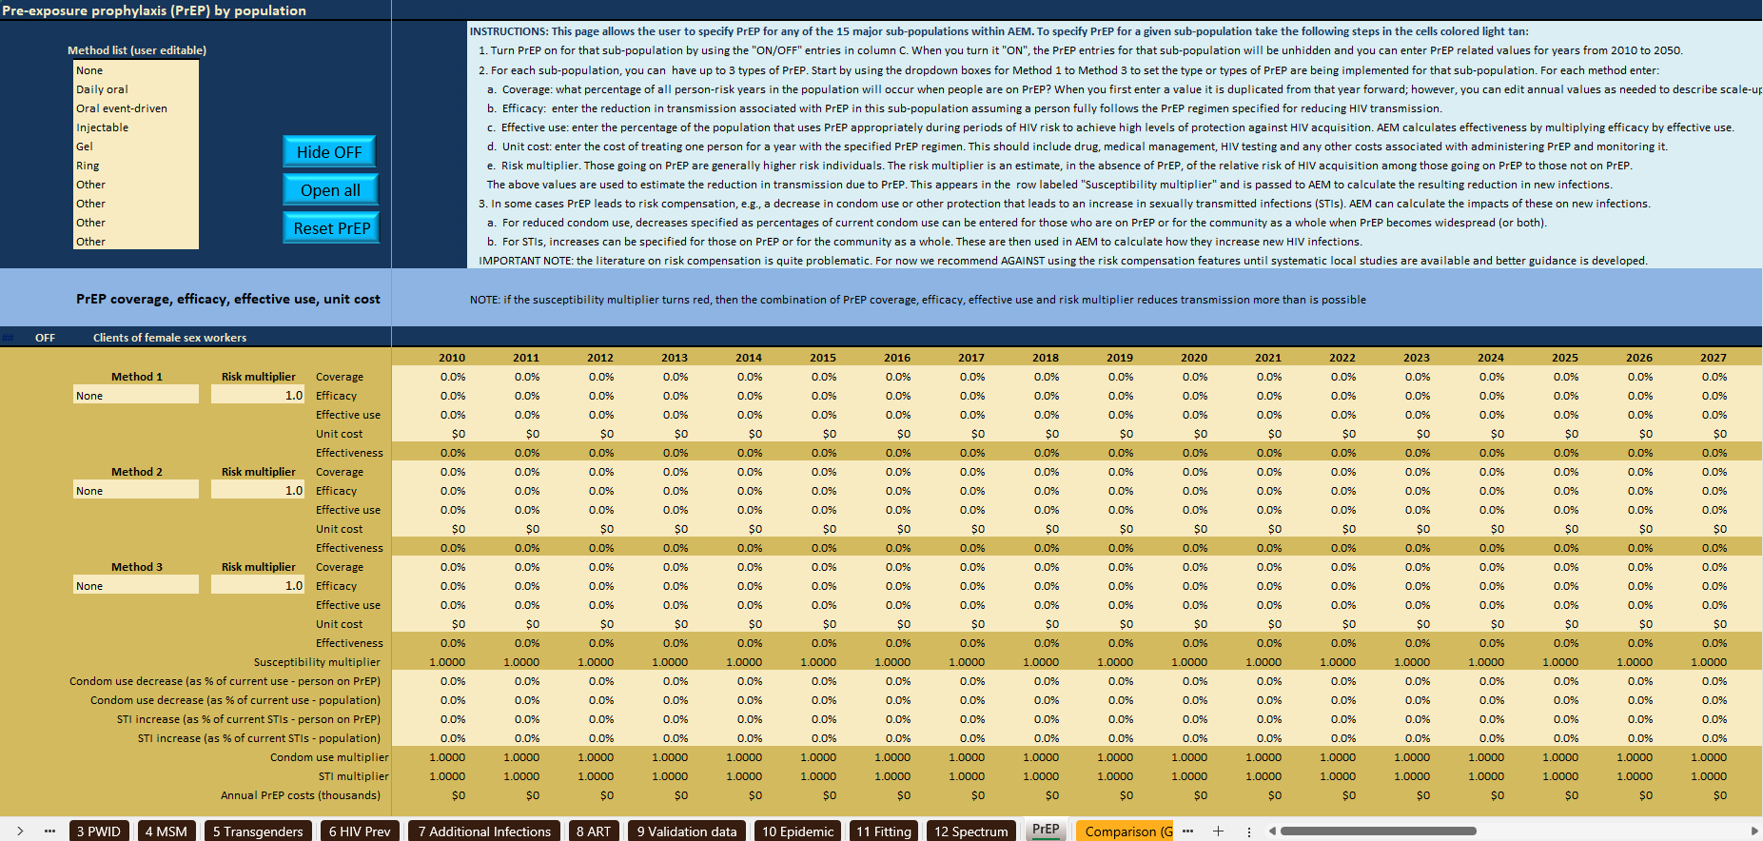
The AEM 5.2 workbooks add a PrEP page

Slide 5
AEM-PrEP inputs
Key inputs
Coverage – for a given population, the proportion of behaviors with risk of acquiring HIV that are protected by PrEP
Efficacy – if fully following the prescribed regimen, what can PrEP achieve in reducing the risk of HIV acquisition?
Effective use – what percentage of people follow the required regimen to prevent contracting HIV?
Unit cost – what is the cost of delivering PrEP to one person for a year?
Separate entries for each key population (KP) in AEM
Up to 3 types of PrEP for each KP

Slide 6
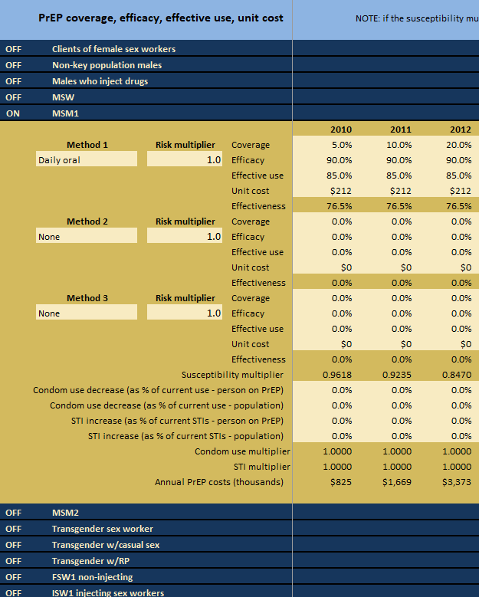
PrEP: Separate data entry for each sub-population
If turn PrEP ON, then entries displayed for that sub-pop
If OFF, these entries are hidden
Up to 3 types of PrEP for each sub-population
Each has its own coverage, efficacy, effective use and unit cost
These inputs can vary with time
Makes complexity more manageable

Slide 7
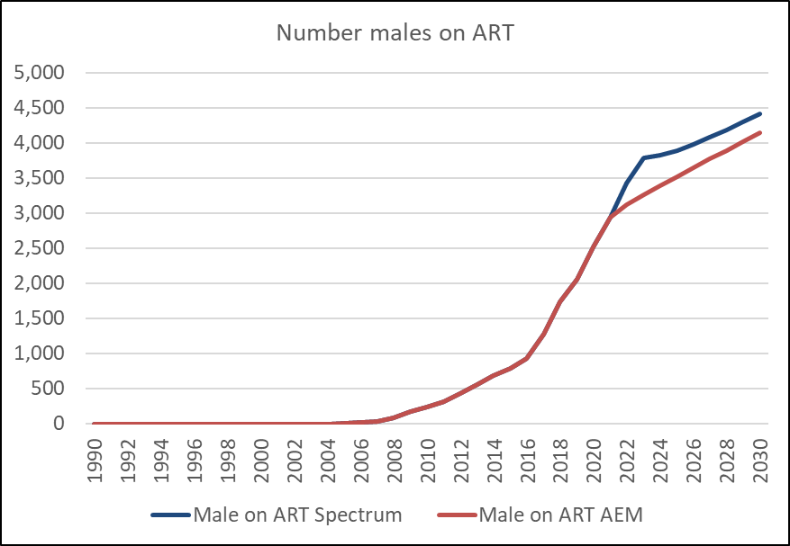
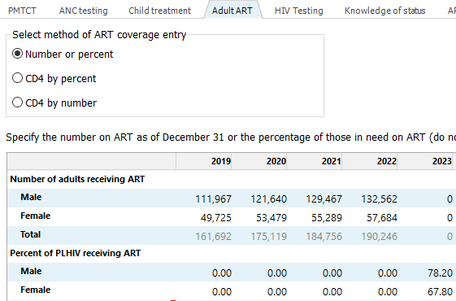
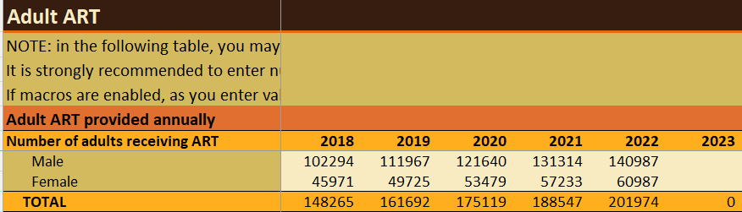
Keeping your Spectrum & AEM files synchronized I
Align ART scale-up trend in Spectrum with AEM
Rerun AEM and reimport it into Spectrum every time you change ART inputs
These affect AEM incidence inputs used by Spectrum

Slide 8
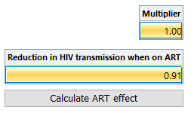
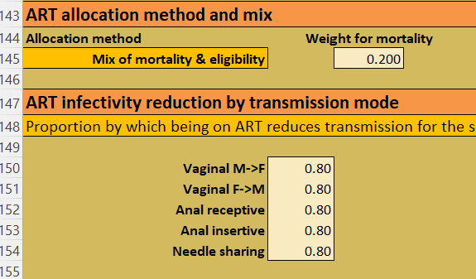
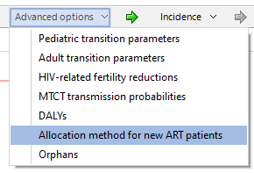
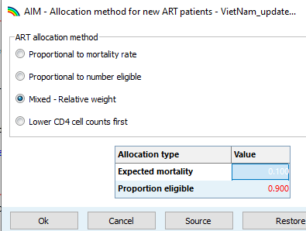
Keeping your Spectrum & AEM files synchronized II
Use the same ART infectivity reduction and ART allocation weights in AEM & Spectrum
Spectrum “HIV mortality
with ART” tab
In AEM near bottom of
“12 Spectrum” page

Slide 9
Keeping your Spectrum & AEM files synchronized III
Be sure to set populations to end of year on “1 Populations” page & update to WPP2022

Slide 10
AEM 5.2 Distribution
AEM 5.2 Baseline
AEM 5.2 Intervention Workbook
Both have PrEP & single years after 2025
Documentation
PowerPoint on AEM-PrEP
AEM 5.2 Distribution README
Detailed info on the distribution
PrEP reference documents
AEM Suite manual
AEM 5.2 Installer
AEM52_windows-x32_5_2.exe
Other AEM Workbooks
Combiner
Impact Analysis
Behavioral extractor
Regional contributions workbook
Spectrum-AEM workbooks
Spectrum-AEM compare
Pop1 Analysis Template
DropBox link to download:
https://www.dropbox.com/scl/fi/nmvmewvuo7vrxqdtm9mx9/AEM-52-Distribution-Jan-25-2024.zip?rlkey=07mqf75rmouajo1tio21omwgn&dl=0
Questions to: Tim Brown (tim@hawaii.edu)

Slide 11
Supplemental slides

Slide 12
How does AEM calculate incidence impacts?
Effectiveness calculated as: Effectiveness = efficacy * effective use
AEM uses coverage to turn effectiveness into a reduction in the number of population members susceptible to contracting HIV
Susceptibility multiplier = 1 – coverage*effectiveness
This multiplier gives a direct reduction in number of new infections in the population
Example. Suppose we have 100 MSM, 10 of whom get infected in a year. The incidence rate is 10/100 = 0.1
Now put all of them on PrEP, 100% coverage, with 90% efficacy and 70% effective use, then incidence declines to:
Incidence on PrEP = 0.1 * (1 – 1.0 * 0.9 * 0.7) = 0.037
So only 100 * 0.037 = 3.7 will get infected

