Slide 1
Basic Steps for Updating EPP Projections
Concentrated Epidemics
Notes:
Hi. I’m Tim Brown from the East-West Center in Honolulu, one of the co-developers of the UNAIDS Estimation and Projection Package, usually referred to as EPP.
EPP is one of several possible sources of HIV incidence for Spectrum. In this video I will describe each of the steps needed to update your EPP projections from last year with new population, turnover, surveillance and survey data and then refit your projections. In this video we will focus on the needs for fitting projections in concentrated epidemics.

Slide 2
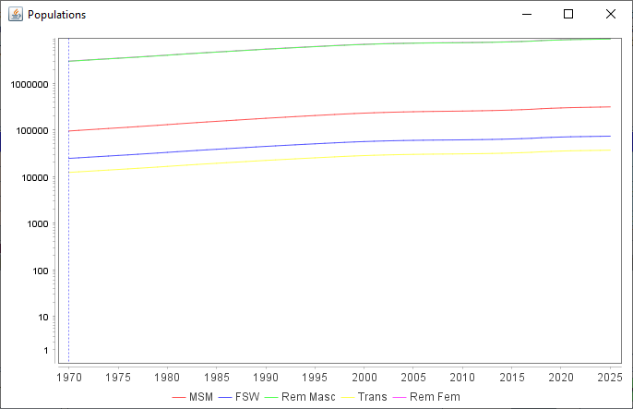
Changes to EPP for 2023
Changes for WPP 2022 (under the hood)
Underlying calculations updated to deal with new Dec 31 and calendar year definitions of prevalence, incidence & populations
Graphs modified to reflect these Dec 31 definitions
2021 on a graph means Dec 31, 2021
Surveys and surveillance data displayed as mid-Year values
EPP urban percentage database modified to reflect % urban on Dec 31st of the corresponding year (only applies to a handful of countries)
Trend graphs are available on
the Define Pops page
Notes:
EPP 2023 has very few changes that are visible to the user. Most of the changes have been made to deal with Spectrum’s switch to using year end populations instead of mid-year ones. This has resulted in a number of changes to the underlying calculations to make sure they reflect year end values. This means graphs have been modified to year end definitions as well. If you see 2021 on a graph, the point above that tick mark represents Dec 31, 2021, previously it would have meant July 1, 2021. The surveys and surveillance data are still considered to be mid-year values and they are entered at half year locations in the graphs. For any countries using urban/rural splits, the EPP urban database has been modified to specify the percent urban at the end of each year instead of mid-year. Finally, some population trend graphs are available on the Define Pops page – we’ll talk more about those when we cover that page.

Slide 3
Basic Steps
Open your 2023 Spectrum file & verify Incidence option set to EPP
Open EPP configuration and verify your epidemic structure
Review and adjust your population sizes, comparing with regional values
Review the percent male and turnover in each key population
Open the EPP surveillance data page and enter new data
Go to the Surveys tab and update with any new surveys available
Review the inputs on the External HIV data page
Open EPP curve fitting and review the data plotted
Verify the desired model has been selected for each sub-population
Make sure you are set to run a National fit
Fit and upon completion of fitting, save your projections
On EPP’s calibration page calibrate your projections as needed
Review the Calibration Table before proceeding
Review your results on the Fitting Results page
Compare your current fits with last year’s fits
Click on Save Results to return the fitting results to Spectrum
Notes:
This list shows the important steps to update your EPP projections from within Spectrum. We will cover each of these in turn, explaining each step and showing you how to carry out the process. Before starting be sure you have updated your Spectrum file following the steps in the video on updating your Spectrum/AIM file. Also be sure you have collated, cleaned and organized any new size estimation, turnover, surveillance or survey data that may have been collected since your projection was last updated and be prepared to enter it into EPP.

Slide 4
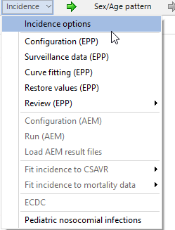
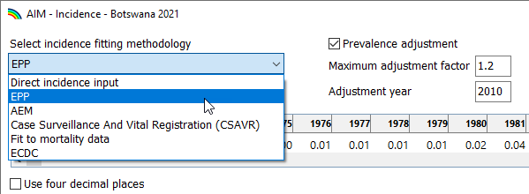
Open your 2023 file Verify the Incidence option is set to EPP
Open the 2023 version of your file in Spectrum
Select ‘Modules->AIM’
Select ‘Incidence->Incidence options’
Verify that EPP is selected
Notes:
The first thing to do is to open the new 2021 version of the file you saved in Spectrum. Click on the Modules tab, then click again on the AIM module, which will bring up the AIM menu. Because we are looking to generate incidence values for Spectrum from prevalence trend data in our country, for the duration of this video we will be working off the ‘Incidence’ menu. First, let’s check that our file is set up to use EPP for its incidence inputs. Click on the ‘Incidence’ menu item which will bring up a more detailed menu of options. Select the first item, ‘Incidence options’ which will open the window shown. Verify that EPP has been selected under “Incidence fitting methodology”. If it is not, this file may have been prepared with one of Spectrum’s other incidence options such as direct incidence input, CSAVR, AEM, or ECDC. If that is the case, you want to refer to the corresponding video for that incidence method in working with this file.

Slide 5
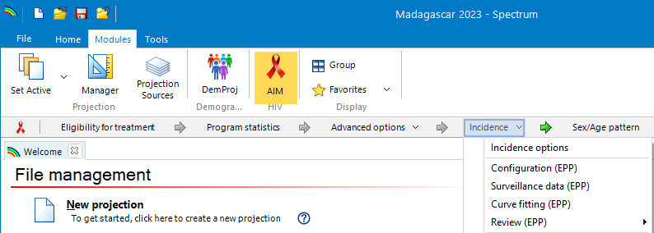
Open EPP Configuration You will see one of three messages
1
Populations have changed
End year has changed
Other inputs have changed, e.g., ART or default parameters
2
3
Notes:
The next step is to open EPP from the Spectrum ‘Incidence’ menu. There are three primary menu items under the ‘Incidence’ menu related to EPP: Configuration, Surveillance data and Curve fitting. “Configuration” gives you the ability to change the epidemic structure or populations within EPP. “Surveillance data” allows you to enter your HIV prevalence data and survey data, while “Curve fitting” is where you fit your data and generate an incidence curve for Spectrum’s use. First, click on “Configuration” to review your epidemic structure and population. Normally at this stage, you will see one of three possible message boxes from EPP, shown here. The first tells you that populations have changed, for example by newly adopting the WPP 2019 population values, and that the populations in EPP need to be reset before proceeding. The second says the end year of the projection has been changed, so populations will need to be added to EPP for the additional years. The third says that other inputs, e.g., ART numbers or transition and mortality parameters, have changed which will affect the fit. In the first two cases, you will need to reset the populations before proceeding, in the third, you will only need to refit after adding any additional surveillance or survey data you may have. The next few slides will show you how to proceed in each case. Start by clicking either “OK” or “Refit” on the EPP message boxes.

Slide 6
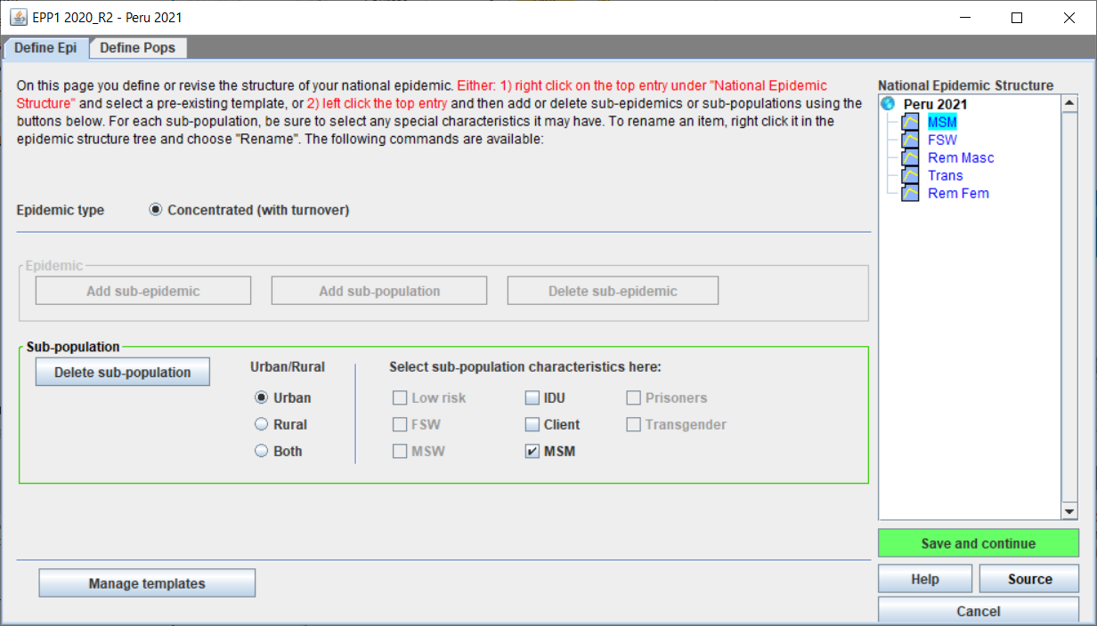
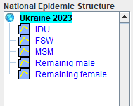
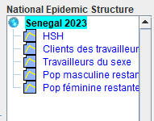
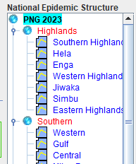
EPP’s Define Epi page Review the epidemic structure and sub-population characteristics
Notes:
This is the EPP Define Epi page. On the right-hand side of the page, you will see the epidemic structure for your country defined in terms of sub-populations, shown in blue or purple, or sub-epidemics, shown in red. A sub-population is a key population such as female sex workers or men who have sex with men or a remaining male and female group for those not in key populations. The blue color indicates that a fit on that sub-population has been completed based on the current inputs, while the purple color indicates that a fit has not yet been done, perhaps because some data inputs have changed and a refit is necessary. A sub-epidemic is a sub-national collection of sub-populations that allows regional epidemics to be modeled within EPP. In most countries with concentrated epidemics the epidemic will be divided into key populations as shown in the examples for Peru and Senegal. It is possible to have a more complex sub-national structure as shown for Ukraine. The structure can vary from country to country based on the populations most important to the epidemic and whether the key populations are to be modeled at the national or sub-national levels. However, a basic rule is that for every sub-population you must have both size estimate and HIV prevalence data to fit.
Verify that the structure you see on this page is the one you wish to use for your country. If you want to change it, you can use the add and remove sub-epidemics and sub-populations buttons. Before leaving this page, check each of the sub-populations in your National Epidemic Structure to ensure that the sub-population characteristics are set properly. When you are satisfied with your structure, click on the green “Save and continue” button in the lower right portion of the window. This will move you on to the next page of EPP.

Slide 7
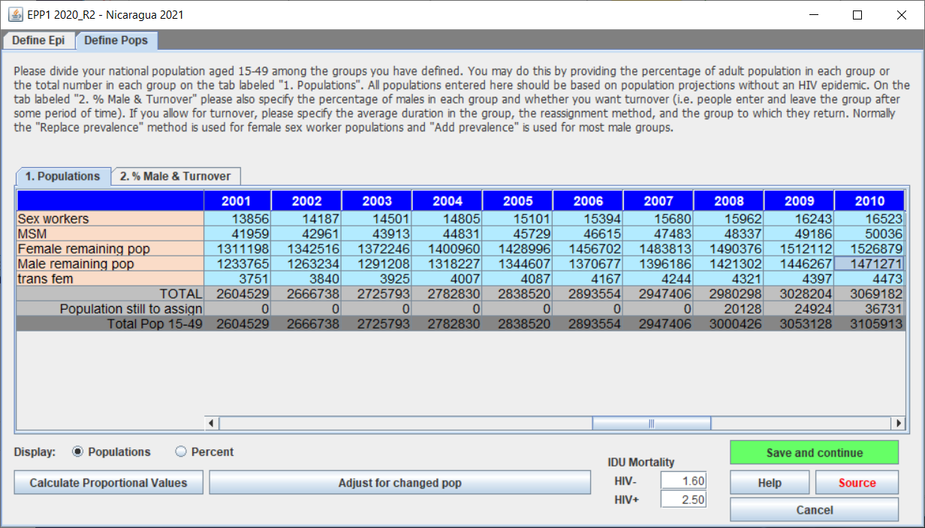
EPP’s Define Pops page Three key things to set here:
Sub-population size estimates
Percent male for each sub-population
Turnover variables for each sub-population
Notes:
This is EPP’s Define Pops page. For concentrated epidemics, this page is structured as two tabs labeled “Populations” and “%Male & Turnover”. On the populations tab, selected in this figure, you will see a table showing the population size estimates for each key population. Size estimates must be entered for each sub-population for every year of the projection. The combined size estimates must total to the national population aged 15-49 shown in the bottom row of the table. If each year’s size estimates sums to the national population, then the “Population still to assign” in the next to last row will be zero. If not, as seen for the years 2008 to 2010 in the figure, then the number of people remaining to be assigned will be shown in that row. You should then adjust the various sub-population size estimates so that they sum to the national population. If you have new size estimates for some of the sub-populations, e.g., for female sex workers and men who have sex with men, this can require moving men and women to and from the remaining male and female populations to ensure that all of the national population is properly assigned to some sub-population.

Slide 8
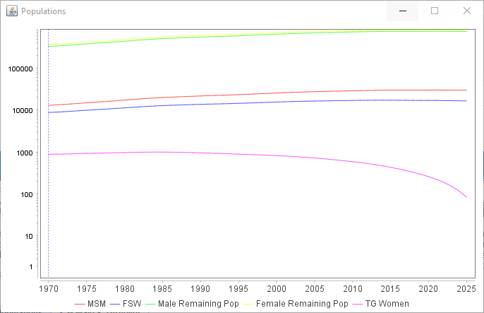
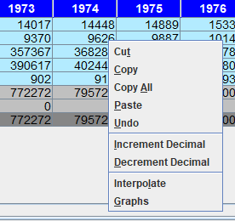
New feature – Population graphs
Right click on the Populations table and select “Graphs”
Notes:
A new feature in EPP for 2023 is the additional of graphs on the Define Pops population table. If you right-click on the table under the tab labeled “1. Population” you will see an entry in the pop-up menu for “Graphs”. If you click on this, it will display a graph showing the size of your key populations over time. This graph is put on a log scale so that the Remaining populations for male and females do not keep you from seeing the trends in the key populations. After you’ve finished updating your populations go ahead and click on “Graphs” and review the results. Look for anything unusual in your population trends, e.g., kinks or sudden changes in the size of a key population. In the graph show here, the trans women population drops in size suddenly from about 2010. This sudden drop is not what we expect, and you should go back and review your data sources to correct this.

Slide 9
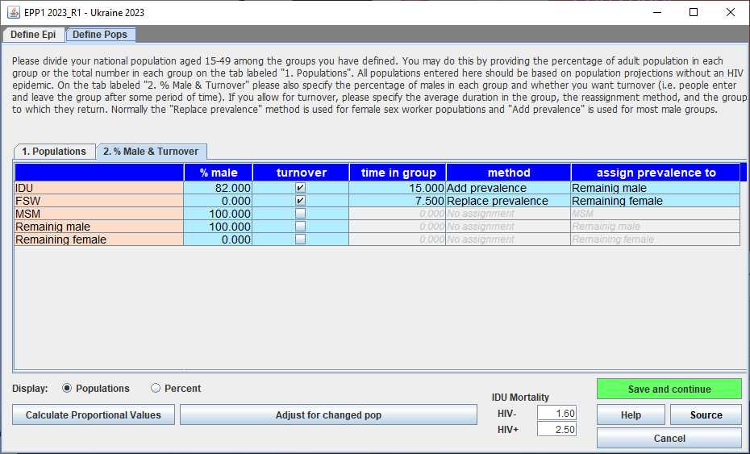
EPP’s Define Pops page The “% Male & Turnover” tab:
% Male
Turnover
Time in group
Method
Assign prevalence to
Notes:
If you click on the “% Male & Turnover” tab, you will see the table shown here. The first column shows each sub-population on a separate row. The second column is set to the percent of males in that group. The next four columns relate to turnover, which affects the incidence and prevalence fitting for the group and is described in more detail in the “Under the Hood EPP Concentrated” presentation. Basically turnover is an indication of whether people remain in the group in which they start forever or if they stay for a certain number of years and then move to another population. If they do not stay in the same group, then click the checkbox under “turnover” and specify how many years they remain in that group under “time in group”. Then in the column labeled “assign prevalence to” specify the group to which they move after leaving the original group. In this example Female sex workers remain in the group for 7 years and then go back to the “Remaining female” group. Those leaving the FSW group will be replaced by individuals from the Remaining female group. The “method” column specifies whether they are added to the existing infections in the receiving group, if you select “Add prevalence”, or if they just replace some of those already calculated to be infected in the receiving group, if selecting “Replace prevalence”. This whole concept and its impact on fitting is explained in more depth in the “Under the Hood” presentation. Once you have adjusted your population size estimates and made any necessary changes to the % male and turnover table, click “Save and continue” to save those changes and return to Spectrum.

Slide 10
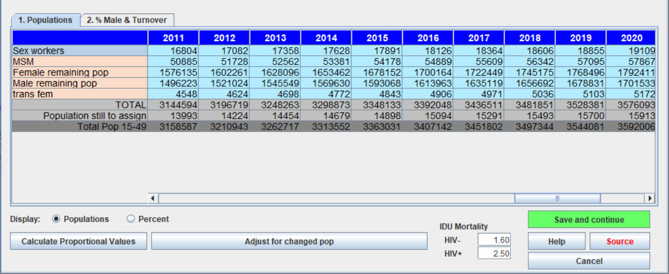
EPP’s Define Pops page If the national population has changed, use ‘Adjust for changed pop’
If the national population changes, then populations will be unbalanced – there will still be population to assign
Click the ‘Adjust for changed pop’ button and EPP will fix the populations, assigning everyone in the same proportions as before
Notes:
When you open EPP through the Spectrum Incidence->Configuration (EPP) menu item you may receive the message “Your EPP projections have been reset because the populations provided have changed”. This can occur, for example, if you a adopt a newer set of population projections such as those from the World Population Prospects for 2019. In this case the sums of the sub-populations will disagree with the national populations in some or all years. The “Population still to assign” row will then show non-zero values; before exiting this page, you must adjust the values in this row so that they are all zero. This can be done manually year by year if you choose to provide new population estimates for the various sub-populations or EPP can do the adjustment for you. If the only significant change is that the national population has increased or decreased, then clicking the “Adjust for changed pop” button will assign the leftover population in the same proportions as the existing proportions among sub-populations. With a single click this apportionment will reduce the “Population still to assign” to zero for all years. If you are happy with EPP’s proposed sub-population size changes, then just click “Save and continue” to save these values and return to Spectrum.

Slide 11
EPP’s Define Pops page If the end year has changed, use ‘Adjust for changed pop’
If the end year has changed, then no population will be assigned in EPP for the years of the extension
Click the ‘Adjust for changed pop’ button and EPP will fix the populations, assigning everyone according to the preceding trend
Notes:
Another possibility when you open the EPP Configuration component is that you receive the message “Your EPP projections have been reset because the end year of your projections has changed”. This happens when you extend the Spectrum file for several years. In the example here, the file has been extended from an end year of 2020 to one of 2025. In this case, EPP has no population assigned for the extended years, leading to the zero values seen here. In order to fix this, once again you can either enter values manually or you can click on the “Adjust for changed pop” button and EPP will take the trend in population sizes for the last few years and project it into the future, automatically filling in the values for you. Before clicking “Save and continue” to leave the page and return to Spectrum, please review these generated values and be sure you are comfortable with them. If necessary, make any changes, before clicking “Save and continue”,

Slide 12
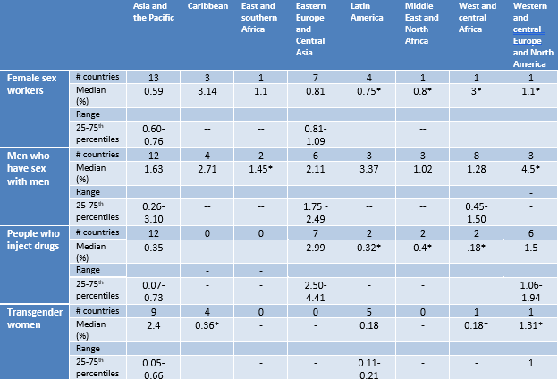
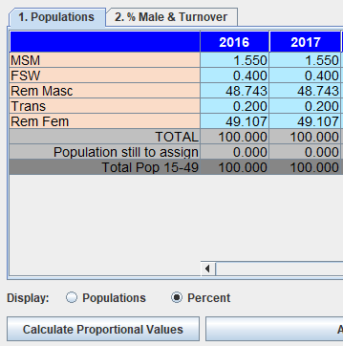
Be sure to compare your population size estimates with regional values
For description of nationally adequate estimates see:
https://journals.plos.org/plosone/article/authors?id=10.1371/journal.pone.0155150
Notes:
Before you leave the Define Pops page, you should make one final check on your key population size estimates – how well they agree with similar estimates in other countries in your region. In the QuickStart guide you will find the latest table for population size estimates for different key populations by region, shown here for convenience. These estimates are given as a proportion of the 15-49 population of men or women depending on the sex of the key population being examined. For easy comparison with the values in the EPP populations table, you can change the EPP table to percent mode by clicking on the “Percent” radio button next to the “Display:” label in EPP. This will then convert the table to percentages of the TOTAL 15-49 population as shown here. It should be noted that to compare with the QuickStart table of size estimates for key populations, you should multiply the values in the EPP table by 2 because they are based on the total population, not on the proportion of males or females aged 15-49. So for example, the men who have sex with men value you should be comparing with the regional averages will be 1.55 * 2 equals 3.1 percent for 2016 and that for female sex workers will be 0.8 percent.

Slide 13
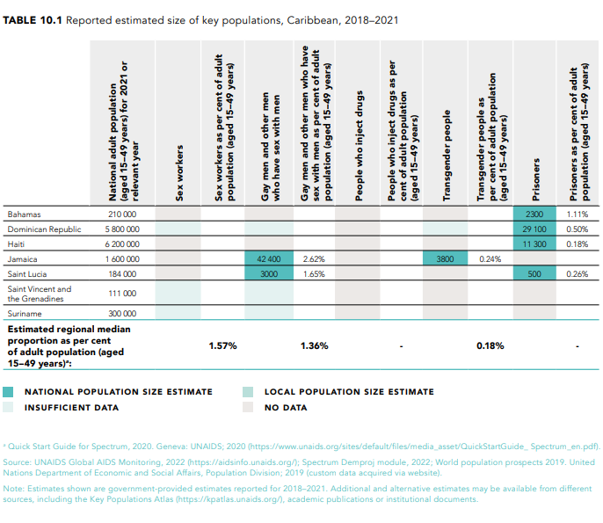
Be sure to compare your population size estimates with regional values
Source: World AIDS Day report 2022
Notes:
For Kingston workshop
Before you leave the Define Pops page, you should make one final check on your key population size estimates – how well they agree with similar estimates in other countries in your region. In the QuickStart guide you will find the latest table for population size estimates for different key populations by region, shown here for convenience. These estimates are given as a proportion of the 15-49 population of men or women depending on the sex of the key population being examined. For easy comparison with the values in the EPP populations table, you can change the EPP table to percent mode by clicking on the “Percent” radio button next to the “Display:” label in EPP. This will then convert the table to percentages of the TOTAL 15-49 population as shown here. It should be noted that to compare with the QuickStart table of size estimates for key populations, you should multiply the values in the EPP table by 2 because they are based on the total population, not on the proportion of males or females aged 15-49. So for example, the men who have sex with men value you should be comparing with the regional averages will be 1.55 * 2 equals 3.1 percent for 2016 and that for female sex workers will be 0.8 percent.

Slide 14
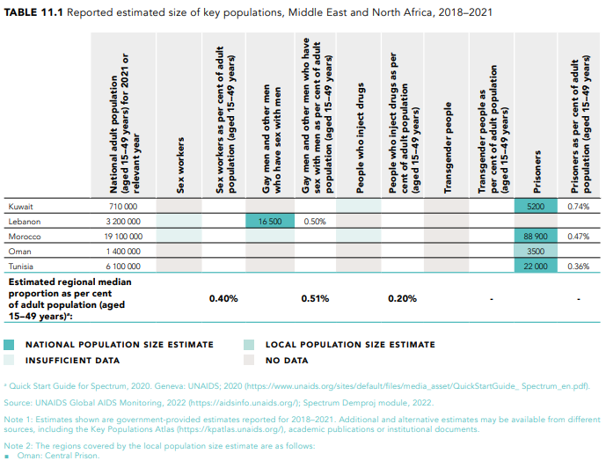
Be sure to compare your population size estimates with regional values
Source: World AIDS Day report 2022
Notes:
For Cairo workshop
Before you leave the Define Pops page, you should make one final check on your key population size estimates – how well they agree with similar estimates in other countries in your region. In the QuickStart guide you will find the latest table for population size estimates for different key populations by region, shown here for convenience. These estimates are given as a proportion of the 15-49 population of men or women depending on the sex of the key population being examined. For easy comparison with the values in the EPP populations table, you can change the EPP table to percent mode by clicking on the “Percent” radio button next to the “Display:” label in EPP. This will then convert the table to percentages of the TOTAL 15-49 population as shown here. It should be noted that to compare with the QuickStart table of size estimates for key populations, you should multiply the values in the EPP table by 2 because they are based on the total population, not on the proportion of males or females aged 15-49. So for example, the men who have sex with men value you should be comparing with the regional averages will be 1.55 * 2 equals 3.1 percent for 2016 and that for female sex workers will be 0.8 percent.

Slide 15
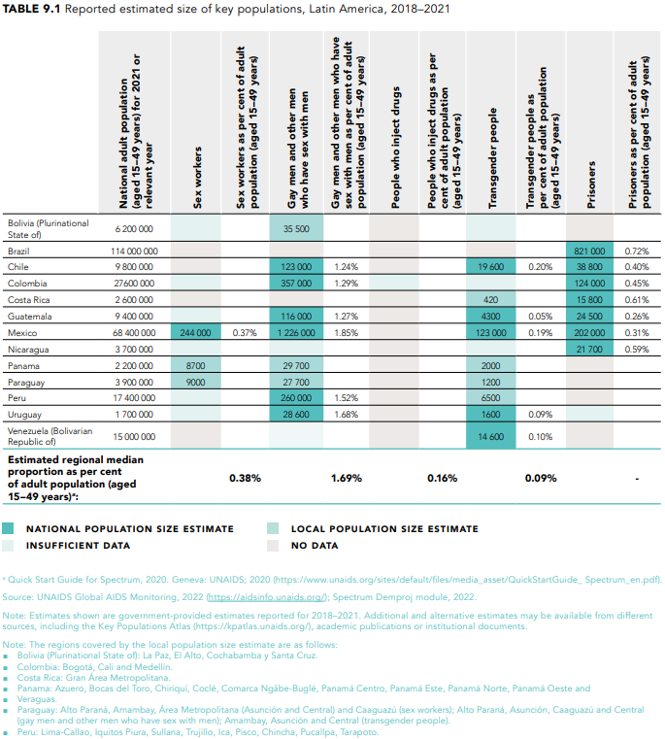
Be sure to compare your population size estimates with regional values
Source:
World AIDS Day report 2022
Notes:
For Panama City workshop
Before you leave the Define Pops page, you should make one final check on your key population size estimates – how well they agree with similar estimates in other countries in your region. In the QuickStart guide you will find the latest table for population size estimates for different key populations by region, shown here for convenience. These estimates are given as a proportion of the 15-49 population of men or women depending on the sex of the key population being examined. For easy comparison with the values in the EPP populations table, you can change the EPP table to percent mode by clicking on the “Percent” radio button next to the “Display:” label in EPP. This will then convert the table to percentages of the TOTAL 15-49 population as shown here. It should be noted that to compare with the QuickStart table of size estimates for key populations, you should multiply the values in the EPP table by 2 because they are based on the total population, not on the proportion of males or females aged 15-49. So for example, the men who have sex with men value you should be comparing with the regional averages will be 1.55 * 2 equals 3.1 percent for 2016 and that for female sex workers will be 0.8 percent.

Slide 16
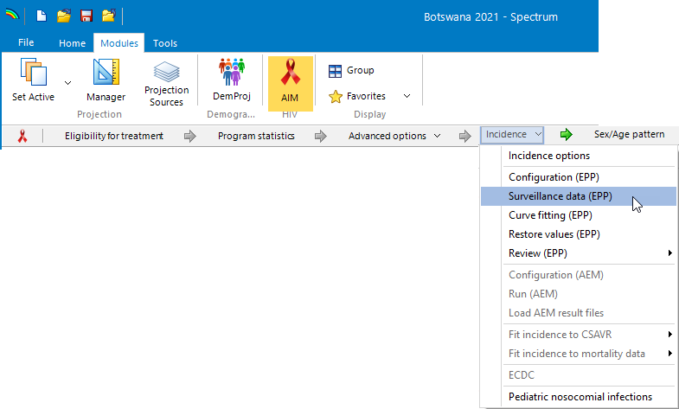
Next turn to updating surveillance & survey data
Select ‘Incidence->Surveillance data (EPP)’ in Spectrum
Enter any new or corrected surveillance data on EPP’s HIV Data page
Enter any new survey data on EPP’s Surveys page
Add in any external infections which may be influencing the sub-populations
Notes:
The next step in the process is to enter any new surveillance or survey data that has become available since the projection was last updated. This is done by clicking on AIM’s “Incidence->Surveillance data” menu item. This will bring up EPP’s HIV Data page where you can review existing surveillance data and enter any new surveillance or ANC routine testing data. Following this you will then add any new survey data before proceeding to fitting. Finally in concentrated epidemics, you can also add infections coming from outside the sub-populations, e.g., from returning migrants or other sources.

Slide 17
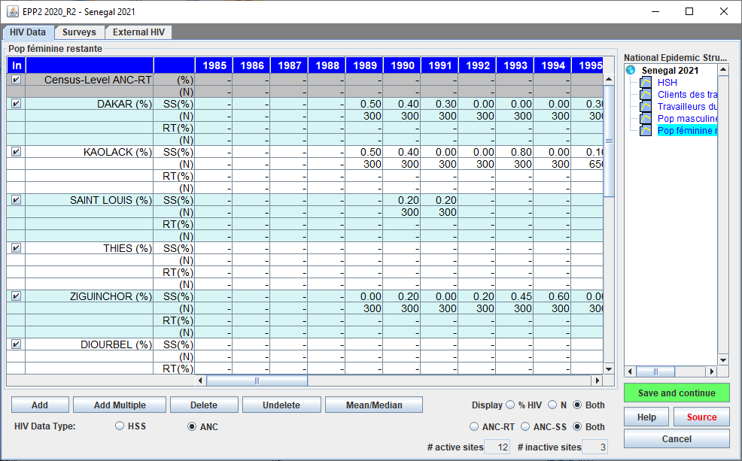
EPP’s HIV Data Page
4
1
Select sub-population
Choose HIV data mode:
HSS
ANC
Enter data in spreadsheet
SS is sentinel
RT is routine testing at ANCs
Enter prevalence & N
If available, enter census-level ANC routine testing data
Click ‘Save and continue’
3
5
2
Notes:
EPP’s HIV Data page is structured as a spreadsheet and is comparatively straightforward to fill in. First, select a sub-population in the National Epidemic Structure pane on the right. Choose the data mode you wish to use, HSS or ANC – we will describe the difference in a moment. Enter the data you have collected into the spreadsheet as prevalence in percent and sample size for each site. If you have aggregate data for all routine testing at ANC sites in the region, what we call census-level ANC routine testing data, enter it on the top two lines of the table. Finally, click “Save and continue” and you will be moved to the next sub-population. When you have entered the data for the final sub-population, click “Save and continue” again and EPP will move you on to the Surveys page.

Slide 18
Key features of EPP’s HIV Data page All data entered as prevalence (%) and sample size (N) Can copy and paste from Excel (Ctrl-C, Ctrl-V)
The two data modes are:
HSS – data is traditional HIV sentinel surveillance data
ANC – data is from antenatal clinics and includes:
Traditional sentinel surveillance data from sites (SS in main table)
Routine testing at specific antenatal clinic sites (RT in main table)
Census level aggregated data from all ANCs in the region (entered at the top of the page)
You can use the buttons at the bottom to add and delete sites
The display can be set to show:
HIV prevalence, sample size or both
Display only ANC-SS data, ANC-RT data or both
Notes:
There are several important things you need to know about the HIV Data page and the data entered there. First, all data is entered as prevalence in percent and sample size. Most data is entered for specific surveillance or testing sites and the sample size is the number of people tested at that site in that year. If you have your data stored in Excel in a format like that of the table in the HIV Data page, you can copy and paste it from Excel into EPP with Control-C and Control-V.
There are two data modes for the HIV Data page. The first data mode is labeled “HSS”. This is for traditional HIV surveillance data, that is, samples of locally relevant key populations or of women presenting for antenatal services at specific sites chosen to track the national epidemic. The second is labeled “ANC”. In concentrated epidemics, The ANC mode will only be used for “Remaining female” (and possibly “Remaining male”) sub-populations, most data for other key populations will be entered in HSS mode. This antenatal data mode allows a mix of both surveillance data, labeled as “SS” in the main table, and routine testing data, labeled as “RT”. With the advent of extensive routine testing, many sites have discontinued sentinel surveillance and switched over to using routine testing data instead. For these sites, the past sentinel surveillance and present and future routine testing prevalence and sample sizes are entered on separate lines. In addition, in ANC mode one can enter the aggregate routine testing data for the entire region, which we call “Census-level ANC-RT”. This is entered on the top two lines of the data table. Given the extent of testing currently done in most countries, well collected and cleaned data of this type can be representative of the overall situation among women giving birth.
At the bottom of the page are a set of buttons that allow you to add and delete sites from the table. To delete, just select the site and then click “Delete”. To add a new site, just click “Add” or “Add Multiple”. Finally, you can bring up a table of means and medians across all sites by clicking “Mean/Median”. Click again to hide the table.
Finally, the table can be adjusted to just show only prevalence, only sample sizes, only ANC surveillance data, only ANC routine testing data or both. Just play with this a bit using the radio buttons at the bottom. As you select different options, the data in the table displayed will adjust accordingly.

Slide 19
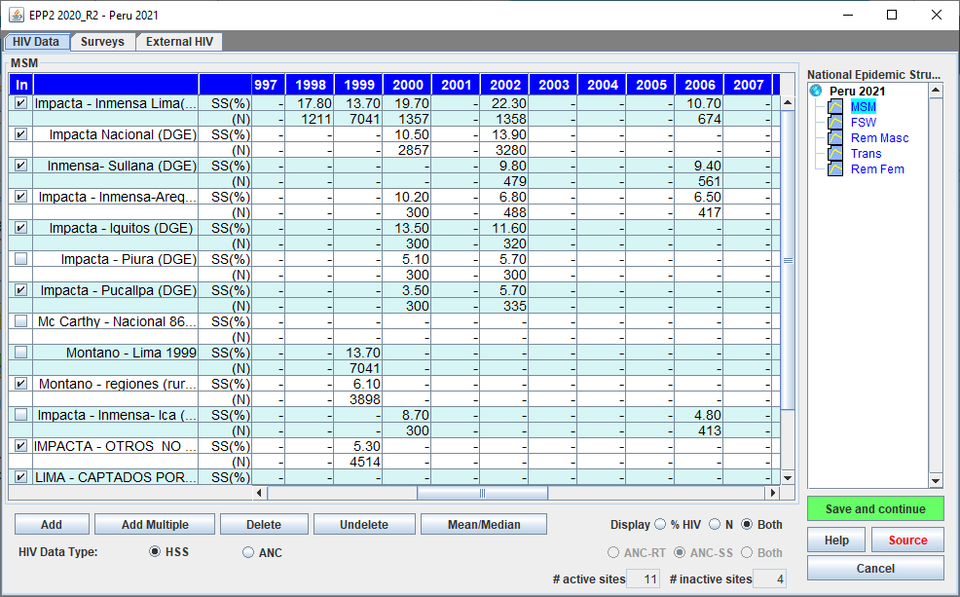
In concentrated epidemics, most data is entered in HSS mode
Notes:
Most of the surveillance data to be entered in concentrated epidemics is for key populations such as people who inject drugs, men who have sex with men or sex workers. This is normally done in HSS mode and the HIV Data page will appear as shown here. Each surveillance site will appear as two lines, the first, labeled “SS(%)” containing the HIV prevalence in percent for each year and the second labeled “(N)” containing the sample size of the measurement for each year. If you click on the “Mean/Median” button, a set of means and medians will appear at the top of the table as shown here.

Slide 20
Key things to review about surveillance data
Is it of quality, valid and reliable?
Has it been cleaned of outliers and low quality data
Does it constitute a trend?
A trend is a repeated measure done in the same way in the same population at different points in time
It’s easy to find data that’s not trends:
Same group, different sampling/surveillance protocols
“Same” group, but definition changes from round to round
Same group, different locations in different years

Slide 21
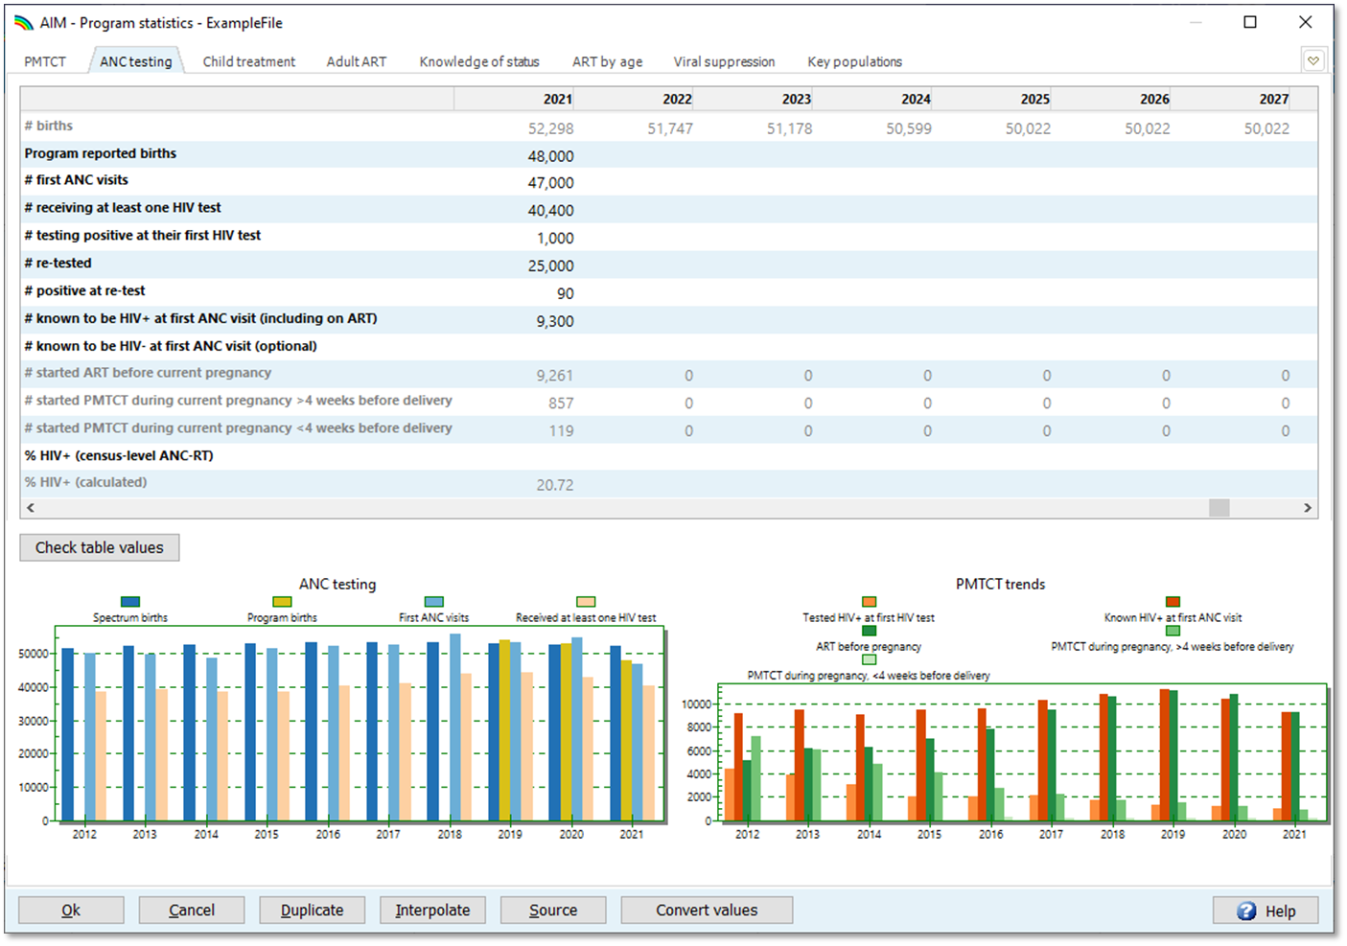
Before entering ANC data for ‘Remaining females’ review your ANC data in Spectrum Program statistics ->ANC testing tab
Notes:
Normally, in concentrated epidemics you will only use the ANC data mode on the HIV Data page for the “Remaining female” and “Remaining male” populations, where the data used for fitting is generally from antenatal clinics. However, because these populations are large, they have a big influence on your national projections. So, it is critical to spend time reviewing your antenatal clinic data carefully before starting.
The quality of the data you enter will affect the fitting results you receive. A good place to start is the “ANC testing” tab under the “Program statistics” menu item in Spectrum. As the video on updating your Spectrum file discussed this can help you identify issues with the number of tests compared to the number of first-time ANC visits, multiple tests being conducted on the same individual, and other issues. We strongly recommend you review this before entering your data into EPP.

Slide 22
Pay careful attention to analyzing data quality Only enter quality data into EPP – it will determine your national trends
Routine testing data introduces numerous challenges to discerning true epidemiological trends from reporting artifacts
Service provision has changed with routine testing introduction.
Coverage normally scales up for years as the system expands then stabilizes as it matures.
Reporting often problematic, especially before electronic reporting systems became common. Make sure it is timely & complete.
Before using ANC-RT data:
Look for sharp increases or decreases; true trends should be stable
Make sure women known to be positive already are included
Make sure only the first test at ANC visit is included for each women
Include first tests occurring at labour and delivery
Watch for: false positives, changes in testing algorithms, stockouts and their impacts, and rates of refusal
Consider quality assurance reviews and how the results compare with household survey data to understand data issues and biases
Notes:
Many issues can influence the prevalence trends produced by ANC routine testing data including changes in service provision over time, the expansion of coverage of routine testing, and the increasing reach of electronic reporting systems as they expand to more and more places. All of these can affect how timely and complete your data is. They can also influence the epidemiological trends, e.g., as systems expand, they normally move from higher prevalence areas to lower prevalence ones introducing an artifactual decline in HIV prevalence. One way to deal with this might be to not use the trend data from routine testing until the coverage of the system has stabilized.
Accordingly, we recommend that before you use your ANC-RT data you consider some of the issues presented here: how has your routine testing system and its geographic and population coverage been changing over time? Have known positive women been included in the reporting or not? Has only the first test at an ANC visit been included? Are first tests at labour and delivery included? Have you considered changes in the testing over time, including the kits used and false positive rates in low prevalence settings, the algorithms used, refusal rates and the influence of stockouts on completeness of testing? Have you read any available quality assurance reports and compared the prevalence data against other sources such as household surveys?
Given how important the trends produced by EPP will be to determining the trends in your national estimate, it is worth spending some time considering these factors and consulting with experts as necessary to better understand how they influence your data and which data should be used or excluded.

Slide 23
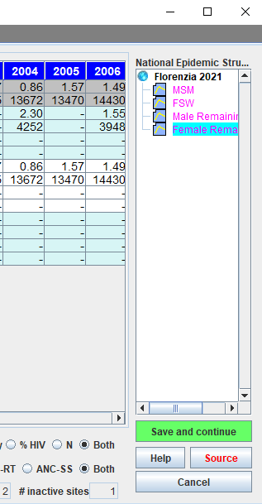
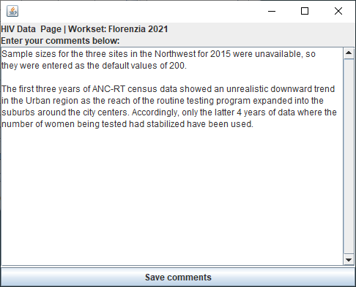
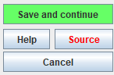
Be sure to document changes with the ‘Source’ button
Red means
‘comments here’
Notes:
Like Spectrum, EPP provides a “Source” button in the lower right of the screen. If you click this button, it will pop up a dialog that allows you to enter a description of any adjustments, removals or changes to the data entered here as well as any other comments you may wish to make. This will be extremely helpful to the next person who uses your file as they will learn the source of the data and about any adjustments made. Once you enter comments in this box, the “Source” button will turn red, indicating to users that there are comments they should review about the data on this page. We strongly encourage you to make liberal use of the “Source” buttons both in EPP and in Spectrum.

Slide 24
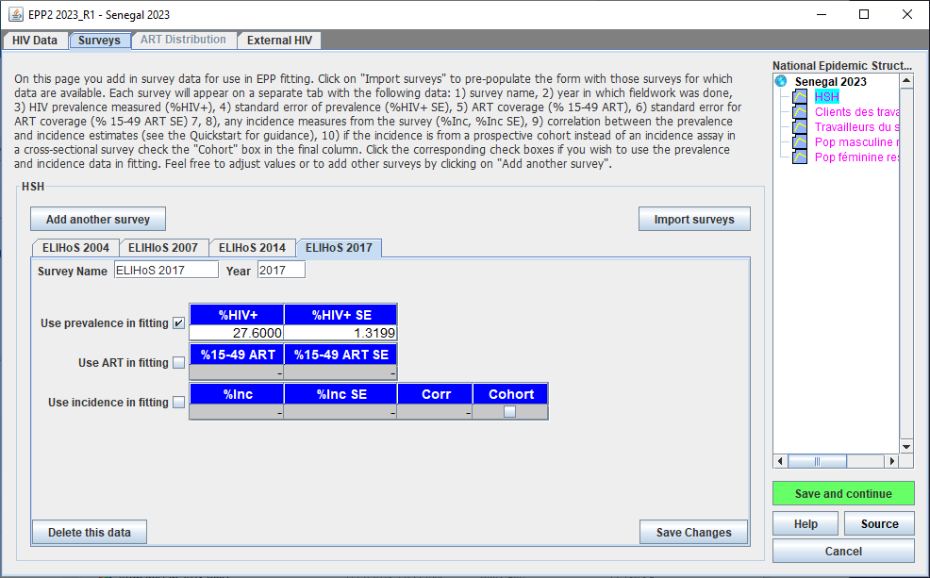
Enter any new survey data on the EPP Surveys page Rarely used in concentrated epidemics: 1. General pop. surveys are difficult at low prevalence 2. IBBS and other Key Pop surveys usually not nationally representative
Notes:
After you complete entering updated surveillance and routine testing data on the HIV Data page, you can enter survey data if any is available. When you click “Save and continue” on the HIV Data Page after updating the data for the last sub-population, EPP will move you on to the Surveys page, shown here. The Surveys page has a tab-based structure in which the data for each individual survey is entered on a separate tab.
Normally the Surveys page is not used in concentrated epidemics as it is really intended for entering large scale survey data in the sub-population being considered and most countries do not do large surveys among key populations. In most concentrated epidemics HIV prevalence is low outside of the key populations, so surveys in the population at large are also rare. Large scale general population surveys have a hard time measuring prevalence at such low levels without using such large sample sizes that they would be prohibitively expensive to conduct.
For key populations it is also rare to have a nationally representative survey for a specific key population. Integrated Biological and Behavioral Surveillance surveys are often not representative of the entire spectrum of sex workers or MSM in a country and they are normally geographically limited due to cost factors. In addition, the geographic sites chosen often vary from round to round. Thus, they are not nationally representative of prevalence in these key populations. Most frequently they will be entered as independent data sources on the HIV Data page and/or used for calibrating the prevalence in a specific key population post-fitting.

Slide 25
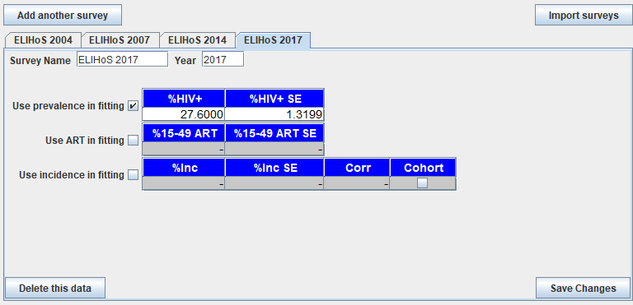
To enter new survey data
1
2
3
4
5
Click on ‘Add another survey’
Provide a short name for the survey
Enter the year of the survey
Provide the prevalence and standard error
If survey has ART or incidence, check box & enter values
Be sure to click ‘Save changes’
6
If you do not want this survey included in fitting the prevalence, uncheck the box next to ‘Use this survey’s prevalence in fitting’
When done entering surveys, click the green ‘Save and continue’ button
Notes:
If you do click to add another survey, there are a few pieces of information you will need to enter:
You must provide a short name for the survey – this will be used to describe the survey on the Tab, so keep it short but descriptive.
You must provide the year in which the survey data was collected. Note that this is the time of data collection, not the time of publication, which is normally somewhat later.
You must give the prevalence and standard error for this survey in percent.
Finally, if the survey contained any incidence estimate, check the box labeled “Use incidence in fitting” and enter the incidence estimate in percent and standard error for that estimate. These incidence numbers will then be used in calculating the goodness of fit of your projection during fitting.
When done entering the data for this survey, click on the “Save Changes” button to register the data with EPP
As always, when you’ve completed entering new survey data for each sub-population, click “Save and continue”. After you click “Save and continue” for the final sub-population, you will be taken to the External HIV page with any new surveillance or survey data now added to EPP.

Slide 26
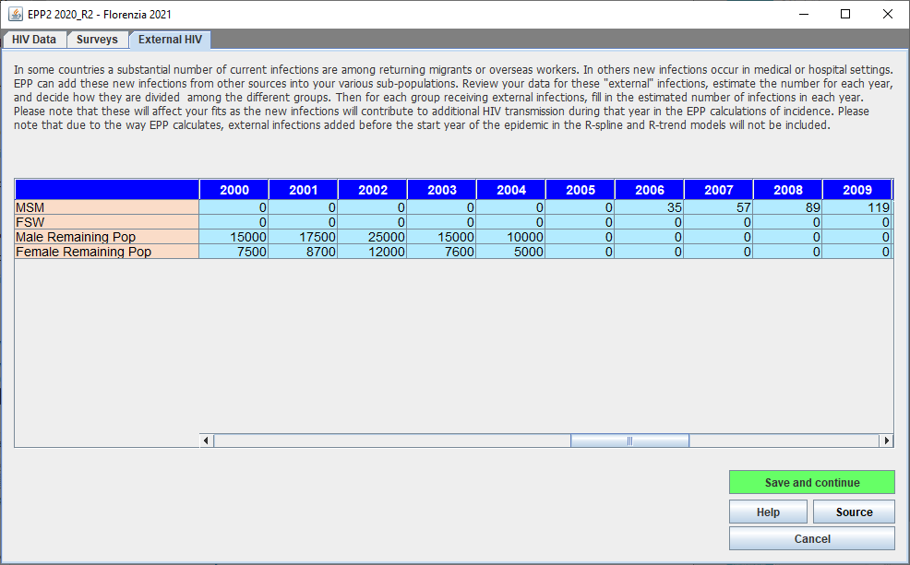
External HIV page Allows you to add HIV infections coming from outside sources
Notes:
For concentrated epidemics, it is also possible to add infections coming from sources other than sexual or needle sharing behaviors. This might for example be large numbers of migrant or overseas workers becoming infected outside the country and then returning with those infections. In a low prevalence setting these could be important contributors to the early epidemic. Additional infections might also be generated from events such as plasma donation with shared equipment. In some countries such events have been important components of the epidemic. The External HIV page allows these infections to be captured and they will influence transmission from the year in which they are introduced. It should be noted that if using the R-Spline or R-Trend model, they will not be included until after the start year of the epidemic specified by the user. Most countries do not use this feature, but it is here if you need it. When satisfied with the values or if you don’t wish to enter any additional data, just click “Save and continue” and EPP will return you back to Spectrum ready to move onto fitting. At this point, it is also good practice to save your Spectrum file to ensure the data you have entered into EPP will be reflected in the Spectrum file should your work become interrupted.

Slide 27
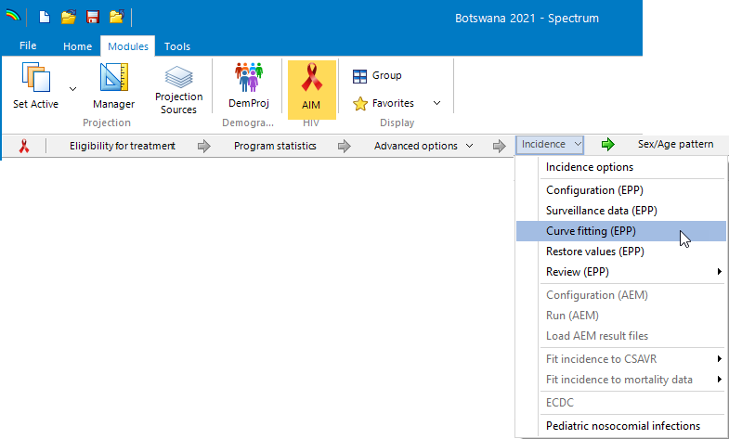
Back in Spectrum and ready to fit your data
Select ‘Incidence->Curve fitting (EPP)’ in Spectrum
Review the data for each sub-population before fitting
Select the model to use for fitting each sub-population projection
Click ‘Fit all’
Notes:
You are now ready for the most important step of this process, fitting all the data you have just provided to EPP taking into account any changes made to program data and parameters in Spectrum. To launch the EPP Project page, from the Spectrum Incidence menu select the “Curve fitting (EPP)” option. This will launch EPP open to the Project page, where you will update your fits to include the effects of the new data on your national projection.

Slide 28
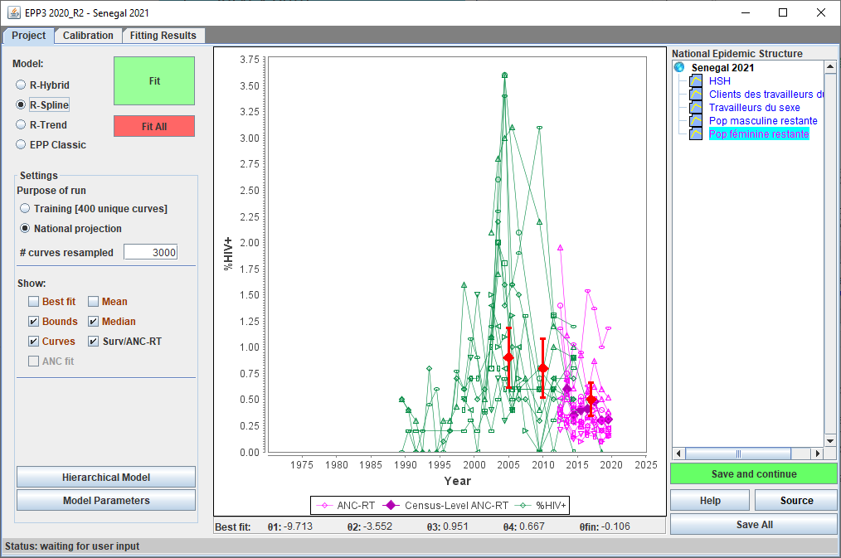
EPP Project Page: data
2
What types of data are displayed on this page?
Survey data
Sentinel surveillance sites (HSS or ANC-SS)
ANC- RT sites
Census ANC-RT data
Before going further:
Look for data outliers and remove as needed
Make sure all the data you want to fit is here
3
4
1
If surveys missing check Surveys page:
If no census data check HIV Data page:
Notes:
Since you have chosen to refit, when you enter the Project Page only the data to be fit will be displayed.
Before reviewing the steps to fit your data, let’s start by looking at the different types of data displayed in the graph. Each type of data used in the fit has a different color on this page:
Survey data points are red diamonds with error bars. Senegal shown here is one of the few concentrated epidemic countries that does have surveys. If available, surveys do inform the fitting; so if you entered survey data, make sure all of it is displayed here. If not, go back to the Surveys page and make sure “Use this survey’s prevalence in fitting” has been checked for each survey you want to include.
Key population surveillance or ANC-Sentinel Surveillance data are shown in green. Each site is shown as a set of connected markers. Review this data carefully and if you see major outliers or unrealistic trends consider removing them in the surveillance data table on the HIV Data page.
ANC-routine testing sites are shown in light purple with the points for each site connected by a line. Again, look for unrealistic trends or extreme outliers in the data.
Census ANC-routine testing data is displayed as dark purple diamonds. If you entered Census ANC-RT data and do not see it here, go back and make sure the check box for “Census-Level ANC-RT” data has been selected on the HIV data page.
Before going further make sure you have cleaned up any unrealistic or inconsistent data and that all the data you intend to use in fitting are displayed.

Slide 29
EPP Project Page: fitting
2
4
1
For each sub-population
Click on the sub-population in the National Epidemic Structure
Select a model
Set for a national projection
After completing this
Click ‘Fit All’
When fitting is done, click ‘Save All’
3
5
Notes:
After you’ve reviewed your data, you’re now ready to fit. For each sub-population go through the following procedure:
Select the sub-population in the National Epidemic Structure pane by clicking on it.
For that sub-population select the model you wish to use. For most concentrated epidemic countries, the preferred model is either “R-Spline” or “EPP Classic”, depending on data availability. For more details on the different models and criteria for choosing the right model, see the Quickstart guide or the “EPP Under the hood” presentation for concentrated epidemics.
Set the “Purpose of the run” to “National projection”. This will iterate until it finds sufficient curves to represent the national situation with appropriate uncertainties. For workshop purposes, you can use the “Training” setting which generates fewer curves, but it is possible the algorithm has not converged to a good result with this setting. So, for your final country fits be sure to use the “National projection” setting.
Repeat this process for each of your sub-populations. After you have done this, click the “Fit All” button. EPP will now proceed to run through your sub-populations fitting the data in each one. When this process is completed, and it can take a while, you will be back on your first sub-population with fitting results displayed. Now click “Save All” to save the results of your fits. If you don’t click this (or click “Save and continue” for each sub-population separately) then you will need to refit.

Slide 30
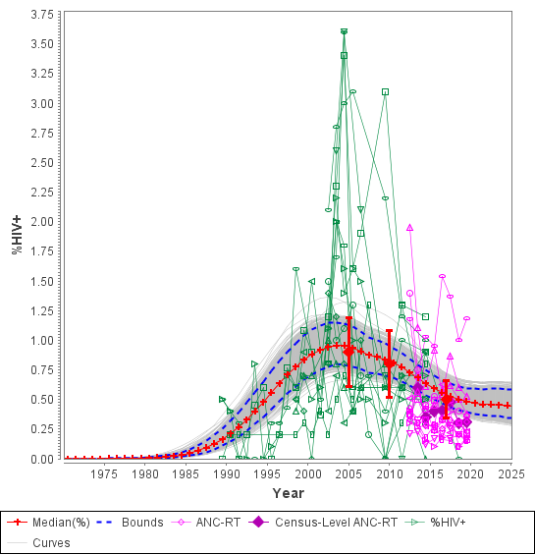
EPP Project Page: results
The results display shows
Bayesian median prevalence fit (red curve)
Annual Bayesian medians (red cross)
95% confidence intervals (blue dashed curves)
Unique curves fitting the data (light gray curves)
2+
1
4
3
Notes:
When you’re done fitting, the final graph showing the fit for each sub-population will look like this figure. The notable features of this graph are:
The red line represents the Bayesian median prevalence projection produced from fitting your data.
The red crosses are the Bayesian medians for each individual year
The two blue dashed lines represent the 95% confidence intervals for the projection.
The gray lines are the individual resamples of prevalence coming out of the fitting procedure and are used in establishing the Bayesian medians and confidence intervals.
After reviewing each sub-population, click on the green “Save and continue” button to advance to the next one. When you finish reviewing the last sub-population, EPP will move you on to the Calibration page.

Slide 31
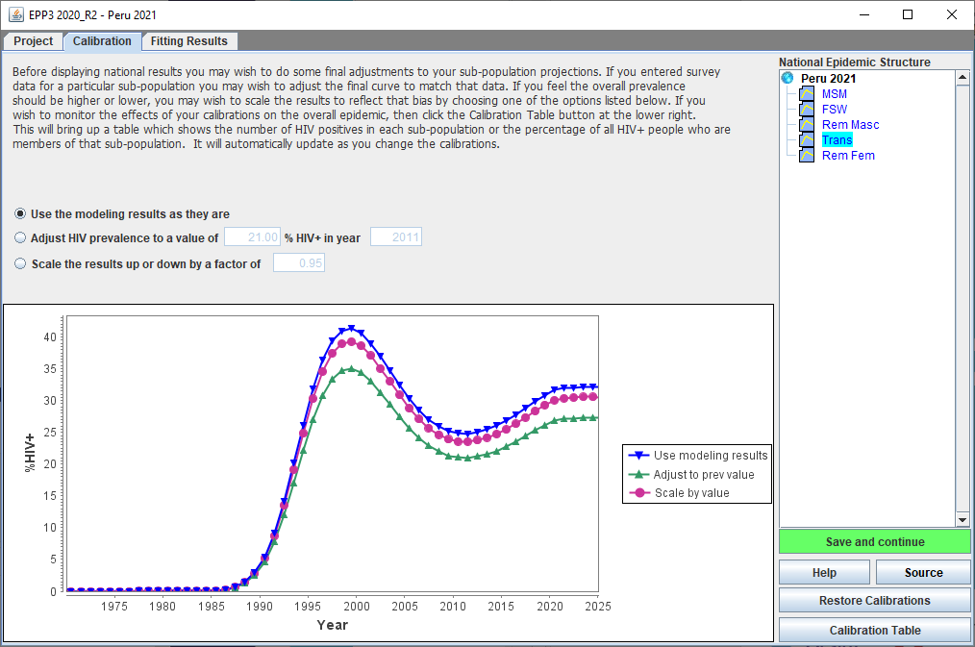
EPP’s Calibration Page Provides a way to adjust your key population and remaining population fits to be more nationally representative
Key features:
Calibration options
Restore Calibrations
Calibration Table
Notes:
For each of your sub-population fits, the Calibration page allows you to choose to either 1) keep the fitting results as they are, 2) calibrate to a fixed prevalence in a given year, or 3) calibrate by a scale factor. These are the three options available in concentrated epidemics. Because surveillance data in key populations are rarely national representative, your different key population fits may require some calibration. As you alter the calibration choice for each sub-population, the results will be shown in the graph displayed.
The calibration to be used will depend on what data you have available from different studies in your country. For key populations, calibration may be done by looking at higher quality, more representative surveys in those populations, for example, well-conducted IBBS surveys. It may be done based on an analysis of known biases in the surveillance sites relative to higher quality studies. Or it may be done based on assumptions, e.g., that ANC prevalence is often higher than prevalence among remaining males and females as discussed in the QuickStart manual. A UNAIDS analysis for concentrated epidemic countries found that, on average, ANC data needed to be down calibrated by a factor of 0.47 to represent women outside of key populations and by 0.56 for men outside of key populations.
Two other notable features here. There is a “Restore Calibrations” button in the lower right corner. EPP records the calibrations currently in place when EPP starts. If you re-run your fits, the default calibration will be set to “Use the modeling results as they are”. By clicking on the “Restore Calibrations’ button before making any other changes, these previous calibrations will be restored, letting you start with the values used the last time the fit was completed.
In addition, there is a Calibration Table that can be brought up using the “Calibration Table” button in the lower right.

Slide 32
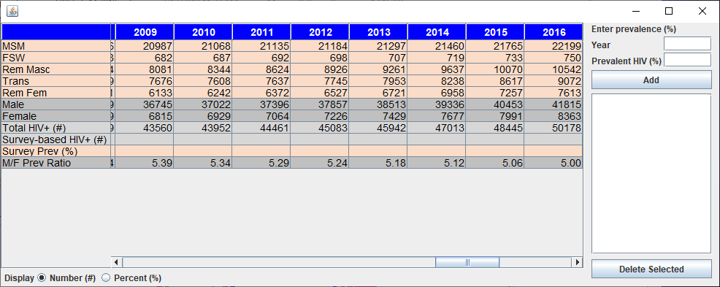
The Calibration Table Strongly recommend examining it to see the impact of your calibrations
Adjusting the
MSM calibration
Notes:
The Calibration Table shows you the impact of your calibrations on the total number of people living with HIV in your different sub-populations and on the male to female prevalence ratio. Each row represents a sub-population, the sums for males, females and all groups are displayed in the first 3 gray rows and the male to female prevalence ratio is provided in the final row of the table.
This is a dynamic “live table”. If you alter the calibration on a group while the table is displayed, the values in the table will adjust accordingly. In the above example, the MSM calibration on entering the page was “Use the modeling results as they are” so the actual prevalence numbers coming out of the projection are shown in the top table. If the MSM calibration is then adjusted to 0.5, that is, the number of MSM scaled by 50%, then the number of MSM living with HIV is cut in half. The total HIV+ number is also reduced accordingly and the M/F prevalence ratio is reduced because there are fewer men living with HIV.
After you have made any other changes to your calibration and reviewed this table, click on the “X” in the upper right corner to close it. Then do a final review of your Calibrations on the Calibration Page and when satisfied with them, click on “Save and continue” to move on to the Results Page.

Slide 33
A few thoughts on calibration in concentrated epidemics
Do calibration after the fitting not before
That is, don’t adjust your input data before fitting, calibrate after
Know your data. Types of biases to watch for:
Geographic limitations on the data, e.g., surveillance from high prevalence areas
Types of key populations being surveilled, e.g., brothel-based versus bar-based sex workers
Where data is collected, e.g., drop-in centers or STI clinics vs community-based data collection
Data collection approach: TLS, RDS, convenience
Analyze the impact of these biases on your prevalence levels and calibrate accordingly
Document any calibrations you make using the ‘Source’ button in the lower right of the window
Notes:
Before moving on to finalize your updated projections, we should say a few things about calibration in concentrated epidemics. First, because of the various biases in data about key populations, it is important to examine all the data available and bring them to bear to do the best calibration possible.
Normally, you should do calibration after the fit has been done. It is possible to adjust your data before fitting, but this means the data on the HIV Data page will not be recognizable since the values will be different from the measured ones in the official reports. This can generate a lot of confusion among those reviewing your projections. Instead, it is better to fit the data first, then do a calibration afterwards and document why you did it.
In calibrating in concentrated epidemics there are many biases to watch for, a few of which are listed here:
Surveillance data often comes from high prevalence areas so it will overestimate prevalence nationally.
The prevalence among different types of sex workers can vary greatly – brothel-based surveillance sometimes produces higher prevalence than surveillance done in bars.
Samples done at specific locations may be biased up or down, e.g., surveillance at an STI clinic is likely to produce prevalence that is too high for the MSM population as a whole
The data collection approach: time-location sampling, respondent driven sampling or convenience sampling may produce very different results depending on what populations it taps into.
Before calibrating, consider these and other biases of which you are aware and take them into account in deciding how to calibrate each sub-population and the amount of calibration needed.
Finally, whatever calibration you ultimately settle on, document your thought processes using the “Source” button so that the next person to review your file will understand what you did.

Slide 34
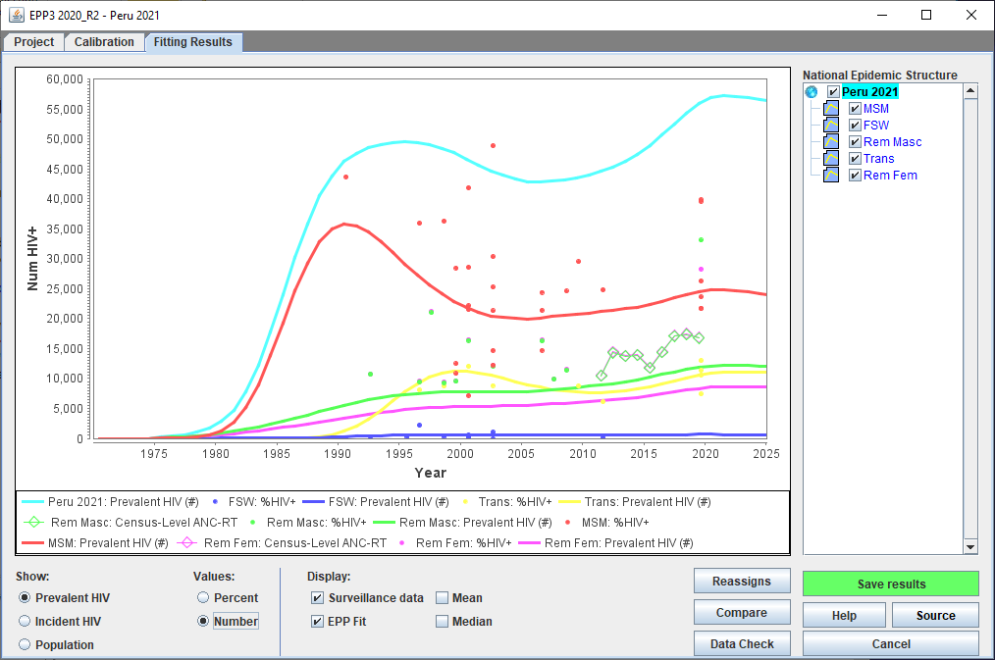
EPP’s Fitting Results Page A final chance to review your fits, before handing off to Spectrum
2
What to show: prevalence, incidence or pop/ as percent or number
Which projections to show in the graphs
Compare with previous projection
1
3
Notes:
The Fitting Results Page is the last stop before returning to Spectrum, but it serves the critical function of allowing you to review your fits before sending incidence to Spectrum.
In the set of radio buttons in the lower left corner you select what you want to show in the graphs. Your options are prevalence, incidence or population. You can also choose whether to show the prevalence and incidence as either percent or number of current or new infections.
In the National Epidemic Structure pane you will find a set of checkboxes that determine which sub-population projections are displayed on the graphs. The checkbox next to the overall projection name will show the national results obtained by summing all the sub-population projections.
Finally, you can click the “Compare” button to load a previous projection and compare it with the present one. We strongly recommend you spend some time on this page before proceeding to Spectrum. Look at the prevalence and incidence and the contributions from different sub-populations. See how your updated projection compares with your previous one. This is particularly important given the changes in the natural history parameters this year.
Start by examining the prevalence curves and make sure the trends are in accord with your expert understanding of the epidemic and how much each sub-population is contributing to the overall national epidemic.

Slide 35
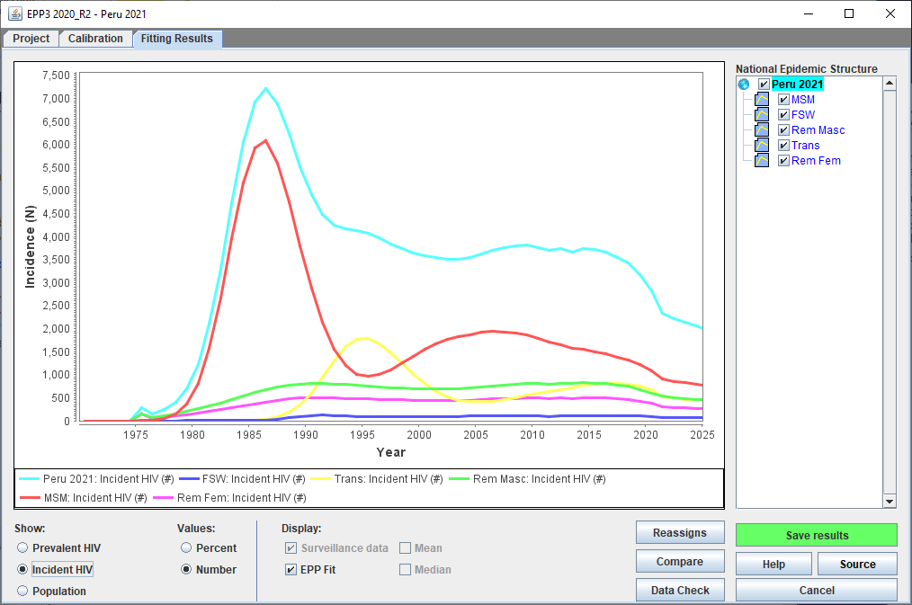
EPP’s Fitting Results Page Take the time to look at your incidence trends
Notes:
Select “Incident HIV” as a number and take the time to look at the contributions of each sub-population to the national incidence trend. Be sure they agree with your understanding of the epidemic and its relative timing and magnitude in the different key populations.

Slide 36
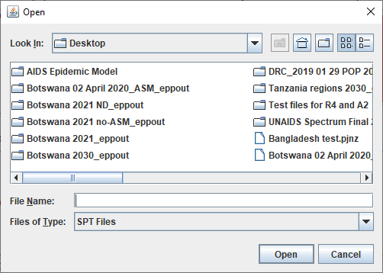
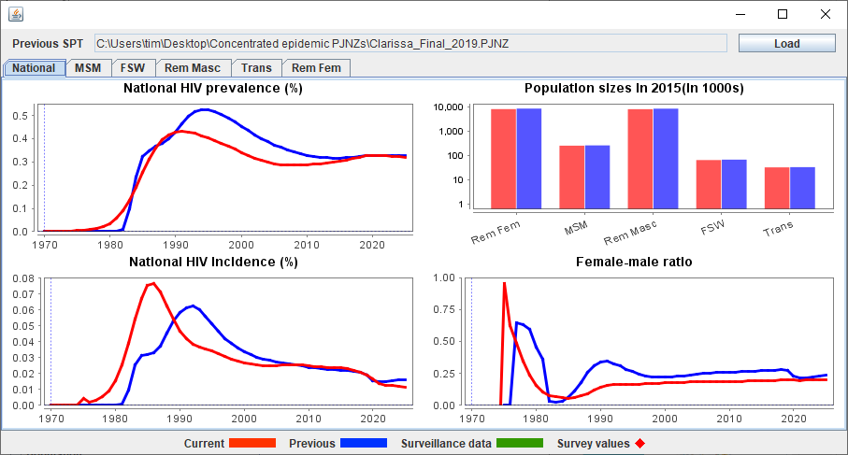
EPP’s Fitting Results Page Compare with your previous year’s projection
3
2
Click on the ‘Compare’ button
In the pop-up screen, click ‘Load’
Locate your previous year’s Spectrum file
1
Notes:
Click on the “Compare” button and a screen will pop up that will allow you to compare this year’s projection with last year’s. To load last year’s projections, click on the button labeled “Load”. This will pop up a file dialog that allows you to locate your Spectrum file from last year – this file will have the extension PJNZ. After you select the file and click “Open”, the graphs will show you the prevalence and incidence comparison between the two projections. The red curves are your current fit, the blue are last year’s fit. Look for any differences in incidence and prevalence between the two projections. This is particularly important this year with the changes made in many of the natural history parameters and the increase in ART impacts on incidence that have been made in Spectrum. Before you leave the workshop, your country team should understand how prevalence and incidence estimates have changed and be prepared to explain those changes to your decision makers.

Slide 37
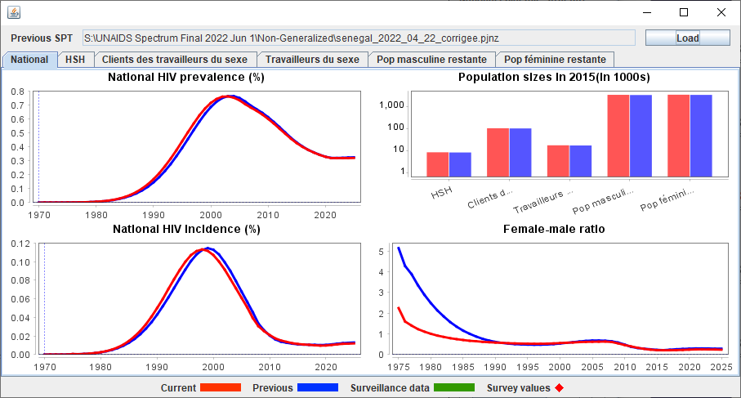
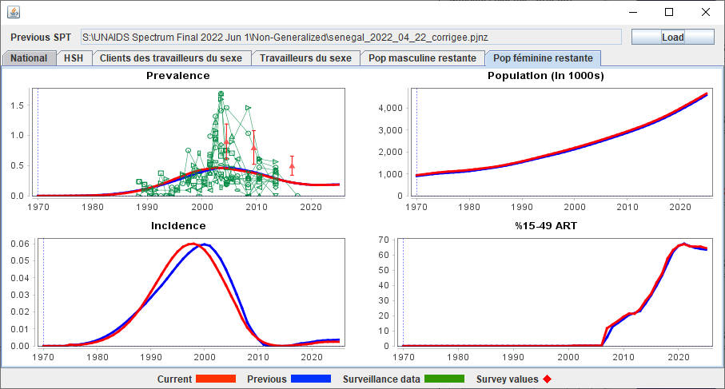
EPP’s Fitting Results Page Examine both national and sub-national results
Notes:
If you select the tabs on the Compare screen, you can also compare each of the sub-population fits separately. This is valuable in identifying unusual trends in the projections or changes in the fitting results from year to year, For example you may see changes due to the new natural history parameters this year, or you may identify inconsistent trends in the sub-population fits that may merit closer inspection. Try to understand the source of these differences and feel free to consult your facilitator on this. It might be due to new prevalence data added, changes in program data such as ART, changes in size estimates, changes to the model used, changes in the natural history parameters or many other causes. However, as you WILL need to explain it to your bosses, it is to your benefit to understand it before trying to do so.

Slide 38
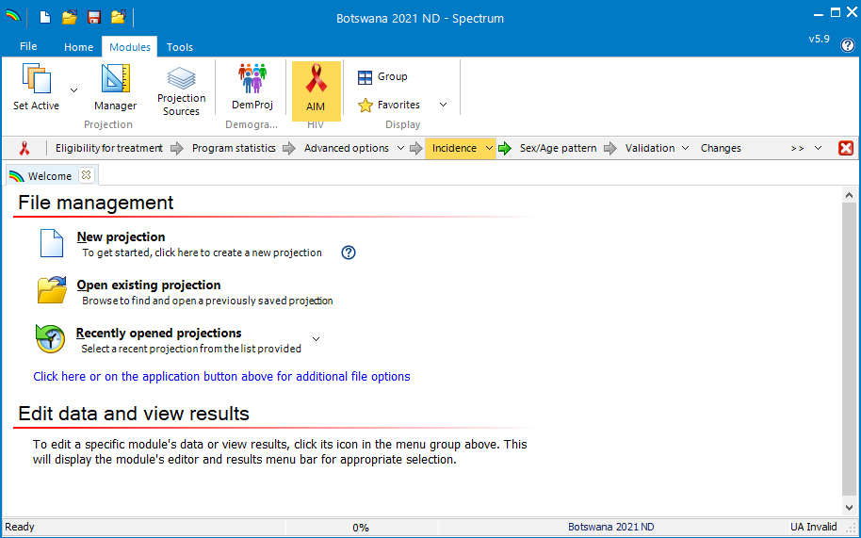
EPP’s Fitting Results Page To pass your incidence results back to Spectrum, click on ‘Save results’
Notes:
After reviewing your fitting results, the final, but critically important step is to click on “Save results”. This passes your incidence results from EPP to Spectrum for finalization. If you don’t click “Save results”, Spectrum will still be operating with your old incidence estimate, so don’t skip this step. After writing the results for Spectrum to read, EPP then returns control to Spectrum and you’re ready to move on to setting the Sex/Age pattern as described in the video on “Basic Steps to update your Spectrum/AIM file”. We also recommend strongly that you save your Spectrum file at this point to ensure the changes made by EPP are preserved.

Slide 39
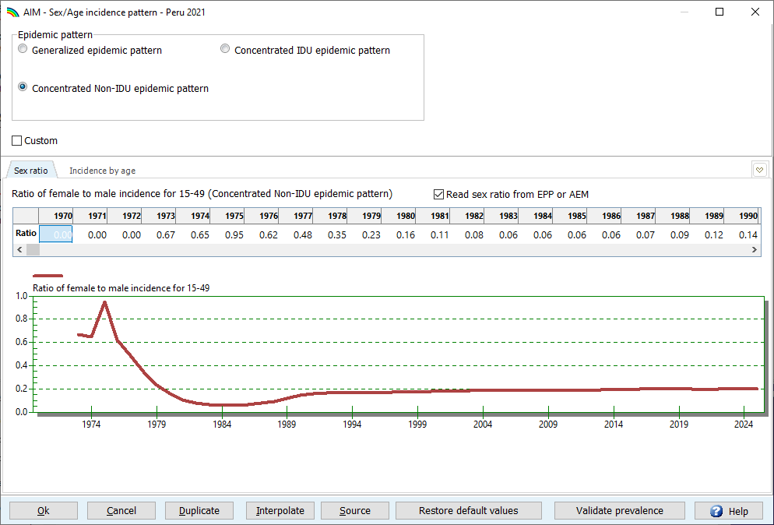
Once back in Spectrum make sure the ‘Read sex ratio from EPP or AEM’ box under ‘Sex/Age pattern’ is checked
Notes:
One final reminder. Once you are back into Spectrum, when you go to the “Sex/Age pattern” dialog, be sure the “Read sex ratio from EPP or AEM” box is checked. This will ensure that Spectrum takes the female to male incidence being produced by your EPP projection to apportion new infections within its own age-sex structured model.

Slide 40
Basic Steps in Updating Your EPP Projections
1. Open new 2023 Spectrum file, verify incidence option is EPP
6. Enter new survey data on Surveys Page
12. Calibrate if needed on Calibration Page
7. Review External HIV inputs page
2. On Define Epi Page review your epidemic structure
13. Review the Calibration Table.
8. Open EPP Project Page. Review data.
14. Review your results on the Fitting Results Page
3. Review population sizes on Define Pops page. Compare to regional averages.
9. Select a model for each of your sub-pops
15. Compare your new projection with the previous year’s
10. Make sure you are set to run a national projection
4. Review % male and turnover in each pop
16. Click on Save Results to return incidence to Spectrum
5. Open the HIV Data page, review and enter new surveillance data
11. Fit All and save your projections on the Project Page
Notes:
Congratulations, you’ve now completed the updating of your fits with EPP. Here is a summary of the steps you’ve taken to update your EPP projections. To update, you just proceeded through these steps in order. You have now provided Spectrum with a new incidence trend to use in its calculations.

