Slide 1
Basic steps to update CSAVR
Eline Korenromp, UNAIDS
UNAIDS 2023 Workshops on
HIV Estimates and Identifying Inequalities
Notes:
This presentation will walk you through the basic steps of updating your Spectrum file using case surveillance and vital registration data, or CSAVR for short.
This presentation covers just the basic steps, and explanation of data required and data entry. You can find another presentation about CSAVR technical details, as “Under the hood CSAVR” on the HIVtools.unaids.org website. That presentation covers some in-depth methodological (mathematical and statistical) details, and some advanced features that may help if you run into problems.

Slide 2
Some countries use an alternative incidence model, e.g., AEM or ECDC. Their incidence rates can be directly entered into Spectrum.
Notes:
The tool we cover here is most appropriate for estimating HIV incidence from robust, historical national case surveillance and vital registration data that captures HIV-related deaths. The CSAVR fitting tool offers several curves that capture various HIV incidence trends, including steadily increasing incidence over time, incidence that peaks and declines, or epidemics that exhibit multiple peaks. Countries that don’t have these data may consider using EPP, the Estimates and Projections Package, instead.
Caution: If you do not have accurate data on the number of people on treatment over time, UNAIDS does not recommend using the rLogistic model.

Slide 3

Basic Steps to update CSAVR: part 1, entering data
Open your 2022 Spectrum file
& verify incidence option is set to CSAVR.
Update data:
  HIV case diagnoses
  AIDS deaths from Vital Registration
  Optionally, CD4 counts at initial diagnosis
In Model fitting form, fit 4 statistical models in turn – including Sex/Age Incidence Rate Ratios if case and/or death data had this disaggregation.
Select the best-fitting model, return to AIM, save the file.
In Program Statistics > Knowledge of Status,
Load the CSAVR-estimated numbers of PLHIV knowing their status
– unless you have reliable numbers straight from program data, that are also compatible with (i.e., in between) CSAVR-estimated PLHIV and ART numbers.
If CSAVR fitted IRRs by Sex and/or Age, adopt the fitted
‘pattern from CSAVR’ into AIM.
Notes:
This slide lists the basic steps. We’ll go into each in more detail, but you may want to refer to this slide as you work through the process of updating your Spectrum file..

Slide 4
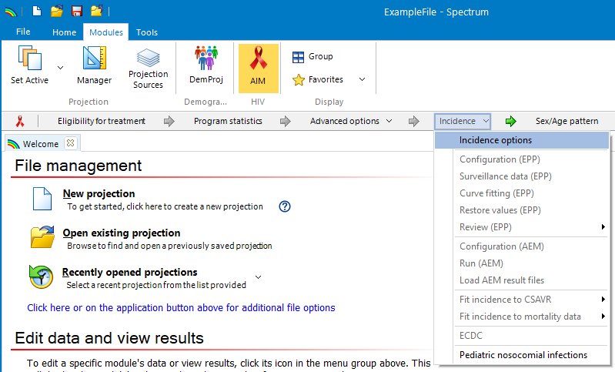
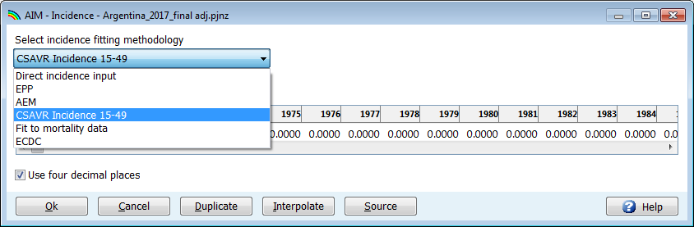
Open your 2022 Spectrum file
Verify
Incidence option is set to CSAVR
Open your 2021 Spectrum file
Select “Modules > AIM”
Select “Incidence > Incidence options”
Verify that CSAVR is selected
Notes:
First, with your 2021 Spectrum file open, you should make sure that CSAVR is selected. Make sure that you are in the AIM module of Spectrum and click on the “Incidence” menu. Select “Incidence options” from the dropdown list. That will bring up a form with a dropdown menu labeled “Select incidence fitting methodology”. Verify that “Case Surveillance and Vital Registration” is selected, or choose it from the dropdown menu if you used something else last year, then press “Ok” to accept your choice and leave the form.

Slide 5
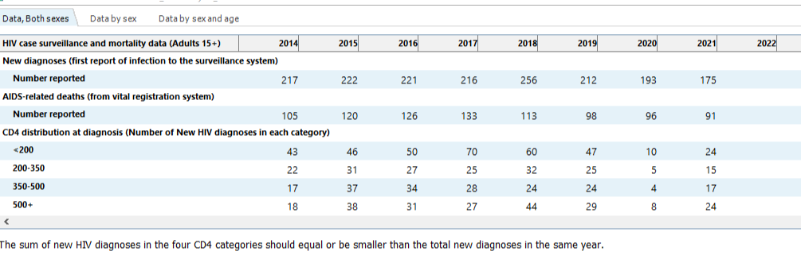
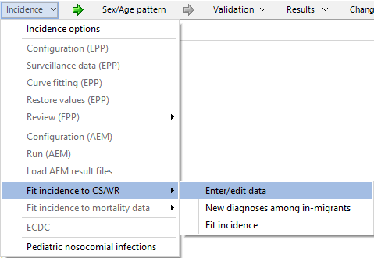
Enter surveillance data into CSAVR
AIDS deaths
New HIV diagnoses
Optional: CD4 count at initial diagnosis.
Enter annual totals (15+ years) & if available by Sex, and by Age & Sex
– for years (nearly) complete relative to annual total.
Enter zeroes only if a recorded number was 0.
Press “OK” to accept your data and leave the form
Notes:
Enter and update the data that CSAVR will fit too, overall and if available by sex, and by sex and age. Besides the overall annual totals, you can enter the granular data even if these are not there for all years, or if the sum of men + women or across age groups doesn’t fully match the total. If you do enter granular data, you will need to enter the corresponding totals in the less granular tabs.
Be careful of entering zeroes into this form. You should only enter zeroes when the number of recorded diagnoses or deaths was actually zero. If your file hasn’t used CSAVR in a while, for example if you used EPP last year but want to try CSAVR this year, you may see zeroes entered in some years when there were no data available. You should delete those, otherwise CSAVR would think there were no AIDS deaths in a year where those data just weren’t collected, which would bias your incidence estimates.
Once your data have been entered, you can press “OK” to accept your changes and leave the form. Now, if you accidentally entered inconsistent values – for example, if the numbers of new diagnoses by sex don’t add up to the total number of new diagnoses – you will get an error message when you try to leave the form. You will need to fix those errors before moving on to the next step.

Slide 6
Which indicators to fit in CSAVR?
Indicator | Required? | Function | Data requirements
AIDS deaths | Yes | Basis for estimating the epidemic level | If possible, include (add) deaths misclassified to other (non-HIV) causes (next slides)
New HIV diagnoses | Yes | Informs Knowledge of Status and, for recent years, incidence | Count every first-time diagnosis in the country once → deduplicate!
CD4 count at initial diagnosis | Optional | Informs the lag from infection to diagnosis, and so Knowledge of Status | Enter in 4 categories: <200, 200-350, 350-500 & >500/mL Enter and fit CD4 data only for years they covered >=80-95% of new diagnoses
To publish a CSAVR-based historic incidence trend, UNAIDS requires:
8 years of Deaths data AND 8 years of Case diagnoses
  Death data classified by IHME as medium or good-quality (groups 2A and 2B), not poor quality (group 2C)
Both cases & deaths within 1990-2022
Spectrum file covering the full ‘de facto’ population: all residents including non-nationals.
Notes:
IHME quality of Cause of Death country groupings:
https://www.thelancet.com/cms/10.1016/S2352-3018(21)00152-1/attachment/7371c03e-887f-4e26-a718-bae190b81c2f/mmc1.pdf

Slide 7
New HIV case diagnoses, in CSAVR
Serve to inform:
Progress in Knowledge of HIV sero-status
Secondarily, HIV incidence – for recent years mainly,
where deaths, lagging behind infection and diagnosis, are less informative.
In 2022 round, some countries ‘suppressed’ 2020 and/or 2021 case numbers, which were below pre-2020 numbers due to COVID-related testing disruptions – to avoid under-estimating recent/current incidence.
In 2023 round, once adding 2021 and/or 2022 case numbers, put back all years of case data
– to not over-estimate progress in Knowledge of Status.
This should not bias the incidence estimate.
Count every first-time diagnosis in the country once → deduplicate!
Include new/first-time diagnoses among immigrants (unless if deported at diagnosis)
Notes:
Special cases:
Venezuela, humanitarian crisis 2018-19: in 2023 round, recommend to put (back) into CSAVR all years of case data.
Chile: net HIV+ immigration – include (keep) HIV+ immigrants in total CSAVR-inputted case numbers.

Slide 8
AIDS deaths: Which data are good to fit CSAVR?
UNAIDS recommends CSAVR for countries with medium or good quality and completeness of Cause of Deaths data.
Using the IHME quality scoring* :
2A. High quality Vital Registration data
2B. Some usable VR data (mixture of quality)
2C. No useable-quality HIV-specific mortality data used by IHME → do not fit CSAVR.
1A/B: Prevalence data to estimate incidence & mortality using EPP; mixed-quality VR data.
Based on:
Completeness of death registration – minimum threshold
Contribution of garbage and ill-defined causes of deaths – maximum threshold
Similar to WHO/PAHO’s quality assessment;
IHME added ill-defined causes as criterion and for adjustment/redistribution.
* IHME country groups: Section 2.3 of the supplementary material (page 5) and depicted in Figure S1 on page 6 of: https://www.thelancet.com/cms/10.1016/S2352-3018(21)00152-1/attachment/7371c03e-887f-4e26-a718-bae190b81c2f/mmc1.pdf
Notes:
https://www.thelancet.com/journals/lancet/article/PIIS0140-6736(17)32152-9/fulltext
The IHME created a star rating system for the overall quality of cause of death data for each location in each year.
This system represents VR completeness, percentage of deaths coded to causes that cannot be true underlying causes of death (garbage codes),
detail of the cause list and age groups,
and time periods covered.

Slide 9
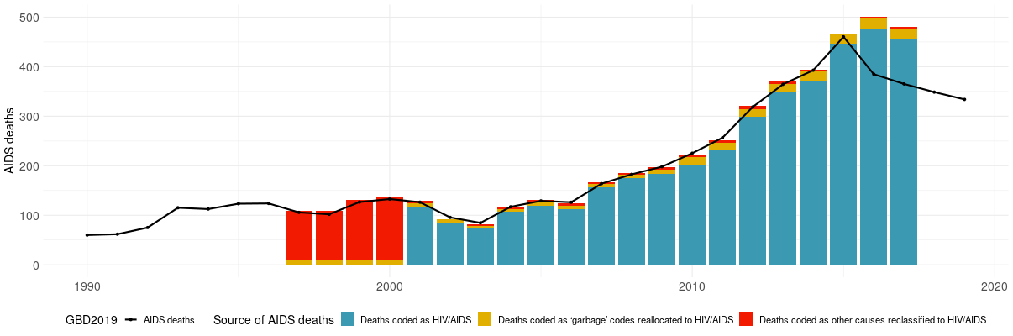
AIDS deaths data: misclassified causes
Example:
Cuba
Visualizer of IHME adjustment for (redistribution of) misclassified causes of deaths
https://shiny.dide.imperial.ac.uk/csavr_mortality

Slide 10
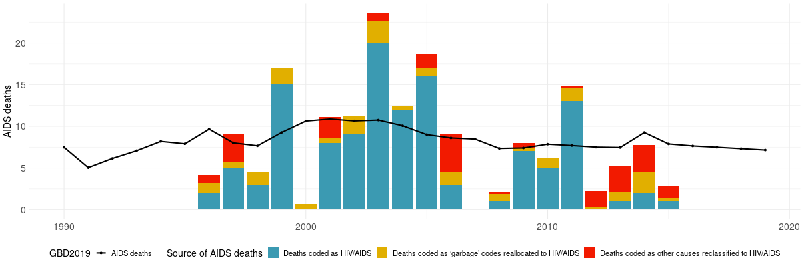
AIDS deaths data: misclassified causes
Caution: If the adjustment makes a large (>2-fold) difference, scrutinize it and see which series (original or adjusted) produces more reasonable PLHIV estimates & coherent cascades with adult ART coverage <100%.
Example: St. Lucia
Visualizer of IHME adjustment for (redistribution of) misclassified causes of deaths
https://shiny.dide.imperial.ac.uk/csavr_mortality

Slide 11
AIDS deaths to fit: combine IHME adjusted data with original Vital Registration
Enter to CSAVR up to 3 death series, to assess and address missingness due to misclassified causes of deaths.
UNAIDS recommends to fit CSAVR to misclassification-adjusted HIV/AIDS deaths – complemented with
original (non-adjusted) Vital Registration data for more recent years – and optionally for years before the adjusted data.
Having entered 3 data series, you may run alternative CSAVR fits and compare results.
Source | Fit? | Definition & Source | Data availability: example
1 | No | Original HIV/AIDS death reports, Vital Registration: ‘Immediate’ and ‘intermediate’ causes of death – but HIV/AIDS as underlying cause of death is often mis-characterized i.e. , under-reported | 1988 – 2021
2 | No | IHME dataset used for 2020 Global Burden of Disease, adjusted up to include deaths misclassified as other (including ‘garbage’) codes | 1997 - 2017
3 | Yes | Hybrid: IHME adjusted for years available + original reports for other years | IHME 1997-2017 + Unadjusted 2018-2021 + optionally, Unadjusted 1988-1996
Notes:
From your 2022 Spectrum file, the data (whether it was original VR, IHME or a hybrid already) will show up as Source 1. Fill the empty tables Source 2 and Source 3, with the other two options.
Cause of death data correction by the Institute of Health Metrics and Evaluation (IHME) are done as part of the Global Burden of Disease. Raw data are those submitted by countries to the WHO Mortality Database, from where IHME extracted them and applied a three-step cleaning process. After this, the mortality data are adjusted for Cause-of-death coding errors.
For details, see slide deck: 50S_Cause-of-death-Sankey-diagram-tool.PPT

Slide 12
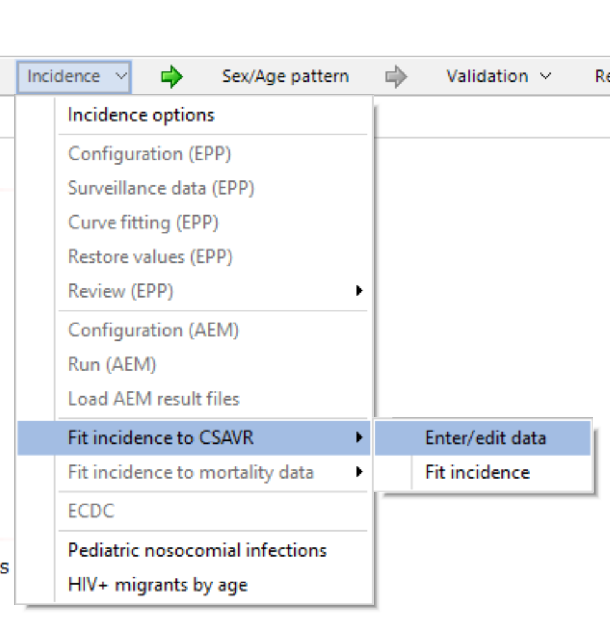
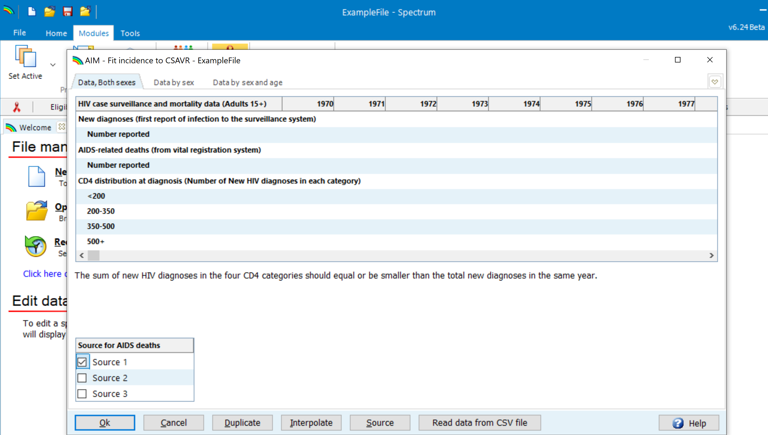
AIDS deaths to fit CSAVR to: enter & switch between up to 3 data series
Enter to CSAVR up to 3 death series, to assess and address missingness due to misclassified causes of deaths.
UNAIDS recommends to fit CSAVR to misclassification-adjusted HIV/AIDS deaths – complemented with
original (non-adjusted) Vital Registration data for more recent years – and optionally for years before the adjusted data.
Having entered 3 data series, you may run alternative CSAVR fits and compare results.
Notes:
From your 2022 Spectrum file, the data (whether it was original VR, IHME or a hybrid already) will show up as Source 1. Fill the empty tables Source 2 and Source 3, with the other two options.
Cause of death data correction by the Institute of Health Metrics and Evaluation (IHME) are done as part of the Global Burden of Disease. Raw data are those submitted by countries to the WHO Mortality Database, from where IHME extracted them and applied a three-step cleaning process. After this, the mortality data are adjusted for Cause-of-death coding errors.
For details, see slide deck: 50S_Cause-of-death-Sankey-diagram-tool.PPT

Slide 13
Basic Steps to update CSAVR: part 2, fitting the data
Open your 2022 Spectrum file
& verify incidence option is set to CSAVR.
Update data:
  HIV case diagnoses
  AIDS deaths from Vital Registration
  Optionally, CD4 counts at initial diagnosis
In Model fitting form, fit 4 statistical models in turn
– including Sex/Age Incidence Rate Ratios
if case and/or death data had this disaggregation.
Select the best-fitting model, return to AIM, save the file.
In Program Statistics > Knowledge of Status,
Load CSAVR-estimated numbers of PLHIV knowing their status
– unless you have reliable numbers straight from program data, that are also compatible with (i.e., in between) CSAVR-estimated PLHIV and ART numbers.
If CSAVR fitted IRRs by Sex and/or Age,
adopt the fitted ‘Pattern from CSAVR’ into AIM.
Notes:
This slide lists the basic steps. We’ll go into each in more detail, but you may want to refer to this slide as you work through the process of updating your Spectrum file..

Slide 14
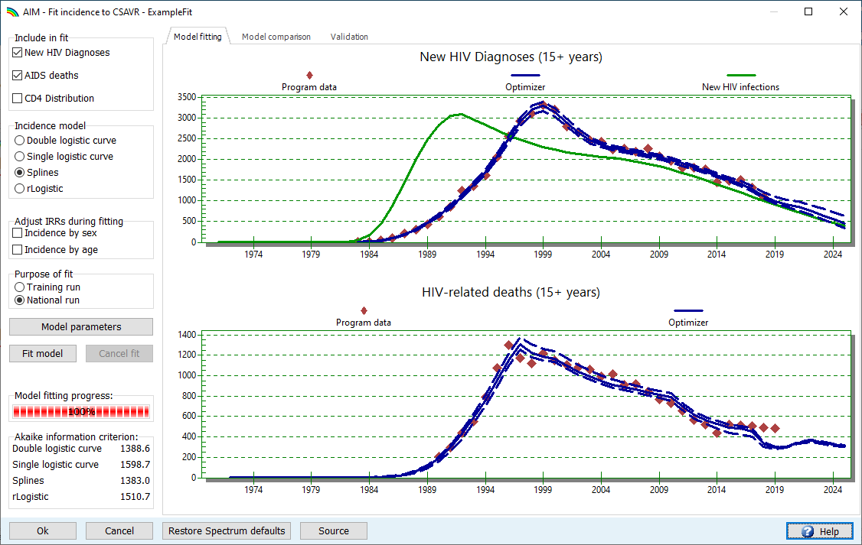
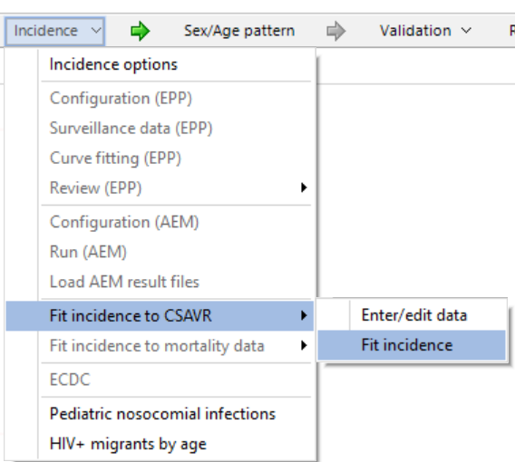
Fit incidence to CSAVR:
Model fitting form
Notes:
Once you have entered your data, you can fit HIV incidence. You can access the CSAVR fitting form in Spectrum’s “Incidence” menu, under “Fit incidence to CSAVR” by selecting “Fit incidence”.
This form has three tabs. The “Model fitting” tab, shown on this slide, has options for choosing what data to fit to, what incidence curve to use, and whether to perform national or training runs. And it has buttons to run model fits, and graphs to compare the model fit to your data.
The “Model comparison” tab lets you see all 4 incidence models side-by-side.

Slide 15
Running a CSAVR model fit
Choose which data to fit to
Choose which statistical model to fit
Choose if also fitting Incidence Rate Ratios (IRRs) by sex and/or age, to the sex/age disaggregated data.
Select Training or National run
Press “Fit model”
Wait for model fitting to complete
  Graphs and AIC scores will update while CSAVR finds
  improving model fits
Notes:
In order to fit an incidence model, first choose which indicators to fit too, between: new HIV diagnoses, AIDS deaths and/or CD4 counts at initial diagnosis. Generally, you should use all 3 data sources if you have them.
Next, choose which model to fit. We’ll talk about this more on the next slide. You will then choose whether to do a training run or a national run of the selected model. A national run generates uncertainty bounds but can take quite a while to run. Training runs don’t take as long, and usually find a fit that is close to the national run, but don’t generate the uncertainty bounds you need for the final file. You can find out more about the incidence models, and details on the methods used for training and national runs, in the “Under the hood” CSAVR presentation.
Once you’ve made these choices, press “Fit model” to start the model fitting algorithm. You can monitor fitting progress via the progress bar (bottom-middle), and the graphs and Akaike nformation criterion display at the bottom-left will update as model fitting runs.

Slide 16
Choosing a model
As a rule of thumb, choose the model with lowest
Akaike information criterion (AIC)
  Better-fitting models with fewer parameters have lower AIC:
  But, models are “similar” if AIC scores are within 10 points of one another.
If multiple models have similar AIC, choose the most reasonable
one by comparing results, notably:
  New infections
  PLHIV
  % of PLHIV knowing their status,
  all over time.
  … using graphs under Model comparison and Validation tabs.
Notes:
For initial CSAVR runs, to save time you may a training run of each model before doing any national runs. Once you have done training runs for each model, choose the model with lowest Akaike information criterion (AIC) – or the one . For those unfamiliar with the AIC, this criterion assigns lower scores to models that fit the data more closely while using fewer parameters. You may end up with multiple models that have similar AIC. Conventionally, we consider AIC scores similar if they are within 10 points of each other. In this case, you might look at the trends the models produce and choose the model that looks more realistic. The other two tabs of the fitting form, the “Model comparison” tab and the “Validation” tab, can help with this.

Slide 17
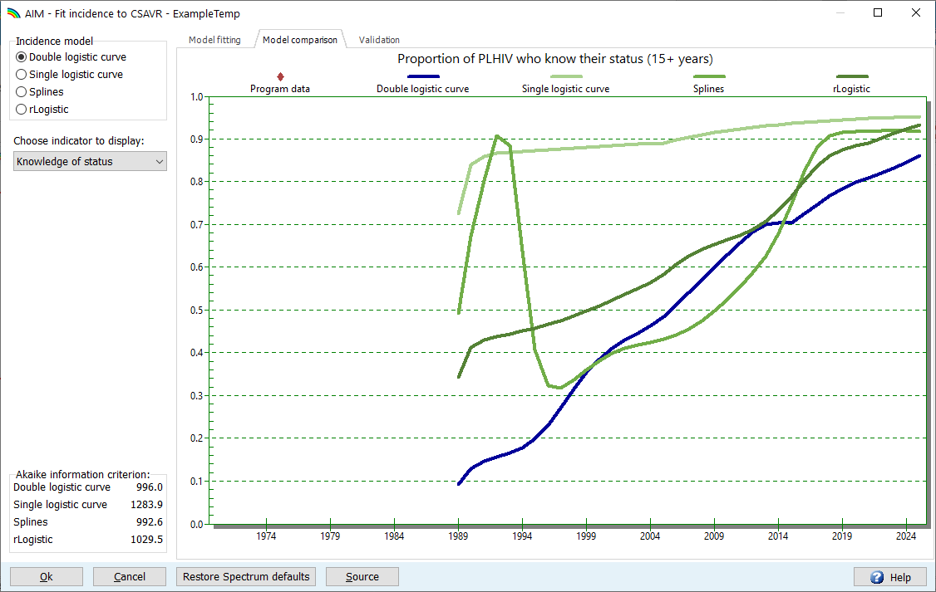
Choosing a model
Model comparison
Notes:
The Model comparison tab shows one curve for each incidence model. Your current model selection is shown in blue, the others in green. You can toggle between selections to highlight different curves. For the example here, the Spline curve has the best AIC, but suggests knowledge of status reached 90% between 1989 and 1994. Meanwhile, the double logistic curve in blue has similar AIC and a knowledge of status trend that seems more reasonable early on, so this country could justifiably choose the double logistic curve over the spline, provided other indicators also look reasonable.

Slide 18
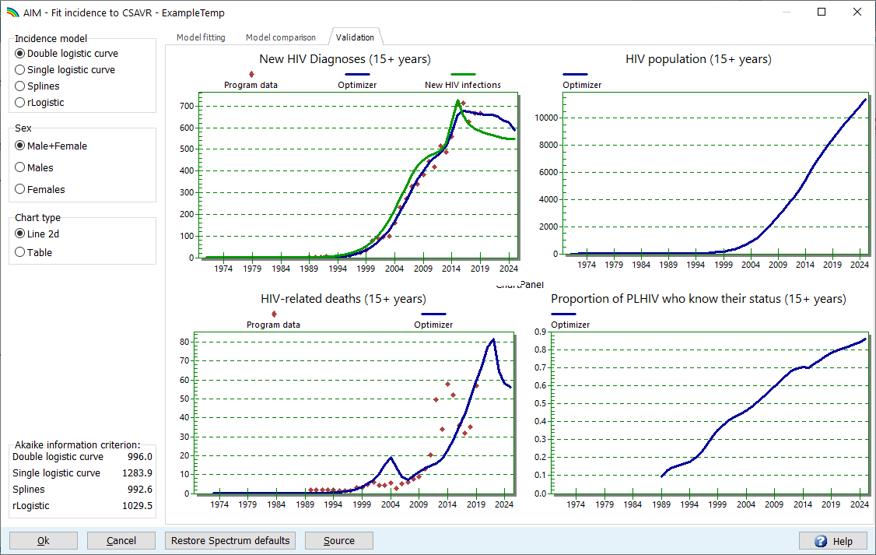
Choosing a model
Validation – disaggregated by sex
Notes:
The “Validation” tab shows you new diagnoses, numbers of people living with HIV, HIV-related deaths, and knowledge of status side-by-side for your selected model. By default, this shows you line graphs for both sexes summed, but you can toggle these displays to show sex-specific results, or tables with numbers (that underlie these line graphs).
If you entered sex-specific data, this tab helps check whether the model fits those data well. This may help choose the final best model if some models have similar AIC.

Slide 19
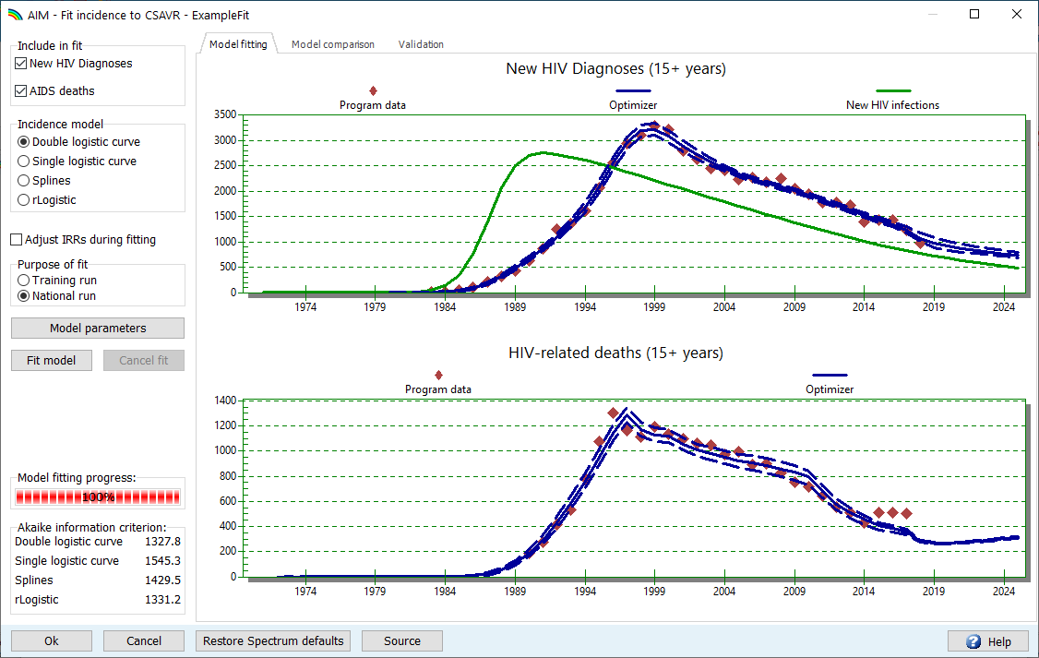
Finalizing the incidence estimate
Perform a National run of your selected model to produce uncertainty bounds
  Once complete, graphs show uncertainty bounds, as dashed lines
Review Model comparison and Validation tabs, to ensure you are satisfied with the selected model.
Ensure your preferred model is selected and press “Ok”.
Save the
Spectrum file
2
1
3
Notes:
Once you’ve selected a model based on training runs, return to the “Model fitting” tab and perform a National run. Review the Model Comparison and Validation tabs to make sure the fit looks OK for the selected national run. Press OK to accept this fit and leave the form. Once back at the main Spectrum form, make sure to save your file, so all model fits and your final model selection are saved.

Slide 20
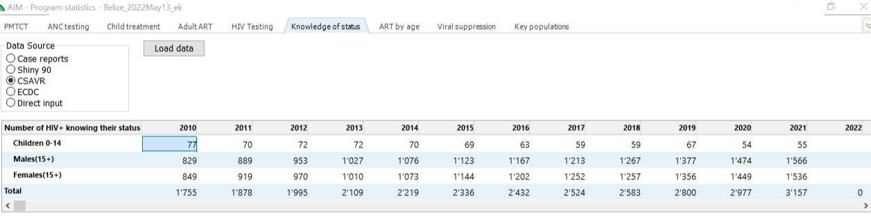
Knowledge of Status: Load estimate from CSAVR in AIM
In Program Statistics > Knowledge of Status,
Load the CSAVR-estimated (adult) PLHIV knowing their status.
& Reload every time your incidence estimate (or IRRs by sex) change!
Unless you have reliable numbers straight from program data, that are also compatible with
(i.e., in between) CSAVR-estimated PLHIV and reported ART numbers.

Slide 21
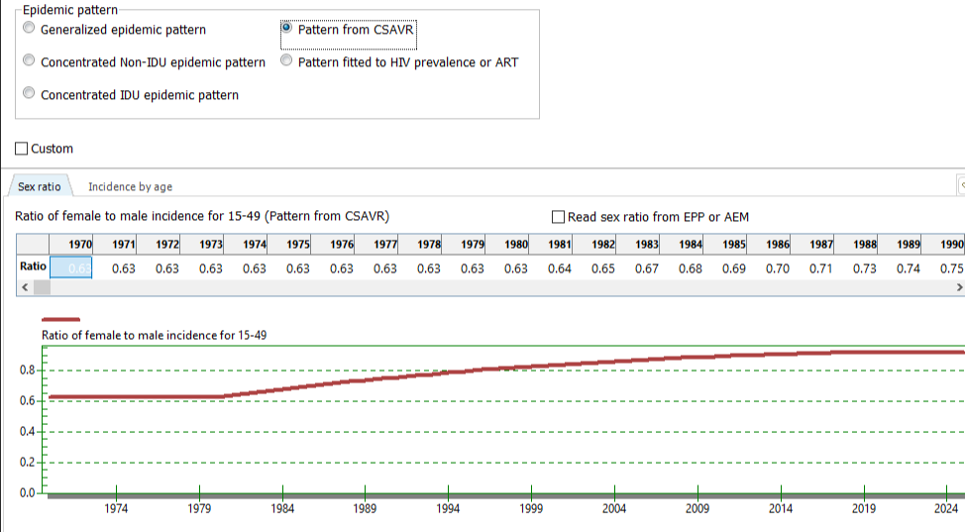
Import Incidence Rate Ratios (IRRs) by Sex and Age from CSAVR into AIM
If in CSAVR you fitted IRRs by age and/or sex, then in AIM under Sex/Age Pattern, select ‘Pattern from CSAVR’ , so AIM will use the same IRRs (by sex and age) as CSAVR.
…
Notes:
(Only) AFTER setting the IRRs in AIM, under Advanced Options, fit the HIV-related fertility reduction to national ANC data, setting the Local Adjustment Factor, to ensure the correct corresponding prevalence in pregnant women (which can be different from prevalence in all adult women) and need for and coverage of PMTCT and pediatric ART. This additional step will be explained in a next presentation.

