Slide 1
Updating Spectrum to WPP 2022
Redouane Betrouni, U.S. Census Bureau
UNAIDS workshop on HIV Estimates and Identifying Inequalities in the Middle-East and North Africa region
Cairo, 19-23 February 2023

Slide 2
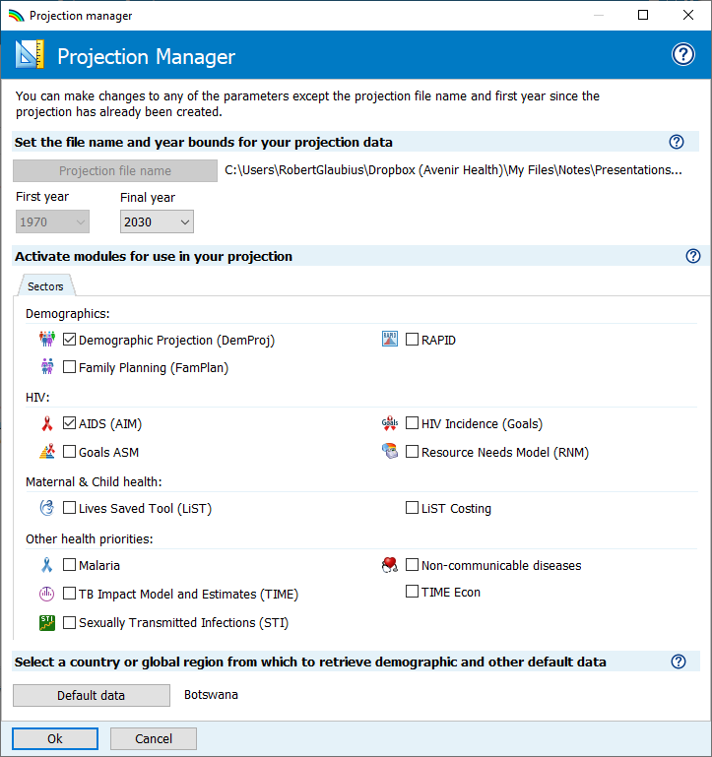
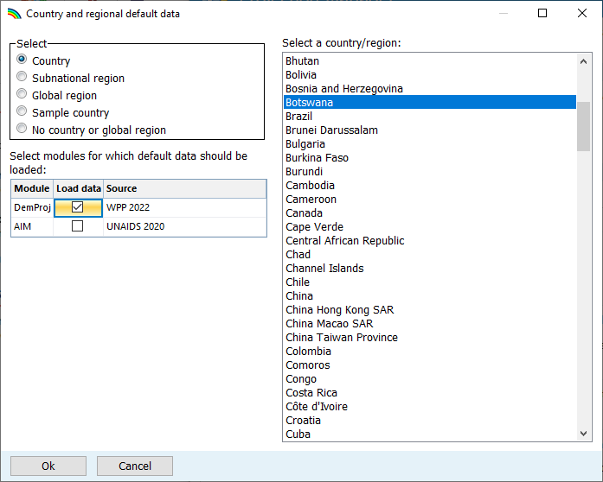
How to update the demographic inputs
Open the projection manager
Change Final year to 2030
Click “Default data”
Tick the box next to “WPP 2022” to load updated demographic inputs
Press “OK” to leave the default data editor
Press “OK” again to leave projection manager

Slide 3
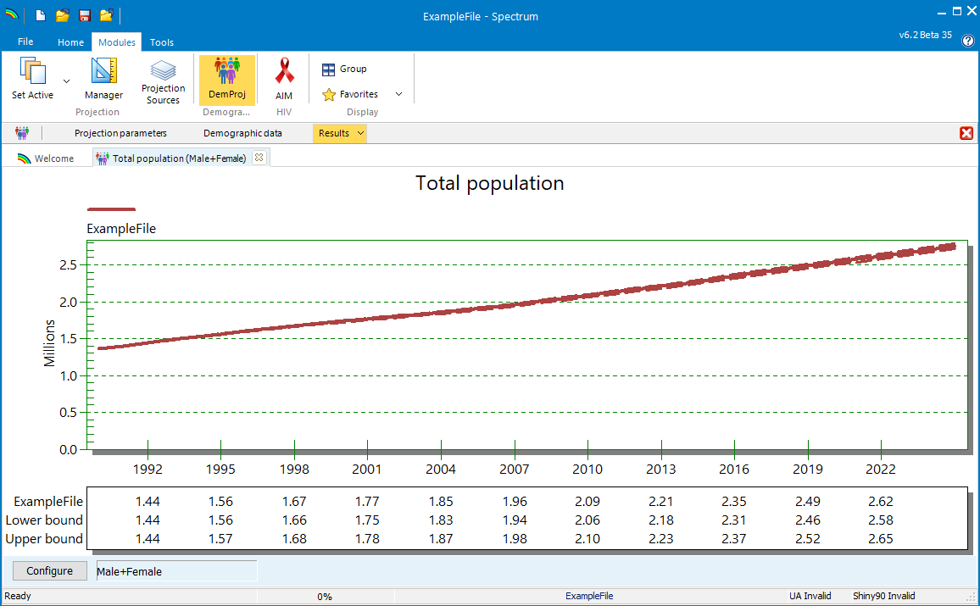
Review the population estimate
Use ‘DemProj > Results > Population > Total population’ to see if Spectrum’s (de facto) population estimate is close to the latest official national estimate.
UNAIDS strongly encourages countries to use WPP 2022 estimates as-is.
However, countries may wish to apply an ad hoc adjustment, multiplying the 1970 population by a scale factor, to match their own 2022 population estimate.

Slide 4
Improvements in WPP 2022 (from WPP 2019) and advantages for use in Spectrum
From 5-year age groups to single-year age groups
Age range changed from 0-110, to 0-130 years
Reference dates: For Counts-type indicators: changed from July 1st (WPP 2019) to January 1 (WPP 2022) For ‘Rates-type indicators: changed from July 1 to June 30 (WPP 2019) to January 1 to December 31 (WPp 2022).
→ Spectrum adopted the same change in reference dates, so is fully consistent.
COVID effects are included in WPP 2022 -- whereas NSOs usually do population projections after a population and housing census, so may not yet have incorporated demographic effects (fertility, mortality, and migration) of the pandemic.
Other advantages of WPP 2022, as basis for Spectrum projections:
WPP 2022 are smooth over time
WPP 2022 uses historical data from census and surveys and population models, to estimate all demographic indicators over time, in one coherent framework.
WPP 2022 models the full de facto population, including all residents where they reside and need services.

Slide 5
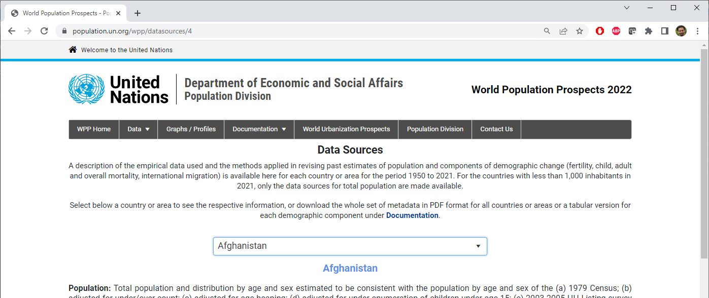
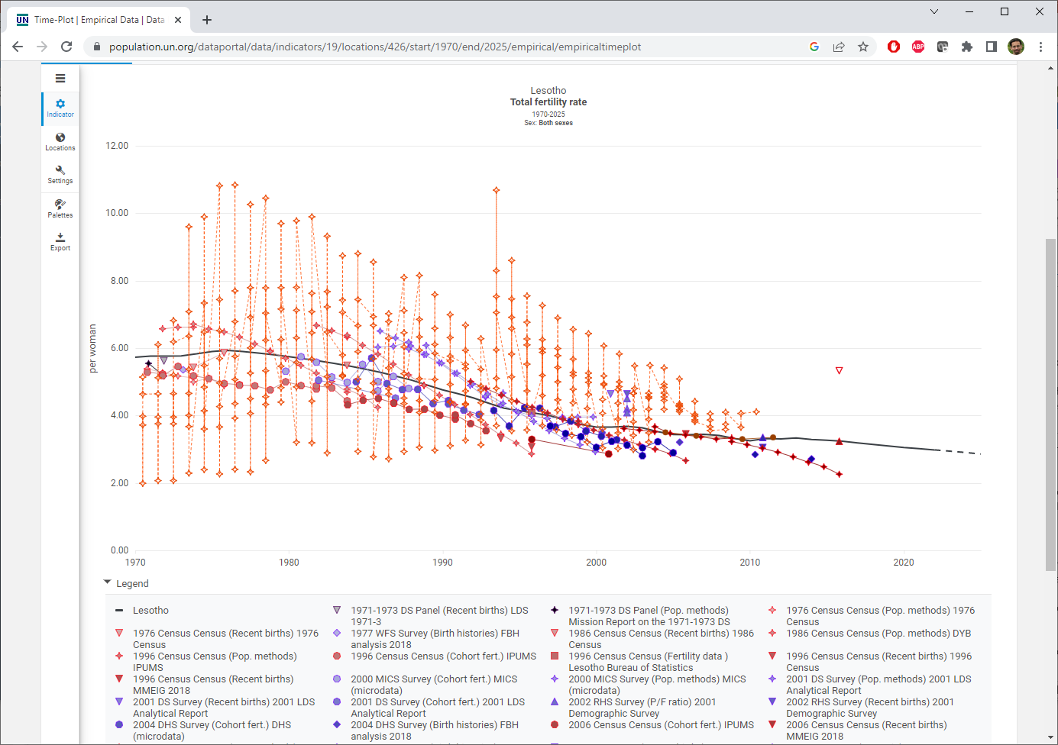
WPP 2022 web resources
Data Sources
https://population.un.org/wpp/datasources
Data Portal
https://population.un.org/dataportal/home
World Population Prospects 2022: Methodology of the United Nations population estimates and projections (page 6)
Notes:
The UN Population Division has made some great resources available online for understanding the data that went into WPP2022. The Data Sources web page gives a text description of the data sources and methods. The Data Portal lets you access estimates of demographic indicators from WPP 2022 and includes some useful visualizations of the estimates alongside the empirical data that informed them. The example screenshot here shows the total fertility rate in Lesotho alongside the data used to estimate it.

Slide 6
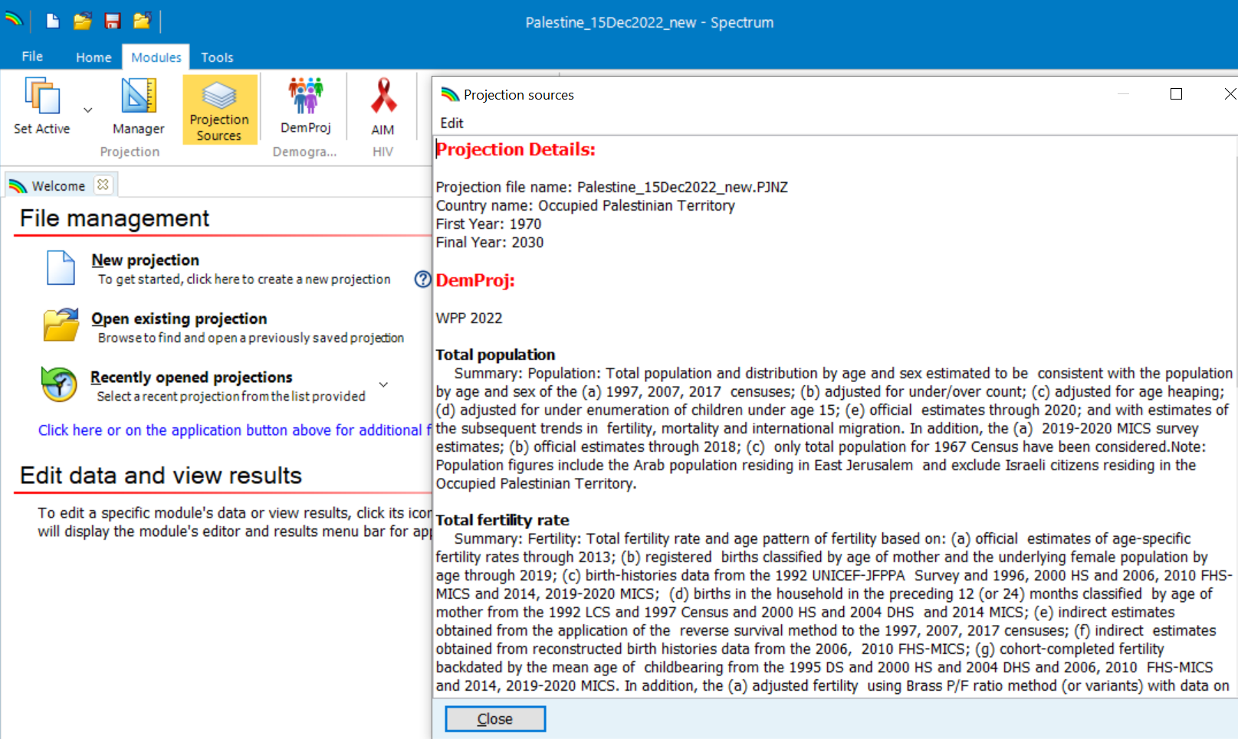
Data sources
WPP 2022 data sources information can also be accessed directly within Spectrum, via the “Projection Sources” button

Slide 7
Updates to demographic inputs affect national HIV estimates differently from EPP and CSAVR
 | EPP | CSAVR
HIV data used in model fitting | Prevalence rate | Absolute numbers of case diagnoses and deaths
Indicator passed to AIM | Incidence rate | Incidence rate
AIM-estimated rates: incidence, prevalence, mortality | Unchanged | Larger population → lower rate Smaller population → higher rate
AIM estimated numbers: infections, PLHIV, deaths | Larger population → higher number Smaller population → lower number | Unchanged
From 2023, UNAIDS recommends that all countries estimate for the full de facto population, including immigrants -- such that every person counts in some country, for prevention and/or treatment.
This will increase population denominators for several Middle-East (Gulf) states, who had previously been estimating only nationals. Since all these use CSAVR, the population increase will decrease estimated indicator rates, but not change epidemic numbers.

