Slide 1
Naomi sub-national estimates: Data review function in Naomi
December 2022 / January 2023
version 28 November 2022

Slide 2
Naomi team
Rob Ashton
Lekan Anifowoshe
Rachel Esra
Nick Dolan
Jeff Eaton
Rich Fitzjohn
Alex Hill
Emma Russell
Oli Stevens

Slide 3
Data review function in Naomi
Logging into Naomi with an existing ADR account
Importing data from the ADR
Data review tool

Slide 4
1. Naomi log in
https://naomi.unaids.org
Logging in with SSO:
Click ‘Log In with AuthO’
Login with ADR username and password
Enables:
ADR integration
Project and version saving and sharing
To create an account:
Click 'Sign Up'
If you cannot log in with your historical details please contact naomi-support@imperial.ac.uk

Slide 5
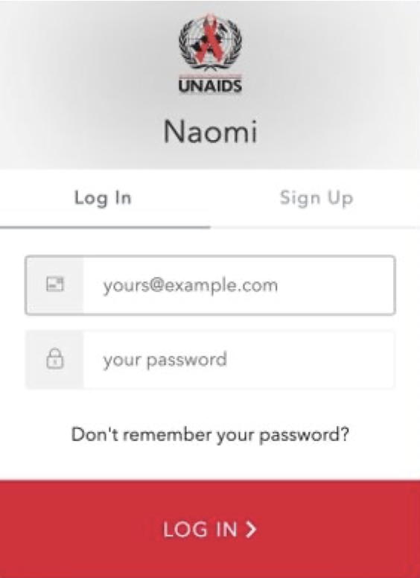
1. Naomi log in
https://naomi.unaids.org
Logging in with SSO:
Click ‘Log In with AuthO’
Login with ADR username and password
Enables:
ADR integration
Project and version saving and sharing
To create an account:
Click 'Sign Up'
If you cannot log in with your historical details please contact naomi-support@imperial.ac.uk

Slide 6
1. Naomi log in: Create demo project
https://naomi.unaids.org
Create a project from project landing page

Slide 7
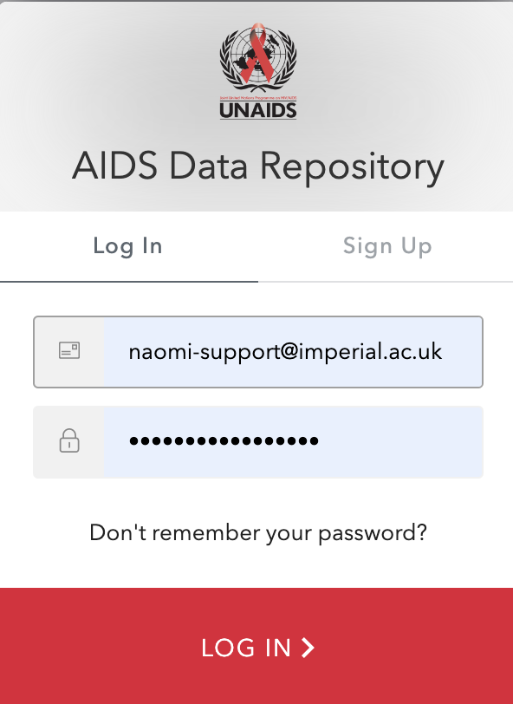
2. Upload data from the ADR
https://adr.unaids.org
Log into the ADR using the same details

Slide 8
2. Upload data from the ADR
https://naomi.unaids.org
Click `access key from ADR` an you will be redirected to the ADR where you can copy your ADR key
xxxxxxxxxxxxx

Slide 9
2. Upload data from the ADR
https://naomi.unaids.org
Click `Add` to fill in ADR key
Add ADR access key
Click `Save`
Click `Select ADR dataset`
Select data from dropdown menu and `Import`

Slide 10
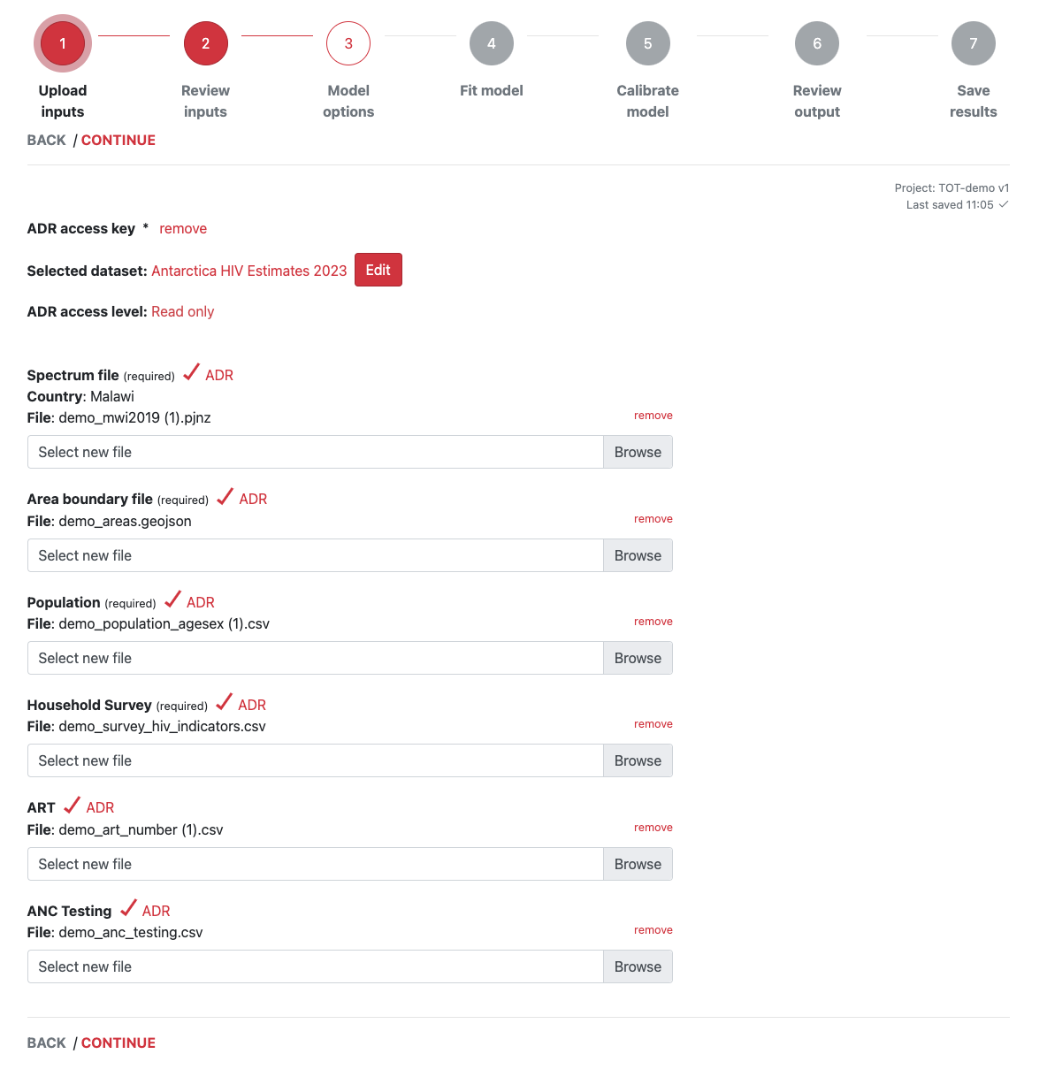
2. Upload data from the ADR
https://naomi.unaids.org

Slide 11
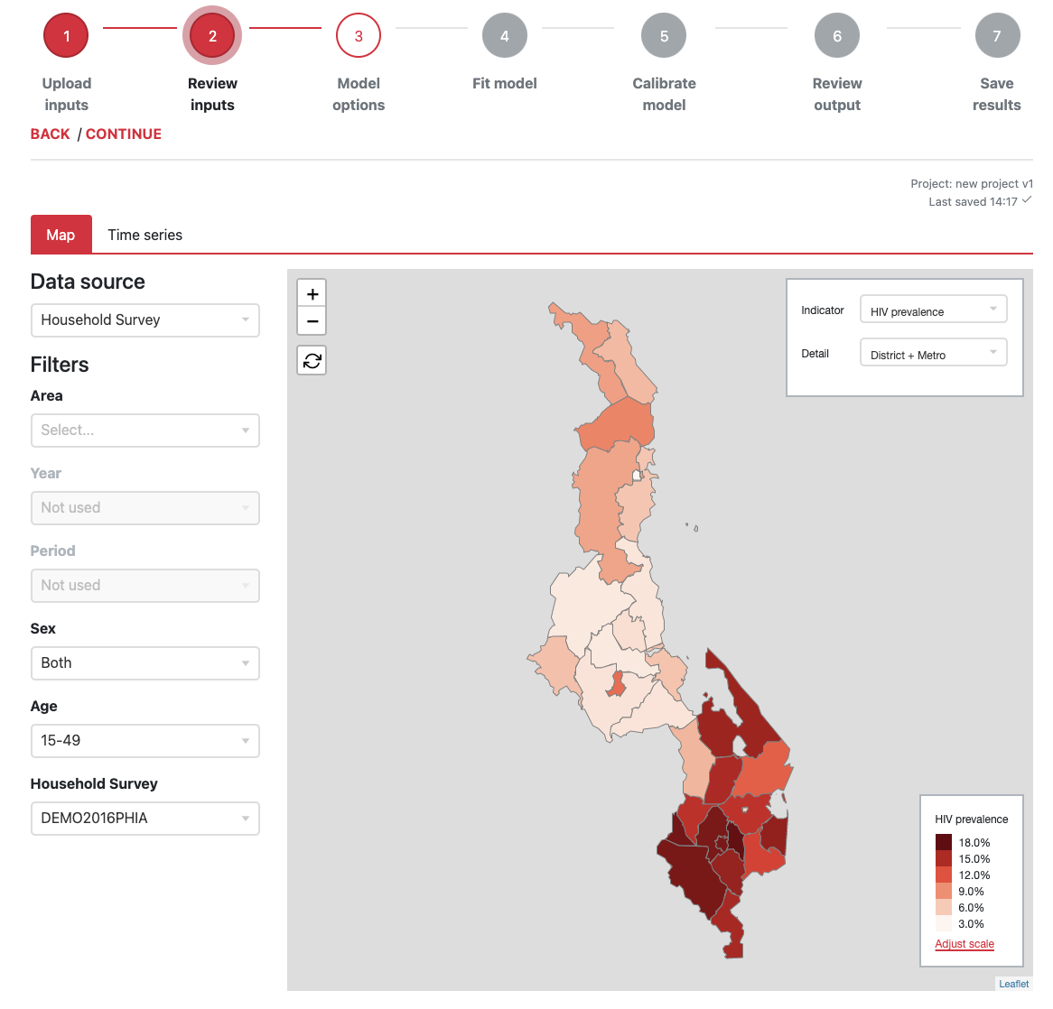
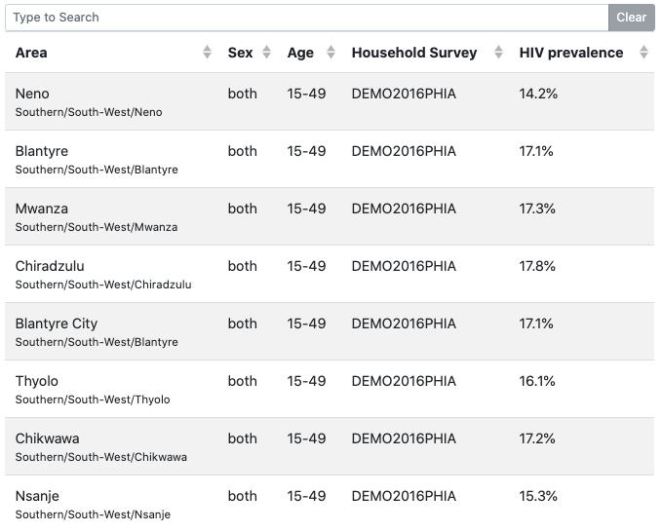
3. Review data: Maps
Map + tabular view of input data
Select all available stratifications:
Admin level and areas
Sex and age
Year / period

Slide 12
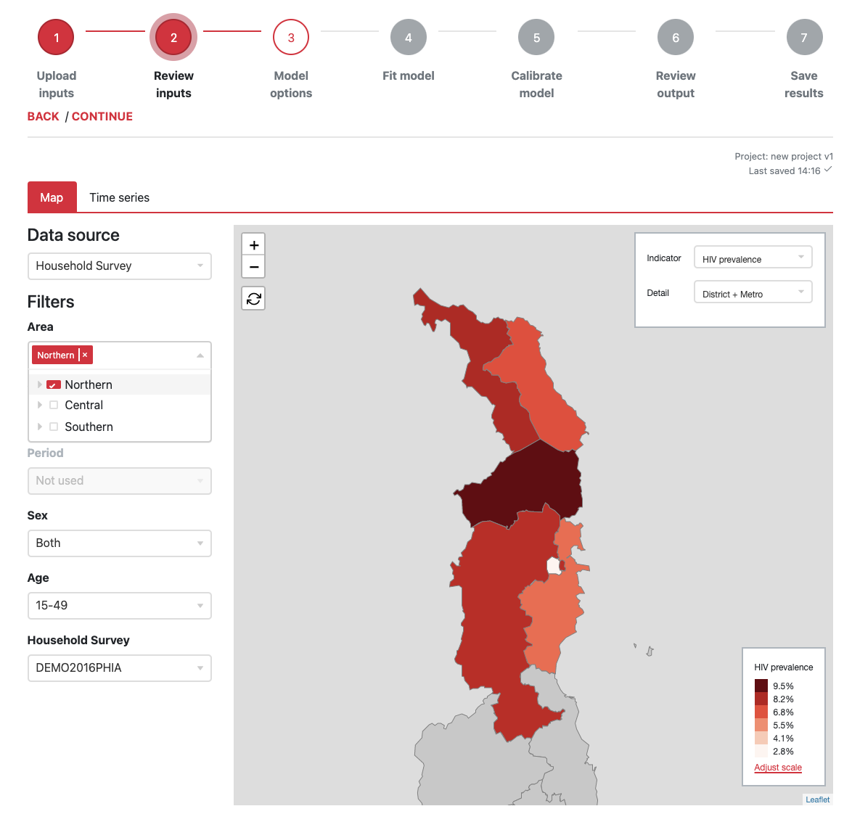
3. Review data: Maps
Map + tabular view of input data
Select all available stratifications:
Admin level and areas
Sex and age
Year / period

Slide 13
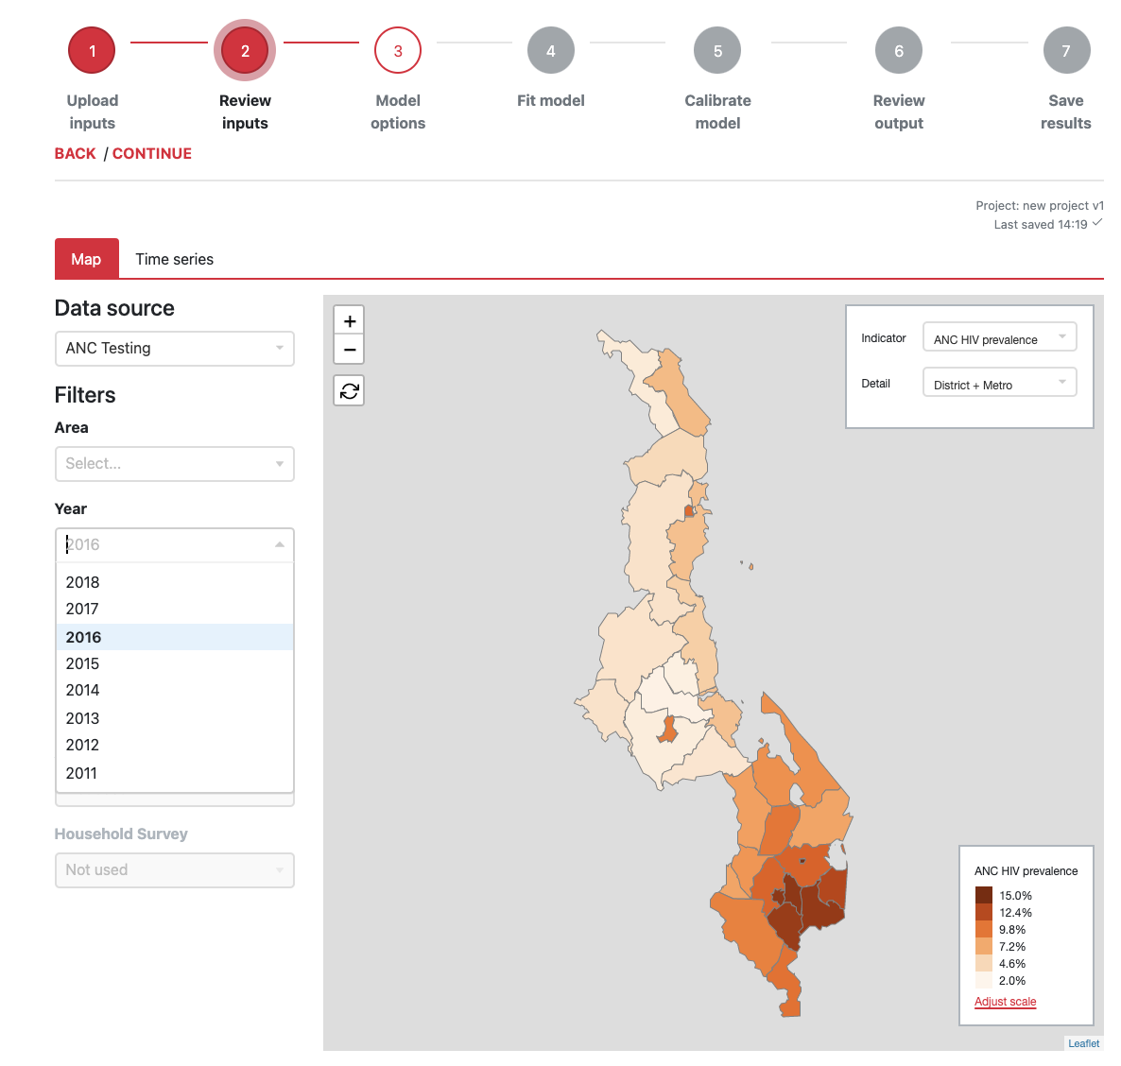
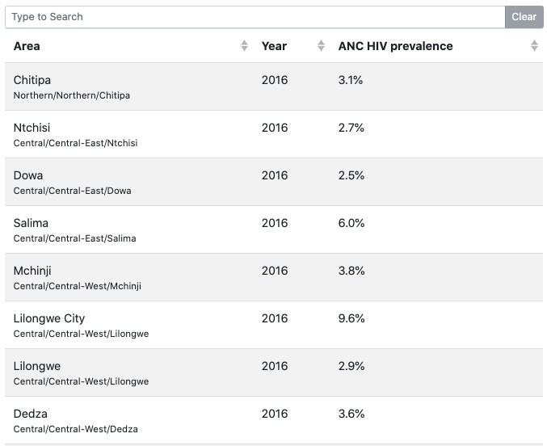
3. Review data: Maps
Map + tabular view of input data
Select all available stratifications:
Admin level and areas
Sex and age
Year / period

Slide 14
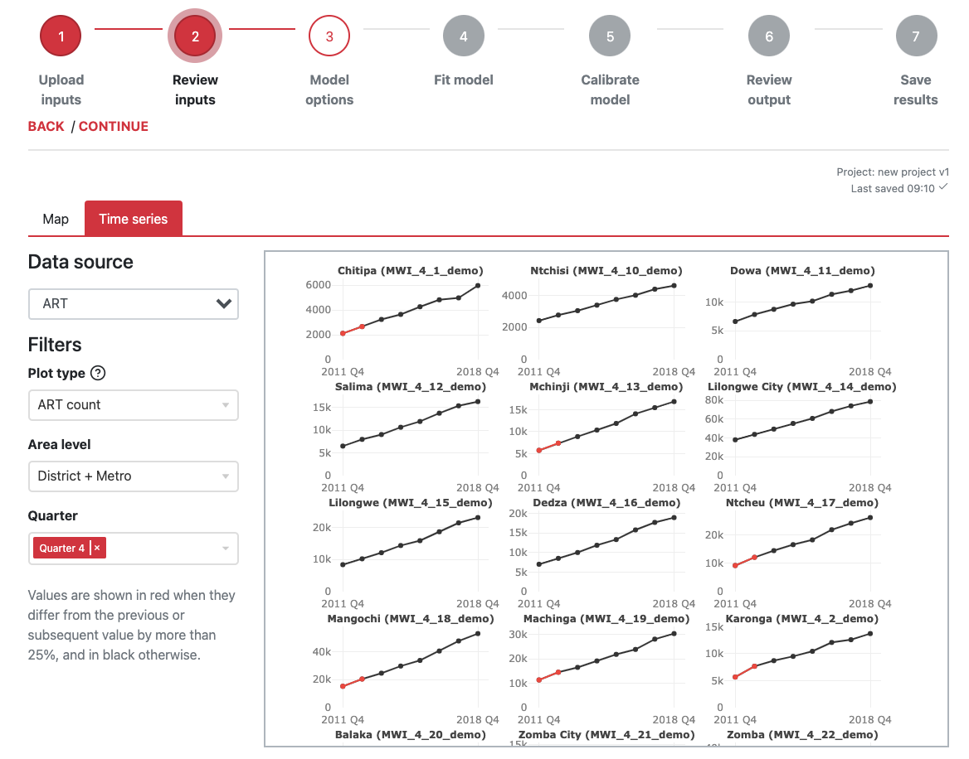
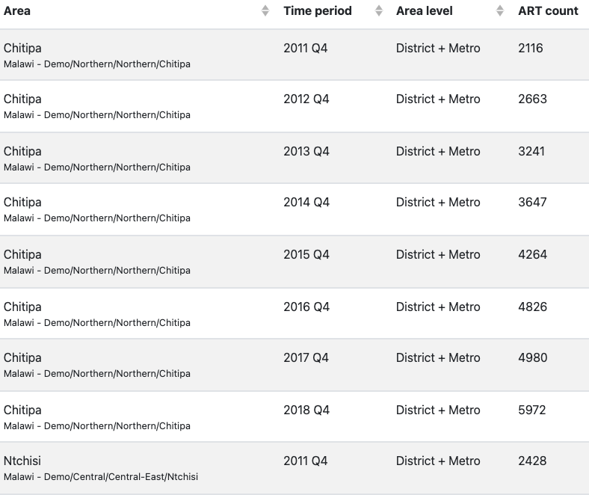
3. Review data: Time series
Time series view of programme data (ART +ANC) with similar functionality to ShinyRob

Slide 15
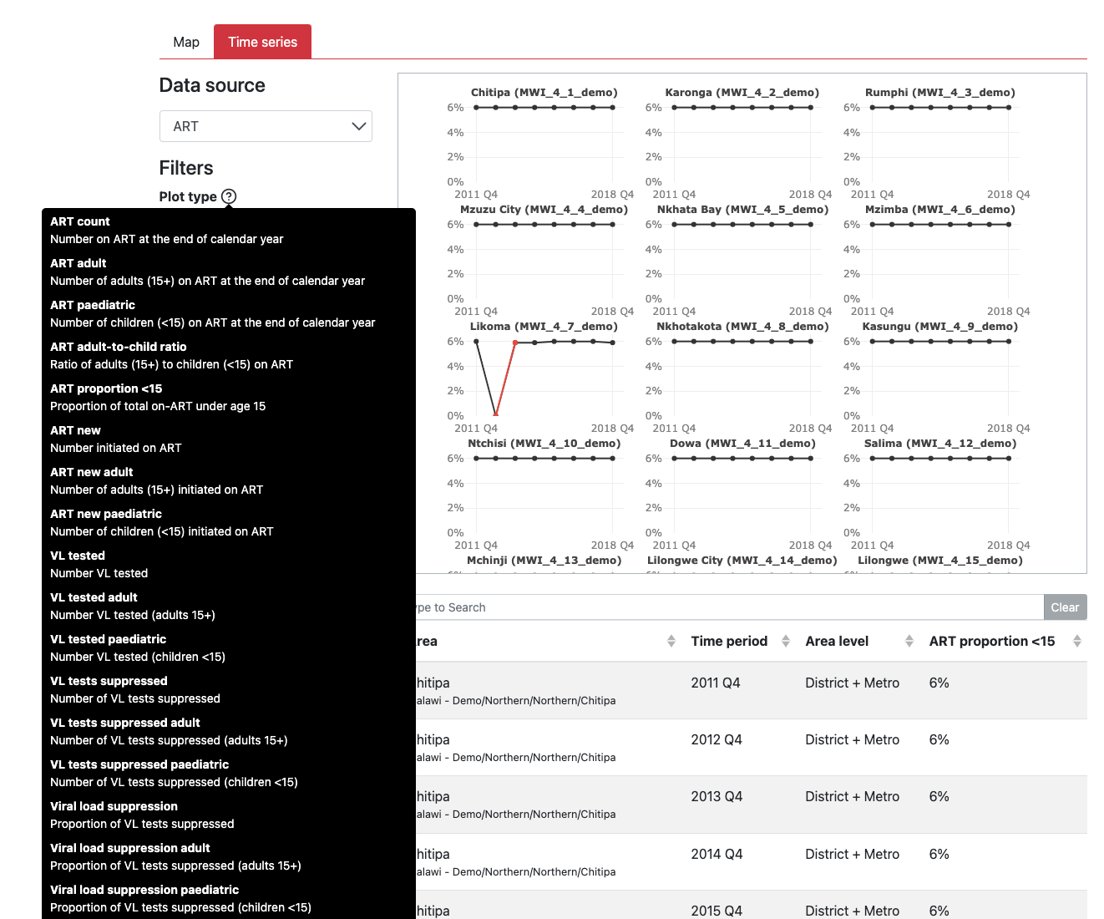
3. Review data: Time series
Hover cursor for a full description of plots available:
ART + ANC input indicators
Age/sex ratios

Slide 16
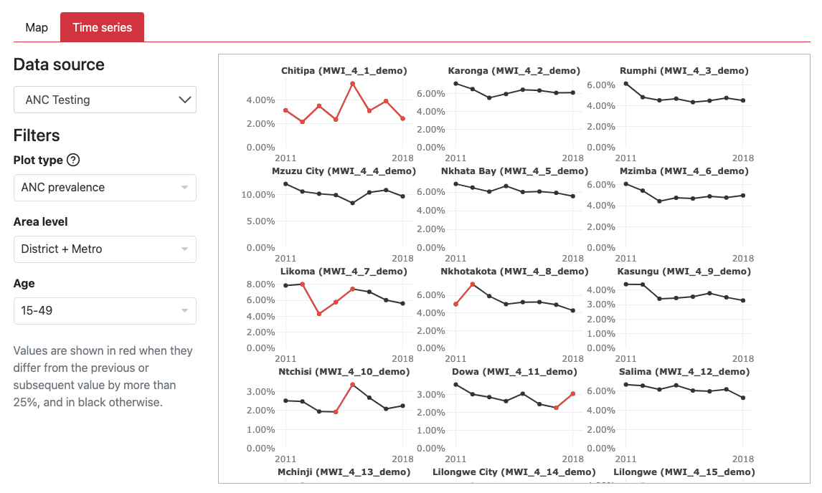
3. Review data: Time series
Indicator of data quality issue:
Red values indicate large changes between timepoints

Slide 17
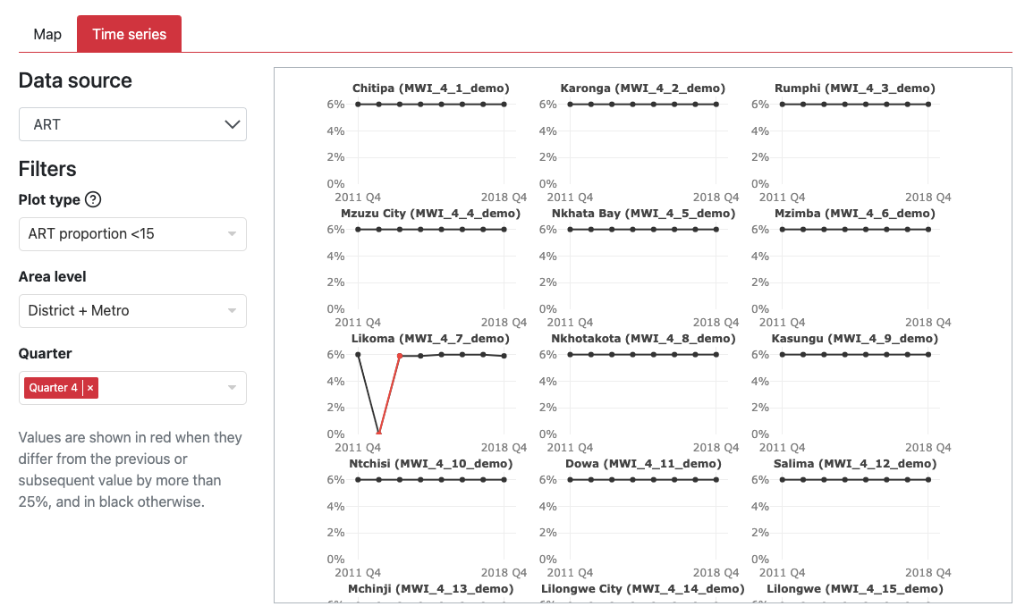
3. Review data: Time series
Indicator of data quality issue:
Ratios and proportions are expected to be relatively constant over time
Useful in identifying duplicated data
Ratio of peads:adults
Prop <15 on ART

Slide 18
Teamwork and recap of key steps
Team member updates
Ensure ADR teams members have access 
Ensure you can log into ADR and Naomi 
Review list of all team members and update if needed 
Update your ART and ANC subnational data and load to your Country 2023 folder
Confirm your geographic hierarchy 
Pull in new data from DHIS (or other system), (If needed ADR-DHIS can be automated to make this easier) 
Ensure loaded in the correct format (no validation issues) 
Open Naomi and review trends in your ANC and ART subnational data
Where needed flag potential issues for correction 
Make changes and re-upload to ADR and review in Naomi 

Slide 19
End
Thank you.
Questions?

