Slide 1
Naomi model for subnational HIV estimation
Version 4 December 2023

Slide 2
Outline
Background of Naomi model
Overview of Methods
Naomi outputs
2024 updates
Extended future projections
Data inputs: Reviewing missing data
Naomi outputs: Tabular results
For model use: see ‘Naomi basic steps’ slide set in training materials folder

Slide 3
Naomi model: objectives
District level HIV estimates
Increasing focus on HIV programming, targets, and resource allocation at the district level.
Annual targets for HIV testing and treatment based on district-level unmet need.
Metric of local programme effectiveness, accountability.
Requires timely and accurate strategic information about current status of the epidemic.
Challenge: Data much sparser at district level vs. province, national.

Slide 4
Naomi model: objectives
Develop robust district-level estimates for multiple outcomes of interest:
Prevalence / PLHIV
ART coverage & unmet meet
New infections
Stratified by sex and 5-year age group
For current time period; short-term projection for programme planning
Initial approaches developed in Malawi and South Africa in 2018.
First used for UNAIDS estimates process in Dec 2019 / Jan 2020.

Slide 5
Naomi team
Rob Ashton
Lekan Anifowoshe
Rachel Esra
Mantra Kumsumgar
Jeff Imai-Eaton
Rich Fitzjohn
Alex Hill
Emma Russell
Oli Stevens

Slide 6
Naomi model: approach
Synthesise and triangulate multiple data sources available at district level.
Population:
NSO subnational projections (or GPW, WorldPop)
Spectrum national / admin 1
Household surveys:
HIV prevalence
ART coverage
Recent infection
Antenatal HIV testing
HIV prevalence at ANC
ART coverage prior to first ANC visit
Number on ART:
EMR reporting

Slide 7
Naomi model: approach
Synthesise and triangulate multiple data sources available at district level:
Population:
NSO subnational projections (or GPW, WorldPop)
Spectrum national / admin 1
Household surveys:
HIV prevalence
ART coverage
Recent infection
Antenatal HIV testing
HIV prevalence at ANC
ART coverage prior to first ANC visit
Number on ART:
EMR reporting
Components for which district-level data are not available are derived from national Spectrum model estimates:
HIV transmission rates
HIV survival rates
Age distributions of new infections
Ratio of CLHIV to PLHIV

Slide 8
Time periods in Naomi
Naomi generates cross sectional estimates for the time of the most recent household survey (T1), the current time point (T2) and short term projections for target setting (T3-T5).
One step projection to extrapolate from cross-sectional survey (e.g. mid-2020) to current situation (December 2023).​
Survival for HIV+ population based on Spectrum national estimates​
Accounts for effects of ART on survival​
New infections by age and sex: transmission rate from incidence model and national estimates for sex/age pattern​
Programme data for end 2023 for calculating ART coverage​
Further short-term projection 9-12 months as baseline for future policy and target setting
If most recent survey is before subnational data availability, ART and ANC programme data are only included at T2
T1
T2
T3
T4
T5
Survey
Programme data

Slide 9
Time periods in Naomi
Naomi generates cross sectional estimates for the time of the most recent household survey (T1), the current time point (T2) and short term projections for target setting (T3-T4).
One step projection to extrapolate from cross-sectional survey (e.g. mid-2016) to current situation (December 2022).​
Survival for HIV+ population based on Spectrum national estimates​
Accounts for effects of ART on survival​
New infections by age and sex: transmission rate from incidence model and national estimates for sex/age pattern​
Programme data for end 2023 for calculating ART coverage​
Further short-term projection 9-12 months as baseline for future policy and target setting
If subnational programme data is available at time of survey, ART and ANC programme data included at T1 and T2:
T1
T2
T3
T4
T5
Survey
Programme data

Slide 10
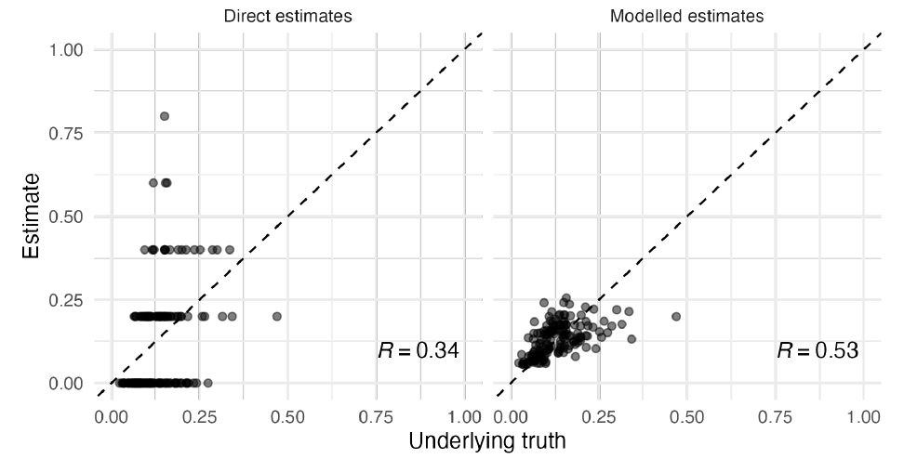
Naomi model: approach
Naomi is a Bayesian small-area estimation (SAE) statistical model
Small samples at the district level provide noisy estimates
SAE model uses information about the spatial relationships between neighbouring locations.
Borrows data from neighbours to smooth variations in data across space

Slide 11
Methods: Small area estimation
Jointly model HIV prevalence, ART coverage, and HIV incidence
Small-area model for HIV prevalence
Improve precision and accuracy of district estimates by combining:
Survey estimates (district HIV prevalence)
Auxiliary data (ANC testing prevalence)
Spatial structure (correlation between neighbouring districts)

Slide 12
Methods: Small area estimation
Jointly model HIV prevalence, ART coverage, and HIV incidence
Small-area model for ART coverage
ANC ART coverage prior to first ANC → relative spatial pattern of population ART coverage

Slide 13
Methods: District-level HIV incidence
Jointly model HIV prevalence, ART coverage, and HIV incidence
Log linear model for HIV incidence
Challenge: very low counts of recent infections in subnational areas
Not possible to make a direct survey estimate for incidence by district
Basic transmission dynamics:
$$\left[incidence\right]=\left[transmission rate\right]⋅[prevalenece]⋅\left(1−ω⋅[ART coverage]\right)$$
‘My risk of infection depends on how likely I am to contact someone infectious’
Log-linear form for incidence by district $i$:
${log(λ}_{i})=$ $log\left(κ_{0}\right)+log(ρ_{i})+log\left(1−ω⋅α_{i}\right)+u_{i}$

Slide 14
Methods: ART patient mobility
Observed: number receiving ART at health facilities in each district
Need: number of people residing in each district who are on ART
Model of ART attending:
For all districts $j$ that neighbor district $i$, model proportion $γ_{ji}$ that residents in district $j$ receive ART in district $i$
Mechanism to balance ART programme data vs. [Population] x [Prevalence] x [ART coverage]
Naomi estimates:
PLHIV: Number of PLHIV residing in district ( [Population] x [HIV prevalence] )
ART current (residents): Number of PLHIV who reside in a district who are on ART
ART current (attending): number of people receiving ART at health facilities in a district

Slide 15
Methods: ART patient mobility
Observed: number receiving ART at health facilities in each district
Need: number of people residing in each district who are on ART
Model of ART attending:
For all districts $j$ that neighbor district $i$, model proportion $γ_{ji}$ that residents in district $j$ receive ART in district $i$
Mechanism to balance ART programme data vs. [Population] x [Prevalence] x [ART coverage]
Naomi estimates:
PLHIV: Number of PLHIV residing in district ( [Population] x [HIV prevalence] )
ART current (residents): Number of PLHIV who reside in a district who are on ART
ART current (attending): number of people receiving ART at health facilities in a district

Slide 16
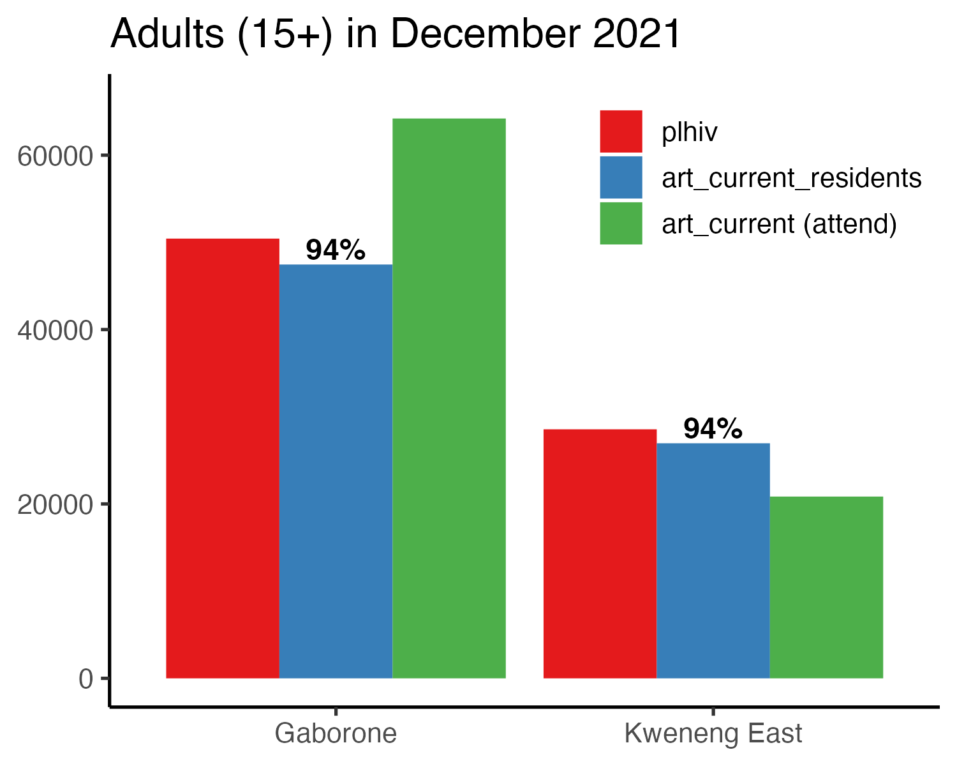
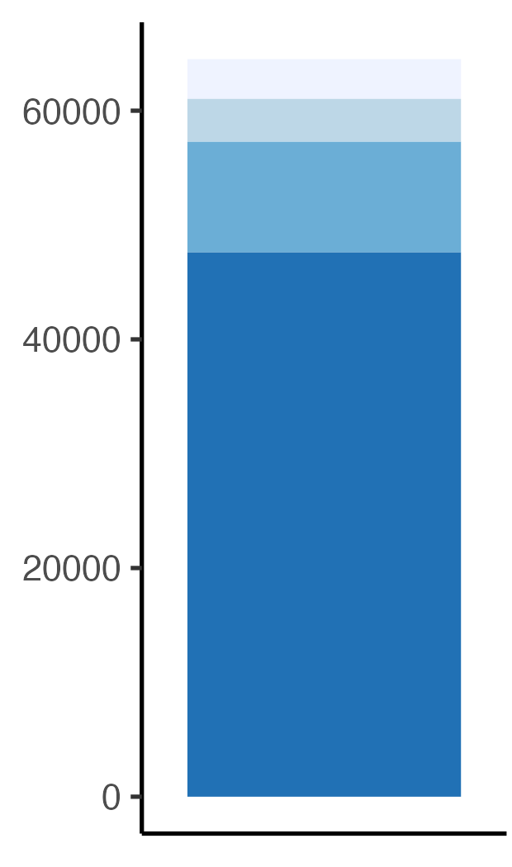
Methods: District-level unmet Tx need
Issue with target setting: Example from Botswana
Adults receiving ART in Gaborone: district of residence
Kgatleng
South East
Kweneng East
Gabarone
plhiv: Number of PLHIV residing in district ( [Population] x [HIV prevalence] )
art_current_resident: Number of PLHIV who reside in a district who are on ART
art_current (attending): number of people receiving ART at health facilities in a district

Slide 17
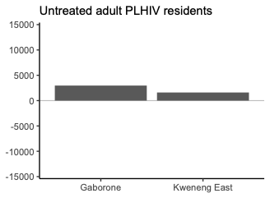
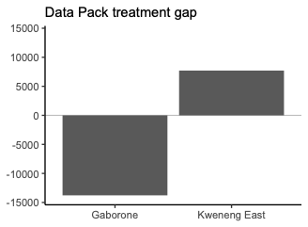
Methods: District-level unmet Tx need
Challenge—target setting strategy:
$$\left[Treatment gap\right]=\left[facility ART current\right] −[resident PLHIV]$$
‘Facility ART current’ does not correspond to ‘resident PLHIV’ denominator
→ Implausible representation of treatment gap

Slide 18
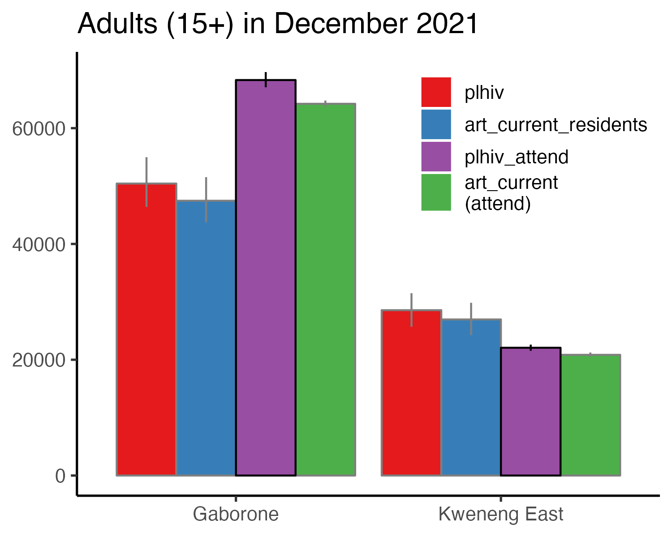
Methods: District-level unmet Tx need
Additional indicator for treatment gap:
PLHIV (attending): PLHIV who would seek treatment in each district → direct estimate of ‘treatment gap’ for facilities in district

Slide 19
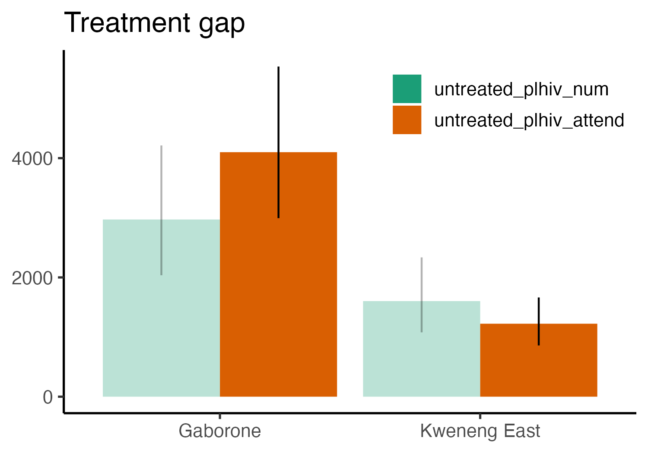
Methods: District-level unmet Tx need
Additional indicator for treatment gap:
PLHIV (attending): Estimated number of PLHIV who would attend health facilities in a district if 100% ART coverage.
Untreated PLHIV attending
PLHIV who would seek treatment in each district → direct estimate of ‘treatment gap’ for facilities in district.

Slide 20
Running the Naomi model
https://naomi.unaids.org
Click ‘Log In with AuthO’
Login with Naomi username and password
Enables:
ADR integration
Project and version saving and sharing
‘Continue as guest’
Ability to upload datasets, run model, download results.
No integration with ADR.
No online management of projects and versions.
User login recommended to save workflow.
To create an account
Click 'Sign Up'
If you cannot log in with your historical details please contact naomi-support@imperial.ac.uk

Slide 21
Naomi model outputs
Indicators
Population
HIV prevalence / PLHIV
ART coverage / Residents on ART
Awareness of HIV status
Number accessing ART at health facilities
Incidence rate / new infections
ANC clients by HIV & ART status
Statistics
Mean / median
Standard error / 95% uncertainty
Stratifications
All levels of health planning hierarchy:
National / province / district
Sexes:
Female, male, both
Age groups:
5-year age group
0-14, 15-24, 25-34, 45-49, 50+
15-49, 15-64, 15+, all ages
Time points:
T1: Most recent HH survey
T2: Current - Dec 2023
T3 – T5: Short-term projections - Sep 2024, 2025, 2026

Slide 22
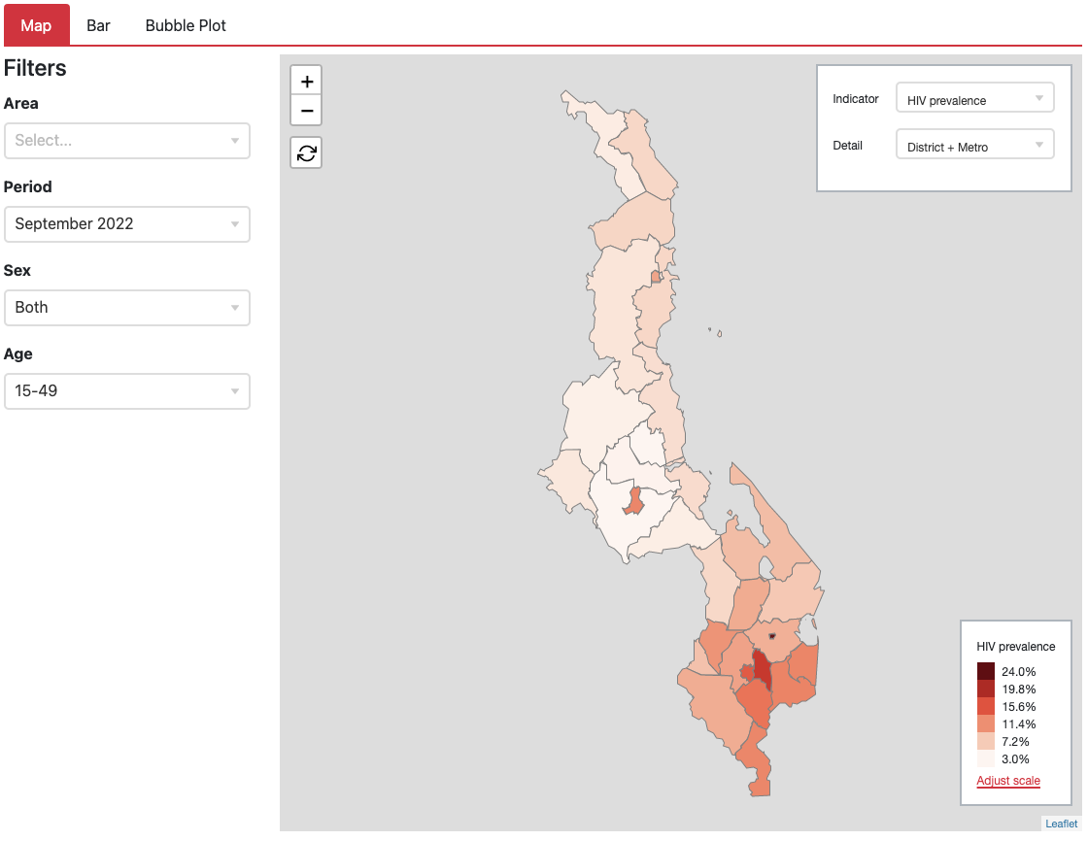
Naomi model outputs
https://naomi.unaids.org
Visualisations:
Chloropleth
Bar chart
Bubble plot
Tabular results:
Estimates and CIs
Sortable and searchable
All stratifications of:
Indicators
Levels
Areas
Time points
Sexes
Age groups

Slide 23
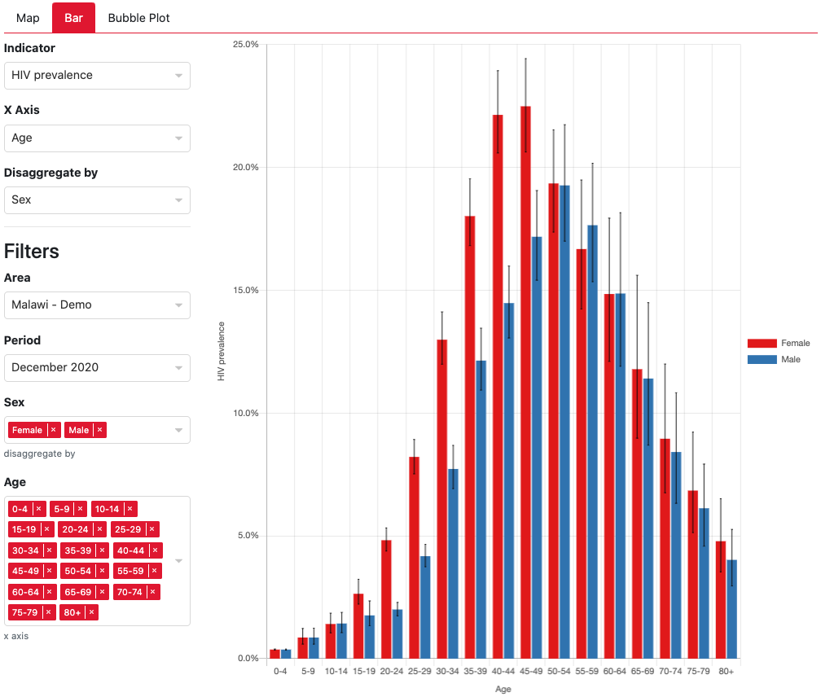
Naomi model outputs
https://naomi.unaids.org
Visualisations:
Chloropleth
Bar chart
Bubble plot
Tabular results:
Estimates and CIs
Sortable and searchable
All stratifications of:
Indicators
Levels
Areas
Time points
Sexes
Age groups

Slide 24
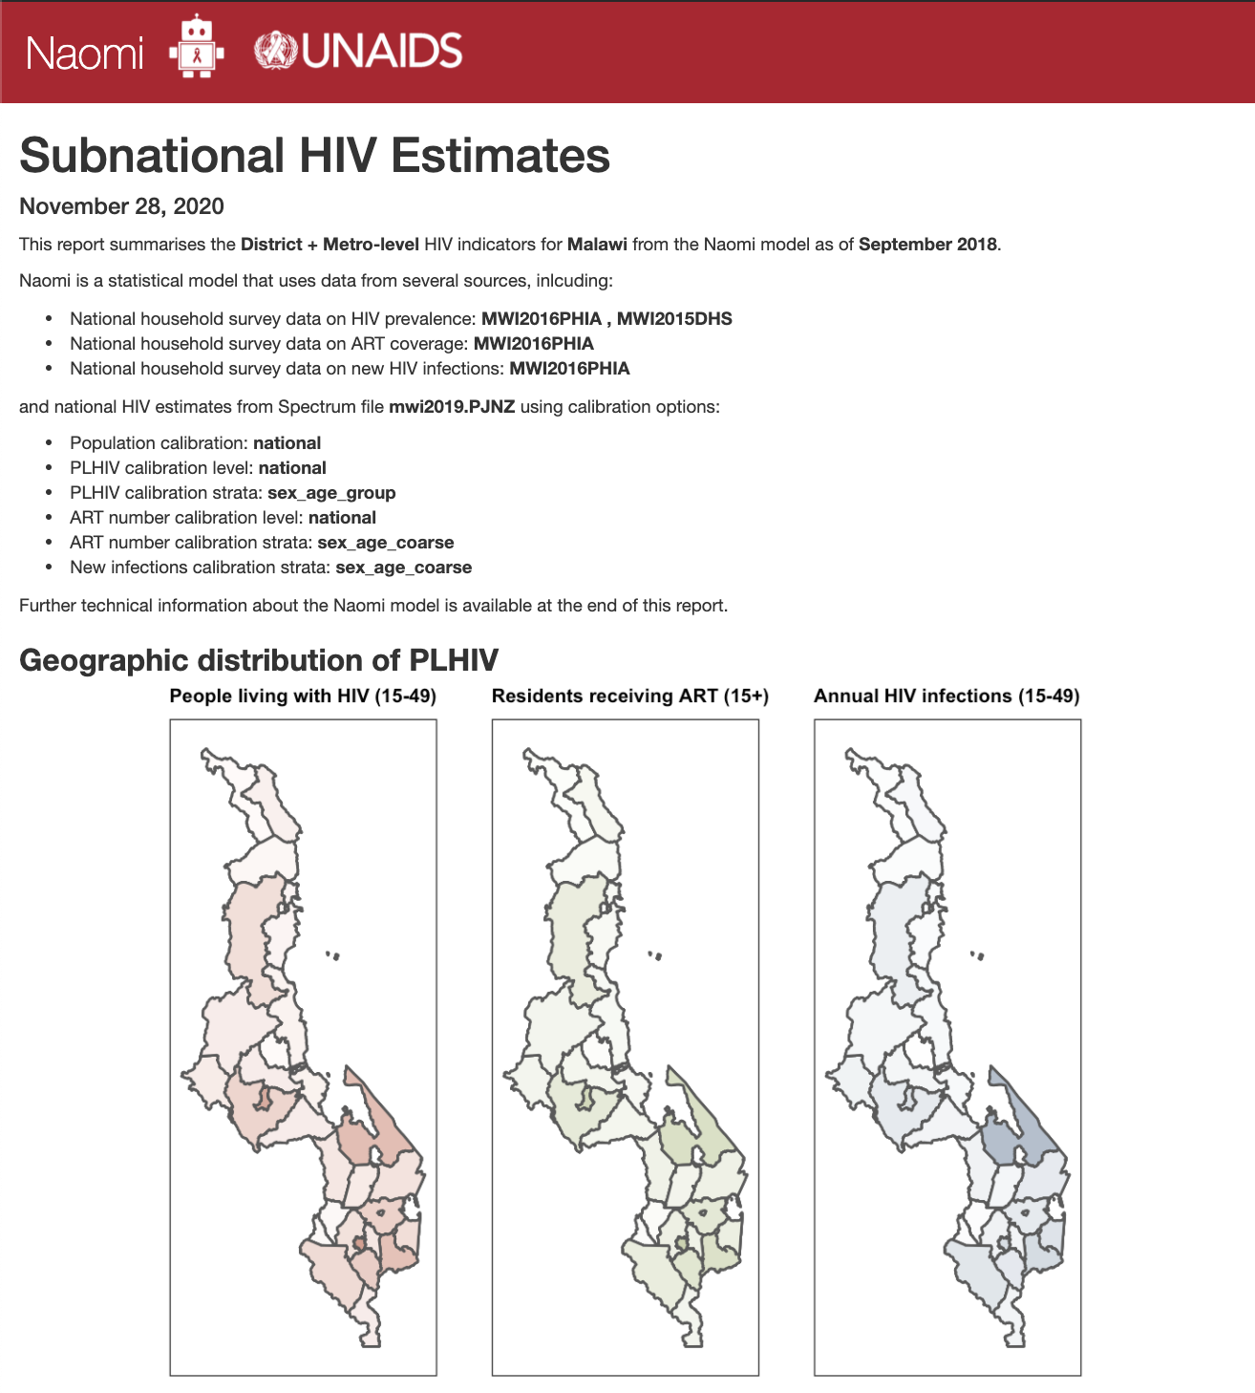
https://naomi.unaids.org
Naomi model outputs

Slide 25
2024 updates:
T4 – T5 future projections
Found in the advanced options section:
T4
T5
T3 –T5: Quarters for short-term projection:
Informed by Spectrum inputs for transmission rate, mortality rate, and increase in ART coverage.
September 2024, December 2025 and December 2026 for PEPFAR COP 2024 Data Pack inputs.
The administrative level at which datapack outputs are generated are prepopulated with country specific options. Please contact Naomi support or the in country PEPFAR coordinator if the available PEPFAR PSNU Level is not correct.

Slide 26
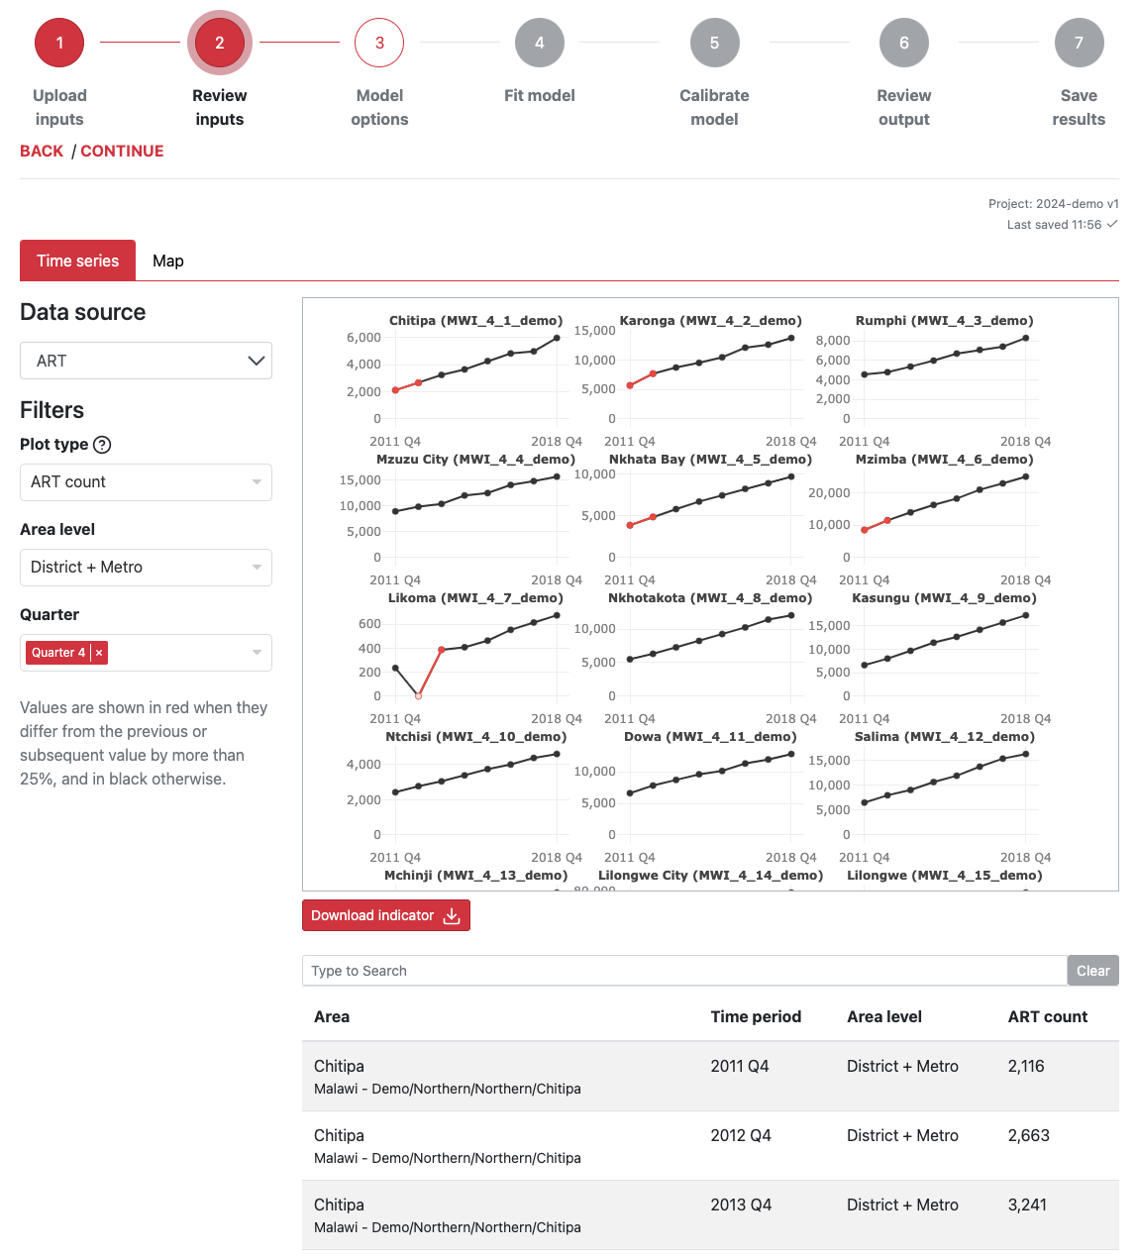
2024 updates:
Reviewing missing data
Time series view of district level ART + ANC data
Similar functionality to ShinyRob (now deprecated)
Large changes over time are highlighted in red

Slide 27
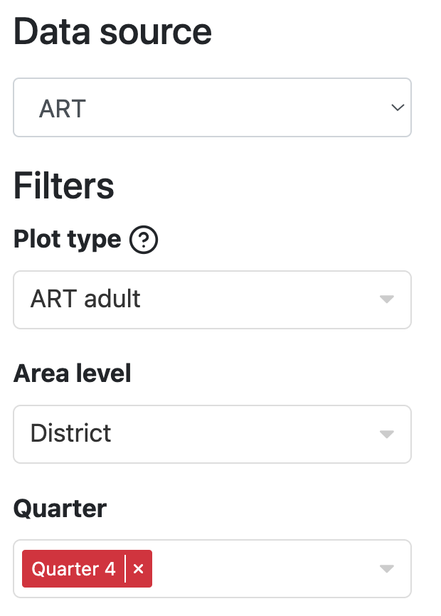
2024 updates:
Reviewing missing data
Missing observations at the district level will be highlighted in light grey or pink
Hovering mouse over missing data point will give further information on the source of the missing data

Slide 28
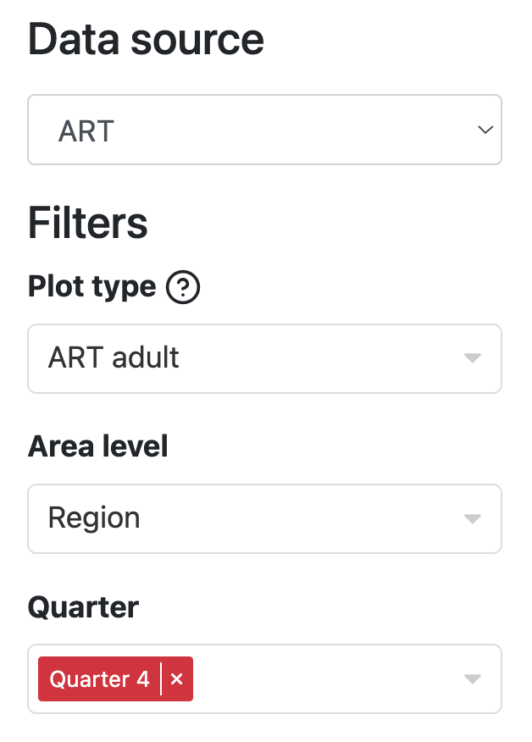
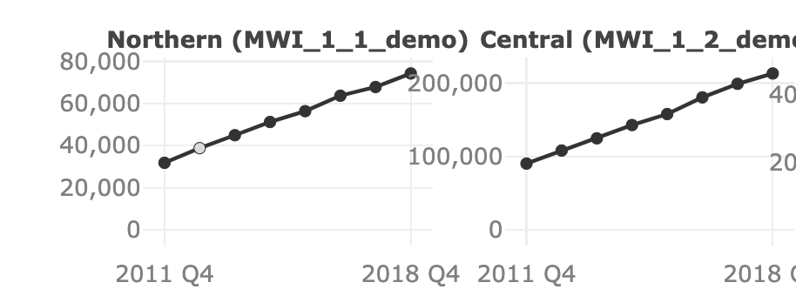
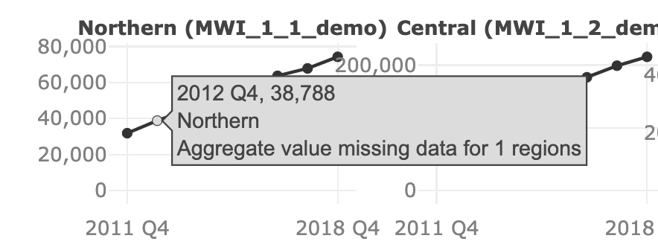
2024 updates:
Reviewing missing data
Missing observations at the district level will be flagged in higher level admin aggregates
Hovering mouse over missing data point will give further information on number of missing observations

Slide 29
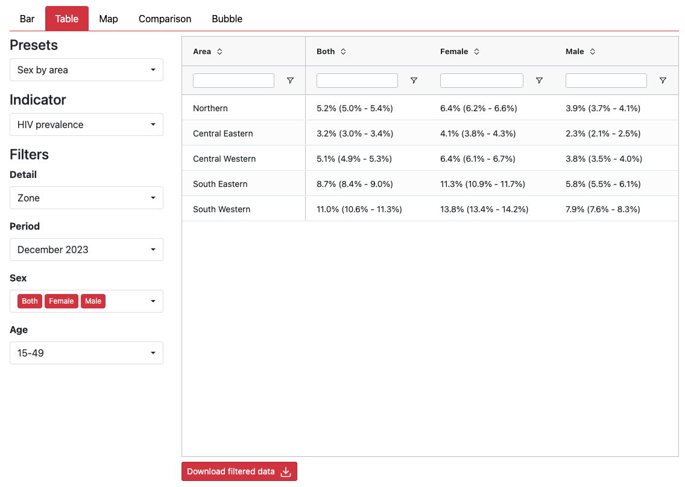
2024 updates:
Tabular outputs view
New tabular data review feature:
Tabular outputs view
Tables are searchable and can be ordered by value

Slide 30
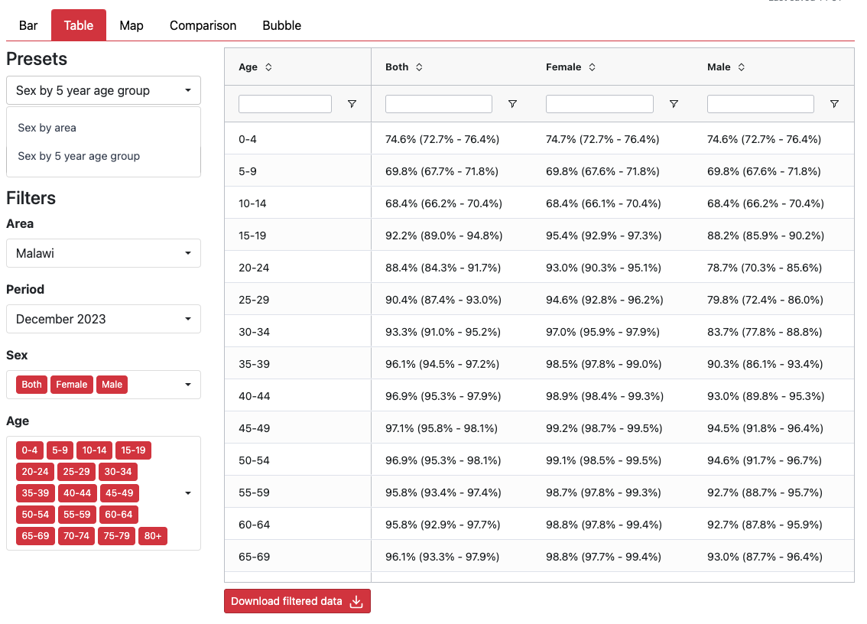
2024 updates:
Tabular outputs view
Table presets for:
Sex by area
Sex by 5-year age group

Slide 31
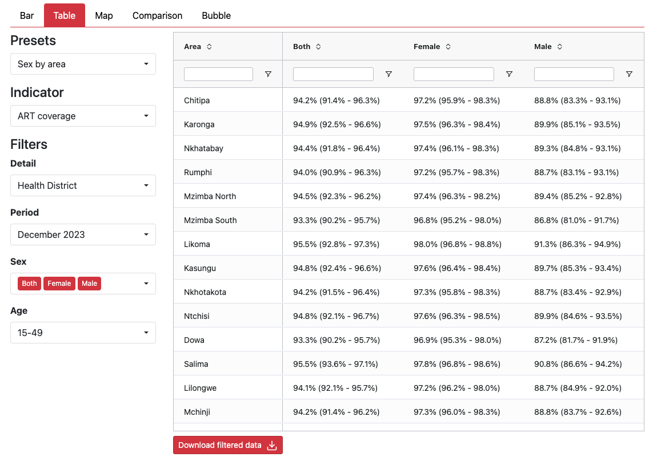
2024 updates:
Tabular outputs view
Filters for:
Admin level
Time period
Age

Slide 32
2024 updates:
Tabular outputs view
Filters for:
Admin level
Time period
Age

Slide 33
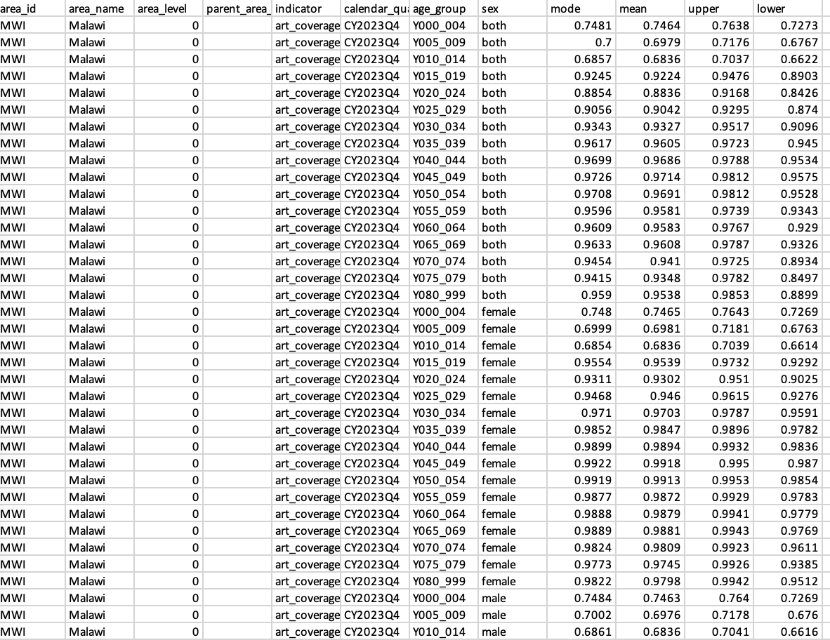
2024 updates:
Tabular outputs view
`Download filtered data’ will download an excel extract of the tabular data selected

Slide 34
Supporting publications and resources
Publications:
Naomi methods: https://onlinelibrary.wiley.com/doi/10.1002/jia2.25788 ​
Tutorials:
Adding ADR key: https://www.youtube.com/watch?v=h0Sro4ZHxe4​
Generating estimates: https://www.youtube.com/watch?v=zsfedL9TTXA​
Model options: coming soon!​ ​
Using projects history: https://www.youtube.com/watch?v=p7Bs6li1Rfs​
Support with issues or errors: https://www.youtube.com/watch?v=OMENcuNhNPs​
Or contact naomi-support@imperial.ac.uk

