Slide 1
Triangulate and select between CSAVR with EPP; Requirements for publishing an incidence trend
Eline Korenromp (UNAIDS)
UNAIDS workshop on HIV Estimates and Identifying Inequalities in the Middle-East and North Africa region
Cairo, 19-23 February 2023

Slide 2
Triangulating models: rationale
Some concentrated epidemic countries have enough years of both surveillance, survey and routine testing data to run both a prevalence-driven (e.g., EPP) and a routine reports-driven model (e.g., CSAVR).
If capacity allows, run two suitable models alongside, compare the results, and evaluate and try explain differences and uncertainties.
Overall historic epidemic
F-to-M ratio in incidence and prevalence (e.g. if EPP suggested a low F/M ratio than ART, Knowledge of Status and PMTCT data)
This presentation shows and examples of such triangulations, done in 2022, and discusses the interpretation.

Slide 3
Requirements for publishing an incidence trend from EPP or CSAVR
EPP:
All major key populations covered!
Each key population estimated based on:
A national population size estimate
An estimate of the % male in each population
An estimate of duration spent in population (e.g., years in sex work)
At least 3 prevalence data points over time
CSAVR:
8 years of HIV/AIDS deaths data AND 8 years of Case diagnoses (within 1990-2022)
Death data classified by IHME as medium or good-quality (groups 2A and 2B)
Spectrum file covering the full ‘de facto’ population: all residents including non-nationals.
Notes:
See Guide to update Spectrum.doc, Decision tree Figure 1

Slide 4
Triangulations done in 2022
Country | 2021 model | 2022 final | 2022 trian-gulation | Motivation for triangulation
Trinidad | EPP | EPP | CSAVR | EPP misses Key Populations → see if CSAVR gives a larger epidemic
Jamaica | EPP | EPP | CSAVR | Uncertain about 2021 EPP results
Peru, Morocco | EPP | EPP | CSAVR | Pilot of CSAVR-KP model (new to-be, for 2024+)
Cambodia | AEM | AEM | CSAVR
Kazakhstan | Direct Incidence | CSAVR | EPP | Optima model (NSP scenario analysis for Global Fund) suggested a flatter epidemic than 2022 CSAVR
Uruguay | EPP | EPP | 2023: + CSAVR | EPP gave lowish F-to-M ratio and >100% PMTCT and pediatric ART coverage
Paraguay | EPP | EPP | 2023: + CSAVR | Knowledge-of-Status program data above EPP-estimated PLHIV. CSAVR helping to confirm the problem is likely in the program data, not in the estimate.

Slide 5
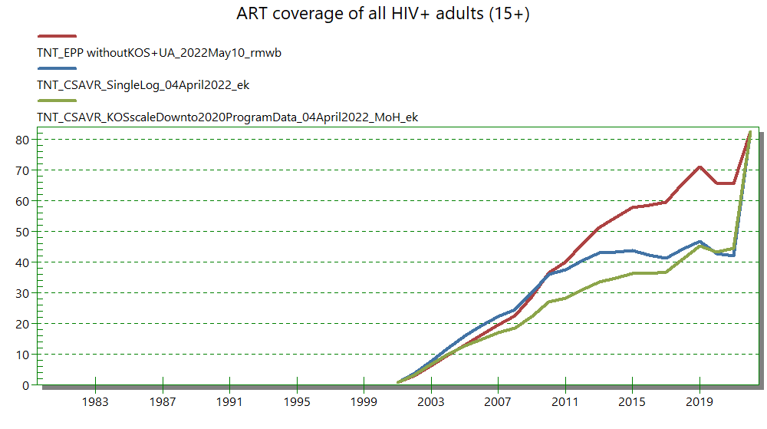
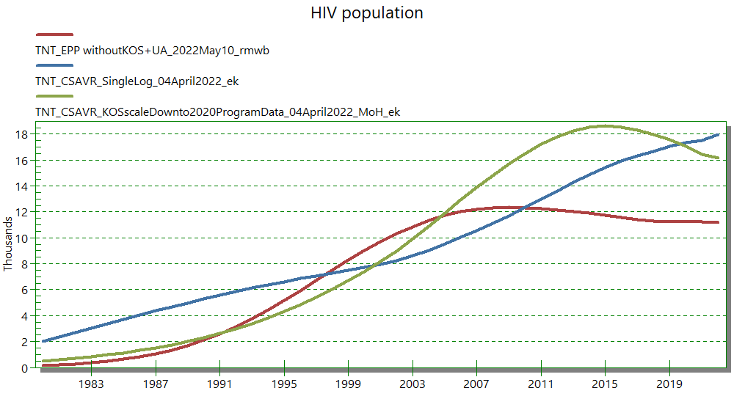
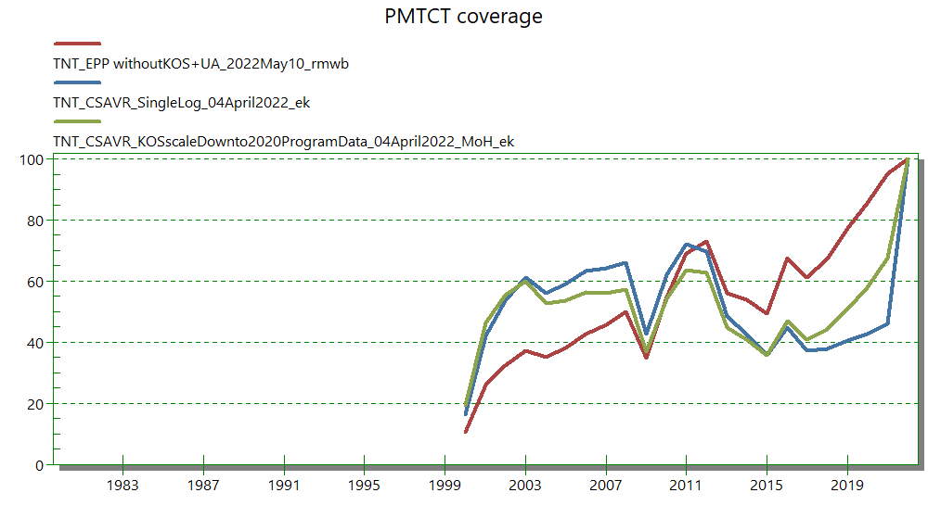
Trinidad: CSAVR & EPP (I)
EPP misses all KPs – fitting the entire population to ANC data
CSAVR fits a larger epidemic,
and so lower ART and PMTCT coverage

Slide 6
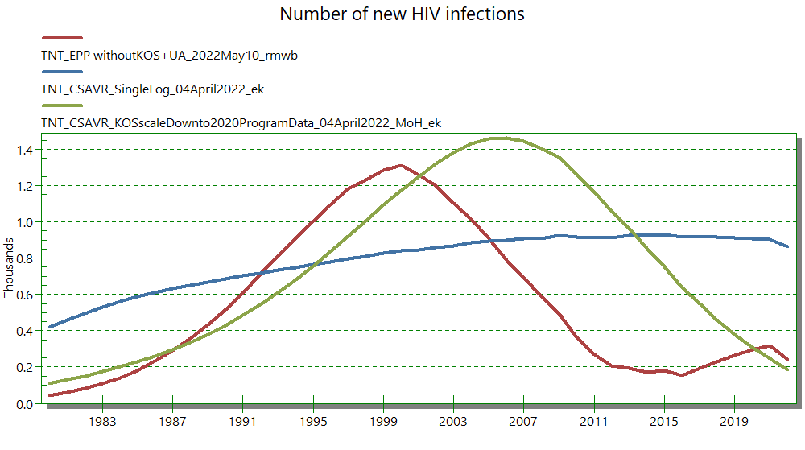
Trinidad: CSAVR & EPP (II)
CSAVR fits a high-ish recent (and, in single logistic option, highish current) epidemic, EPP misses the contribution of KP.

Slide 7
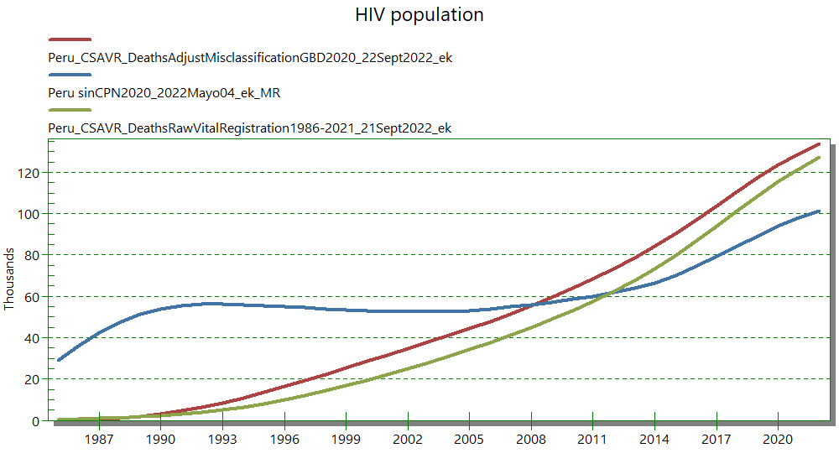
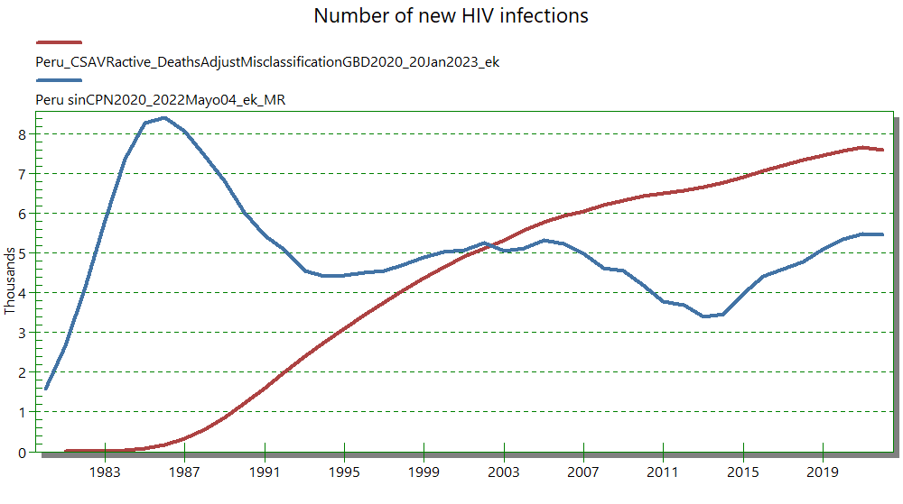
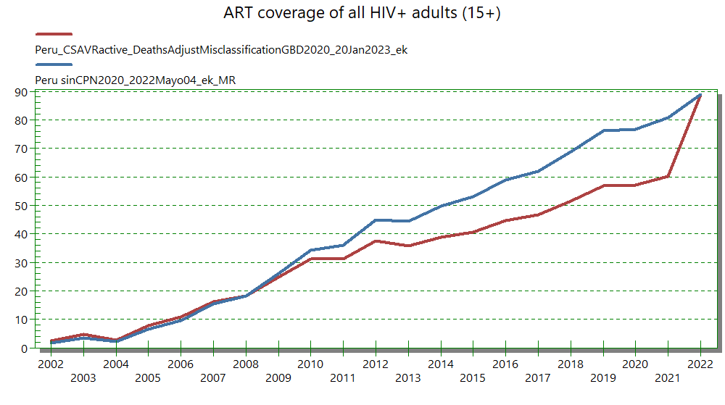
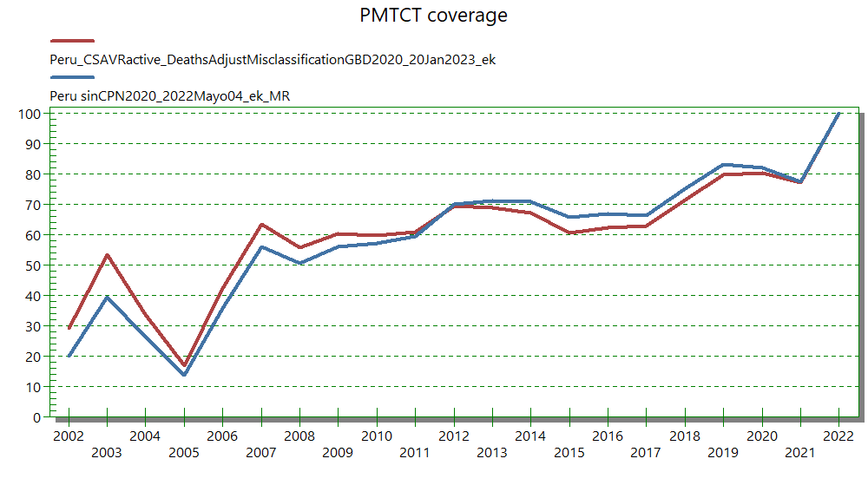
Peru: CSAVR & EPP (I)
Fitted to AIDS deaths (with or without adjustment for misclassified causes), CSAVR produces a later, but then higher epidemic than EPP.
Notes:
The adjustment adding deaths misclassified under other causes make only a small difference to CSAVR – either with or without this adjustment the CSAVR epidemic is lower than EPP

Slide 8
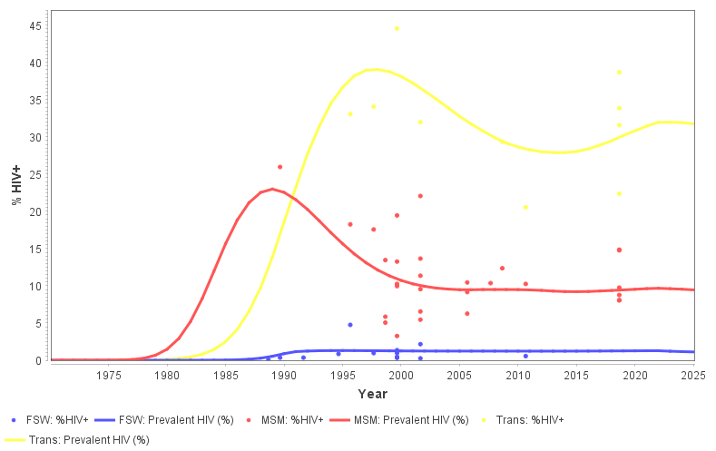
Peru: CSAVR & EPP (II)
EPP looks more consistent with surveillance prevalence data, for both ANC and KPs: flattening after early rapid rise … but CSAVR better matches AIDS and death reports!
Did early surveillance over-sample high-prevalence sites?
Were AIDS and AIDS deaths under-reported in early years?
Notes:
The adjustment adding deaths misclassified under other causes make only a small difference to CSAVR – either with or without this adjustment the CSAVR epidemic is lower than EPP

Slide 9
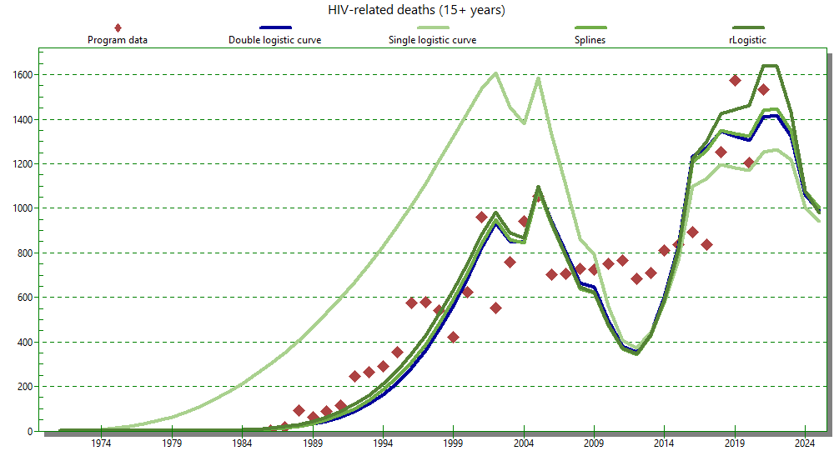
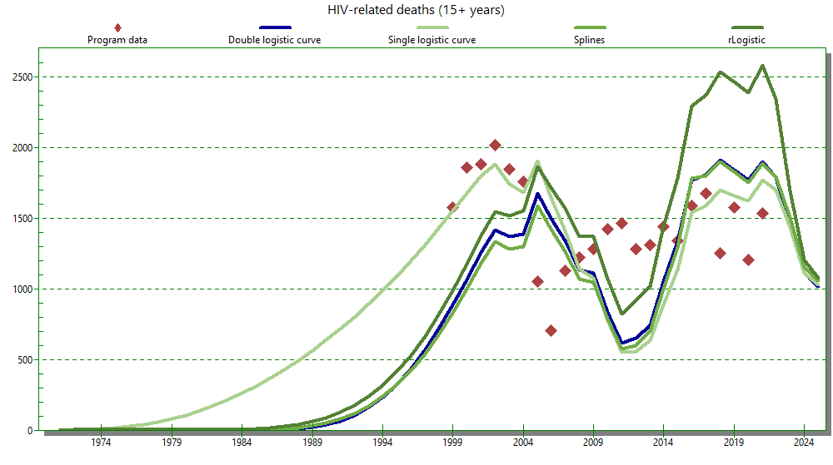
CSAVR fit, Peru, deaths with/-out adjustment
Registered deaths Deaths adjusted for misclassification, GBD 2020
Underreporting in VR (death certificates): around 50% pre-2017; since 2017-2018 with online SINADEF system implemented, around 30%

Slide 10
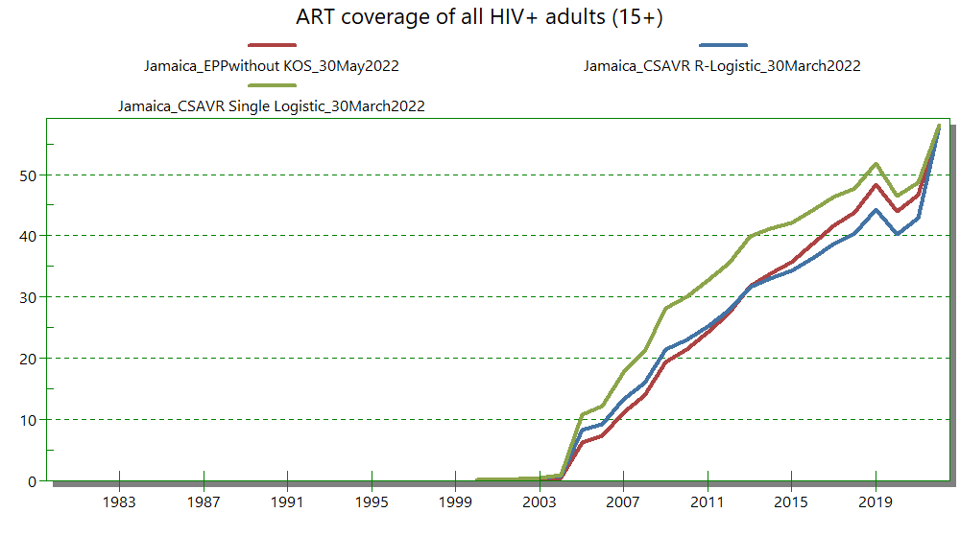
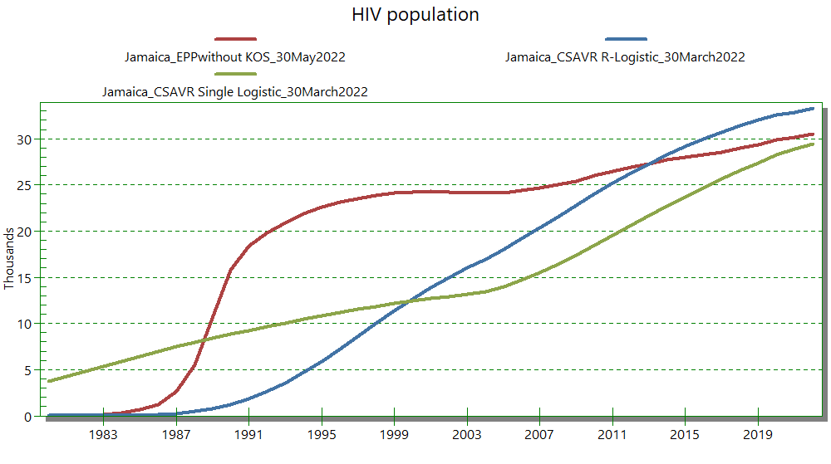
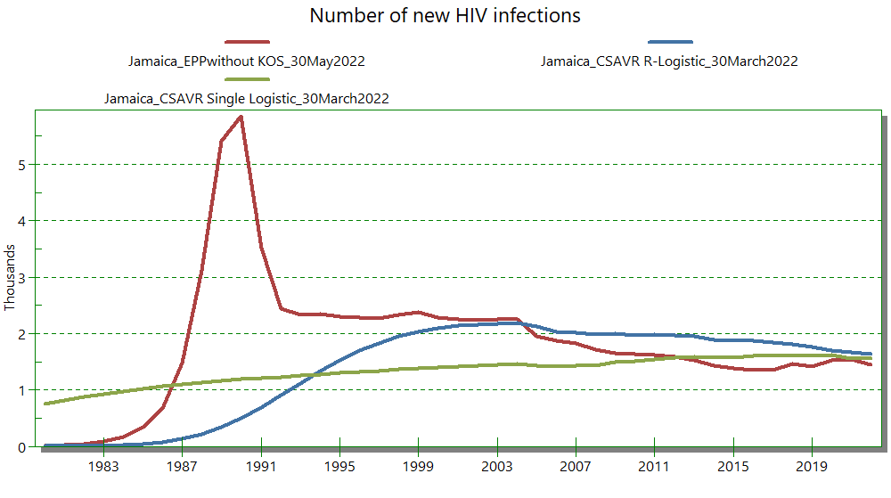
Jamaica: CSAVR & EPP (I)
CSAVR estimated similar PLHIV, cascades and PMTCT coverage from around 2010
… following a more gradual epidemic growth than EPP.
Notes:
This is the case despite the use of IHE/GBD death data, adjusted upward to account for HIV/AIDS deaths misclassified to other causes

Slide 11
Jamaica: CSAVR & EPP (II)
CSAVR estimated similar PLHIV (and cascades and PMTCT coverage) from around 2010,
… following a more gradual epidemic growth than EPP.
Early-year sentinel surveillance, oversampling high-prevalence sites, may have misled EPP?
Notes:
This is the case despite the use of IHE/GBD death data, adjusted upward to account for HIV/AIDS deaths misclassified to other causes

Slide 12
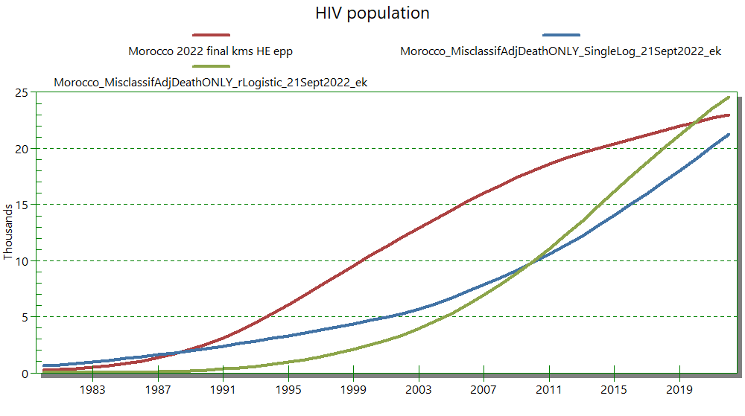
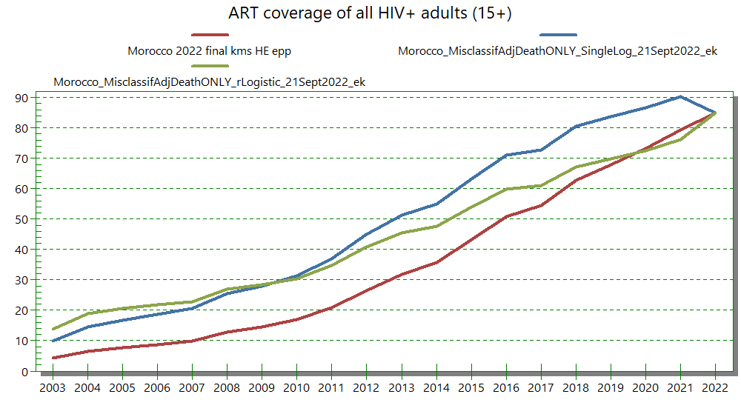
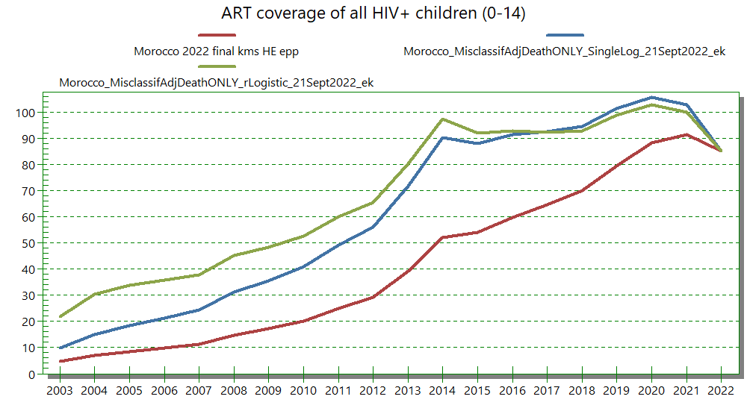
Morocco: CSAVR & EPP (I)
Fitting reported AIDS deaths, CSAVR produces a later & lower epidemic with higher pre-2014 pediatric ART coverage than EPP.
Despite adjusting death data for misclassified causes.

Slide 13
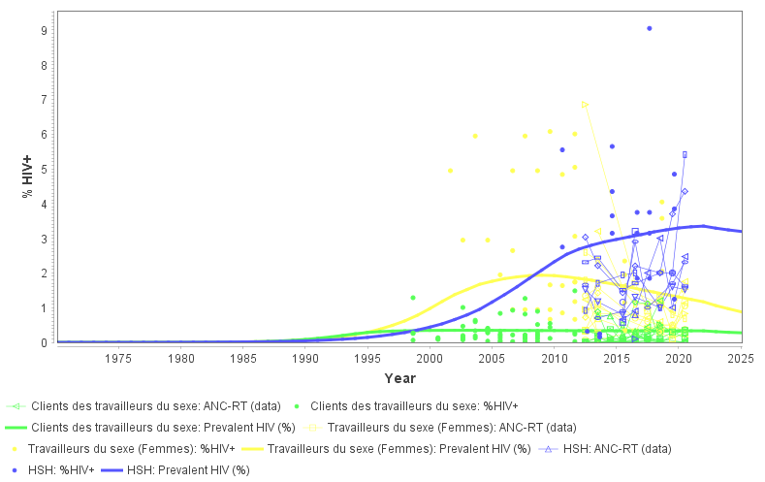
Morocco: CSAVR & EPP (II)
EPP is more consistent with surveillance prevalence data: flattening after 2012, for both ANC and KPs
EPP also gives more plausible ART coverage (<100%, including in children in recent years)
CSAVR better matches AIDS diagnoses and death reports.
Did early surveillance over-sample high-prevalence sites?
Are AIDS and AIDS deaths under-reported?

Slide 14
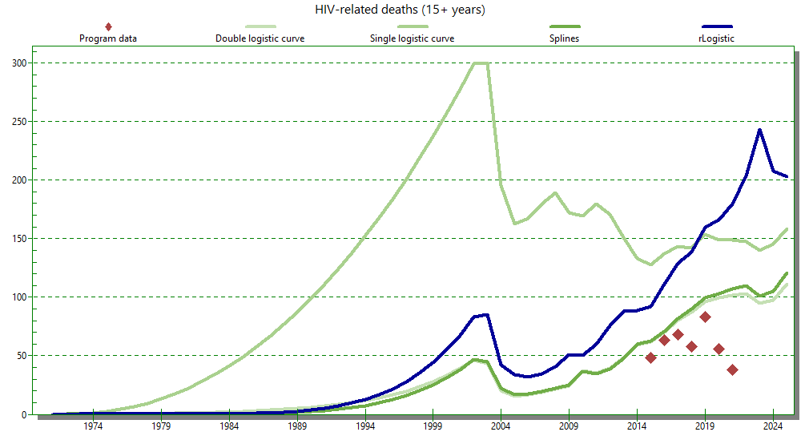
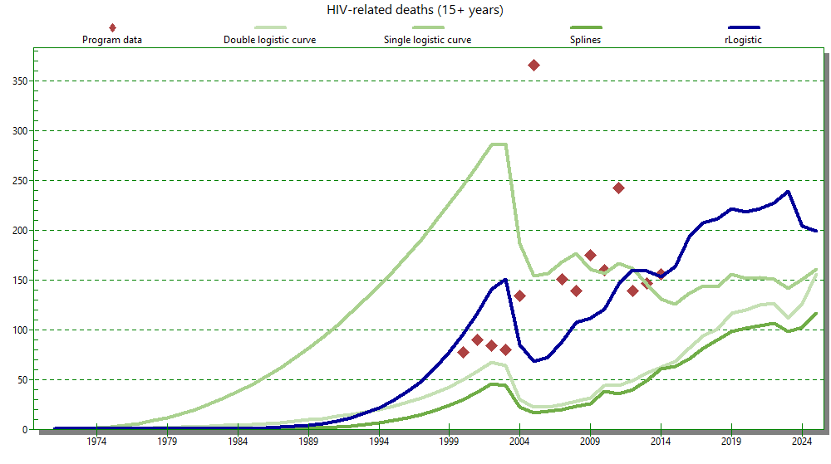
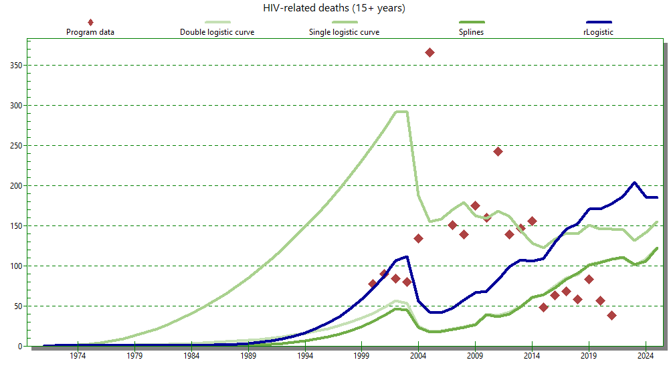
Morocco: CSAVR fit
Original registered deaths, only Misclassification-adjusted death data of GBD 2019
300
350
Original registered deaths + Adjusted GBD 2019
350

Slide 15
Interpretation
CSAVR gave similar current PLHIV estimates, and cascades, but later epidemic start than EPP for most countries -- even when inputting deaths misclassified to other causes to CSAVR.
In Trinidad, where EPP missed all KPs, CSAVR gives a higher epidemic.
Possible reasons for different epidemic start:
HIV/AIDS death reports incomplete and/or misclassified as other causes, especially pre-2000 → CSAVR may under-estimate early incidence – and compensate with a longer (too) sustained increase.
CSAVR fits AIDS deaths using Spectrum/AIM’s assumed excess (=AIDS + HIV-associated non-AIDS excess) death rates.
Early sentinel surveillance (prevalence) over- sampled high-risk locations → EPP peaks too early? Such peaks are typically not estimated by more refined dynamic transmission models, like Goals or Optima.

Slide 16
Criteria for selecting EPP or CSAVR
Quality and representativeness of input data
EPP:
surveillance prevalence data, for ANC & Key Populations
early and recent; representative and comparable over time
complete Census-level routine ANC testing data for recent years.
CSAVR: complete vital registration, with quality cause-of death-coding (IHME groups 2A/B) -- including early in the HIV epidemic.
Not program-reported deaths within the cohort of patients on ART! Those miss the many AIDS deaths among people not yet diagnosed…
Do estimation results make sense?
PLHIV > program-reported KOS & ART – adults
Plausible scale-up in ART and PMTCT coverage over time (no peaks with subsequent dips)
If CSAVR, consistent with any good-quality ANC prevalence data (i.e., a Fertility Local Adjustment Factor close to 1, at least within 0.5-2.5)
Choose the final model by appropriateness of input data & plausibility of results, not by historic precedents!
Nevertheless, large differences from last year‘s estimates, or between EPP and CSAVR, inspire scrutiny and warrant explanation for the direction and magnitude of difference.

Slide 17
Who may use CSAVR? Quality of death data
UNAIDS recommends CSAVR for countries with medium or good quality and completeness of Cause of Deaths data: IHME groups 2A and 2B, but not group 2C.
IHME country groups: Section 2.3 of the supplementary material (page 5) and depicted in Figure S1 on page 6 of: https://www.thelancet.com/cms/10.1016/S2352-3018(21)00152-1/attachment/7371c03e-887f-4e26-a718-bae190b81c2f/mmc1.pdf
Examples, Middle East & North Africa region:
2A |  | 1B or 2B |  | 2C
 | 2022 Spectrum model |  | 2022 Spectrum model |  | 2022 Spectrum model
Kuwait | CSAVR | BHR, EGY, IRQ, JOR, OMN, QAT, SAU, SYR | CSAVR | DZA, LBN, LBY, ARE, YEM | CSAVR
Djibouti | EPP-Conc. | SOM, SDN | EPP-Conc. | MAR, TUN | EPP-Conc.
Notes:
In recent estimation round, countries using CSAVR generally complied by this rule. Exceptions are Algeria, Lebanon, Libya, UAE, and Yemen, who strictly, by the IHME classification, should not use

Slide 18
Model selection recommended for 2023
Country | Cause-of-Death quality* | 2022 final | Trian-gulation | 2023 final | Reason for 2023 selection / UNAIDS recommendation
Trinidad | 2A | EPP | CSAVR | CSAVR? | EPP misses Key Populations → CSAVR gives a larger epidemic
Jamaica | 2A | EPP | CSAVR | EPP
Peru | 2B | EPP | CSAVR | EPP | Pilot of CSAVR-KP model (new to-be, for 2024+)
Morocco | 2C | EPP | CSAVR | EPP | AIDS deaths input to CSAVR likely incomplete.
Cambodia | 1A | AEM | CSAVR | AEM | No AIDS death data (only all-cause, ART cohort)
Kazakhstan | 2A | CSAVR | EPP | EPP? | Optima model (NSP scenario analysis for Global Fund) suggested a flatter epidemic than 2022 CSAVR
Uruguay | 2A | EPP | 2023: + CSAVR | CSAVR? | EPP 2023 draft gave lowish F-to-M ratio and >100% PMTCT and pediatric ART coverage
Paraguay | 2B | EPP | 2023: + CSAVR | EPP | Knowledge-of-Status program reports above EPP-estimated PLHIV. CSAVR confirmed this problem resides in the program data, not in the estimate.
UNAIDS recommends CSAVR for countries with medium or good quality and completeness of Cause of Deaths data, that is, IHME groups 2A and 2B, but not group 2C.
* IHME country groups: Section 2.3 of the supplementary material (page 5) and depicted in Figure S1 on page 6 of: https://www.thelancet.com/cms/10.1016/S2352-3018(21)00152-1/attachment/7371c03e-887f-4e26-a718-bae190b81c2f/mmc1.pdf

Slide 19
Who may use CSAVR? Quality of death data
UNAIDS recommends CSAVR for countries with medium or good quality and completeness of Cause of Deaths data: IHME groups 2A and 2B, but not group 2C.
IHME country groups: Section 2.3 of the supplementary material (page 5) and depicted in Figure S1 on page 6 of: https://www.thelancet.com/cms/10.1016/S2352-3018(21)00152-1/attachment/7371c03e-887f-4e26-a718-bae190b81c2f/mmc1.pdf
Examples, Caribbean region:
1A or 2A |  | 1B or 2B | 2C |  | Unclassified
 | 2022 Spectrum model |  |  | 2019 Spectrum model |  | 2019 Spectrum model
BHS, BRB, BLZ, ATG, GRD, DMA, VCT, CUB | CSAVR | NA | Saint Kitts & Nevis | CSAVR | Saint Lucia | CSAVR
GUY, JAM, SUR, TTO, DOM | EPP-Conc.
Notes:
In recent estimation round, countries using CSAVR generally complied by this rule. An exception is Saint Kitts & Nevis, who strictly, by the IHME classification, should not use CSAVR (which they used in 2019, before the IHME/GBD grouping was published).

Slide 20
Who may use CSAVR? Quality of death data
UNAIDS recommends CSAVR for countries with medium or good quality and completeness of Cause of Deaths data: IHME groups 2A and 2B, but not group 2C.
IHME country groups: Section 2.3 of the supplementary material (page 5) and depicted in Figure S1 on page 6 of: https://www.thelancet.com/cms/10.1016/S2352-3018(21)00152-1/attachment/7371c03e-887f-4e26-a718-bae190b81c2f/mmc1.pdf
Examples, Latin America region:
2A |  | 2B |  | 2C
 | 2022 Spectrum model |  | 2022 Spectrum model |  | 2022 Spectrum model
ARG, CHL, CRI | CSAVR | SLV | CSAVR | Bolivia | EPP-Conc.
COL,ECU, GTM, URY | EPP-Conc. | HND, NIC, PRY, PER | EPP-Conc.
BRA | Direct Incidence = External model
Notes:
In recent estimation round, countries using CSAVR generally complied by this rule. An exception is Saint Kitts & Nevis, who strictly, by the IHME classification, should not use CSAVR (which they used in 2019, before the IHME/GBD grouping was published).

Slide 21
How to run & compare 2 models within Spectrum?
After complete data entry, in an initial ‘master Spectrum file’, first run EPP & use ‘File -> Save projection as’ to save the file adding ‘_epp’ to its name.
Switch the incidence model type to CSAVR, run CSAVR then use ‘File -> Save projection as’ to save the file with a new name ending with ‘_csavr’.
Finish both files with their own respective Local Fertility Adjustment factor – and optionally, for CSAVR, update Knowledge-of-Status numbers to those estimated by CSAVR.
Open ‘_epp’ and ‘_csavr’ files alongside, to show Results for both: graphs with 2 lines, or tables with 2 columns.
Resave (within Spectrum) the ‘_csavr’ variant as new master version (without ‘_epp’ or ‘_csavr’), to indicate this master file includes both fits. In this file, you can switch the incidence model back and forth between EPP and CSAVR.
Repeat this process whenever you change any AIM input data (e.g., ART) or parameter (e.g., progression rates), to avoid double data entry & inconsistencies between EPP and CSAVR inputs.
Do not rename Spectrum files via Windows Explorer: that may mess up EPP fitting display.

