Slide 1
Estimating Incidence by Age and Sex
Guy Mahiané (Avenir Health)
UNAIDS workshop on HIV Estimates and Identifying Inequalities in the Middle-East and North Africa region
Cairo, 19-23 February 2023

Slide 2
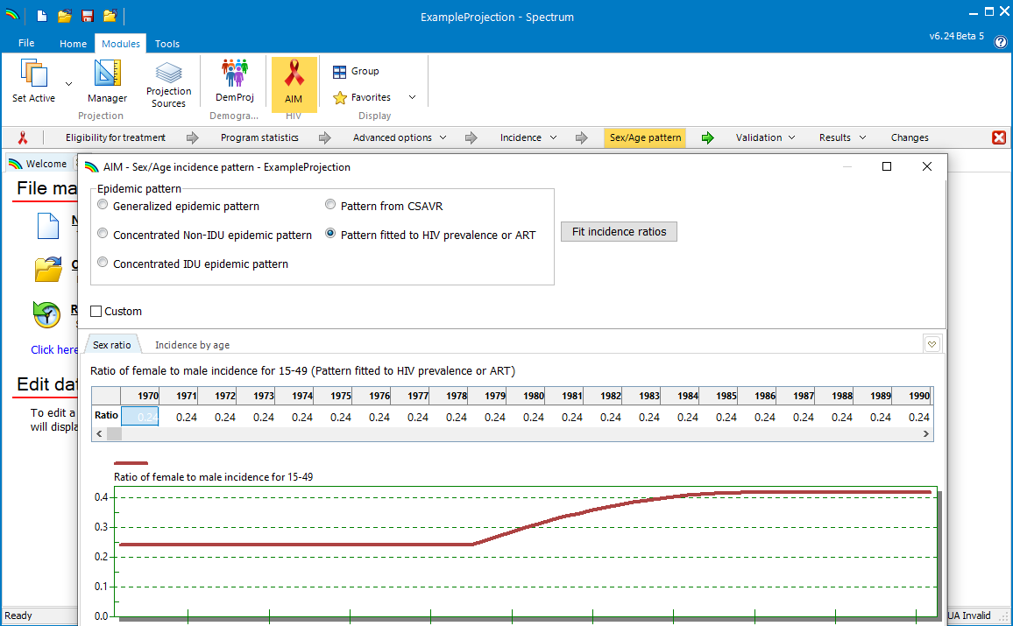
Sex/age pattern background
AEM, CSAVR, and EPP give AIM an overall adult incidence trend that aggregates sex and age (15-49 or 15+)
Spectrum uses incidence rate ratios (IRRs) to disaggregate incidence
The sex/age pattern editor is used to specify these incidence rate ratios
Options
CSAVR: can fit IRRs to case surveillance and/or vital registration data
Other incidence models:
Fit to ART by age data
Use a default epidemic pattern

Slide 3
Updating the sex/age pattern Case 1: CSAVR used to estimate incidence
If case surveillance and/or vital registration data are disaggregated by sex or age, then CSAVR can estimate the sex/age pattern for you…
Once back in AIM, choose “Pattern from CSAVR” in the sex/age pattern form

Slide 4
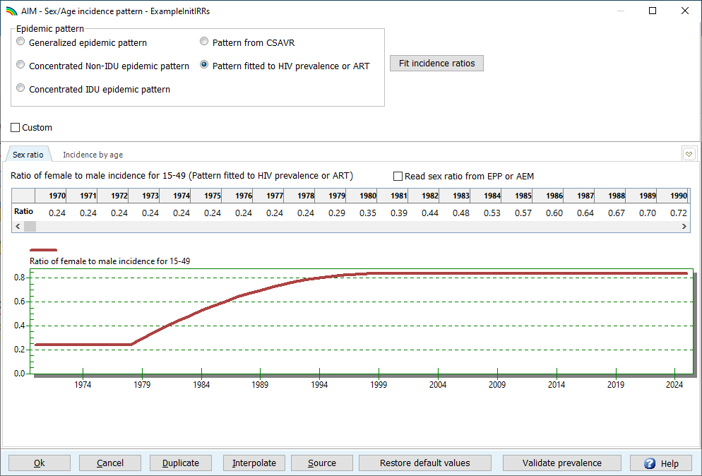
Updating the sex/age pattern Case 2: Fitting to ART data
In the sex/age pattern form:
Set the incidence rate ratios by sex
From EPP or AEM
Epidemic pattern defaults
Select “Pattern fitted to HIV prevalence or ART”
Click “Fit incidence ratios” to open the fitting tool
2
3
If you entered program data on people on ART by age, these can be used to estimate IRRs by age
5-year age group data work best
For GAM age groups, review the resulting IRRs carefully!
1A
1B
Notes:
GAM age groups aggregate ages 25-49 and 50+, which discards most of the information available in the ART by age data.

Slide 5
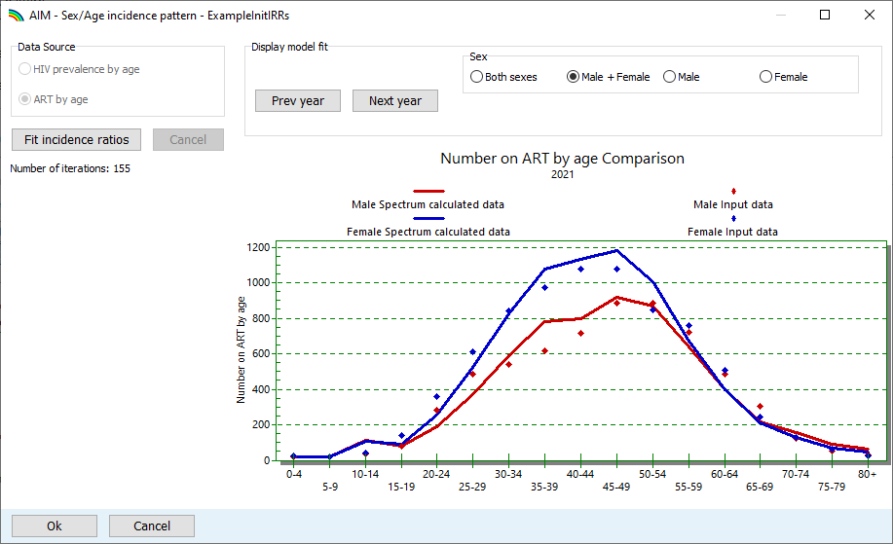
Updating the sex/age pattern Case 2: Fitting to ART data
Data source: Select “ART by age” (may be preselected from last year, or if no other data source available)
Press “Fit incidence ratios”
When fitting done, press “OK” to accept the fit
1
2
Poor IRR fits are likely if your ART by age data don’t add up to your overall numbers on ART!
3

Slide 6
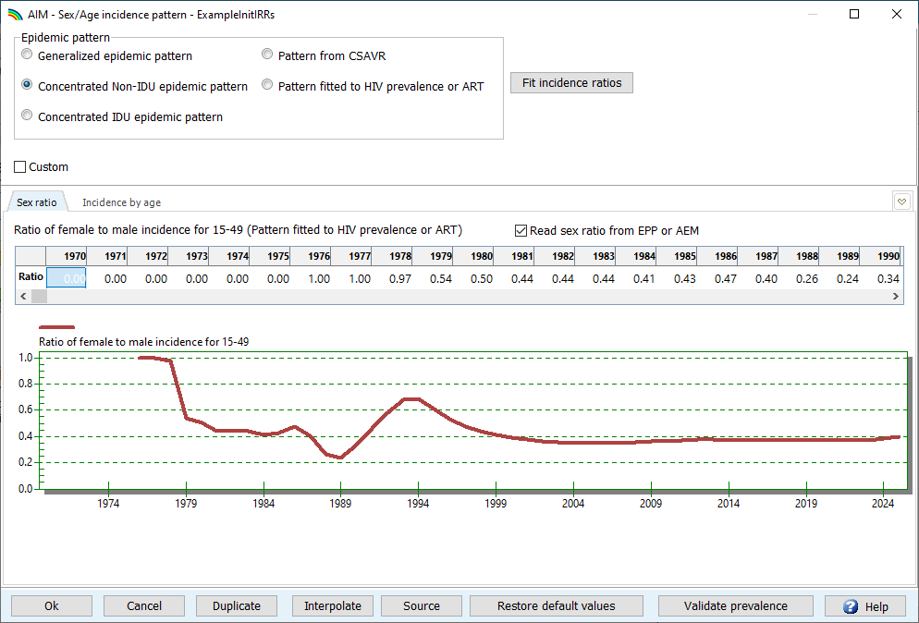
Updating the sex/age pattern Case 3: Default epidemic pattern
Restore default values will revert to a default pattern based on your epidemic typology
If using EPP or AEM, tick the box next to “Read sex ratio from EPP or AEM”
Optionally: Use “Custom” to edit IRRs by age manually if warranted
2
1

Slide 7
How does Spectrum’s age pattern in incidence influence indicator results?
For women, the age pattern in incidence and prevalence influences the prevalence in pregnant women, given fertility by age.
If Spectrum has the age distribution too old (for example), it tends to under-estimate pregnant women prevalence, and so overestimate PMTCT and pediatric ART coverage.
Fitting the Local Fertility Adjuster would compensate for this – but may then need a high value, possibly above the typically accepted 2.0.

