Slide 1
Advanced Options in Spectrum
Houssine El-Rhilani (UNAIDS)
UNAIDS workshop on HIV Estimates and Identifying Inequalities in the Middle-East and North Africa region
Cairo, 19-23 February 2023

Slide 2
Advanced Options
Items to review
Pediatric transition parameters
Adult transition parameters
HIV-related fertility reductions
MTCT transmission parameters
Allocation method for new ART patients
General points
Advanced options include parameter values that are generally based on global or regional analyses
Default values are usually shown in black or grey, non-default values in red
Each form has a button to restore defaults
Please review non-default values and consider restoring defaults where appropriate
Any changes to these inputs should be done before estimating incidence

Slide 3
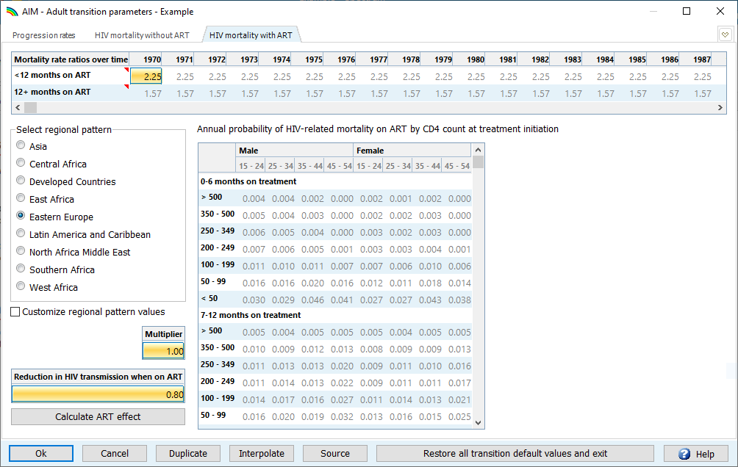
Adult mortality on ART
There were two changes to regional default rates for this estimates round affecting concentrated epidemic settings:
Increased mortality rates in Asia
Reduced mortality rates
in high income countries
Notes:
Note to speakers (Rob Glaubius, 2023-01-19): consider skipping the next two slides if no countries in your workshop use the “Asia” or “Developed countries” pattern in this form. If you do skip these, please make the general note (touched on in the next slide) that the changes in these two regions that are driven by comparison of Spectrum estimates to vital registration data on deaths to people on ART from any cause; there is a new validation form to help make this comparison. That comparison may be grounds for adjusting mortality rates in this form, especially the mortality multiplier.

Slide 4
Adult mortality on ART: Asia
The default on-ART mortality multiplier has been changed from 1 to 4
Several countries in the region multiplied default on-ART mortality rates by 1.5-6 to match on-ART mortality data
Regional on-ART mortality rates are from IeDEA analyses
This multiplier update is an interim solution, pending further investigation by IeDEA, in 2023
If data on all-cause deaths among people on ART are available in your country, please compare them to Spectrum’s estimates via the new validation option:

Slide 5
Adult mortality on ART: High-income countries
Pre-2023 default rates for high-income countries reflected all-cause mortality, not just HIV-related mortality
Some countries reduced mortality rates manually or used other regional patterns to compensate
The new default rates reflect only HIV-related mortality
NOTE: old defaults will still show up in grey, but will be flagged by the file completeness checker

Slide 6
Reduction in HIV transmission on ART (EPP)
HIV incidence falls as ART coverage rises – in EPP
Default (2022 round): 0.8 percentage point decrease in incidence per percentage point increase in ART coverage
This captures historic, average effects of viral suppression on HIV transmission, discounted for age and sexual activity of PLHIV on ART
This effect could be larger at high levels of ART coverage and viral suppression, and may vary over time
For the 2023 estimates round, the ART effect should be calculated based on national viral suppression data
ART effect: (Viral Suppression % – 0.07) or 0.7, whichever is larger
VLS = 0.95 → Effect = 0.88 → lower recent incidence (vs. effect = 0.8)
VLS <= 0.70 → Effect = 0.70 → higher recent incidence (vs. effect = 0.8)
The UNAIDS Reference Group will review this further after the 2023 round, triangulating Spectrum-projected incidence against (low) incidence and high viral suppression seen in PHIA surveys in high-HIV African countries.

Slide 7
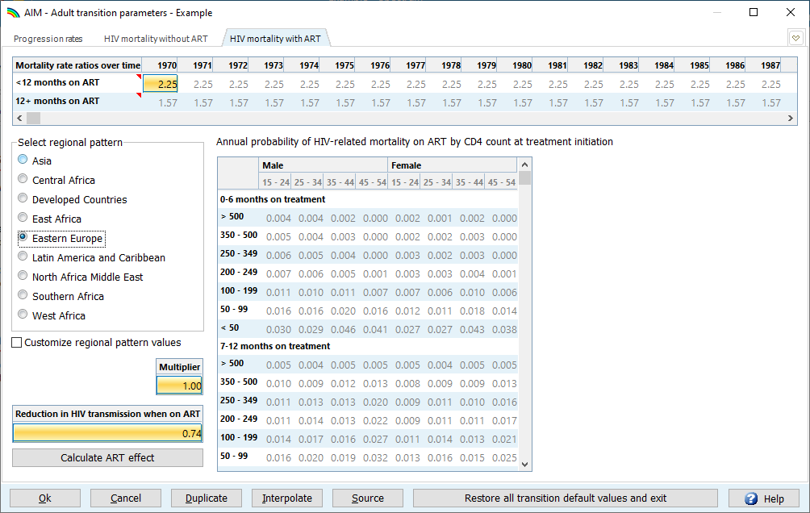
How to update the ART effect on transmission
Requires 3 years of viral suppression data: the average of the last 3 years is used
Before you calculate the ART effect:
Update Viral Suppression data (Program Statistics > Viral suppression)
Restore defaults to pick up any other new default values NOTE: This will reset the ART effect to 0.8 and close the form!
Once these steps are done, reopen ‘Advanced Options > Adult transition parameters’
and calculate the ART effect

Slide 8
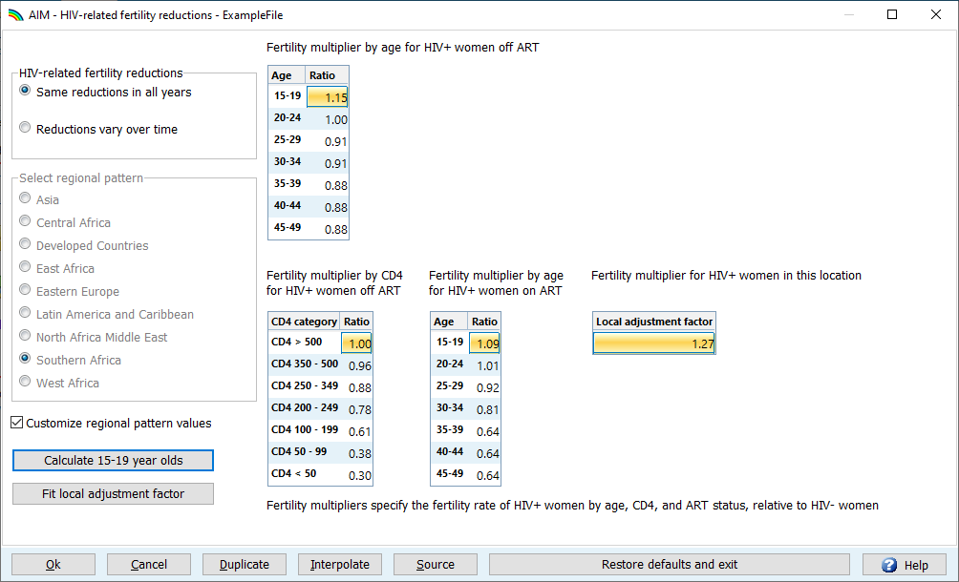
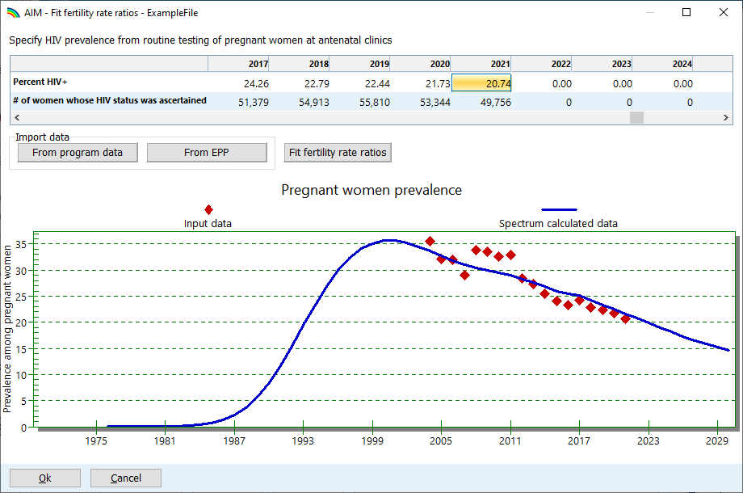
HIV-related fertility
Fitted parameter value appears here
1
2
4
3
How to calibrate HIV+ fertility to ANC data
Press “Fit local adjustment factor”
Import data or enter data manually
Verify that data are of high quality
Representative?
HIV% plausible?
Fit to high quality data
Press “OK” to accept fit
5

Slide 9
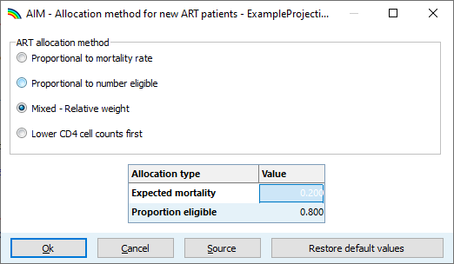
Allocation method for new ART patients
Spectrum calculates how many people must initiate ART each year to match ART program data
What is their baseline CD4 cell count?
Modelled options:
Proportional to the number of expected HIV-related deaths in each CD4 category
Proportional to the number of PLHIV in each ART-eligible CD4 category
Default: A 20:80 mix of (1) and (2)
Lowest CD4 cell counts first.
Putting more weight on mortality or allocating PLHIV with lower CD4 cell counts first, reduces estimated HIV-related deaths among PLHIV on ART, increase the (estimated) age of PLHIV on ART, may reduce estimated pregnant PLHIV and so increase PMTCT coverage
Glaubius et al., J Int AIDS Soc. 2021; 24 (Suppl 5):e25784. doi:10.1002/jia2.25784
Notes:
The "number eligible" language may seem outmoded in the current treat-all era, but it is important for Spectrum's ART allocation mechanism because it applies historic CD4 thresholds when calculating ART uptake in past years

