Slide 1
Fertility, prevalence in pregnant women in Antenatal Care, PMTCT and pediatric ART coverage
Eline Korenromp (UNAIDS)
UNAIDS workshop on HIV Estimates and Identifying Inequalities in the Middle-East and North Africa region
Cairo, 19-23 February 2023

Slide 2
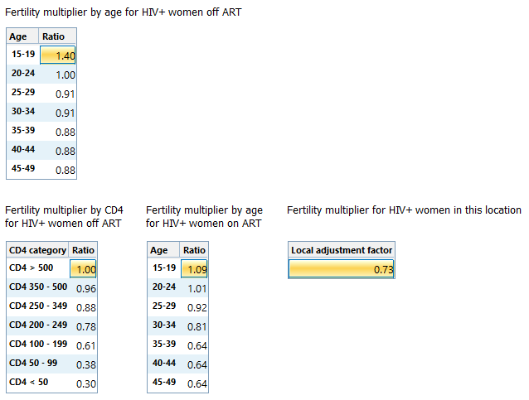
We know the fertility of all women of reproductive age but need to estimate fertility among women living with HIV.
Studies have shown that the fertility of HIV-positive women is lower than HIV-negative women. The effect is greater with older age and lower CD4 count.
Global effects have been estimated from survey data.
We can adjust these global values by fitting to prevalence among pregnant women as measured at ANC visits.
Fertility among women living with HIV

Slide 3
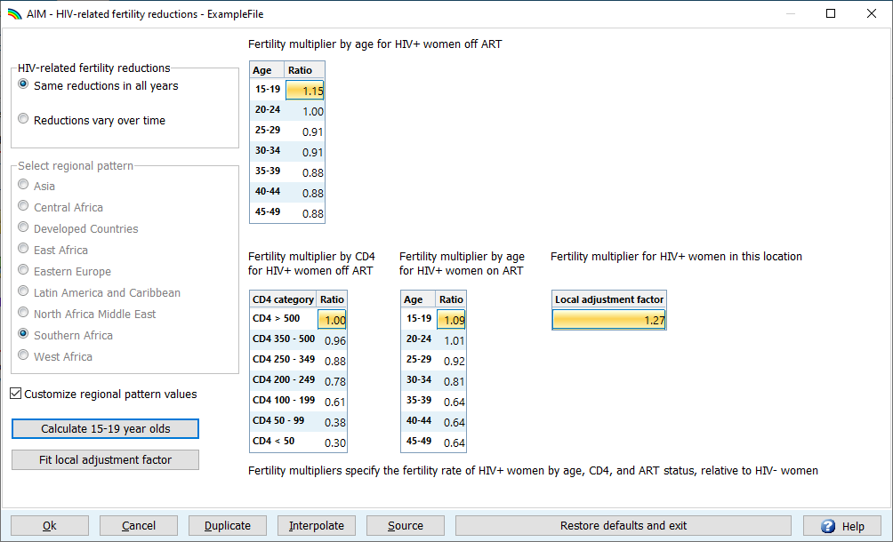
HIV-related fertility
Fitted parameter value appears here
Select ‘Advanced Options’ > ‘HIV-related fertility reductions’
Press “Fit local adjustment factor”
1

Slide 4
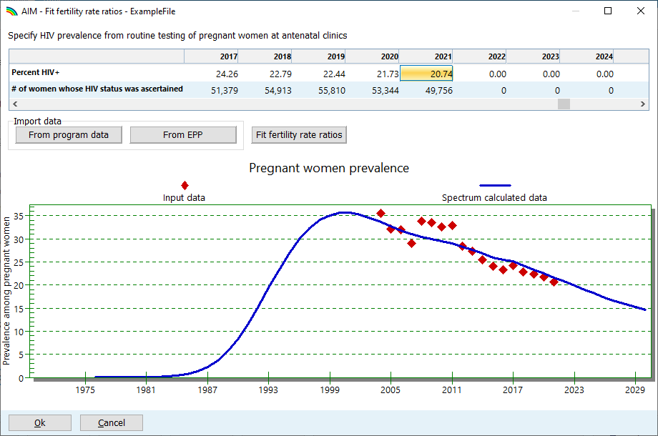
HIV-related fertility
Fitted parameter value appears here
Select ‘Advanced Options’ > ‘HIV-related fertility reductions’
Press “Fit local adjustment factor”
Enter or import data (prefer “From program data”)
Verify that imported data are appropriate to use
HIV% plausible?
Smooth denominators?
Fit to appropriate data
Press “OK” to accept fit
1
2
4
3
Re-fit every time the EPP/CSAVR fit, or IRRs by sex change!
5

Slide 5
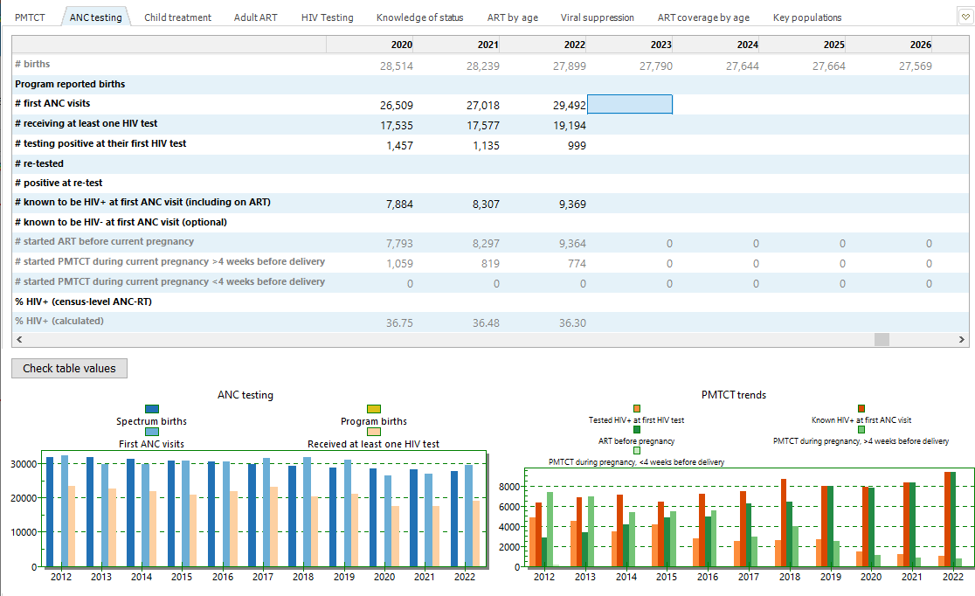
ANC prevalence is taken from the ANC testing editor

Slide 6
Analyze ANC data quality: Before fertility adjustment and/or EPP fitting
Routine testing data can be challenging, sometimes difficult to discern trends from reporting artifacts
Initial guidance on ANC sentinel surveillance suggested focus on high burden ANC sites
HIV testing at ANC scaled-up as HIV testing at ANC was rolled out, then stabilized → early years not nationally representative.
Managing individual level reporting difficult, especially before electronic reporting systems are available
Before using ANC-RT data:
Include women already known to be positive, in numerator (HIV+) and denominator (sample size).
Count all first tests (max. one per pregnancy) – including first tests at labor or delivery
Fit only years of data that are complete, or representative nation-wide.
Watch for sharp increases or decreases; prevalence trends should be stable
Watch for: false positives, changes in testing algorithms, stockouts and their impacts, and rates of refusal.
Review household survey data on the % of women not attending ANC and their characteristics, to understand biases.
Notes:
Many issues can influence the prevalence trends produced by ANC routine testing data including changes in service provision over time, the expansion of coverage of routine testing, and the increasing reach of electronic reporting systems as they expand to more and more places. All of these can affect how timely and complete your data is. They can also influence the epidemiological trends, e.g., as systems expand, they normally move from higher prevalence areas to lower prevalence ones introducing an artifactual decline in HIV prevalence. One way to deal with this might be to not use the trend data from routine testing until the coverage of the system has stabilized.
Accordingly, we recommend that before you use your ANC-RT data you consider some of the issues presented here: how has your routine testing system and its geographic and population coverage been changing over time? Have known positive women been included in the reporting or not? Has only the first test at an ANC visit been included? Are first tests at labour and delivery included? Have you considered changes in the testing over time, including the kits used and false positive rates in low prevalence settings, the algorithms used, refusal rates and the influence of stockouts on completeness of testing? Have you read any available quality assurance reports and compared the prevalence data against other sources such as household surveys?
Given how important the trends produced by EPP will be to determining the trends in your national estimate, it is worth spending some time considering these factors and consulting with experts as necessary to better understand how they influence your data and which data should be used or excluded.

Slide 7
Is the fitted Local Adjustment Factor <0.5 or >2.5?
This implies that (estimated) HIV prevalence differs between pregnant women in ANC differs from all adult women
Review the ANC HIV prevalence data (previous slide)
Cap the local adjustment factor to 2.5 max. or 0.5 minimum, provided this produces acceptable (<100%) coverage of PMTCT and pediatric ART.
Last resort: if reliable data are available from other sources on PMTCT coverage, pediatric ART coverage or children living with HIV, adjust to match those.
Other items to review in Spectrum
If using EPP: Check KP population size estimates and prevalence – esp. FSW. Check turnover for FSW.
If using CSAVR: Were deaths (and/or new case diagnoses) under-reported (e.g., missing deaths misclassified) or over-reported (e.g., duplicates)?
Review Sex incidence rate ratios (IRRs) and adjust (e.g. to the default pattern for Concentrated epidemics) if that helps.

Slide 8
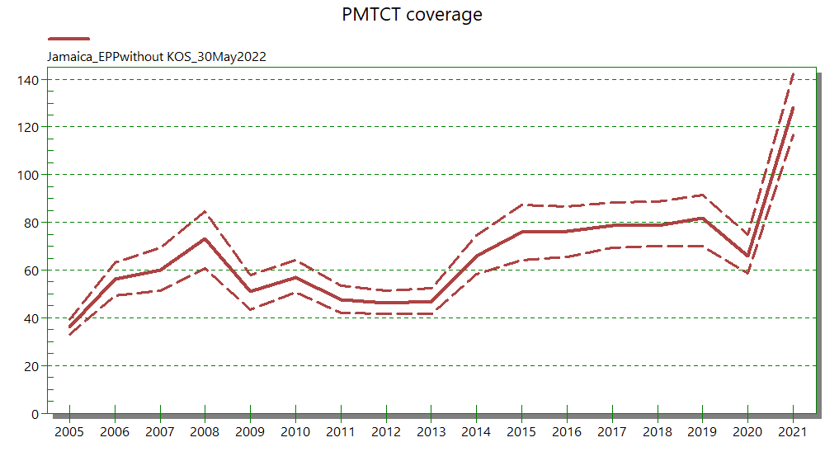
PMTCT coverage >100% signals a problem!

Slide 9
Estimated PMTCT or pediatric ART coverage >>100%?
If value is just over 100%, keep in mind the uncertainty in estimates → may leave as is, unless the programme is weak and 100% coverage is very unlikely.
If value is >110% in 2011-2015, go back to programme data and see if there were challenges in identifying when women were double counted in transition from Option A to Option B or B+.
If value is >110% post-2015 go back to Fertility Local Adjustment (previous slide): review ANC prevalence and Spectrum assumptions (e.g., M/F ratio in incidence) that impact prevalence among women.
Some concentrated epidemics do not have (good) enough ANC data to accurately estimate births to women living with HIV nation-wide. For these, UNAIDS will not publish indicators related to MTCT and pediatric HIV.
Notes:
Conversely, very low pediatric ART coverage may instead indicate that follow-up of children turning 5 years is not complete – these children no longer regularly access EPI and young-child services…

