Slide 1
Review and Validate Results
Eline Korenromp (UNAIDS)
UNAIDS workshop on HIV Estimates and Identifying Inequalities in the Middle-East and North Africa region
Cairo, 19-23 February 2023

Slide 2
Comparing with last round (2022) estimates
Open last year’s file as ‘Read-only’
File > Read only
Alongside the draft 2023 file.
Display key indicators (graphs will show 2 lines, for the 2 files)
PLHIV
New infections
AIDS deaths
ART coverage
PMTCT coverage

Slide 3
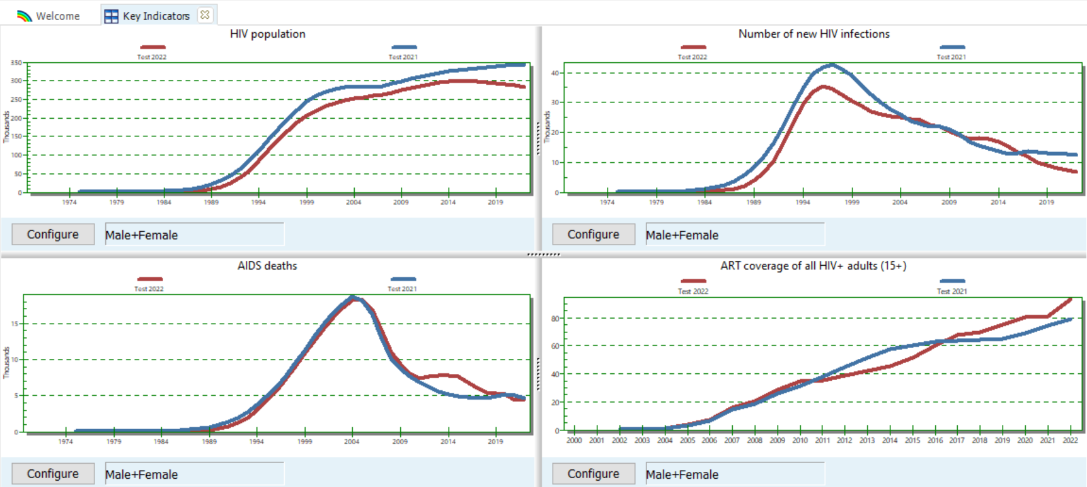

Slide 4
Why did estimates change since last round?
Demographic data were updated (WPP 2022)
Additional year of data on ART, Viral Suppression, PMTCT and surveillance
Updates (or restoring defaults) to values for parameters (by epidemic patterns):
Mortality rates
Incidence Rate Ratios F/M
Allocation of new ART patients
Different incidence curve type selected (within EPP or CSAVR)?
The only change within Spectrum methods, in 2023, was a half-year shift, from mid-year to end-year

Slide 5
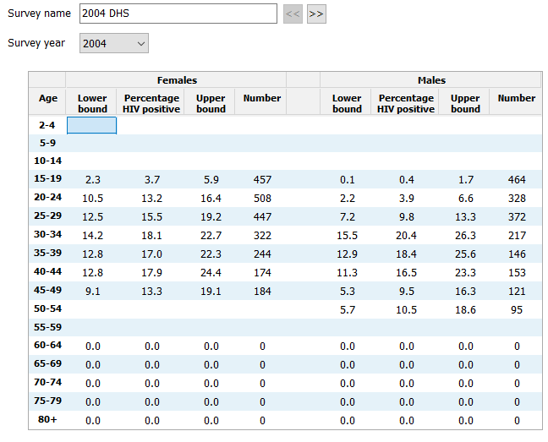
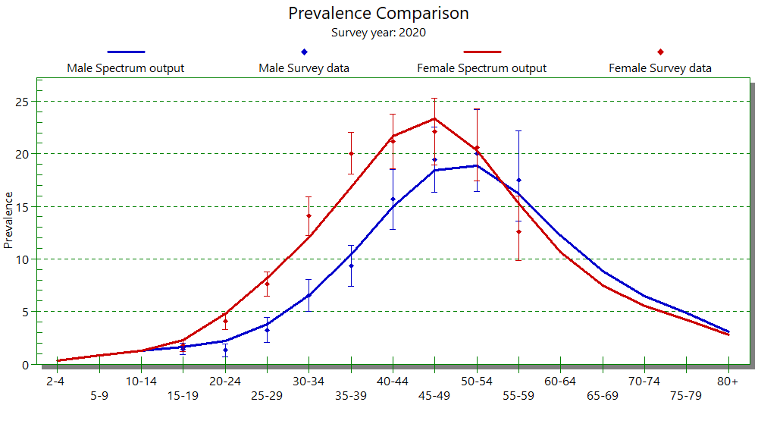
Validations
Prevalence*
ART
Previously treated population
Number on ART
Number on ART by age
Number newly starting ART
ART coverage by age*
All-cause deaths on ART
Waterfall analysis: ART change 2021 to 2022
Under-5 mortality rate
Adult mortality 15+ (45q15)
Mortality by age
Check file completeness (next presentation)
Enter/Edit data
Comparison
* These validations require national data from household surveys with HIV serology

Slide 6
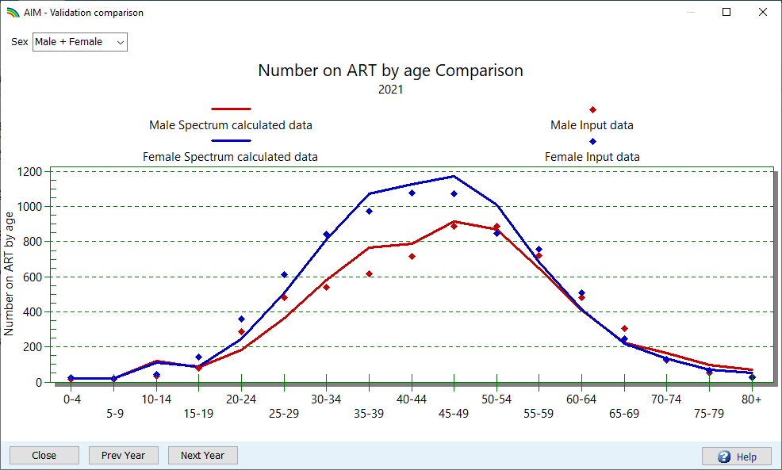
Number on ART by age
Enter data in “AIM > Program statistics > ART by age”
Five-year age groups
GAM age groups.
If Spectrum and data disagree:
Check consistency between age-specific and overall ART numbers (AIM > Program statistics > Adult ART)
Try fitting the sex/age pattern in incidence to ART by age data (AIM > Sex/age pattern).
Spectrum may have the age of PLHIV on ART too old, if Loss-to-Follow-up (LTFU) from ART is missing → Enter LTFU % in Program statistics > Adult ART.
A good fit for incidence and ART by age for women can help to accurately estimate MTCT and PMTCT coverage.

Slide 7
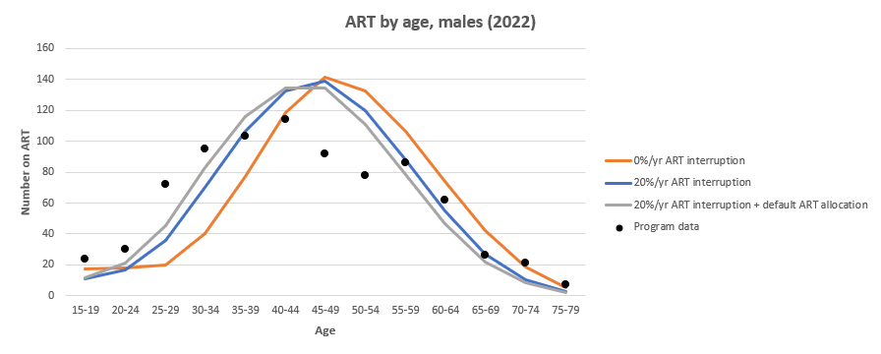
How LTFU and method of new ART allocation influence PMTCT coverage
Adding LTFU from adult ART, and changing the Spectrum’s allocation method for new ART patients, from e.g. 50/50% by expected mortality versus by eligibility, to the new default of 20/80% will shift the age distribution of females on ART to younger age. In countries and year with high ART coverage, younger age of women on ART will typically increase Spectrum’s estimated prevalence in pregnant women i.e. the need for PMTCT, and lower PMTCT coverage accordingly.
Example (below), Belize: 7% higher PMTCT need in Belize, from ART-by-age fitting and setting the new ART allocations to 20/80% default.

Slide 8
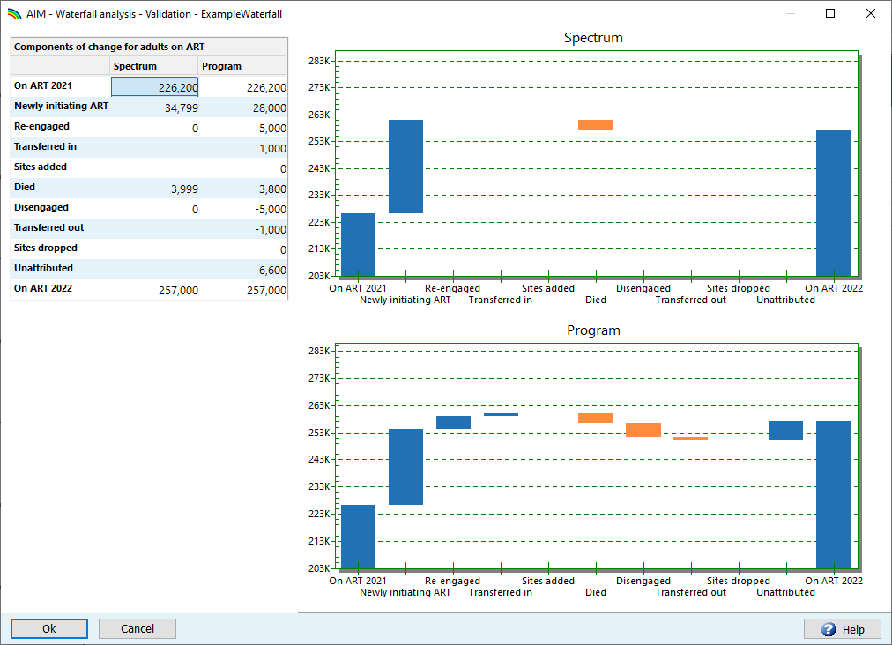
Waterfall Analysis of the change in ART

Slide 9
Waterfall Analysis of the change in ART
Died
Disengaged
Re-engaged
Newly initiating
Unknown
On ART 2022
On ART 2021

Slide 10
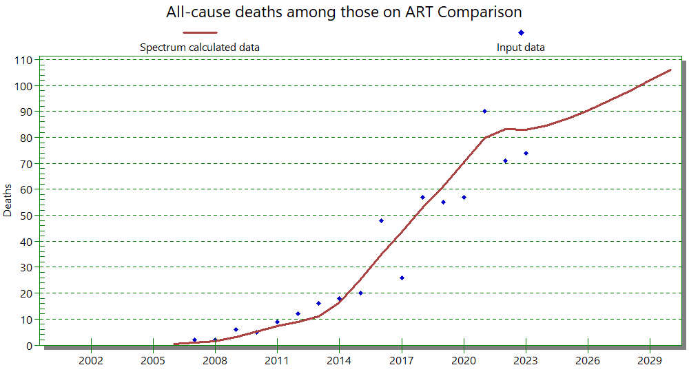
All-cause deaths on ART
Some countries collect data on All-cause mortality among PLHIV on ART.
When available, enter them in the Validation form.
A mismatch could indicate that Spectrum’s on-ART mortality rates need to be adjusted.
These data could also help identify data quality issues in vital registration of HIV-related deaths (among PLHIV on and off ART) used in CSAVR model fitting.

