Slide 1
Viewing Results in Spectrum
Yoko Shimada
UNAIDS workshop on HIV Estimates and Identifying Inequalities in the Middle-East and North Africa region
Cairo, 19-23 February 2023

Slide 2
Viewing results
Indicators
Number of people living with HIV
New HIV infections
HIV-related deaths
ART coverage
PMTCT coverage
MTCT rate
Population configuration
All ages
Adults 15-49, 15+, 50+
Children 0-14, <1, <2, 1-4
Adolescents 10-19
Young people 15-24
Custom age groups
HIV+ pregnant women
People on ART

Slide 3
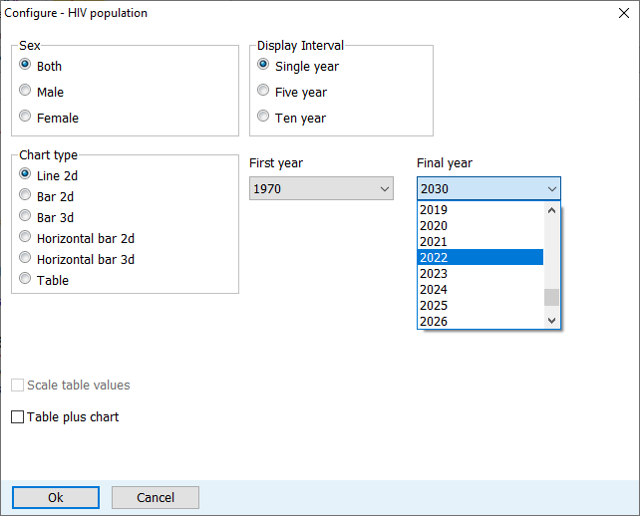
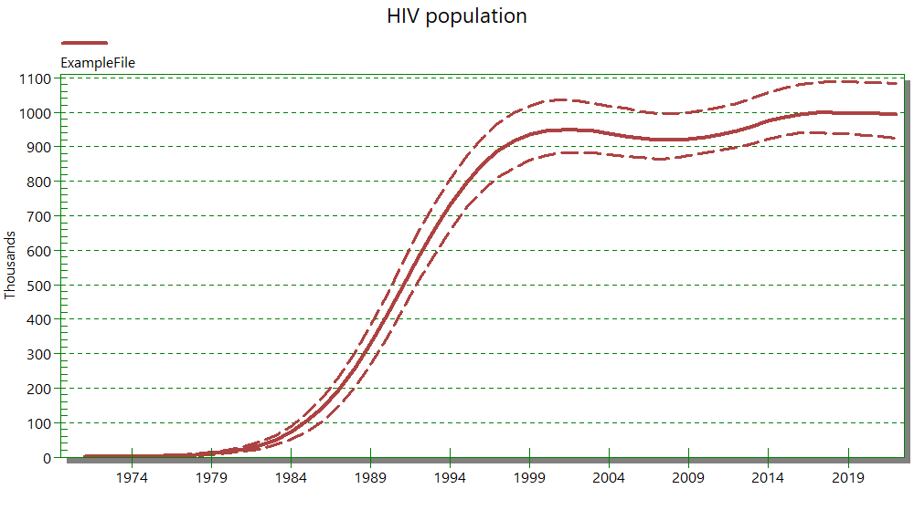
Configuring results

Slide 4
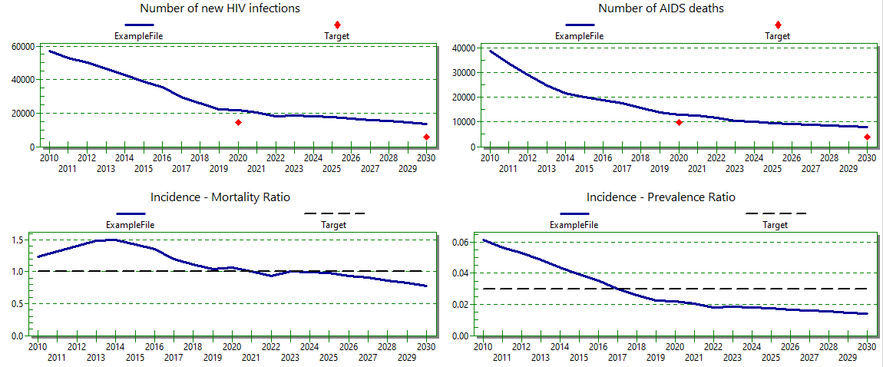
Results examples Dashboard

Slide 5
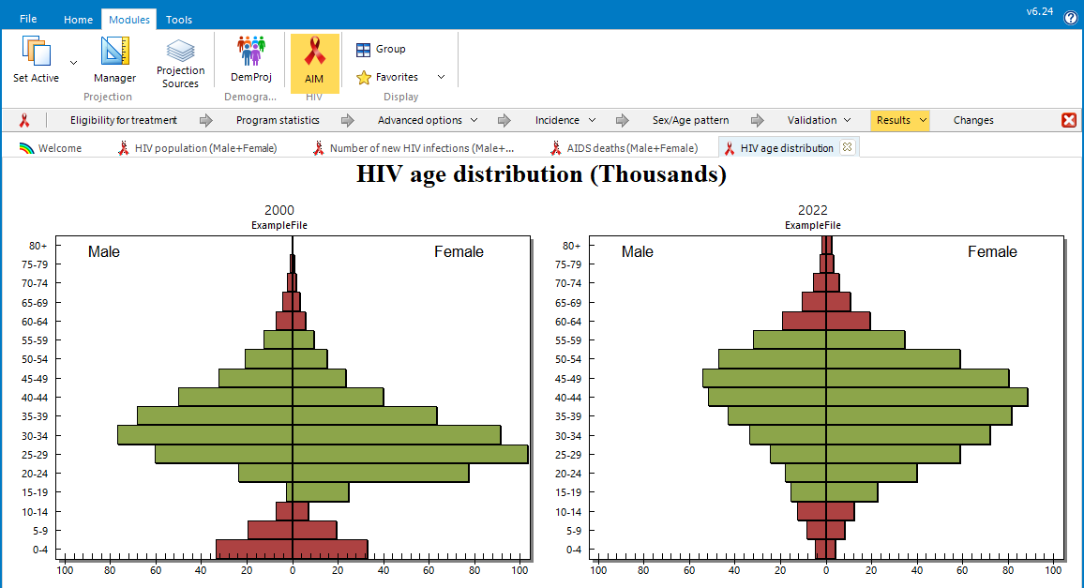
Results tabs
You can display a new result without closing the window for the current result
Access other results with the tabs
To close all tabs, select ‘Home > Close All’

Slide 6
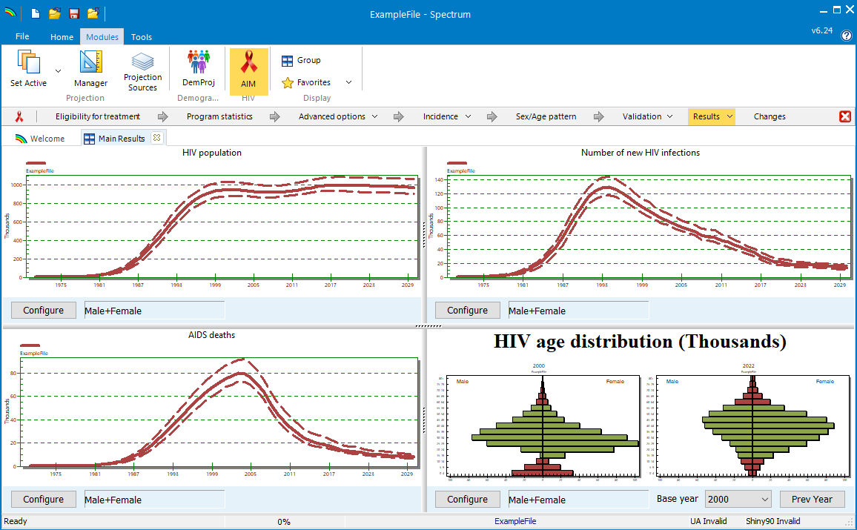
Display groups of results
Use the ‘Group’ function to display multiple results together

Slide 7
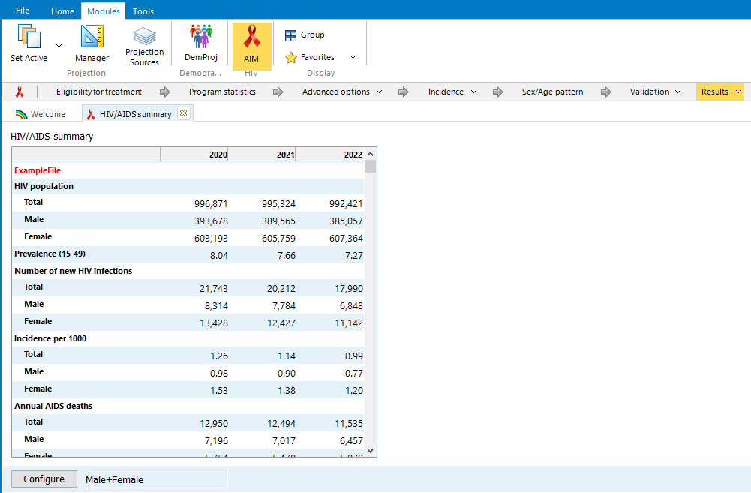
Results Summary Tables
All result categories have summary tables that include all the indicators in the category
Like all Spectrum tables, you can
Right Click on the table
Copy All
Paste into Excel

