Slide 1
Spectrum Validation Checklist, Tools, and Uncertainty Analysis
Guy Mahiané (Avenir Health)
UNAIDS workshop on HIV Estimates and Identifying Inequalities in the Middle-East and North Africa region
Cairo, 19-23 February 2023

Slide 2
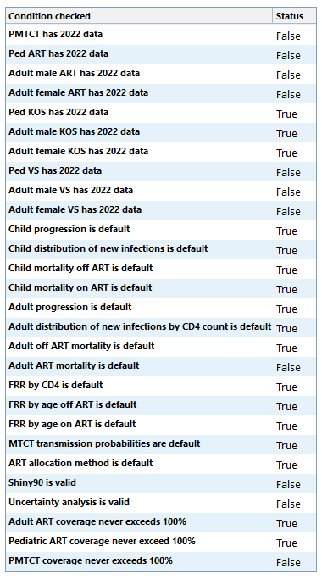
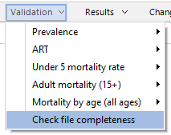
File Completeness Checklist
Were program data entered for 2022?
Were default patterns used?
Red font in advanced options indicates custom value.
Shiny90 and UA are valid?
Coverage < 100%?

Slide 3
Tools for further analysis Access the ‘Tools’ window
Select ‘Tools’ then ‘More tools’ to see the available tools for AIM
Some tools are available only when a projection is open
E.g., Uncertainty Analysis
Other tools are available only if no projections are open
E.g., Extract, Aggregate, Aggregate uncertainty, GAM

Slide 4
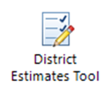
Tools for further analysis
Calculate uncertainty bounds for Spectrum estimates
Calculate national totals from sub-national files – point estimates only
Calculate national totals from sub-national files – includes uncertainty bounds
Prepare district-level estimates – requires HIV prevalence data by district
Output results from Spectrum files to GAM
Extract any Spectrum indicators from one or more Spectrum files to Excel

Slide 5
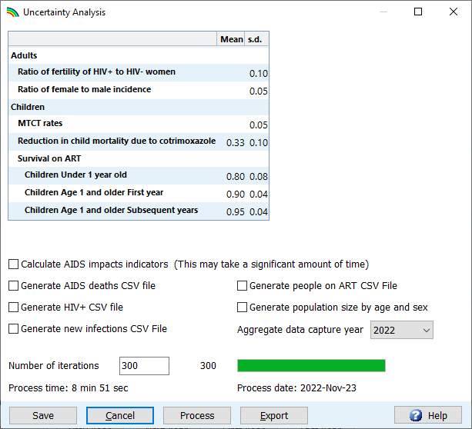
Running uncertainty analysis
Set the number of iterations to 300
Set the aggregate data capture year to 2022
Click “Process”
Press “Save” once processing is complete
2
Update to 2022
1
4
3

Slide 6
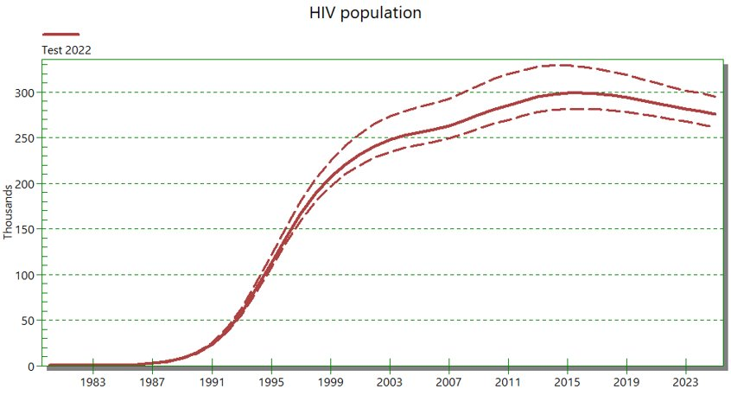
Interpreting uncertainty
Notes:
After running uncertainty analysis, results you view in Spectrum will show uncertainty bounds about the central point estimates. Let’s talk a bit about where that comes from and what it means.

Slide 7
Sources of uncertainty
Model structure
What if we had modeled some processes differently?
Model parameters
What if we had used different parameter values?
Surveillance and survey data
What if we had sampled different people or places?
Program data
How closely do our data match service utilization on the ground?

Slide 8
HIV prevalence – males 15-49 and female 15-49
The estimates from DHS & ZIMPHIA were part of the minimum data recommended for calibration purposes.
Notes:
To account for uncertainty in model structure, we generally need to compare results obtained from different models that make different structural assumptions. This is not something we do within the HIV estimates workshops, but for an example of how this goes more generally, this slide shows a comparison done within the HIV modeling consortium. For the activity here, four different modeling groups calibrated their models to the HIV epidemic in Zimbabwe. Despite different structural assumptions, the model agree well in the period with household survey data (the gold dots) but make different estimates before the data and make different projections into the future. The UNAIDS Reference Group also considers these kinds of comparisons when considering modifications to the models used for HIV estimates.

Slide 9
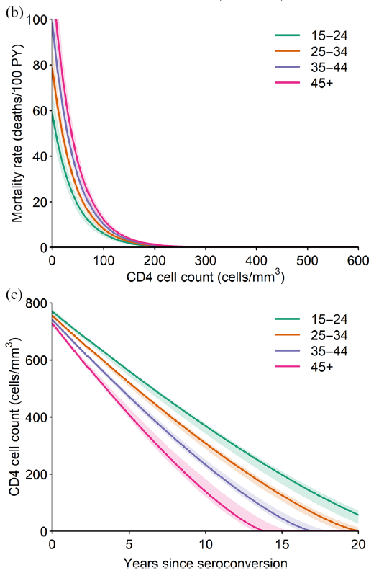
Uncertainty in model parameters HIV natural history
Spectrum has uncertainty information about many advanced options parameters
While running uncertainty analysis, Spectrum draws different, plausible values of these parameters
R Glaubius et al. JIAS 2021, 24(Suppl 5):e25784

Slide 10
Uncertainty in model parameters Mortality rates on ART
Johnson LF et al. AIDS 2019, 33 (Suppl 3):S283-S294

Slide 11
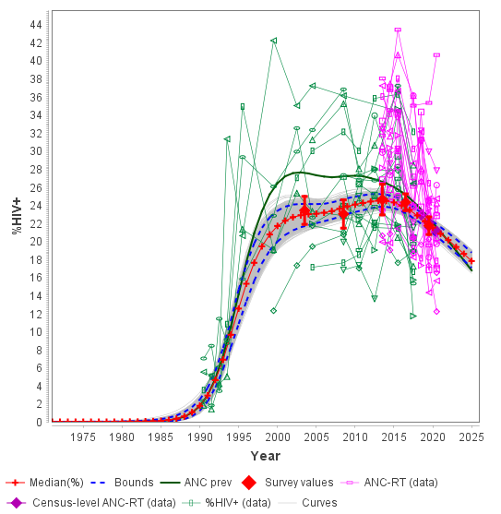
Uncertainty in surveillance and survey data
Incidence estimation models like EPP account for uncertainty in surveillance and survey data when assessing how well the model fits these data
This data uncertainty is represented by different, plausible HIV incidence curves used when running uncertainty analysis

Slide 12
Uncertainty in program data
Uncertainty is added to ART inputs: –12% / +4%
No other uncertainty in program data is accounted for
Ensuring the quality of these data is critical!

Slide 13
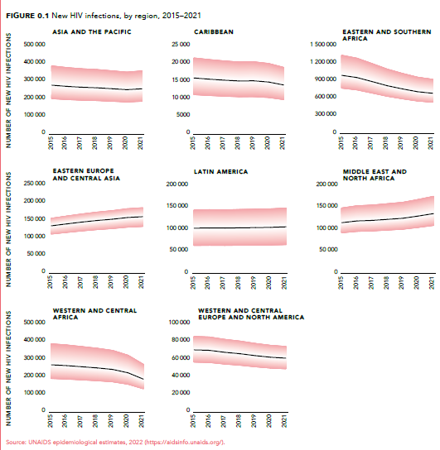
Global estimates with uncertainty ranges

Slide 14
Precision of Estimates
Notes:
Uncertainty bounds can be interpreted as a measure of the precision of estimates. For example, our point estimate of ART coverage in 2022 might be 80%, but the uncertainty bounds suggest that could be somewhere between 70% and 95%. Keep in mind, though, that values near the point estimate are much more likely in comparison to values that are just inside the bounds.

Slide 15
Achievement of Targets
Notes:
Uncertainty bounds can help put targets for HIV indicators into perspective. For example, if the point estimate for new HIV infections is far from a target level, and that target falls far outside the uncertainty bounds, you can be reasonably confident that the target was missed.

Slide 16
Achievement of Targets
Notes:
Meanwhile, if the uncertainty bounds are wide enough to include the target, then it is plausible that the target was reached in reality

