Slide 1
Under the Hood in Spectrum
Notes:
Hi. I am John Stover from Avenir Health and one of the developers of the Spectrum model. In this presentation we will cover the main methods and assumptions behind the Spectrum estimates.

Slide 2
Structure
Demographic Data
Demographic and Epidemic Calculations
Mother-to-child transmission
Child model
Adult model
Results
Number HIV+
New Infections
AIDS deaths
Need for ART
Need for PMTCT
Program Statistics
Epidemic Patterns
Surveillance, Survey and Routine Testing Data
Prevalence / incidence trend
Notes:
This is the basic structure of the approach to estimates. The four purple boxes on the left represent the inputs required. The middle boxes represent the model calculations. The outputs are shown in the gray box on the right. The workshop will follow this diagram:
First we will consider the inputs required
Second we will estimate the prevalence/incidence trend
Third we will discuss the methods and data behind the main Spectrum model
Finally, we will examine outputs

Slide 3
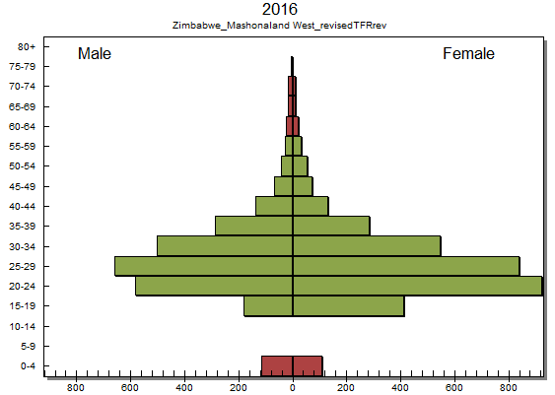
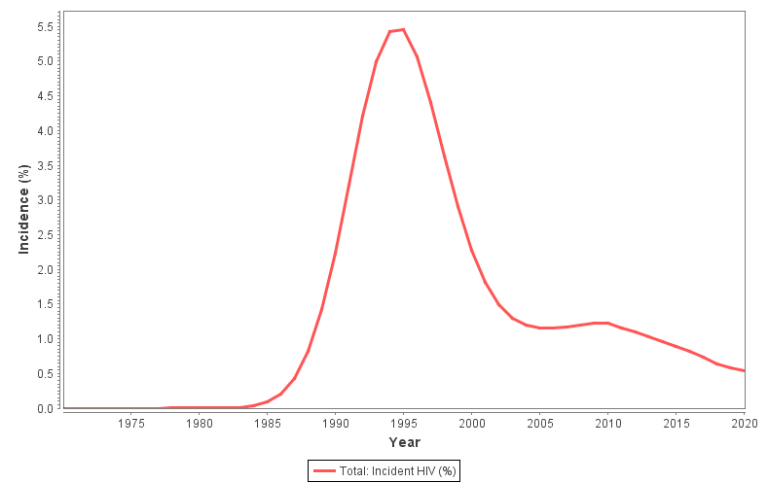
Using Incidence Trends in AIM
EPP or CSAVR tool provides incidence Trend for M&F 15-49
AIM needs male and female separately…
…and by age group
Use IRR Fitting Tool if surveys or data on ART by age are available
Use default patterns otherwise

Slide 4
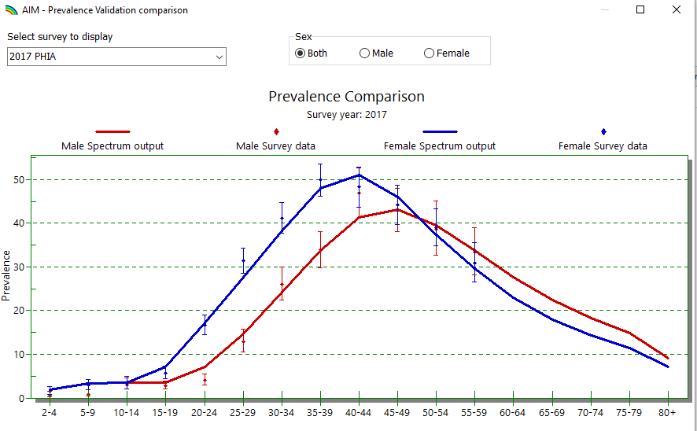
Calculate Incidence Rate Ratios by Fitting to Prevalence by Age from Surveys
Notes:
The aggregate incidence trend from EPP, AEM or CSAVR is disaggregated by age and sex using a set of incidence rate ratios, which describe the ratio of incidence at any age to incidence at age 25-29. These incidence rate ratios are estimated by fitting to survey or program data. For generalized epidemics with national surveys the fitting tool searches for a set of incidence rate ratios that allow the model to best fit prevalence by age from surveys, as shown in this chart. For countries with concentrated epidemics without national household surveys, the incidence rate ratios can be derived by fitting to data on the number of people on ART by age.

Slide 5
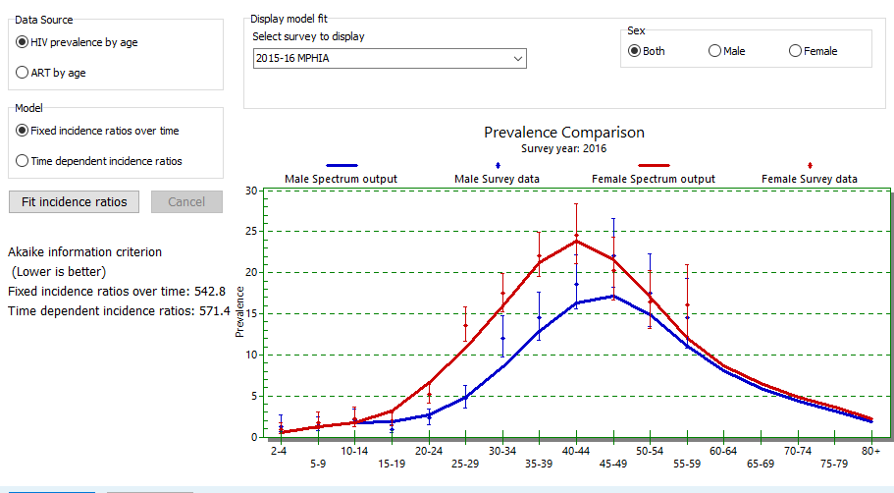
Calculate Incidence Rate Ratios by Fitting to Prevalence by Age from Surveys
Select Sex/age pattern > Fit incidence ratios
In most cases use Fixed incidence ratios over time
Notes:
Incidence rate ratios may be fixed for all years or they may change over time if you have multiple surveys or several years of ART by age data. In general, fixed ratios are preferred as time-vary ratios may over-fit the data and introduce rapid changes from one year to the next. You can determine the best approach by first fitting time dependent incidence ratios and then fitting fixed ratios. The option with the lower value for the Akaike Information Criterion (AIC) is considered the better approach as it indicates the closest fit to the data taking into account the number of data points. This page shows an example for a generalized epidemic with a national prevalence survey. The approach is the same for concentrated epidemics that fit to data on ART by age.

Slide 6
Tracking New Adult HIV Infections by CD4 Count
New Infections
>500
350-499
250-349
200-249
100-199
50-99
<50
On ART
μ₁
c₁
α₁
>500
μ₂
λ₁
c₂
α₂
350-499
μ₃
λ₂
c₃
α₃
250-349
μ₄
λ₃
c₄
α₄
200-249
μ₅
λ₄
c₅
α₅
100-199
μ₆
λ₅
c₆
α₆
50-99
μ₇
λ₆
c₇
α₇
<50
AIDS Death
µ = non-AIDS mortality rate, λ = progression rate, c = rate of initiating ART, α = mortality rate on ART

Slide 7
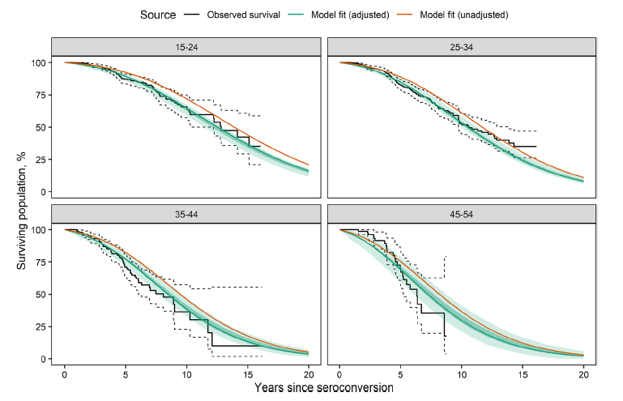
Progression and mortality rates selected to fit survival patterns
Glaubuis R, Kothegal N, Birhanu S, Jonnalagadda S, Mahiane GS, Johnson LF, et al. (2021) Disease progression and mortality with untreated HIV infection: evidence synthesis and HIV seroconverter cohorts, antiretroviral treatment clinical cohorts and population-based survey data. Journal of the International AIDS Society, 24(S5):e25784

Slide 8
…and CD4 distributions for PLHIV not on ART
x

Slide 9
Default Patterns of Mortality and Progression

Slide 10
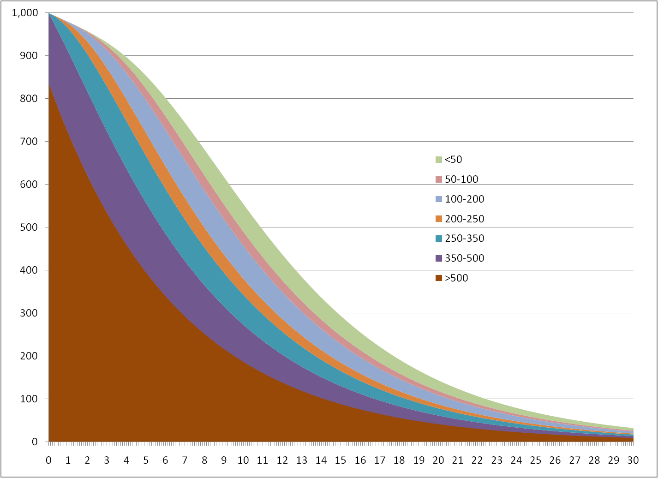
Evolution of Cohort of New Infections

Slide 11
Mortality rates on ART are derived from treatment cohorts
Data and analysis provided by IeDEA Consortium
Latest update completed November 2018
Methods described in Johnson et al. Global variations in mortality in adults after initiating antiretroviral treatment: an updated analysis of the International epidemiology Database to Evaluate AIDS cohort collaboration. AIDS 2019, 33 (Suppl 3):S282-S294.
Rates vary by
CD4 count at treatment initiation
Duration on treatment
Age
Sex
Region
Time period

Slide 12
Mortality on ART by Duration and Age
Patterns shown are for East Africa, Females

Slide 13
Mortality on ART (12+ months, 25-34) by Sex and Region
Patterns shown are for age 25-34, 12+ on treatment

Slide 14
ART mortality rates have declined over time

Slide 15
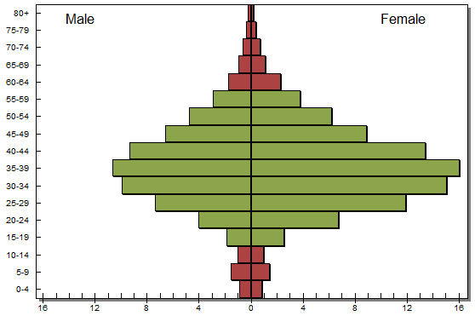
Estimating New Child Infections
The adult model estimates the number of HIV+ women of reproductive age. From this we can estimate the number of HIV+ pregnant women and new child infections.
Number of HIV+ women of reproductive age

Slide 16
Fertility of HIV+ women is less than HIV- women
Marston et al. The effects of HIV on fertility by infection duration: evidence from African population cohorts before antiretroviral treatment availability. AIDS 2017, 31 (Suppl 1):S69-S76.

Slide 17
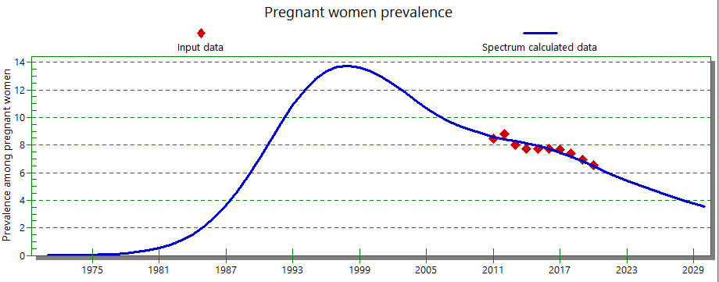
The fertility rate ratio is fit for each country to data on HIV prevalence among pregnant women

Slide 18
Probability of Mother-to-Child Transmission
Stover J, Glaubius R, Mofenson K, et al. Updates to the Spectrum/AIM model for estimating key HIV indicators at national and subnational levels. AIDS 2019, 33 (Suppl 3):S227-S234.

Slide 19
Probability of Mother-to-Child Transmission
Stover J, Glaubius R, Mofenson K, et al. Updates to the Spectrum/AIM model for estimating key HIV indicators at national and subnational levels. AIDS 2019, 33 (Suppl 3):S227-S234.

Slide 20
Calculation of New Child Infections

Slide 21
New displays for visualizing the sources of mother-to-child transmission

Slide 22
Tracking Pediatric HIV Infections
New Infections (0-4)
>30%
26-30%
21-25%
16-20%
11-15%
5-10%
<5%
5-14 years
μ₁
u₁
>1000
μ₂
λ₁
u₂
750-999
μ₃
λ₂
u₃
500-749
μ₄
λ₃
u₄
350-499
μ₅
λ₄
u₅
200-349
μ₆
λ₅
u₆
<200
μ₇
λ₆
AIDS Death
µ = non-AIDS mortality rate, λ = progression rate, c = rate of initiating ART, α = mortality rate on ART

Slide 23
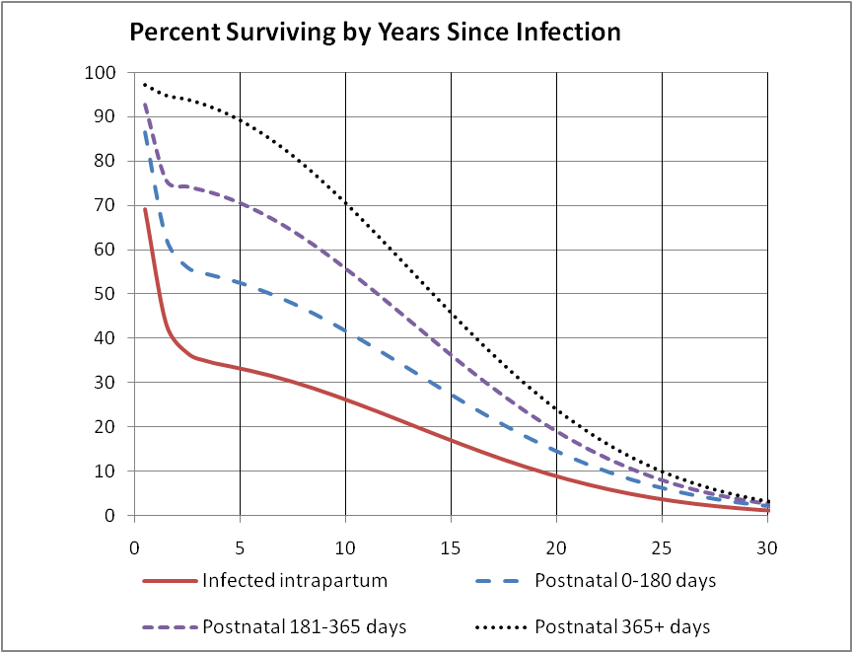
Child HIV-Related Mortality
Marston M, Becquet R. Net survival of children HIV-infected perinatally and through breastfeeding: a pooled analysis of individual data from resource-constrained settings, December 2010.

Slide 24
Mortality on ART
Mortality on ART by CD4 Percent and Age for Males on ART > 12 Months
Mortality on ART by CD4 Count and Age for Males on ART > 12 Months
Kassanjee R et al. Global HIV mortality trends among children on antiretroviral treatment corrected for under-reported deaths: an updated analysis of the International epidemiology Databases to Evaluate AIDS collaboration. Journal of the International AIDS Society 2021, 24(S5):e25780

Slide 25
Distribution of New Pediatric ART Patients by Age: SSA
Stover J, Glaubius R, Mofenson K, et al. Updates to the Spectrum/AIM model for estimating key HIV indicators at national and subnational levels. AIDS 2019, 33 (Suppl 3):S227-S234.

Slide 26
Results: Key Output Indicators
Indicators
HIV+ population
New infections
HIV-related deaths
Need for ART
Need for PMTCT
Orphans
Population Groups
All ages
Adults 15-49
Adults 15+
Young people 15-24
Adolescents 10-19
Pregnant women
Children 0-14
Children 0-1
Children 1-4
Children <2
Regions

Slide 27
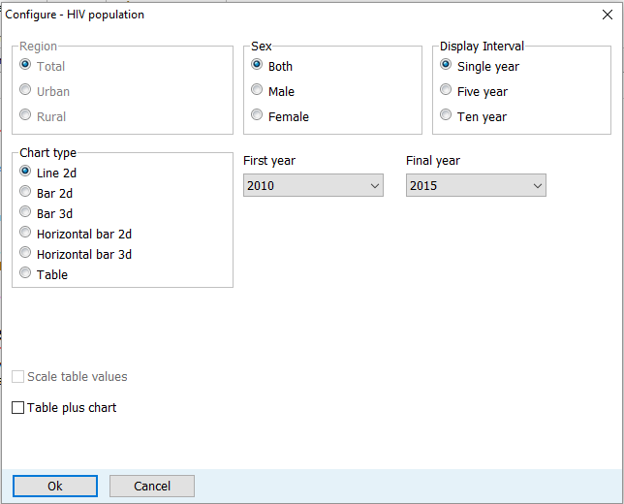
Display Options

Slide 28
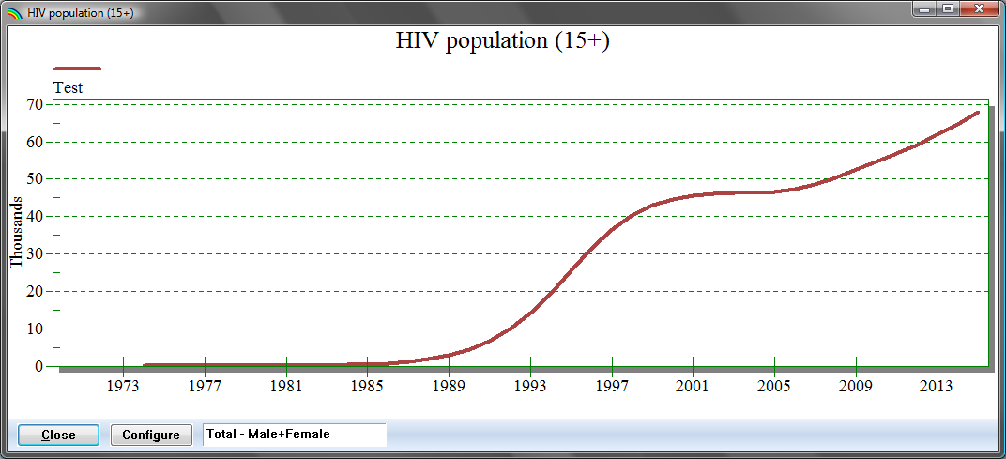
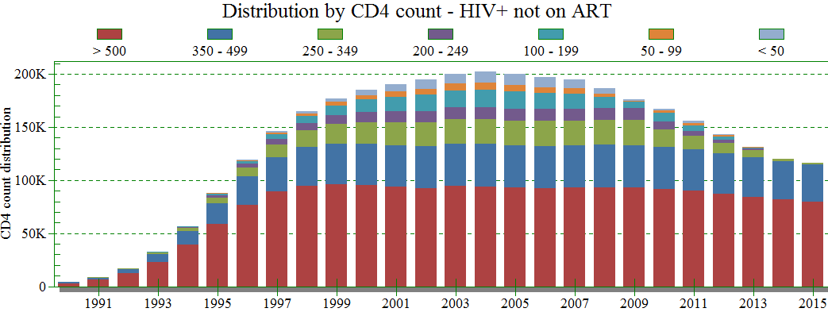
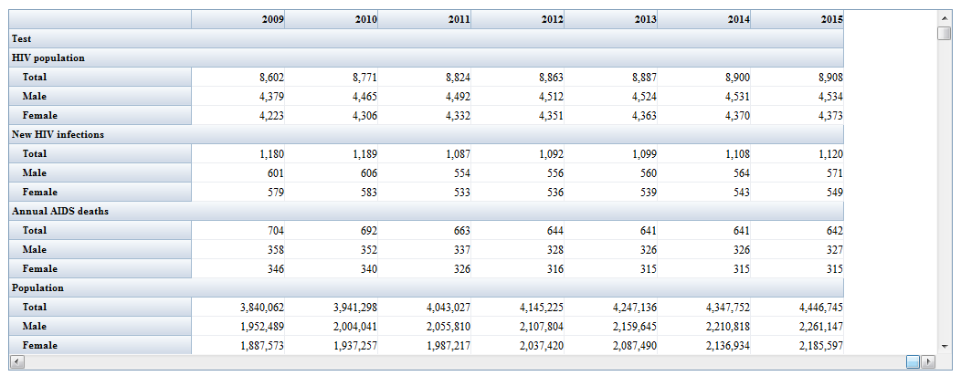
Display Options
Summary Table

Slide 29
Enter treatment cascade data in the Program Statistics editors…

Slide 30
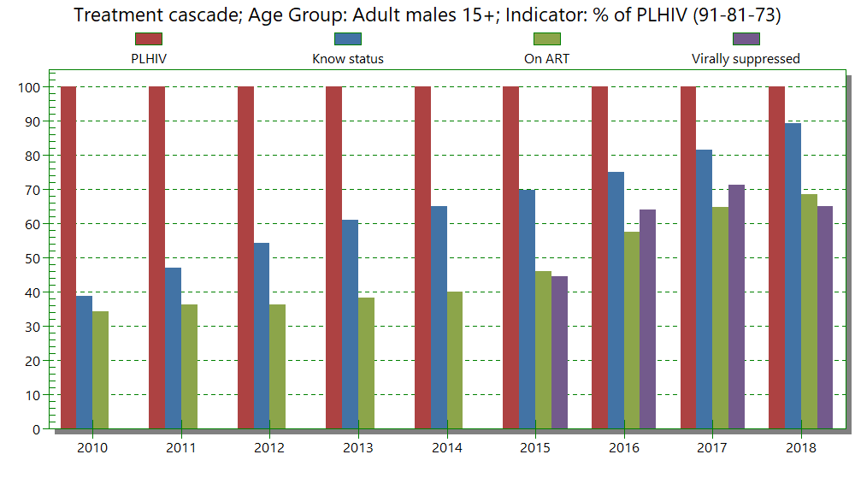
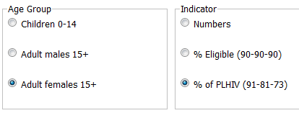
…and view the Treatment Cascade results

Slide 31
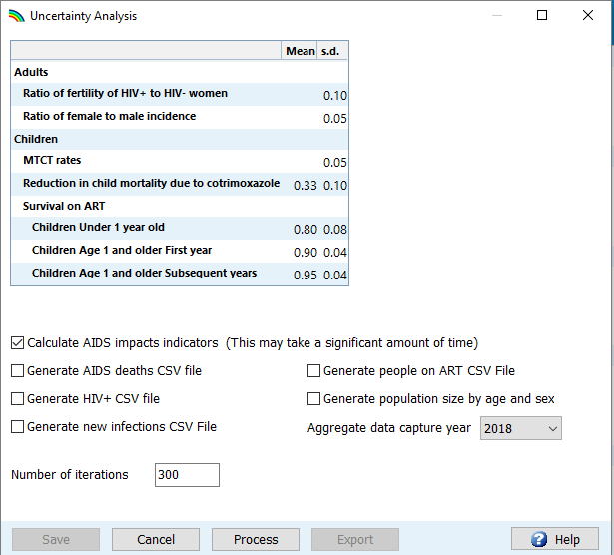
Final step is to run the uncertainty analysis to get ranges on estimates
To calculate uncertainty
Select Tools > More tools > AIM Uncertainty Analysis
Set number of iterations to 300
Set Aggregate data capture year to 2020
Click Process

Slide 32
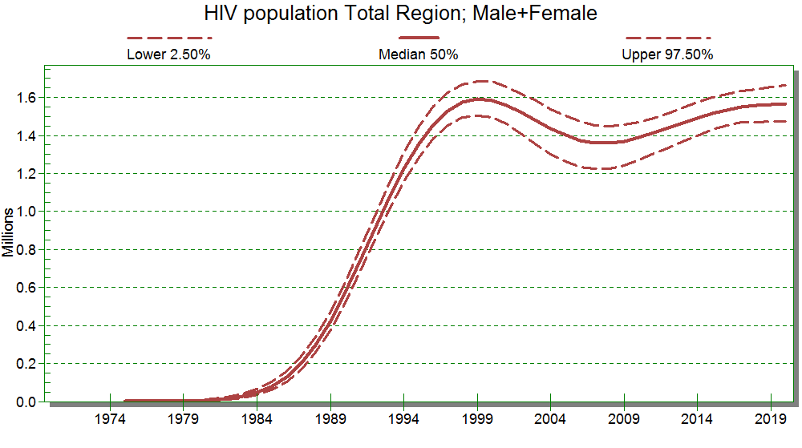
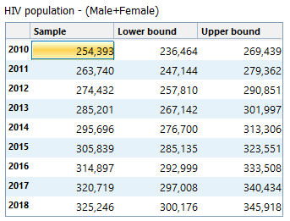
After running UA you will see ranges in charts and tables

Slide 33
More Information
For more information you can look at the Spectrum Help File by clicking the ? icon and selecting ‘Spectrum Modules” or review the methods publications
Stover J, Glaubius R, Kassanjee R, Dugdale KM. Updates to the Spectrum/AIM model for the UNAIDS 2020 HIV estimates. Journal of the International AIDS Society 2021.24(S5):e25778. https://doi.10.1002/jia2.25778
Stover J, Glaubius R, Mofenson L, Dugdale CM, Davies MA, Patten G, Yiannoutsos C. Updates to the Spectrum/AIM model for estimating key HIV indicators at national and subnational levels AIDS 2019, 33, (Suppl 3):S227-S234
Stover J, Brown T, Puckett R, Peerapatanapokin W. Updates to the Spectrum/Estimation and Projections Package model for estimating trends and current values for key HIV indicators AIDS 2017, 31 (Suppl 1):S5–S11
Stover J, Andreev K, Slaymaker E, Gopalappa C, Sabin K, Velasquez C et al. Updates to the Spectrum model to estimate key HIV indicators for adults and children AIDS 2014 28 (Suppl 4):S427-S434
Stover J, Brown T, Marston M. Updates to the Spectrum/Estimation and Projection Package (EPP) model to estimate HIV trends for adults and children (2012) Sex Trans Infect 2012;88:i11-ii16. doi:10.1136/sextrans-2012-050640

