Slide 1
Visualising input mortality data for CSAVR
Oli Stevens
UNAIDS Training of Trainers | Concentrated epidemics
Friday 8th January
https://shiny.dide.imperial.ac.uk/csavr_mortality/
Notes:
This is a short presentation to describe a new visualization tool to assist country teams in understanding mortality inputs for CSAVR

Slide 2
Cause of death data
Unlike case report data, CSAVR mortality inputs are not raw data
HIV/AIDS as a cause of death is often mischaracterised
‘Immediate’ and ‘intermediate’ causes of death recorded within vital registration systems
→ There is a need to use corrected vital registration data for CSAVR accurately to calculate HIV incidence & PLHIV

Slide 3
Cause of death data
Raw vital registration data
IHME Cause of Death
reallocation
Garbage code reallocation
HIV misclassification
Noise reduction
Corrected outputs
(to CSAVR)
Notes:
Mortality data correction is done by the Institute of Health Metrics and Evaluation (IHME) as part of the Global Burden of Disease. Raw data are submitted by countries to the WHO Mortality Database from where it is extracted and undergoes a three step cleaning process. After this process the mortality data are adjusted for cause of death coding errors and can be used by CSAVR

Slide 4
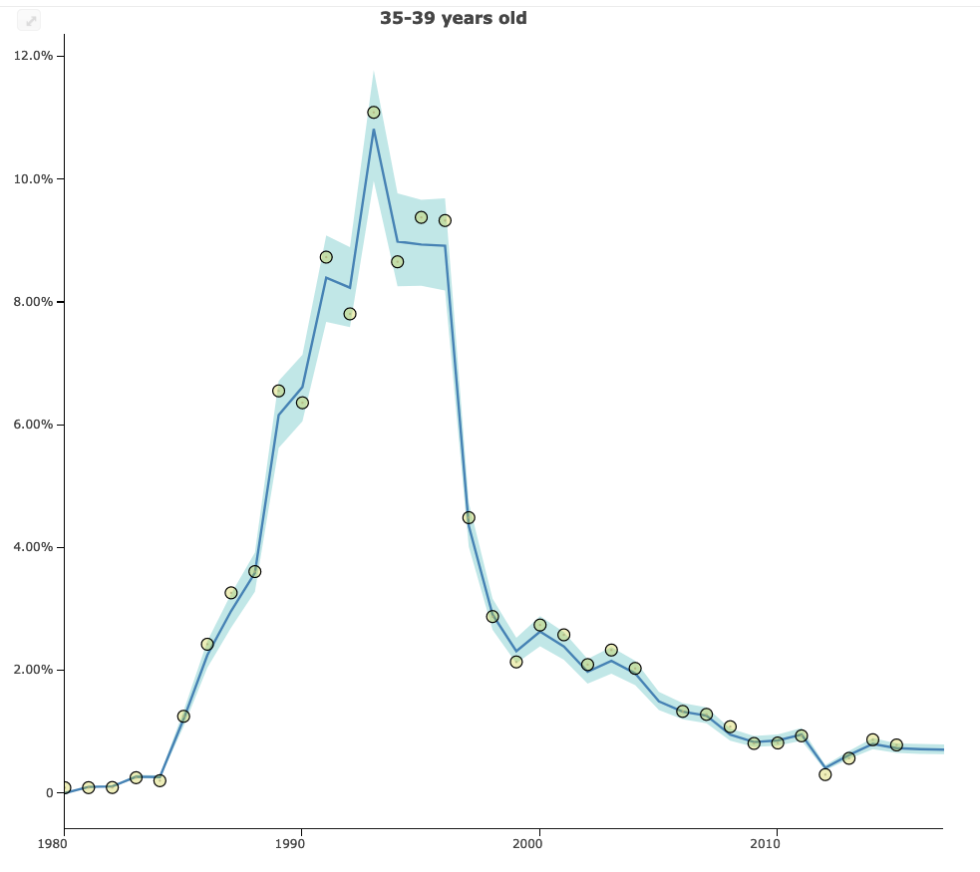
Raw
Final
https://vizhub.healthdata.org/cod/
Notes:
These plots show an example of the data correction process in men aged 25-39 in Australia. Data are shown in yellow dots, with the final corrected mortality trend in blue.
Differences can be substantial, especially in the early years of the epidemic when HIV/AIDS was not recorded as a cause of death. Note also that correction still occurs in recent years, with the data on the left lying under the final estimated trend in the mid 2010s.
Understandably this can be disconcerting for country teams when comparing their raw data to the data that goes into CSAVR and so a tool has been devised to assist their understanding

Slide 5
Objective
A tool that assists country teams to visualise cause of death reallocation by:
Sex
5 year age group
Single calendar year

Slide 6
Hmwe Kyu presentation, UNAIDS RefGp CSAVR Meeting, June 2020
Notes:
“Garbage codes” often refer to cause of death codes refer to immediate or intermediate causes of death rather than the true cause (in this case HIV/AIDS). These often include common bacterial infections, heart attacks and heart failure, and generic immunodeficiencies.
The redistribution is done by comparing the age pattern of mortality for a given cause of death from the pre-AIDS era – 1980-1984 – to the age pattern of mortality during the AIDS era. Any excess deaths above a 5% increase from the 1980-1984 baseline pattern are redistributed to HIV. This process is done by sex, and by five year age period.

Slide 7
Hmwe Kyu presentation, UNAIDS RefGp CSAVR Meeting, June 2020
Notes:
HIV misclassification adjustment is a similar reallocation process, but instead of addressing garbage codes, addresses other underlying causes of death –often tuberculosis and endocarditis.
The three above criteria must be met for a change in the age pattern of a cause of death to be considered for HIV misclassification adjustment

Slide 8
Deaths
1980-1984 age distribution of mortality
Age
Notes:
This is an example to illustrate how HIV/AIDS deaths are identified and reallocated.
Let us take a cause of death which has this age pattern of mortality, which has been calculated using vital registration data from the pre-AIDS era 1980-1984

Slide 9
AIDS-era age distribution of mortality
Deaths
Age
Notes:
We see that the age pattern of mortality for the same cause of death during the AIDS era, for example in the mid 1990s, has shifted much younger.

Slide 10
Deaths
Age
Notes:
Any deaths that are above a 5% relative increase from the 1980-1984 pattern are deemed to be misclassified HIV/AIDS deaths, and apportioned by age to HIV/AIDS

Slide 11
Deaths
Age
Notes:
These deaths are represented by the yellow shaded area

Slide 12
Notes:
Now moving onto the tool itself. There are two main graphical displays.
The first is a time trend. Users are invited to select a country, with the age group and sex fixed as ”15+” and “both” respectively. This shows the evolution of the trend in AIDS deaths over time, and its composition by the three categories shown here. In blue are deaths correctly coded as HIV/AIDS – in this example in Brazil, we see that that begun in the mid 1990s, and before that, no HIV/AIDS deaths were recorded. Instead we see a significant number of deaths that had been attributed to garbage codes, in yellow, and a smaller number coded as other underlying causes – HIV misclassification – in red.

Slide 13
Notes:
The second display is a Sankey diagramme, used to depict flows of data from one state to another. In this visualiusation, users are able to select a single calendar year, a wider range of age groups, and sex disaggregated data.
Turning to the graph itself – on the left hand side we have the raw data, and on the right hand side, the adjusted causes of death. The colour scheme is the same as in the previous graph – at the top we have the correctly coded HIV/AIDS deaths that are unchanged, in the middle, the many garbage codes reassigned to HIV/AIDS resulting in other diseases, and at the bottom, the HIV misclassification adjustment.
All three of the outcomes on the right, HIV/AIDS, HIV/AIDS resulting in other disease, and HIV/TB coinfection resulting in other disease, are counted as “AIDS Deaths” and used within CSAVR

Slide 14
Notes:
Finally, the data may be viewed in tabular view, and downloaded using the button underneath the tabs at the top left. The same filters are applied as in the Sankey diagramme.

Slide 15
Many thanks to Hmwe Kyu, Amanda Novotney and IHME CoD team
Questions and suggestions for additions?
(Best used in Google Chrome or Safari)
https://shiny.dide.imperial.ac.uk/csavr_mortality/

