Slide 1
Aligning Spectrum estimates and GAM reporting
Keith Sabin (UNAIDS)
UNAIDS workshop on HIV Estimates and Identifying Inequalities in the Middle-East and North Africa region
Cairo, 19-23 February 2023

Slide 2
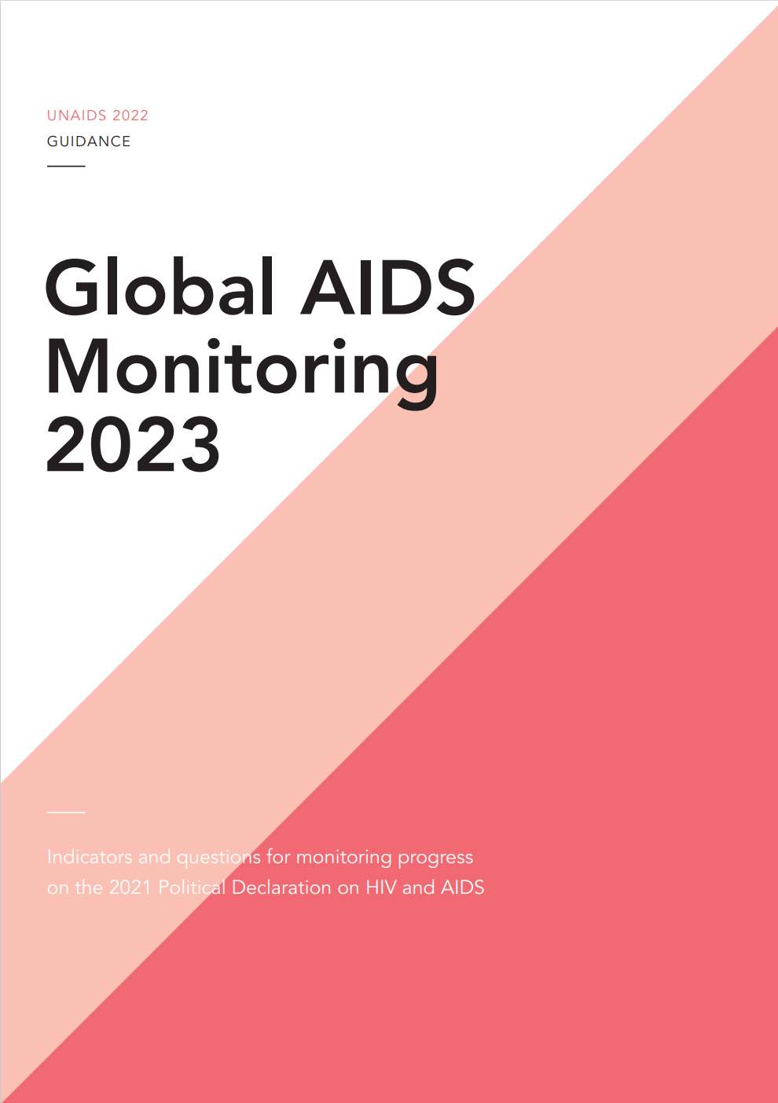
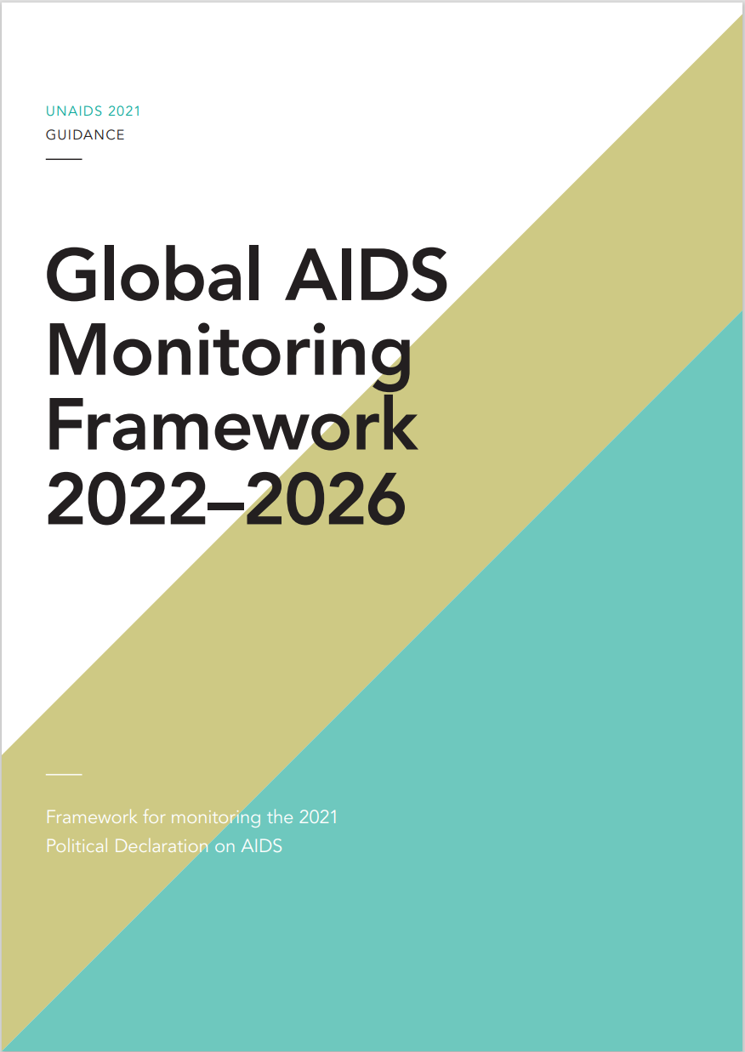
Progress towards Political Declaration targets is monitored through Global AIDS Monitoring (GAM)
Country reports are next due on 31 March 2023
Indicators and questions for monitoring progress on the 2021 Political Declaration on HIV and AIDS — Global AIDS Monitoring 2022 (unaids.org)
Global AIDS Monitoring Framework 2022–2026 — Framework for monitoring the 2021 Political Declaration on AIDS (unaids.org)
Notes:
Global AIDS monitoring (GAM) is the framework based on which countries annually report on progress towards Political Declaration targets. The GAM framework is revised every five years to adapt to global commitments. Countries have been submitting data to UNAIDS through this mechanism since 2003, including quantitative indicators and a policy questionnaire (NCPI). In 2021 the GAM framework was most recently revised. There are two key documents: framework and indicator guidance. The indicator guidance is published every year to reflect any tweaks or adjustments for the next reporting round. Countries have most recently submitted GAM reports on 31 March 2022, with final data published through the AIDSInfo platform and in the 2022 Global Report (In Danger). Country reports are next due on 31 March 2023.
The indicator document provides indicator definitions and the National Commitments and Policy Instrument (NCPI) questionnaire for reporting in 2023 (deadline 31 March 2023)
The GAM framework document provides guidance on the recommended reporting process. This remains the same for the period 2022-2026.

Slide 3
GAM indicators that can be sourced from Spectrum
1.1 HIV incidence – All ages, <15, 15–49, 15–24, 50+ by sex
2.1 People living with HIV who know their HIV status – All, <15, 15+ by sex, detailed age groups (<5, 5–9, 10–14, 15–19, 20–24, 25–49, 50+)
2.2 People living with HIV on antiretroviral therapy – All, <15, 15+ by sex, detailed age groups (<5, 5–9, 10–14, 15–19, 20–24, 25–49, 50+)
2.3 People living with HIV who have suppressed viral load – All, <15, 15+ by sex, detailed age groups (<5, 5–9, 10–14, 15–19, 20–24, 25–49, 50+)
2.7 AIDS mortality – All, <5, 5–14, 15+ by sex
3.2 Early infant diagnosis (denominator only – estimated number of births to women living with HIV)
3.3 Vertical transmission of HIV
3.4 Preventing vertical transmission of HIV – Regimens and coverage

Slide 4
Importance of using Spectrum estimates in GAM
There is an option to import Spectrum data into the GAM online tool:
Improves consistency of data between the two systems, ensuring one set of data are being used to inform country analyses and planning
Simplifies data entry in GAM
Reduces chance of data errors

Slide 5
Tips on using Spectrum estimates in GAM
National estimates team communicates with GAM focal point (if separate individuals):
Define which indicators should be imported from Spectrum
Ensure the final Spectrum file is used
The national estimates teams should export their Spectrum results into a .CSV file and share with the GAM focal point to import into the GAM online reporting tool
Engage with UNAIDS Country Office / Strategic Information Advisers, who accompany estimates and GAM

Slide 6
Steps for national estimates team to export data from Spectrum for GAM import (I)
Open the ‘Tools’ window
Select ‘Tools’ then ‘More tools’ to see the available tools for AIM
GAM tool is available only if no projections are open
GAM tool used to output results from one national (or several subnational) Spectrum files to GAM

Slide 7
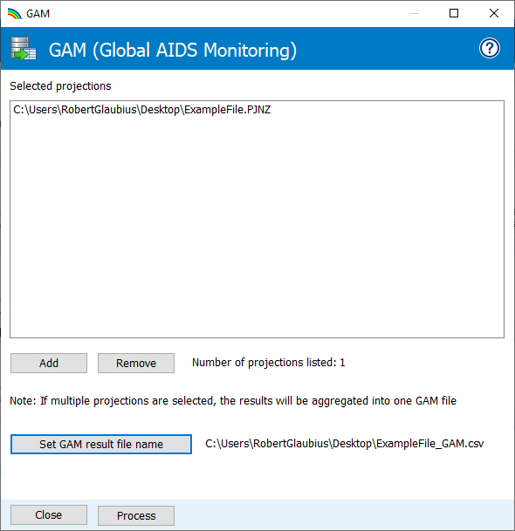
Steps for national estimates team to export data from Spectrum for GAM import (II)
Extracts outputs needed for GAM reporting:
Select Spectrum file(s)
Set output CSV file name
Process the CSV extract
1
2
3
Output CSV file can be imported into GAM

