Slide 1
Annual Program Data Preparation and Upload
Katharine Kripke, Avenir Health

Slide 2
Outline
Introduction
Data requirements
DMPPT 2 Online data flow
Country DMPPT 2 data input form
Preliminary checks
Data entry and age group disaggregation
Final checks
Uploading the DMPPT 2 data input form to the ADR

Slide 3
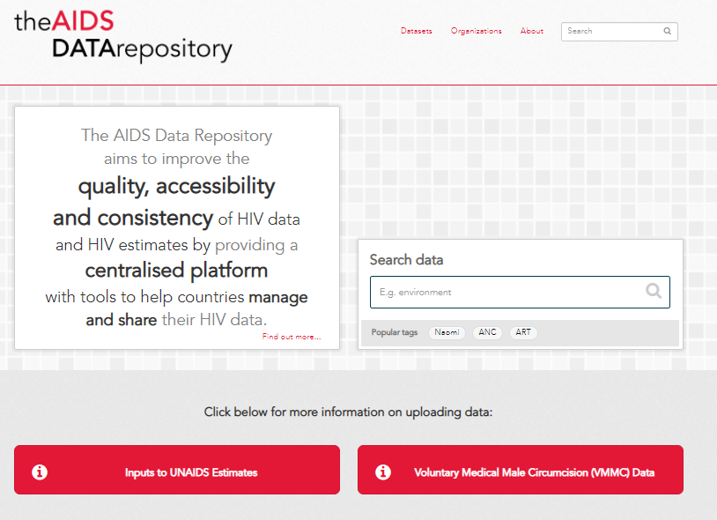
AIDS Data Repository
ADR is a tool used in the UNAIDS estimates process to store and share data
Country specific, you decide who can see and access data
Secure setting
It also allow teams to link files directly to the estimates software (Naomi)
For the VMMC process we hope to use it as a space to store your final DMPPT2 data input form and the results
For team members that need an ADR account:
Go to ADR.unaids.org
Create an account by clicking on the Register button in the top right-hand corner of the page
Once created, log in and request to join your national ADR space.
UNAIDS has notified your ADR administrators to remind them to approve your request

Slide 4
DMPPT 2 Online
The DMPPT 2 Online generates coverage estimates, scale-up targets and impact projection by five-year age bands at the Subnational Unit (SNU), provincial or regional levels as applicable

Slide 5
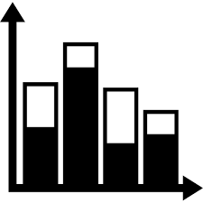
Data requirements
The national overall VMMC performance figures from the immediately preceding fiscal year of implementation, and the estimated achievements for the following year, disaggregated by 5-year age bands and Sub-national Units (SNUs) must be provided
VMMC service statistics must include all VMMCs performed in the country (MoH, PEPFAR, other donors)
The Decision Makers’ Program Planning Toolkit (DMPPT) 2 Online
What | Number of circumcisions performed by SNU, age group, and calendar quarter
When | Annually, as part of HIV Estimates process
How | DMPPT input form updated and uploaded to ADR

Slide 6
DMPPT 2 Online data flow
Country team
Prepare data according to format of DMPPT 2 data input form
Review and validate inputs
Avenir Health
Review data input form for completeness and proper format
Push data live in tool and notify country team
Upload to ADR and alert Avenir Health
Clarify any issues with country team

Slide 7
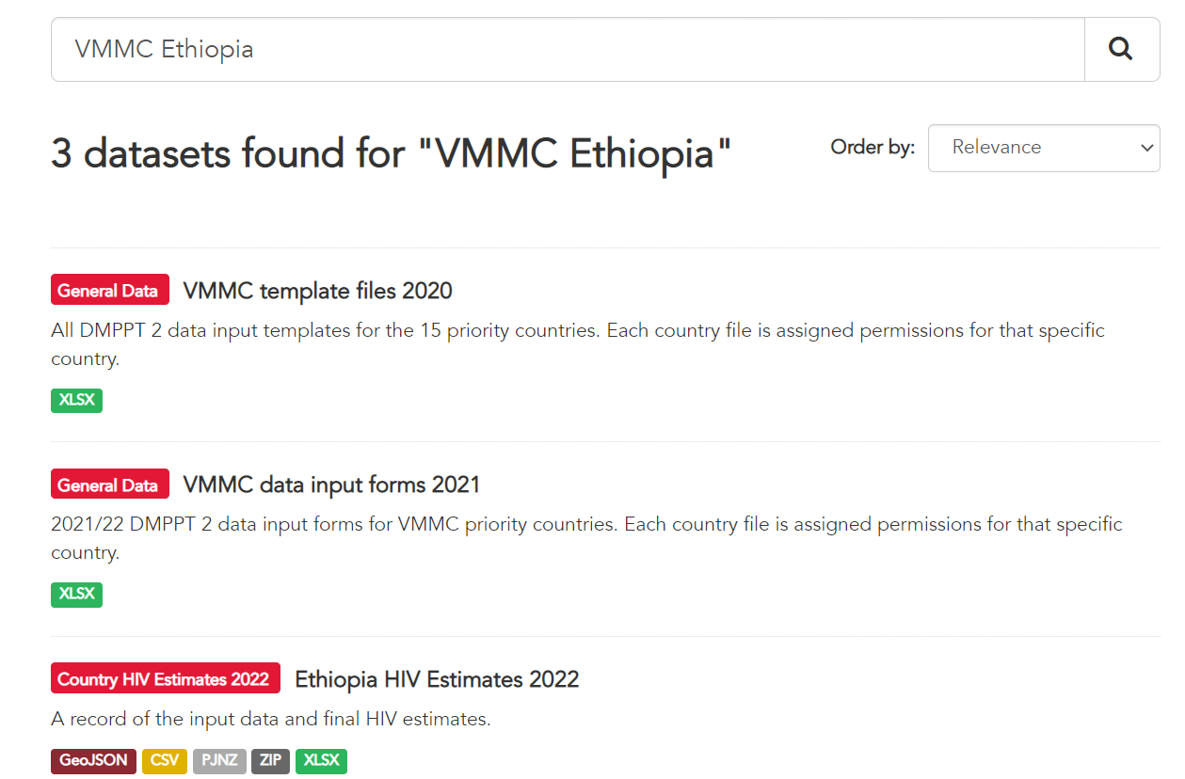
Locate the VMMC2 data input form
Type in VMMC and country name in the search bar or go directly your country HIV Estimates 2022 dataset

Slide 8
Download the VMMC data input for your country
Located in a dataset named Country HIV estimates 2022

Slide 9
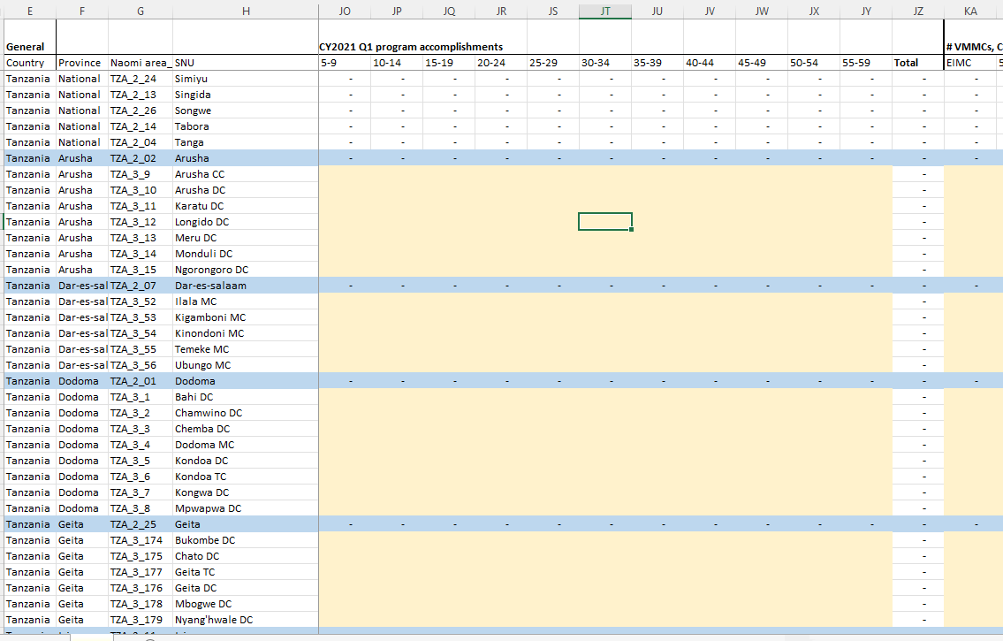
Sample DMPPT 2 data input form
The data template is locked, and users can only update their 2020 data, enter new 2021 data, and enter their projected 2022 accomplishments. If users need to revise other inputs, e.g., redistricting, they should contact VMMC-Avenir@googlegroups.com for assistance.

Slide 10
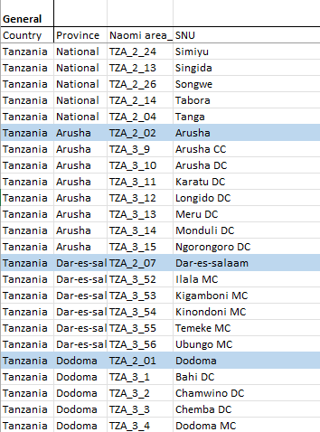
Check to make sure SNU (district) names/boundaries have not changed
If districts have been renamed or moved to different provinces/regions, or district boundaries are changed, contact VMMC-avenir@googlegroups.com for assistance
If district boundaries are changed, the historical program data since the beginning of the program needs to be reallocated to the newly defined districts, and population proportions need to be updated

Slide 11
Review 2020 data inputs and update as needed

Slide 12
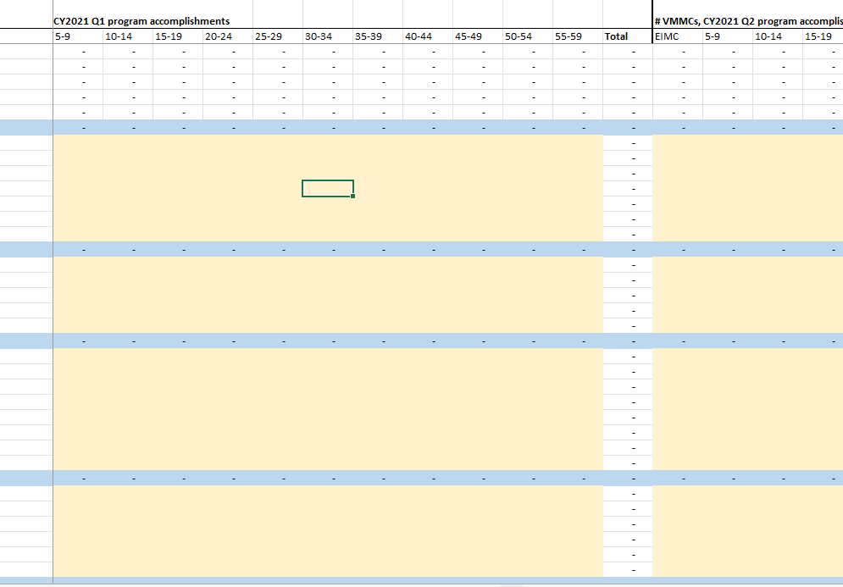
Enter data for 2021 by quarter, SNU, and five-year age group in the light yellow shaded cells
If data for October – December 2021 is not yet final, insert estimated accomplishments and revise when final

Slide 13
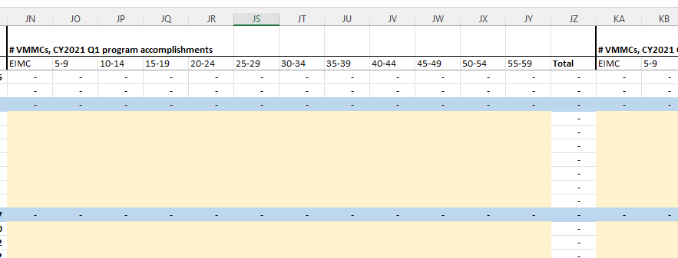
If needed, disaggregate data to five-year age groups
For any age groups that need to be disaggregated, can apply prior year’s age disaggregation
Example follows on next slide

Slide 14
Age disaggregation example
Data provided for age 30-49 (Current #Circ = 5,487)
First, Calculate previous year ratio for each 5-year age group from 30-49
Multiply Current #Circ by the respective ratio to obtain #Circ for each age band (30-34, 35-39, 40-44 and 45-49)
Age group | 30-49
Current # Circ | 5,487
Age group | 30-34 | 35-39 | 40-44 | 45-49 | Total
Prior year # Circ | 2,209 | 1,405 | 769 | 392 | 4,775
Ratio | 0.46 | 0.29 | 0.16 | 0.08
Age group | 30-34 | 35-39 | 40-44 | 45-49 | Total
Current # Circ | 2,538 | 1,614 | 884 | 450 | 5,487

Slide 15
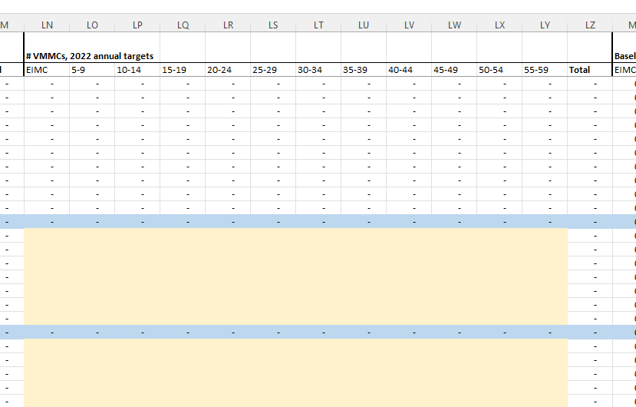
Enter expected annual program accomplishments for 2022 by SNU and five-year age group in the light yellow shaded cells in the section entitled, “#VMMCs, 2022 annual targets”

Slide 16
Final checks
Are VMMCs from all sources included? E.g., government, PEPFAR, other donors
Are PEPFAR numbers greater than the numbers entered in the template? If so, there are data discrepancies
Consult Avenir Health regarding any issues, e.g. data from military, refugee populations
Do the numbers of district VMMCs for each age group across all districts add up to the National number?
Do the numbers of VMMCs across all age groups in a SNU add up to the SNU number?
Do the numbers add up appropriately for provinces/regions, if applicable?

Slide 17
Summary of data requirements
The country team will need to:
Resolve any issues with the list of SNUs
Update quarterly VMMC program accomplishments, disaggregated by age and SNU, for 2020
Enter and validate quarterly VMMC program accomplishments, disaggregated by age and SNU, for 2021
Estimate program accomplishments for the final quarter of calendar year 2021 if not yet finalized
Enter the expected annual VMMC program accomplishments for 2022, disaggregated by age and SNU.

Slide 18
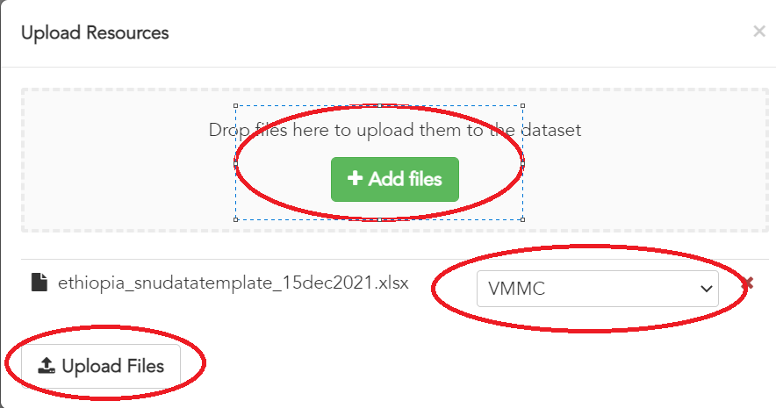
Upload the completed VMMC data to ADR and notify Avenir Health
Please copy and replace (drag and drop) the file in the dataset HIV estimates 2022. Please allow access to Avenir Health when you are creating this resource so they can upload it to DMPPT 2. Contact VMMC-Avenir@googlegroups.com to notify them when the data are in ADR.

Slide 19
Summary: steps for VMMC data review process and linkage with ADR
Avenir has uploaded your DMPPT2 data input form to ADR
The file is entitled “[VMMC] and tagged with “VMMC”
If needed, additional country team members can register for ADR by requesting a log in from ADR.unaids.org
Country admin person approves request
At the home page of ADR is a link to more information on the VMMC upload process
Country teams should:
Download the data template (available in your country HIV Estimates 2022 data set or search for the file using the country name and VMMC tag)
Enter new VMMC data (for most recent year or full time series, if no prior DMMPT2 files)
Validate data (See link for validation tool on ADR VMMC page)
Upload the completed file to ADR
Allow access to Avenir and alert Avenir that file is available
Once Avenir has run the model, the team can pull the DMPPT2 data into Spectrum to populate DataPack
Country team saves DMPPT2 file and the file used to populate datapack in ADR

Slide 20
THANK YOU
For assistance, contact
vmmc-avenir@googlegroups.com

