Slide 1
Impact of stigma and discrimination, unequal gender norms and policies on the HIV epidemic and response
January 2023

Slide 2
Objectives
Increase awareness on what data tell us about the impact of stigma and discrimination, unequal gender norms and punitive laws and policies on the HIV epidemic and response
Increase awareness and information to explore data on policies that may be impacting the HIV epidemic and response
Share information on the monitoring framework to measure progress towards the 10‒10‒10 societal enabler targets in the 2021 Political Declaration.
Notes:
There are three main objectives of this session (on slide).
The group work session later in the agenda will also be an opportunity for country teams to explore some of these data and use them to interpret and better understand data on the HIV epidemic and response.

Slide 3
Definitions – stigma and discrimination
“HIV-related stigma and discrimination” are stigma and discrimination that impact on the HIV response, including on the basis of sex, gender identity, sexual orientation, drug use, sex work and HIV status.
HIV-related stigma includes a range of stigmatizing experiences, such as avoidance behaviours, gossip, verbal abuse and social rejection.
HIV-related discrimination can include the above stigmatizing behaviours where they affect the enjoyment of rights, as well as physical abuse, denial of health or social services, denial or loss of employment or education opportunities or even arrest.
People may experience intersectional discrimination or stigma on several grounds, including race, disability and socioeconomic status.
HIV and stigma and discrimination — Human rights fact sheet series 2021 (unaids.org)
Notes:
To provide some background for the next few slides, will start reviewing two slides with some key definitions. On the slide is the definition for HIV-related stigma and discrimination.
Discrimination can be enshrined in criminal laws, travel restrictions, mandatory testing and employment restrictions.

Slide 4
Definitions – unequal gender norms
Gender norms are “often unspoken rules that govern the attributes and behaviours that are valued and considered acceptable for men, women, and gender minorities.”
Gender norms “sustain a hierarchy of power and privilege that typically favours that which is considered male or masculine over that which is female or feminine, reinforcing a systemic inequality that undermines the rights of women and girls and restricts opportunity for women, men, and gender minorities to express their authentic selves.”
Gender inequality and restrictive gender norms: framing the challenges to health (thelancet.com)

Slide 5
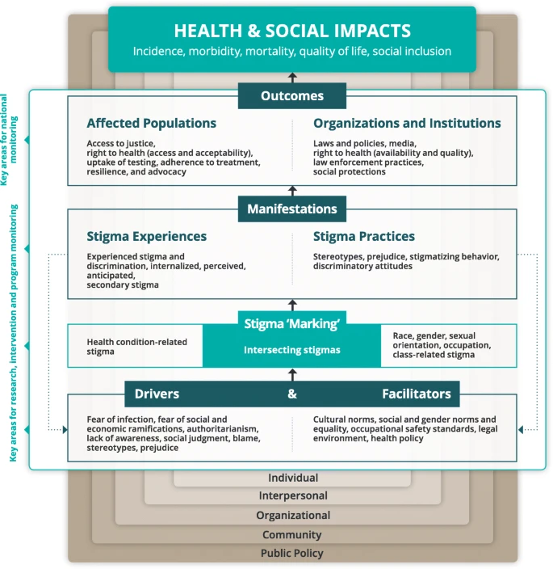
Examples of data on stigma and discrimination
Experiences of stigma and discrimination among people living with HIV, key populations
Avoidance of care due to stigma and discrimination
Healthcare worker attitudes towards people living with HIV, key populations
Discriminatory attitudes towards people living with HIV among the general population
The Health Stigma and Discrimination Framework
Notes:
The slides include some examples of data on stigma and discrimination that can be considered in analyses.
The Health Stigma and Discrimination Framework reflects the stigmatization process and may provide a reference for other data on stigma and discrimination that may be relevant to consider in country analyses. It includes a series of domains, including drivers and facilitators, stigma ‘marking’, and stigma manifestations, which influence a range of outcomes among affected populations.
The Health Stigma and Discrimination Framework: a global, crosscutting framework to inform research, intervention development, and policy on health-related stigmas | BMC Medicine | Full Text (biomedcentral.com) (https://bmcmedicine.biomedcentral.com/articles/10.1186/s12916-019-1271-3)

Slide 6
Examples of data on unequal gender norms
Experience of physical and/or sexual violence by non-partners
Experience of intimate partner violence
Accepting attitudes towards violence against women
Women’s role in decision-making
Notes:
These are some examples of indicators/data on proxies of unequal gender norms.

Slide 7
Stigma and discrimination, unequal gender norms and punitive laws and policies limit access to:
HIV PREVENTION SERVICES
BROADER HEALTHCARE
HIV TESTING AND KNOWLEDGE OF STATUS
HIV TREATMENT AND CARE
Notes:
The next few slides present some of the evidence available on the impact of 1) stigma and discrimination, 2) punitive laws and policies, and 3) unequal gender norms on HIV prevention and the treatment cascade (there are 2 slides for each topic, the first showing evidence of impact on prevention and the second showing evidence of impact on the treatment cascade).

Slide 8
Where to find data on stigma and discrimination and unequal gender norms
The People Living with HIV Stigma Index
Facility surveys among healthcare workers
Population-based surveys​
https://dhsprogram.com/ and https://www.statcompiler.com/en/ ​
https://mics.unicef.org/ and https://data.unicef.org/ ​
https://phia.icap.columbia.edu/surveys/ ​
Resources for indicator definitions:
https://indicatorregistry.unaids.org/
Compendium of Gender Equality and HIV indicators (https://www.measureevaluation.org/resources/publications/ms-13-82/at_download/document)
Guide to DHS Statistics (https://dhsprogram.com/Data/Guide-to-DHS-Statistics/index.cfm)
Notes:
Data on stigma and discrimination and unequal gender norms can be found from special studies, including the People Living with HIV Stigma Index or facility surveys among healthcare workers, as well as population-based surveys. There may be other studies or data collection efforts in countries.
The resources on the slide can provide information on definitions of relevant indicators.

Slide 9
Examples of data to consider in analyses of the HIV epidemic and response
Notes:
In the next few slides there are some examples of results from the estimates exercise this week and related indicators and policy issues that can be considered for joint analysis.

Slide 10
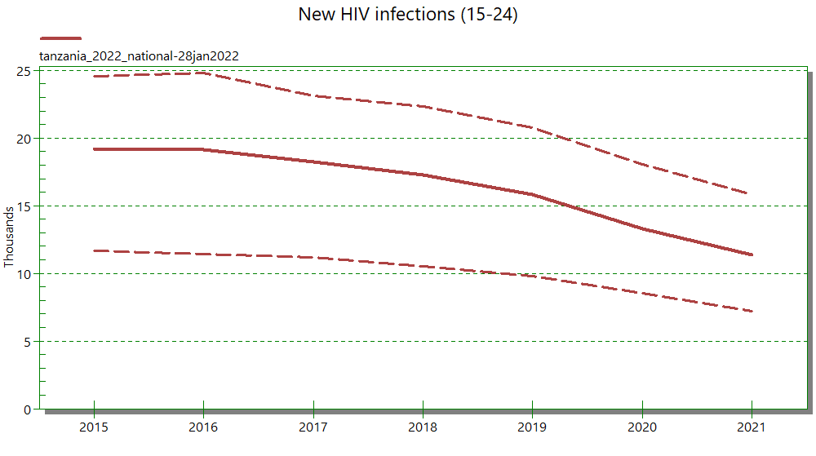
Indicators to consider:
Knowledge of HIV prevention
Condom use
Intimate partner violence prevalence
School attendance
Prevalence of violence (other than intimate partner violence)
Policies to consider:
Comprehensive sexuality education
Condoms
PrEP
Parental/guardian consent for testing
Criminalization
Notes:
Graph of new infections among AGYW 15-24 years
The suggested indicators on the slide refer to outcomes that may be impacted by stigma and discrimination, unequal gender norms and laws and policies.

Slide 11
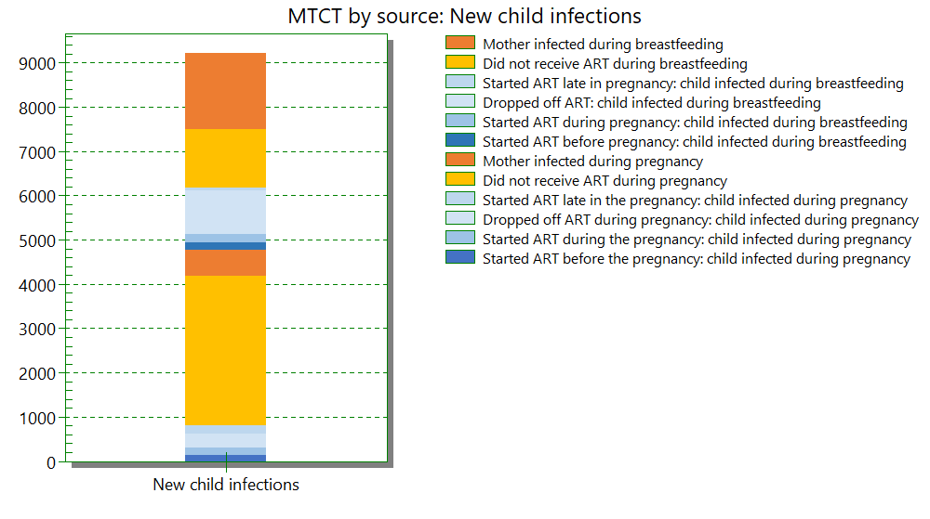
Indicators to consider:
IPV prevalence
Experiences of stigma and discrimination
Avoidance of healthcare
Attitudes towards violence against women
Policies to consider:
MTCT policies (testing, regimens, EID)
Parental/guardian consent for testing
Notes:
Stacked bar of new child infections due to vertical transmission

Slide 12
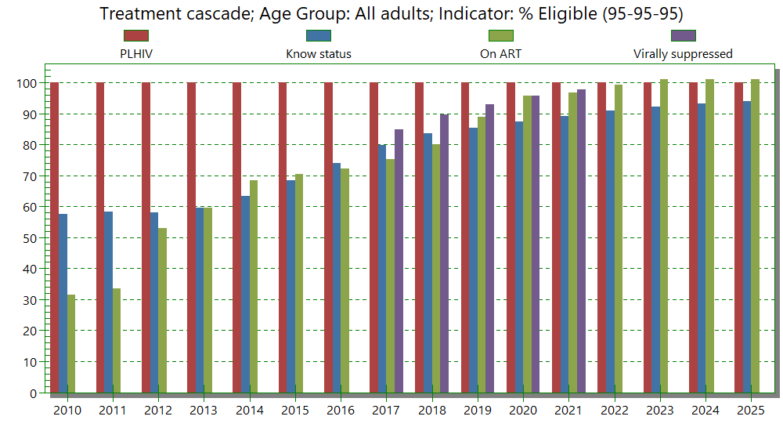
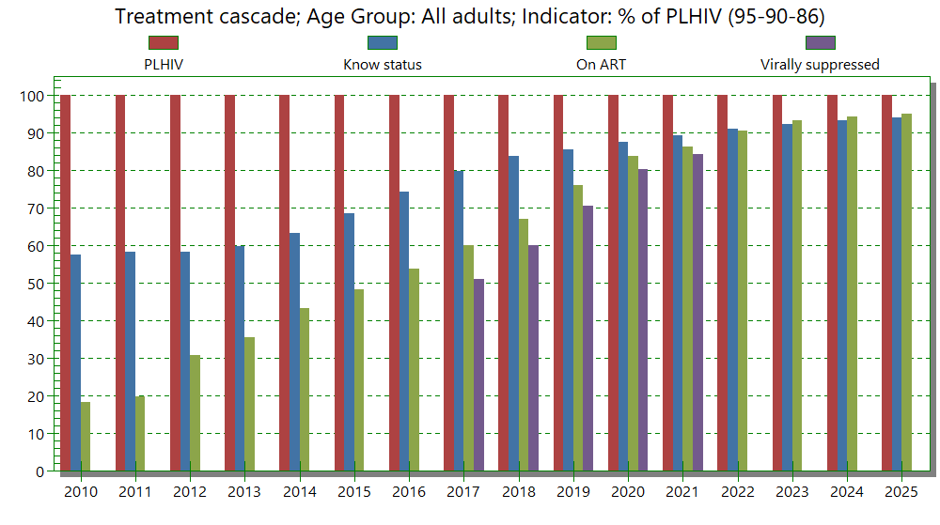
Progress towards 95s
Indicators to consider:
Experiences of stigma and discrimination Avoidance of healthcare
Policies to consider:
ART start
ART regimens
Multi-month dispensing
Criminalization
HIV testing and treatment cascade
Notes:
Graphs of progress towards the 95-95-95 targets and of the HIV testing and treatment cascade

Slide 13
3. Monitoring progress towards the 10‒10‒10 targets
Notes:
The next few slides provide an overview of the global framework that is being developed for monitoring progress towards the 10-10-10 targets in the 2021 Political Declaration related to societal enablers of the HIV response. This framework reflects many of the data elements presented in the previous slides.

Slide 14
The 2021 Political Declaration on HIV and AIDS
3 overarching commitments on societal enablers:
Less than 10% of countries have punitive legal and policy environments that deny or limit access to services
Less than 10% of people living with HIV and key populations experience stigma and discrimination
Less than 10% of women, girls, people living with HIV and key populations experience gender inequality and violence
Notes:
The 2021 Political Declaration set targets and commitments in the AIDS response for countries to achieve by 2026. It includes 3 overarching targets on societal enablers of the HIV response.

Slide 15
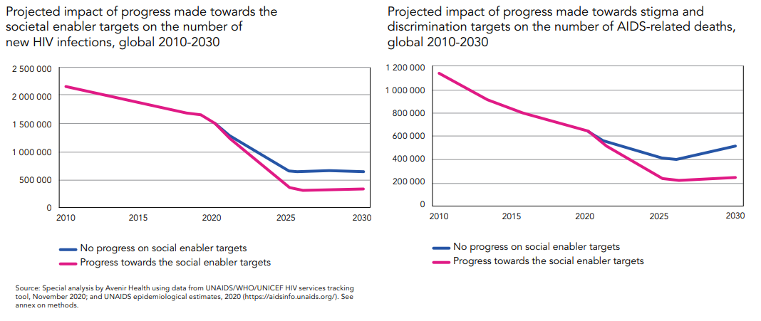
Achieving the societal enabler targets would prevent an estimated additional 2.5 million new HIV infections and 1.7 million AIDS-related deaths between 2020‒2030
Notes:
Modelling indicates that failure to reach the targets on stigma and discrimination, criminalization and gender equality will prevent the world from achieving the other ambitious targets in the Strategy and will lead to an additional 2.5 million new HIV infections and 1.7 million AIDS-related deaths between 2020 and 2030.

Slide 16
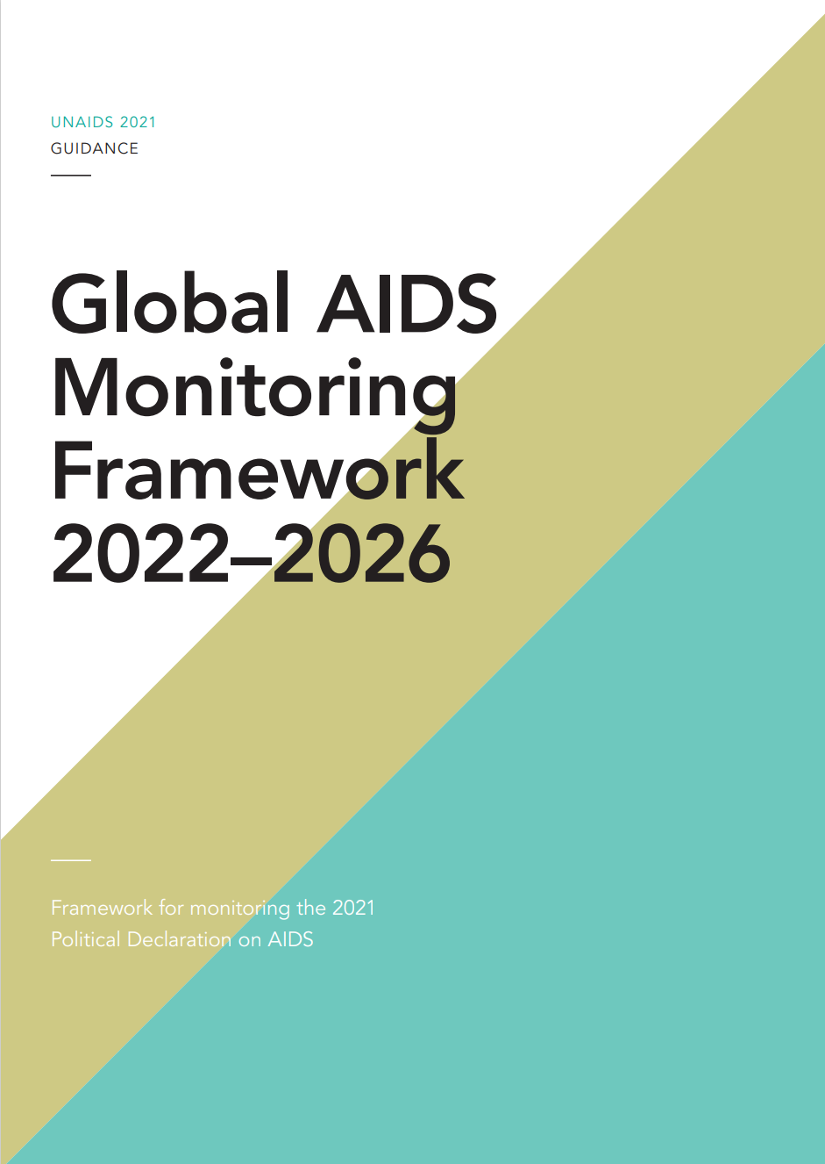
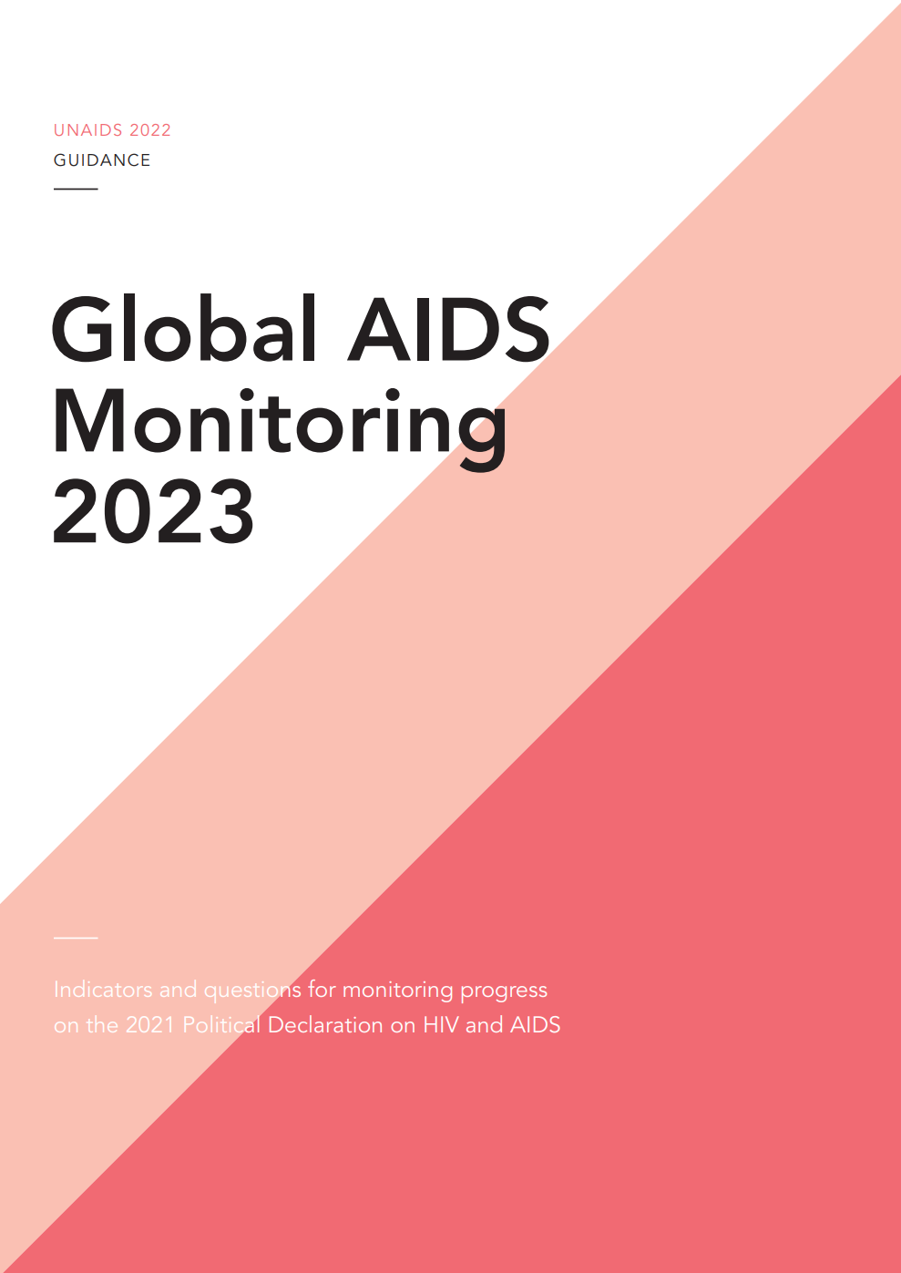
Framework for global monitoring of the 10‒10‒10 targets is integrated in GAM
Notes:
Global AIDS Monitoring Framework 2022–2026 — Framework for monitoring the 2021 Political Declaration on AIDS (unaids.org)
Indicators and questions for monitoring progress on the 2021 Political Declaration on HIV and AIDS — Global AIDS Monitoring 2022 (unaids.org)
Measuring progress towards the societal enabler targets has been integrated within the GAM framework.
Countries are encouraged to report on progress towards the targets in the Political Declaration annually. UNAIDS is also responsible for reporting on progress towards these targets to the UN Secretary General annually. Global AIDS monitoring (GAM) is the framework based on which progress is reported. It is revised every five years to adapt to global commitments. It is also the mechanism through which countries submit data to UNAIDS since 2003, including quantitative indicators and a policy questionnaire (NCPI). In 2021 the GAM framework was revised. Two documents: framework and indicator guidance. The indicator guidance is published every year to reflect any tweaks or adjustments for the next reporting round. Countries have most recently submitted GAM reports on 31 March 2022, with final data published through the AIDSInfo platform and in the 2022 Global Report (In Danger). The deadline for countries to submit the next report is 31 March 2023.

Slide 17
10s monitoring in GAM framework - process for developing and adopting indicators
Based on targets, identified existing indicators or data collection that could be used to construct indicators
3 groups of indicators:
Indicator definitions fully available and included in 2022 GAM
Indicators in development:
Existing data collection tool, indicator definitions being finalized
Data collection tools in development
For targets with no existing indicators / data collection:
Data collection tools being developed
Advisory groups of experts in topic areas convened to guide work
Piloting finalized in South Africa with Stellenbosch University, data analysis ongoing
Indicators presented to MTAG for adoption in GAM framework
Indicators in development will be proposed for inclusion in the 2024 GAM
Notes:
Indicator identification/development process led by UNAIDS in collaboration and with inputs from partners.
As possible, used existing data collection tools / indicators – expect data would be available sooner than if proposed new tools that would need to be implemented; reduce data collection costs and reporting burden as much as possible
Indicators in three groups: (1) definitions fully available and included in 2022 GAM guidelines, (2) in development - indicators/data collection tools exist and definitions being finalized, (3) in development - data collection tools being developed – piloted in South Africa (Western Cape province) with Stellenbosch University
MTAG: UNAIDS Monitoring Technical Advisory Group provides guidance and advice to UNAIDS on AIDS monitoring and in particular the Global AIDS Monitoring indicators and reporting process. The MTAG is composed of measurement experts from academia, entities implementing data collection tools such as DHS, bilateral partners, co-sponsors.
Indicators included in the GAM framework must meet 6 indicator standards: indicator is needed and useful, indicator has technical merit, indicator is fully defined, feasible to collect and analyse data for this indicator, indicator has been field-tested or used in practice, indicator set is coherent and balanced overall

Slide 18
Opportunities for strengthening data availability on societal enablers
Advocate for inclusion of questions to construct societal enabler indicators in data collection instruments:
People Living with HIV Stigma Index 2.0
IBBS / BBS lite
Population-based surveys (DHS, MICS, PHIA)
Notes:
Challenges in data availability:
Items/questions to construct indicators integrated in data collection tools
Surveys may not be implemented as regularly as recommended
New methodologies/data collection tools – time for adoption/implementation
Regular data collection for new indicators/data collection tools would require items/questions being integrated in existing data collection mechanisms/tools (i.e. HMIS, surveys)

Slide 19
Complementary data sources for monitoring implementation of programmes to achieve the societal enablers and measure progress
Routine programme data
Documentation of human rights violations or client experiences
Public health surveillance data
Participatory surveys
Research studies
Others
Notes:
A variety of data sources may be available in countries that can provide complementary information on progress towards the societal enabler targets and on the interim steps towards those, including the implementation of related programmes. These can be analysed jointly with the data mentioned in the previous slides.

Slide 20
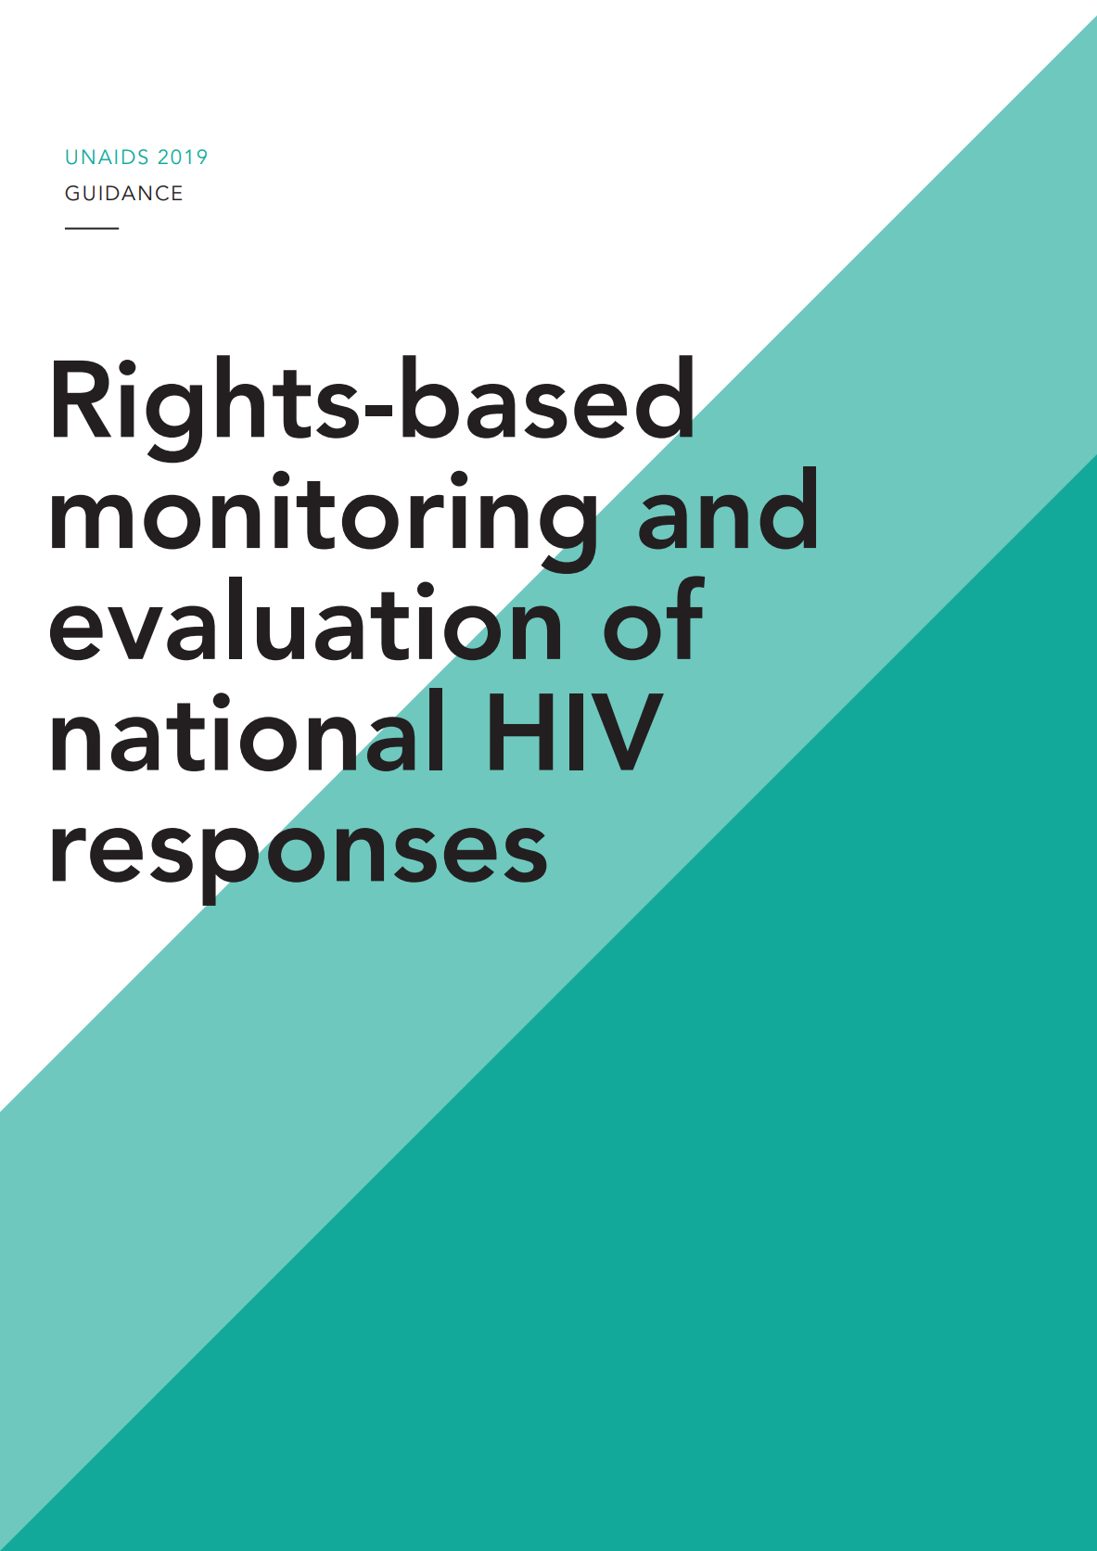
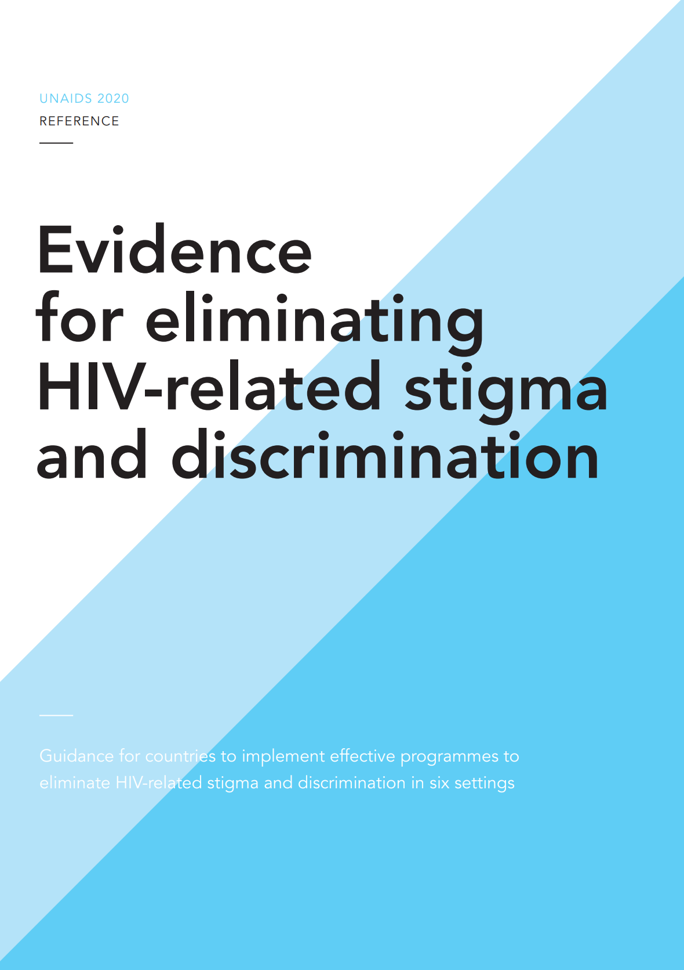
Additional information
Forthcoming accompanying M&E guidance
Rights-basedmonitoring and evaluation of national HIV responses (unaids.org)
Evidence for eliminating HIV-related stigma and discrimination — Guidance for countries to implement effective programmes to eliminate HIV-related stigma and discrimination in six settings (unaids.org)
Notes:
The Global Partnership for Action to Eliminate All Forms of HIV-related Stigma and Discrimination is co-convened by UNDP, UNWomen, the Global Network of People Living with HIV (GNP+), and the UNAIDS Secretariat. It aims to support countries to address stigma and discrimination related to HIV across 6 settings: health-care, education, workplace, legal and justice, family and community, and emergency and humanitarian setting.

Slide 21
Q&A / Discussion

