Slide 1
Selecting EPP vs. CSAVR given data strengths and weaknesses;
Data requirements for robust incidence and mortality trends
Eline Korenromp
Strategic Information to Close Inequalities, UNAIDS Geneva
Training on HIV estimates and Data use,
MENA region, 11-14 February 2025

Slide 2
Incidence model selection: CSAVR or EPP?
Spectrum user guide,
Figure 1
Notes:
As mentioned, data quality is critical for good estimates. To facilitate Data Quality reviews, we recommend you collate and review the input data first in an Excel, and ensure they are good quality, and consistent across related (e.g. cascaded) indicators.
First, please update the XLS, review and ensure the quality and consistency of the data.
Then, copy into the Spectrum file and update the estimation.

Slide 3
Data requirements for robust incidence (and mortality) trends from EPP or CSAVR
EPP-Concentrated:
All major key populations covered
The most important Key Population(s) estimated based on:
A national population size estimate
An estimate of the % male in each population
An estimate of duration spent in population
(e.g., years in sex work)
At least 3-4 prevalence data points over time,
the most recent from 2020+
and/or the remaining (lower-risk) population estimated on
≥ 4 ANC (sentinel surveillance or routine program) prevalence data points
CSAVR:
8 years of HIV/AIDS deaths data and 8 years of Case diagnoses (within 1990-2024)
  Vital Registration of Causes of Deaths classified by IHME as medium or good-quality (groups 2A and 2B)
Spectrum file covering the full ‘de facto’ population: all residents including non-nationals.
Notes:
4
See Guide to update a Spectrum HIV estimation (Word document, on https://hivtools.unaids.org/hiv-estimates-training-material-en/):
Decision tree Figure 1

Slide 4


AIDS deaths: Which data are good to fit CSAVR?
UNAIDS recommends CSAVR for countries with medium or good quality and completeness of
Cause of Death data.
Guided by IHME quality score* :
2A. High quality Vital Registration data
2B. Some usable Vital Registration data (mixture of quality)
2C. No useable-quality HIV-specific mortality data used by IHME → do not fit CSAVR.
1A/B: IHME used prevalence data to estimate incidence & mortality; regardless of (mixed-quality) VR data.
Based on:
Completeness of death registration – minimum threshold
Contribution of garbage and ill-defined causes of deaths – maximum threshold
For years with AIDS death reports incomplete:
Use IHME data, adjusted (up) for AIDS deaths misclassified under other causes
& supplement with original (unadjusted) Vital Registration data for recent years (i.e., post-2021).
* IHME country groups: Section 2.3 of the supplementary material (page 5) and depicted in Figure S1 on page 6 of: https://www.thelancet.com/cms/10.1016/S2352-3018(21)00152-1/attachment/7371c03e-887f-4e26-a718-bae190b81c2f/mmc1.pdf
Notes:
https://www.thelancet.com/journals/lancet/article/PIIS0140-6736(17)32152-9/fulltext
The IHME created a star rating system for the overall quality of cause of death data for each location each year.
This system represents VR completeness, percentage of deaths coded to causes that cannot be true underlying causes of death (garbage codes), detail of the cause list and age groups, and time periods covered.
6
Using CSAVR requires good quality, complete entries of AIDS-related deaths among adults 15 years and above.
An indication of the quality and completeness of cause-of-death reporting is provided by the Institute for Health Metrics (IHME), alongside their Global Burden of Disease (GBD) analysis in 2019: 2A denotes high-quality cause of death data, 2B reasonable quality.
a 2C classification in the IHME's 2019 GBD indicate poor completeness and/or quality of Vital Registration. Countries in this group should not input death data (neither country-reported nor IHME-adjusted) into CSAVR and probably instead use the EPP model.

Slide 5
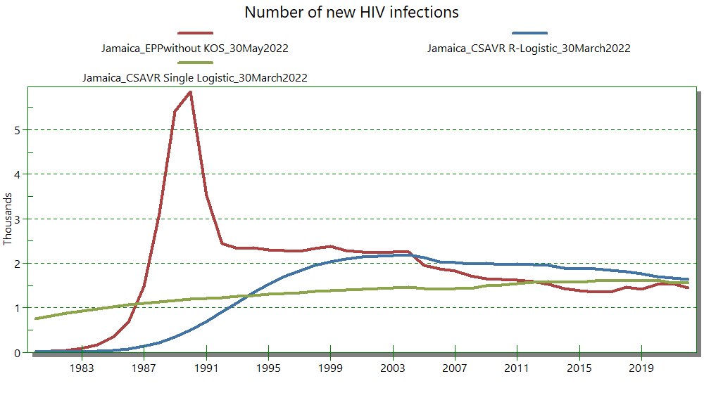
Triangulating alternative incidence models:
rationale
Some concentrated epidemic countries have enough years of both surveillance, survey and routine testing data to run both a prevalence-driven (e.g., EPP) and a routine reports-driven model (e.g., CSAVR).
If capacity allows, run two suitable models alongside, compare the results,
and evaluate and try explain differences and uncertainties:
  Overall historic epidemic – peak year, peak prevalence level
  Historic trend in ART and PMTCT coverage
  F-to-M ratio in incidence and prevalence, and
  consistency with F/M/child ART, Knowing-Status
  and New diagnoses data
Notes:
4
See Guide to update a Spectrum HIV estimation (Word document, on https://hivtools.unaids.org/hiv-estimates-training-material-en/):
Decision tree Figure 1

Slide 6
Incidence model use & countries switching,
2023 to 2024 round
O-2024 round → N-2023 round ↓ | EPP-Gen | EPP-Conc | CSAVR | AEM | ECDC | Direct Incid. | Total 2023
EPP-Generalized | 38 | DJI |  |  |  |  | 39
EPP-Concentrated |  | 35 | TTO |  |  |  | 36
CSAVR |  | KAZ, TJK | 64 |  |  |  | 66
AEM |  |  |  | 13 |  |  | 13
ECDC |  |  | CYP, GRC, SVN |  | 2 |  | 5
Direct Incidence & Thembisa |  |  | RUS, FRA, LTU |  |  | 9 | 12
Countries total, 2024 | 38 | 38 | 71 | 13 | 2 | 10 | 172
Notes:
4
See Guide to update a Spectrum HIV estimation (Word document, on https://hivtools.unaids.org/hiv-estimates-training-material-en/):
Decision tree Figure 1

Slide 7
Incidence model switches, 2024 round
 | 2023 model | 2024 model | Rationale | Epidemic effect
Djibouti | EPP-Generaliz | EPP-Conc. | Added FSW as group | Slightly earlier and higher epidemic peak
Trinidad (shadow) | EPP-Conc. | CSAVR | EPP missed KP data; CSAVR estimates Knowledge-of-Status & is more robust against incidence impact of 2020 ART dip | Later epidemic, now without apparent saturation yet.
Kazakhstan, Tajikistan | CSAVR | EPP-Conc. | Rich prevalence data from historic surveillance; suspected underestimation of early epidemic by CSAVR due to under-reporting | Earlier epidemic now saturating → more plausible gradual ongoing rise in ART and PMTCT coverage
Russia (shadow), France, Lithuania | Direct Incidence | CSAVR | Now able to complete inputs and trust CSAVR outputs
Notes:
N.B. Switches from ECDC to CSAVR and v.v., in high-income countries, shown in July 2024 Addis Ababa Reference Group slide deck.

Slide 8
Triangulating alternative incidence models, 2024 round
Spectrum model selected | Model triangulated
 | EPP-Concentrated | CSAVR | ECDC | Goals | Optima
EPP-Gen. | PNG |  |  | PNG, HTI
EPP-Con-centrated |  | CHN, KAZ, TJK, TUN, PER, JAM |  | CHN, IND, KAZ, TJK, UKR, MDG, SDN, PER, COL, DOM, GUY, JAM, SUR | AZE, BLR, KAZ, MDA, TJK
CSAVR | ARM, GEO, KGZ, UZB, YEM, URY, PRY, SLV, TTO |  | BEL, GRC, POL, PRT, NLD, DNK | GEO, KGZ, RUS, UZB, EGY, LBN, YEM, SRB, PRY, SLV, CRI, MEX, CUB, BLZ | ARM, GEO, KGZ, RUS, UZB
AEM | PAK | KHM
Direct Incidence |  | LVA, GBR |  | PRK, BRA
Why triangulating with transmission models Goals & Optima:
Help validate or select the most suitable Spectrum model and calibration (EPP vs CSAVR, notably)
Help refine Goals model
  for UNAIDS regional and global KP infection estimates (update from J AIDS 2024)
  prepare country-led Goals model (2025 Estimates) & Symphony model replacing EPP 2026+ & CSAVR 2027+
Note: Avenir Health calibrates Goals to match latest-round Spectrum-AIM trend (from EPP, CSAVR or AEM…) so is not fully independent. Optima does similar.
Notes:
4
See Guide to update a Spectrum HIV estimation (Word document, on https://hivtools.unaids.org/hiv-estimates-training-material-en/):
Decision tree Figure 1

Slide 9
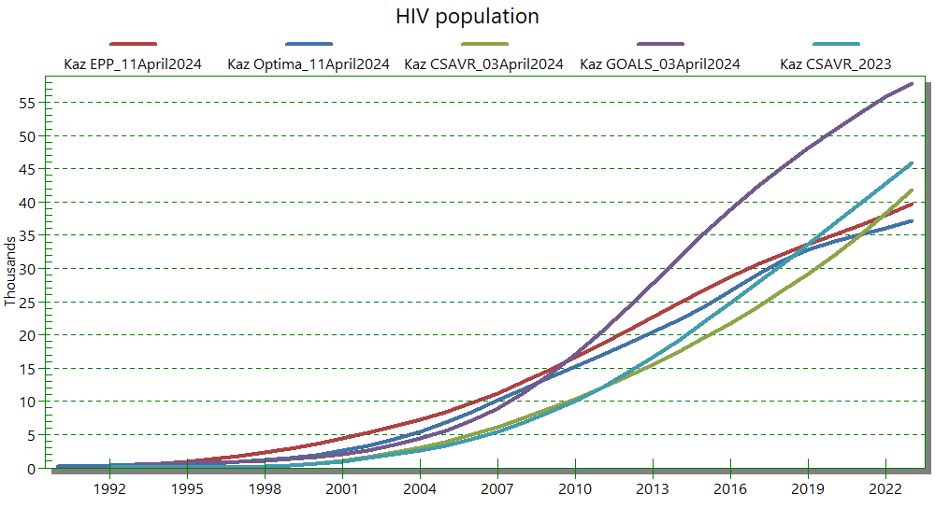
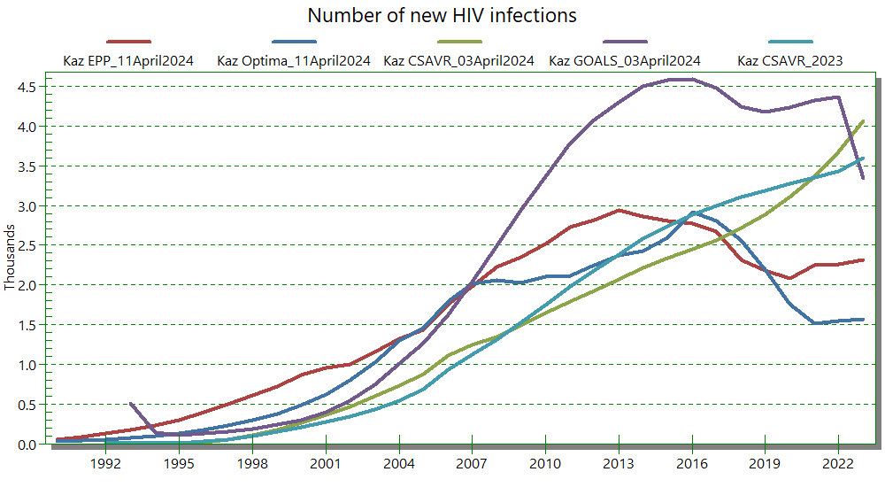
Kazakhstan: from CSAVR (2022-23) back to EPP (i)
EPP fitting rich historic prevalence surveillance data -- aligns with Optima in epidemic trend, peak prevalence and current prevalence – and in time trend with Goals.
CSAVR stipulates a later epidemic – due under-reported (early) case diagnoses & AIDS deaths.
With any model, incidence and mortality are less certain than prevalence – the latter ‘constrained’ by prevalence data (EPP, AEM, Goals, Optima) and program (ART, PMTCT) data (all models).

Slide 10
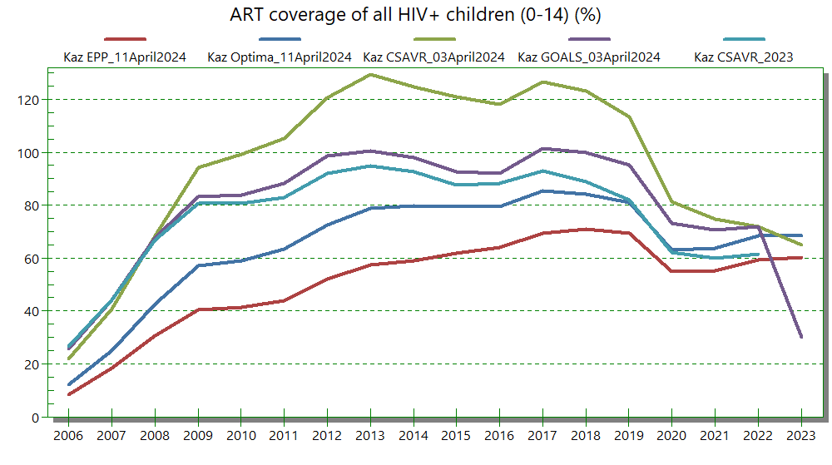
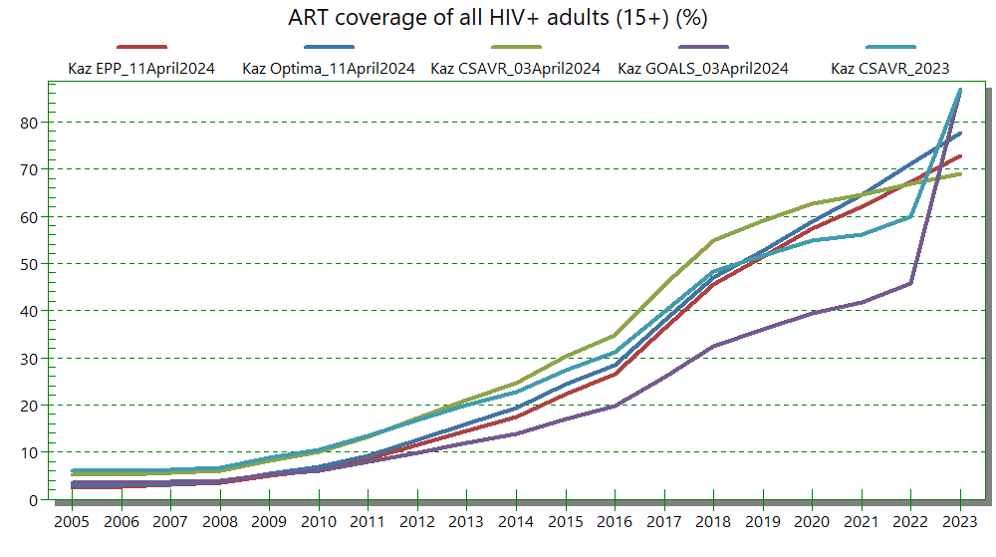
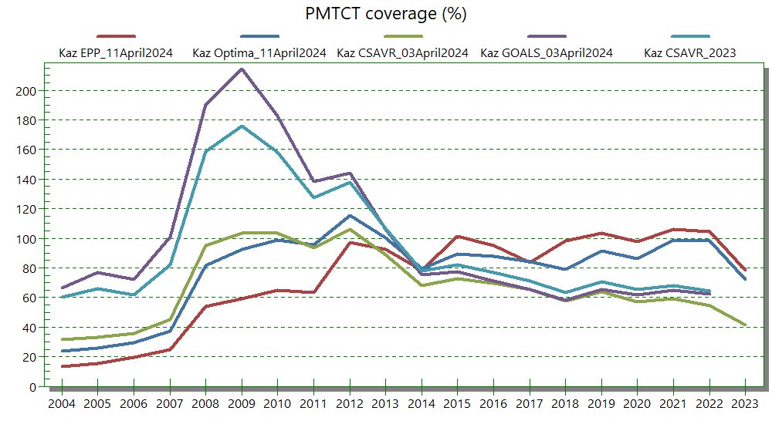
Kazakhstan: from CSAVR
(2022-23) back to EPP (ii)
EPP, like Optima and Goals, with early prevalence rise and stabilization, is consistent with trends in ART and PMTCT program data, producing plausible gradual rise in ART and PMTCT coverage.
CSAVR’s later epidemic implies improbable early ART and PMTCT coverage peaks and PMTCT coverage >100%.

Slide 11
Jamaica: EPP remains the preferred model
EPP & CSAVR give similar PLHIV and incidence post-2010.
EPP more consistent with 2000+ prevalence surveillance data, but may have over-estimated the pre-2000 peak, relative to AIDS diagnoses and deaths.
… due to oversampling high-prevalence sites in early-year
(ANC and Key Population) surveillance?

Slide 12
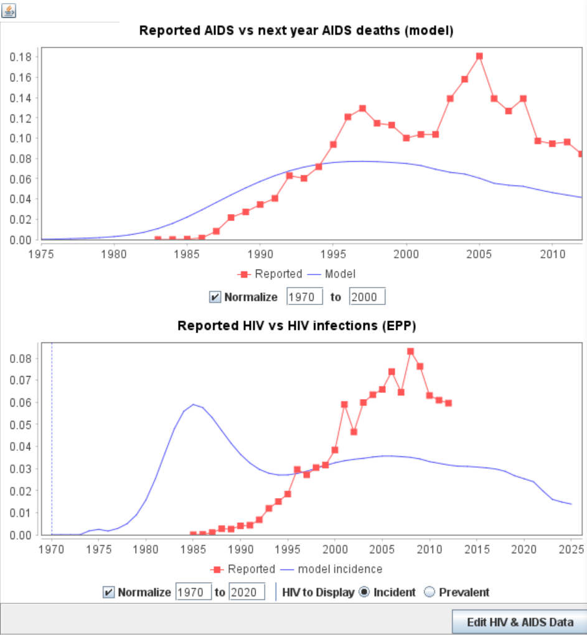
HIV and/or AIDS diagnoses: validate the initial epidemic rise estimated by EPP
EPP > Curve fit > Fitting results > Data Check > Edit HIV and AIDS data
AIDS diagnoses (pre-ART era) a proxy of AIDS deaths (with a ≈1-year lag)
HIV diagnoses expected to follow New infections.
Caveats:
Lags in diagnosis vary by country, group
and year.
Completeness – and timeliness
– of case reporting varies over time.
Mixed AIDS and HIV diagnoses? Sometimes combined, other times not.
→ Assess for broad compatibility (not exact match).
Notes:
7
The EPP model, in contrast to CSAVR; fits adult prevalence and incidence to prevalence data from sentinel surveillance and surveys. But EPP can still also use HIV and AIDS Case diagnoses, as part of its validation. After doing your EPP data entry and fitting, under ‘Fitting Results’ go to Data check, and compare the EPP-estimated initial rise in the epidemic against your national case diagnoses. Case diagnoses of HIV are expected to follow (withn some lag and allowance for under-reporting) the new infections. AIDS case diagnoses are a proxy for imminent deaths from AIDS, that is, in the era before ART was available, most people diagnosed with AIDS would die within a year. In the example shown (from Peru), the rise in AIDS case diagnoses (the red dots in the lower graph) suggest that the EPP estimate (the blue line) was too early. In such cases, you may want to try an alternative curve in EPP (e.g. R-Hybrid instead of EPP-Classic) for one or more subpopulations, to improve the fit.

Slide 13
EPP: ‘Validate’ initial epidemic rise across sub-populations
EPP > Curve fit > Fitting results
Example (Jamaica, 2023 round):
All sub-populations were fitted
with EPP-Classic
Implausible order of rise in incidence:
Remaining males and females took off before MSM
Notes:
Another validation recommended in EPP is to look at the estimated rise in incidence, across all sub-ppulations. Typically, HIV will have spread among key populations, before the general population.
In this example, from Jamaica in an earlier estimation round, EPP estimated that incidence rose among among lower-risk men and women (called ‘Remaining’ men and women) before it rose among MSM. This pattern is implausible or at least atypical. It should also spur your examination of the respective curves, and your possible adjustment of one or more of them, to ensure a plausible sequence of epidemic spread across the subpopulations. Again, trying the R-Hybrid curve instead of EPP-Classic may help avoid a too abrupt early estimated rise in prevalence and incidence, resulting in more plausible and coherent patterns.

Slide 14
How to run & compare 2 models within Spectrum?
After complete data entry, in an initial ‘master Spectrum file’, first run EPP
& use ‘File -> Save projection as’ , adding ‘_epp’ to its name.
Switch the incidence model type to CSAVR, run CSAVR then use ‘File -> Save projection as’
& resave with a new name ending with ‘_csavr’.
Finish both files with their own respective Local Fertility Adjustment factor fit.
Optionally, for CSAVR, reload Knowledge-of-Status numbers estimated by the selected CSAVR curve.
Open ‘_epp’ and ‘_csavr’ files alongside, to show Results for both:
as graphs with 2 lines, or tables with 2 columns.
Resave (within Spectrum) the ‘_csavr’ variant removing ‘_epp’ or ‘_csavr’ from the name, to indicate this ‘master’ file includes both fits.
In this file, you can switch the incidence model back and forth between EPP and CSAVR.
Repeat this process whenever you change any AIM input data (e.g., ART) or parameter (e.g., progression rates), to avoid double data entry & inconsistencies between EPP and CSAVR inputs.
Do not rename Spectrum files via Windows Explorer: that may mess up EPP fitting display.

