Slide 1
Getting started with Spectrum
Rob Glaubius
Avenir Health
UNAIDS 2023 Workshop on
HIV Estimates and Identifying Inequalities

Slide 2
Outline
Overview of models used to generate HIV estimates
Summary of major changes to Spectrum/AIM for 2023
Getting started in Spectrum

Slide 3
Overview of Models and Tools Used to Generate HIV Estimates

Slide 4
Purpose of HIV epidemic modeling
We use models to synthesize data and estimate key indicators
Data
Surveys
Surveillance
Program data
Models
Estimated Indicators
PLHIV
Incidence
Mortality
Treatment coverage
Notes:
UNAIDS coordinates an annual process to prepare estimates of key HIV indicators. These estimates are used to understand the burden of HIV across the world, to track progress in combatting the epidemic and to identify priority areas for action. We use various data sources to prepare these estimates. Each contributes to our understanding, but none provides a complete picture. National surveys are good for understanding prevalence and incidence rates at one point in time but are not available for all years and do not tell us about the number of people affected. Program data tells us about the number of people receiving services but may not tell us anything about who is missed. Special research studies help us to understand HIV dynamics but are limited to the populations studies. Therefore, we use models to translate the available data into estimates of trends and levels of the key indicators that are useful to guide program decisions and track progress. ​

Slide 5
Structure
Data
Model
Results
Demographic Data
Spectrum/AIM Calculations
Adults
Mother-to-child transmission
Children
National Results
Number HIV+
New Infections
AIDS deaths
Need for ART & PMTCT
Coverage of ART & PMTCT
Program Statistics
Epidemic Patterns
Surveillance,
Survey and Routine Testing Data
Prevalence & incidence trend
Generalized epidemics: EPP-Gen
Concentrated epidemics:
EPP / CSAVR / AEM / ECDC
Notes:
The estimates start with data, as shown in the pink boxes on the left. National sources provide demographic data, programs statistics and surveillance, survey and testing data. Epidemic patterns, such as progression and mortality rates, are derived from special studies and reviewed by the UNAIDS Reference Group on Estimates, Models and Projections. These data are used to estimate trends in adult incidence and prevalence over time using one of several models, depending on the type of data available. The incidence trends and other data are used by the Spectrum/AIM model to calculate HIV transmission to children and progression and morality in all PLHIV. The results of these calculations are summarized for the national level in key results such as new infections and AIDS-related deaths by sex, age and time. If surveys are available, the national results can be used in the Naomi model to calculate key indicators at district level. These subnational results can also be transferred to the PEPFAR datapack for detailed PEPFAR planning.

Slide 6
Estimating incidence trends – Concentrated epidemics Different models can be used, depending on the data available
Model | Data Required
Estimation and Projection Package (EPP) | Prevalence data for ANC clients & Key Populations from: Sentinel Surveillance and IBBS Routine programmatic testing & Population Group Size Estimates
AIDS Epidemic Model (AEM) | Surveillance prevalence data: ANC clients & Key Populations Population Group Size Estimates Program service coverage
Case Surveillance and Vital Registration (CSAVR) | New HIV diagnoses AIDS-related deaths Optionally, CD4 count at diagnosis
ECDC HIV Model | Case-based or aggregate surveillance data: New HIV diagnoses, AIDS diagnoses, AIDS-related deaths
Notes:
Several different model are available to estimate HIV incidence and prevalence trends. The selection of which model to use depends on the data available.
EPP is designed for countries with robust HIV surveillance data. For generalized epidemics this includes estimates of HIV prevalence from surveillance among ANC attendees, routine testing among ANC attendees and national household surveys. EPP can also use data on ART coverage from national surveys. For concentrated epidemics, EPP uses data from surveillance among key populations as well as ANC attendees.
CSAVR is designed for countries that do not have good surveillance data but do have good case reporting. It requires information on new HIV diagnoses by year and AIDS-related deaths and can also use information on CD4 counts at diagnosis if available.
AEM is used in most Asian with good surveillance data on key populations and information on behaviors and STI trends over time
ECDC is used in European and other High-Income countries with good case-based surveillance for HIV. It fits reported HIV and AIDS case and/or death numbers.

Slide 7
Models used to create HIV estimates
Incidence model | Countries | Regions
EPP, Generalized epidemic | 37 | Asia and the Pacific Eastern Europe and central Asia Caribbean Latin America Eastern and southern Africa Middle East and North Africa Western and central Africa Western and central Europe and North America
EPP, Concentrated epidemic | 39 | Asia and the Pacific Eastern Europe and central Asia Caribbean Latin America Eastern and southern Africa Middle East and North Africa Western and central Africa Western and central Europe and North America
AIDS Epidemic Model | 13 | Asia and the Pacific Eastern Europe and central Asia Caribbean Latin America Eastern and southern Africa Middle East and North Africa Western and central Africa Western and central Europe and North America
CSAVR or ECDC model | 69 | Asia and the Pacific Eastern Europe and central Asia Caribbean Latin America Eastern and southern Africa Middle East and North Africa Western and central Africa Western and central Europe and North America
Other | 14 | Asia and the Pacific Eastern Europe and central Asia Caribbean Latin America Eastern and southern Africa Middle East and North Africa Western and central Africa Western and central Europe and North America

Slide 8
Summary of Major Changes
to Spectrum/AIM for 2023

Slide 9
Key Changes
Data inputs​
Program-reported births​
Read program data from ADR
HIV testing editor​
WPP 2022​
ART data quality​
ART effect calculation
Methods​
Shiny90​
End year estimates​
Results/Validation​
Warning on saving file​
Reference periods​
All-cause deaths to those on ART​
Waterfall analysis ​

Slide 10
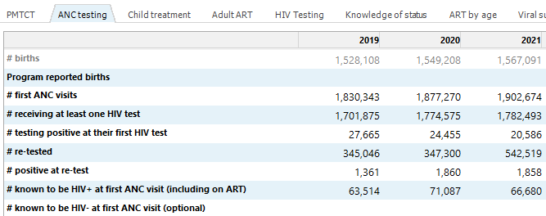
Program reported births
AIM > Program Statistics > ANC testing
Notes:
‘AIM > Program Statistics > ANC testing’ has been updated to include two new rows of input data
Program reported births can be entered for comparison to Spectrum’s calculated births (top row)
Women known to be HIV-negative at first ANC can optionally be entered if this is recorded in your system based on a recent negative HIV test result. If this is available, this should be included in the denominator when calculating HIV prevalence at ANC

Slide 11
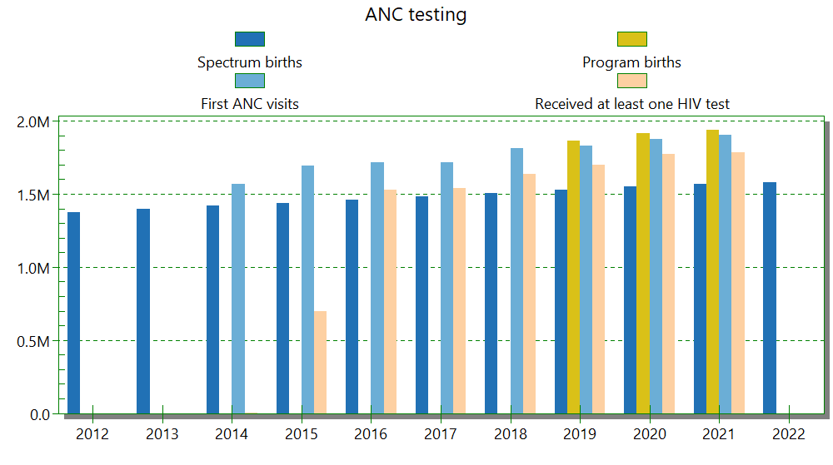
Estimated births, program births, and first ANC visits
AIM > Program Statistics > ANC testing
Notes:
There is a graph in the ANC testing form that visualizes the program reported births alongside other data in the form. The program reported births provide more context for understanding these data. For example, if there are a lot more first ANC visits than Spectrum births, perhaps that is because Spectrum is underestimating births. In countries where a substantial proportion of women give birth at home, it may be helpful to triangulate total births using survey data on ANC attendance.

Slide 12
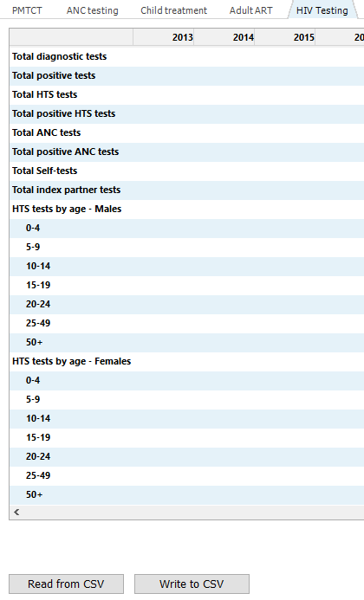
HIV testing editor
AIM > Program Statistics > HIV testing
Notes:
The HIV testing form is a new form we’ve added to Spectrum where you can record data on HIV testing in your country. This currently does not affect Spectrum calculations but can be helpful when interpreting your case surveillance data for CSAVR, and we are exploring other uses of these data in the model in the UNAIDS Reference Group. We have had a lot of interest and questions in using this form, and we recognize the definitions can be a bit ambiguous. When you enter data in this form, please use the “Source” button to document what you’ve entered, and please let us know if you have suggestions for how we can improve this.

Slide 13
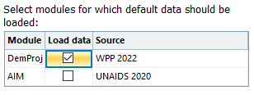
World Population Prospects 2022 (WPP 2022)
Estimates and projections from WPP 2022 are available with Spectrum
Small changes for most countries but some are significant
Estimates include mortality impact of COVID-19
Update is not automatic. User must perform update
Can be done at same time as update of final year to 2030
If not updating, need to extend demographic inputs to 2030

Slide 14
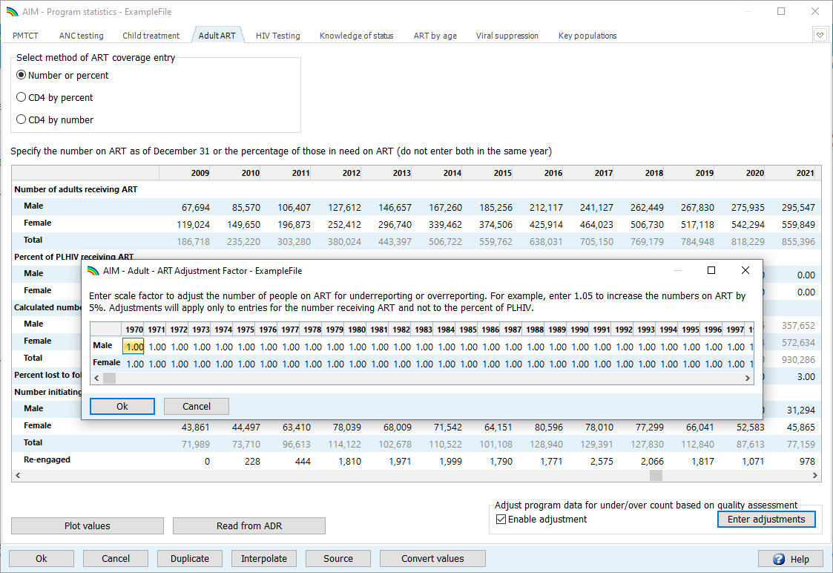
ART data quality adjustment
DHIS data can be used directly in ART editors and any necessary adjustments can be applied separately. This documents the adjustment and makes it transparent.

Slide 15
ART effect calculation
HIV incidence falls as ART coverage rises in EPP
Previously: 0.8 percentage point decrease in incidence per percentage point increase in ART coverage
This value may be higher (or lower) at higher (lower) levels of viral suppression
After entering viral suppression data in Spectrum, you can calculate the ART effect on transmission automatically
AIM > Advanced options > Adult transition parameters

Slide 16
Year-End Estimates
WPP 2022 estimates refer to January 1st rather than July 1st as in previous versions
Spectrum and EPP models have been updated to adjust to the new reference date
All outputs now refer to December 31 (levels) of Jan 1 – Dec 31 (rates)
Effects on HIV estimates are generally small especially compared to updated demographic estimates

Slide 17
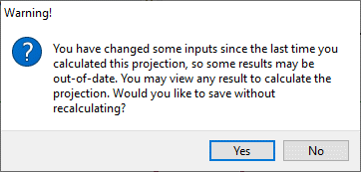
Warning when saving an ‘invalid’ file
This warning means that you may have changed some inputs without re-projecting. The results may change when you display an indicator after saving the file.
It is best to answer ‘No’, display any Result, then ‘Save’ the file.

Slide 18
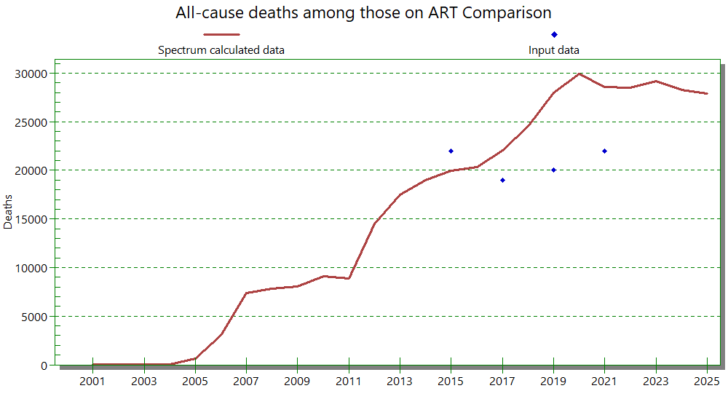
All-cause deaths among those on ART
Notes:
There is a new validation form that can be used to enter data on deaths from any cause among people on ART and compare those data to Spectrum estimates. Last year some countries needed to modify mortality rates on ART to better match these data, and this validation should help determine if this kind of adjustment is needed.

Slide 19
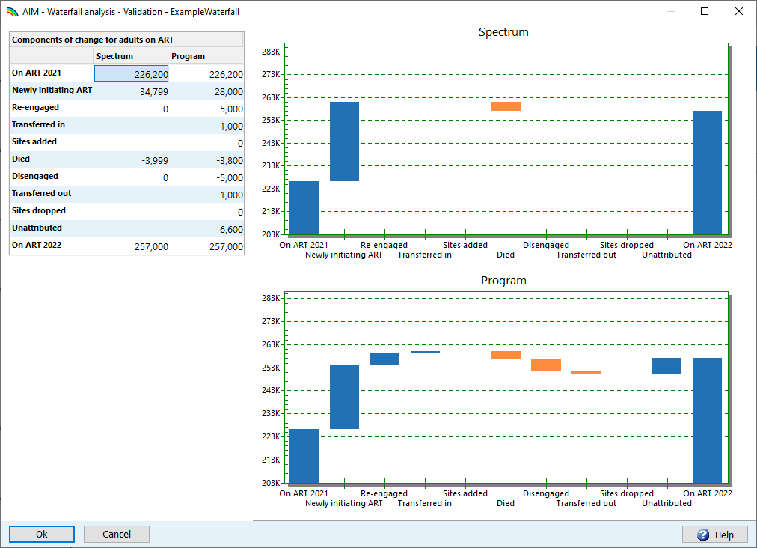
Waterfall analysis of the change in ART
Notes:
The Waterfall analysis is a new validation form we’ve added to help explore the components of change in the numbers on ART from the end of 2021 to the end of 2022. This allows you to enter program-reported components of these changes, like new initiations and re-engagement in care, deaths and disengagement, and compare those to Spectrum’s calculations.

Slide 20
Where to find more information
Online: https://hivtools.unaids.org/hiv-estimates-training-material-en
Basic steps to update Spectrum
Guide to update Spectrum HIV estimates
From within Spectrum
Help button
Online Support
Notes:
Translation note: the URL here should be different for these:
French https://hivtools.unaids.org/fr/hiv-estimates-training-material-fr/
Russian https://hivtools.unaids.org/ru/hiv-estimates-training-material-ru/
Spanish https://hivtools.unaids.org/es/hiv-estimates-training-material-es/

Slide 21
Getting Started in Spectrum

Slide 22
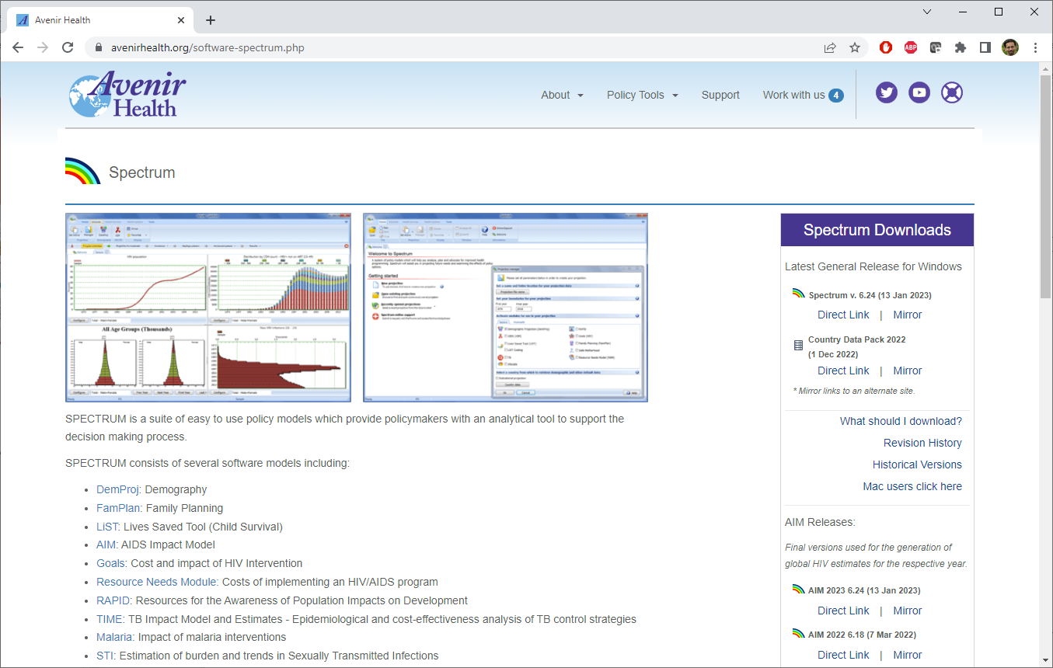
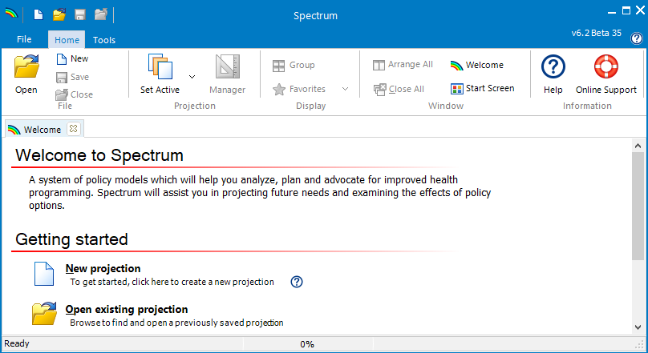
Spectrum Software for 2023 Desktop Version
Download the latest Spectrum software from Avenir Health https://avenirhealth.org/software-spectrum.php
Run the SpecInstall.exe file to install Spectrum
Start Spectrum by choosing it from the Start Menu
Open your Spectrum 2022 projection
Use ‘File > Save As’ to save the file with a new name such as ‘Country_23jan2023’

Slide 23
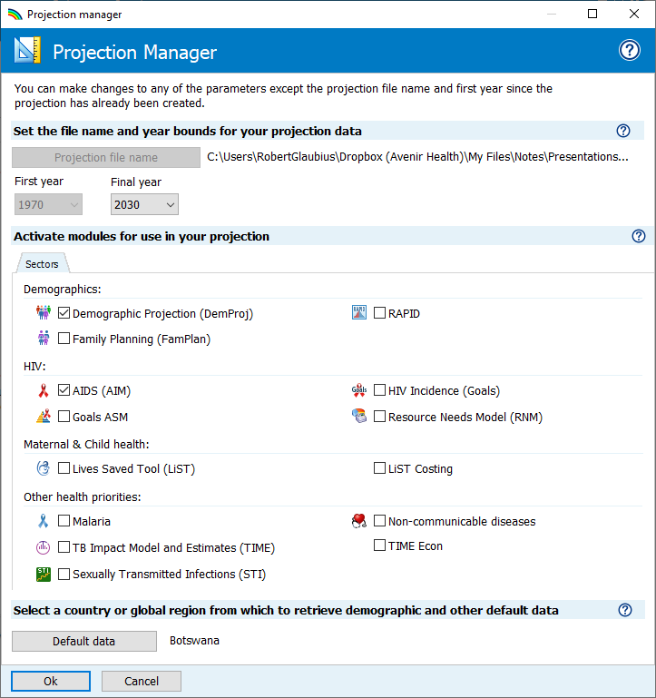
Change final year of your projection to 2030
Open the projection manager
Use the “Final year” dropdown menu to change the final year to 2030 (or later)

