Slide 1
Overview of Child Model in Spectrum
John Stover
HIV Estimates Refresher Webinar
11 December 2023

Slide 2
Mother to child transmission of HIV: Births to HIV+ women
Women of reproductive age
Breastfeeding duration among HIV+ women (on ARV/not on ARV)
Age-specific fertility rates
Births to HIV+ women
Perinatal infections
Postnatal infections
HIV prevalence among WRA
Monthly drop off from ARV regimen
PMTCT coverage by regimen
Fertility rate reduction due to HIV (Fit to ANC prevalence)
Retention at delivery
Postnatal transmission probabilities by regimen
HIV incidence among WRA
Perinatal transmission probabilities by regimen

Slide 3
Useful validation is comparison of Spectrum estimated births with program reported births, ANC visits and number tested

Slide 4
Analyze ANC data quality: Before fertility adjustment and/or EPP fitting
Routine testing data can be challenging, sometimes difficult to discern trends from reporting artifacts
Initial guidance on ANC sentinel surveillance suggested focus on high burden ANC sites
HIV testing at ANC scaled-up as HIV testing at ANC was rolled out, then stabilized → early years not nationally representative.
Managing individual level reporting difficult, especially before electronic reporting systems are available
Before using ANC-RT data:
Include women already known to be positive, in numerator (HIV+) and denominator (sample size).
Count all first tests (max. one per pregnancy) – including first tests at labor or delivery
Fit only years of data that are complete, or representative nation-wide.
Watch for sharp increases or decreases; prevalence trends should be stable
Watch for: false positives, changes in testing algorithms, stockouts and their impacts, and rates of refusal.
Review household survey data on the % of women not attending ANC and their characteristics, to understand biases.
Notes:
Many issues can influence the prevalence trends produced by ANC routine testing data including changes in service provision over time, the expansion of coverage of routine testing, and the increasing reach of electronic reporting systems as they expand to more and more places. All of these can affect how timely and complete your data is. They can also influence the epidemiological trends, e.g., as systems expand, they normally move from higher prevalence areas to lower prevalence ones introducing an artifactual decline in HIV prevalence. One way to deal with this might be to not use the trend data from routine testing until the coverage of the system has stabilized.
Accordingly, we recommend that before you use your ANC-RT data you consider some of the issues presented here: how has your routine testing system and its geographic and population coverage been changing over time? Have known positive women been included in the reporting or not? Has only the first test at an ANC visit been included? Are first tests at labour and delivery included? Have you considered changes in the testing over time, including the kits used and false positive rates in low prevalence settings, the algorithms used, refusal rates and the influence of stockouts on completeness of testing? Have you read any available quality assurance reports and compared the prevalence data against other sources such as household surveys?
Given how important the trends produced by EPP will be to determining the trends in your national estimate, it is worth spending some time considering these factors and consulting with experts as necessary to better understand how they influence your data and which data should be used or excluded.

Slide 5
Mother to child transmission of HIV
Women of reproductive age
Breastfeeding duration among HIV+ women (on ARV/not on ARV)
Age-specific fertility rates
Births to HIV+ women
Perinatal infections
Postnatal infections
HIV prevalence among WRA
Monthly drop off from ARV regimen
PMTCT coverage by regimen
Fertility rate reduction due to HIV (Fit to ANC prevalence)
Retention at delivery
Postnatal transmission probabilities by regimen
HIV incidence among WRA
Perinatal transmission probabilities by regimen

Slide 6
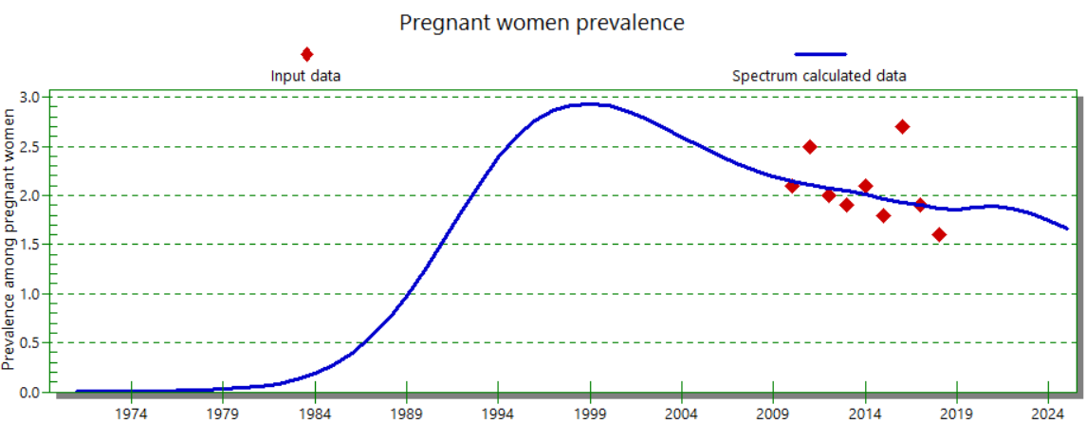
Spectrum’s estimate of prevalence is adjusted to fit ANC prevalence
Local adjustment factor (LAF) = 1.21
If the local adjustment factor (LAF) is very small (<0.5) or very large (>2.5) it may indicate problems with the ANC prevalence data. In those cases, review representativeness of ANC prevalence data, consider restricting the LAF to 0.5-2.5, or consider other ways to validate PMTCT coverage.

Slide 7
Mother to child transmission of HIV: Perinatal infections
Women of reproductive age
Breastfeeding duration among HIV+ women (on ARV/not on ARV)
Age-specific fertility rates
Births to HIV+ women
Perinatal infections
Postnatal infections
HIV prevalence among WRA
Monthly drop off from ARV regimen
PMTCT coverage by regimen
Fertility rate reduction due to HIV (Fit to ANC prevalence)
Retention at delivery
Postnatal transmission probabilities by regimen
HIV incidence among WRA
Perinatal transmission probabilities by regimen

Slide 8
Program reports provide data on the number of women receiving ARVs by regimen

Slide 9
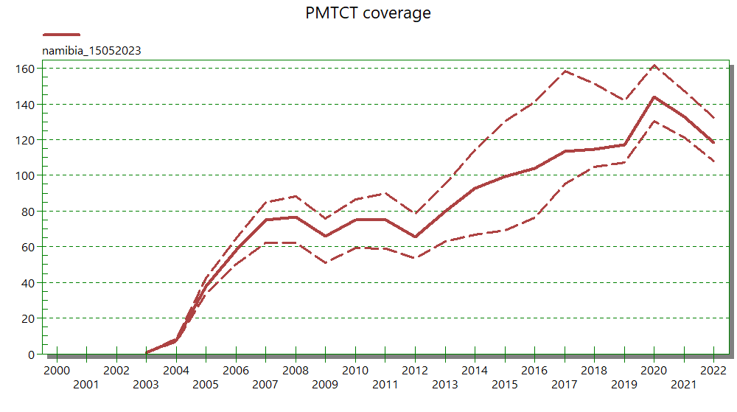
PMTCT coverage >100% signals a problem!
Coverage exceeding 100% in any year indicates a problem. Check to see if births are under-estimated, if the local adjustment factor matches ANC prevalence well or if there is double counting in the numbers of women receiving ARVs.

Slide 10
Mother-to-Child Transmission probabilities are based on studies
Regimen | Perinatal Transmission |  |  |  | Postnatal Transmission (per month)
 | CD4 unknown | CD4 <200 | CD4 200-350 | CD4 350+ | CD4 < 350 |  | CD4 > 350
Incident infections | 18.2% |  |  |  | 27% (one-time event)
No prophylaxis | 19.9% | 37% | 27% | 15% | 1.57% | 0.51%
SD-NVP | 8.9% |  |  |  | 1.57% | 0.51%
WHO 206 dual prophylaxis | 4.1% |  |  |  | 1.57% | 0.51%
Option A |  |  | 4% | 2% |  | 0.23%
Option B |  |  |  | 0.9% |  | 0.23%
ART before pregnancy | 0.21% |  |  |  | 0.013%
ART during pregnancy | 1.9% |  |  |  | 0.13%
ART <4 weeks before delivery | 7.6% |  |  |  | 0.20%
For 2020 we introduced retention on breastfeeding during first 12 months and 12+ months. Default = 80%
Source: Rollins N, Mahy M, Becquet R, Kuhn L, Creek T, Mofenson L. Estimates of peripartum and postnatal mother-to-child transmission
probabilities of HIV for use in Spectrum and other population-based models. Sex Transm Infect 2012,88 Suppl 2:i44-51.
Updated in 2016 by Lynne Mofenson. Mahy et al Improving estimates of children living with HIV from the Spectrum AIDS Impact Model. AIDS 2017, 31 (Suppl 1):S13-22.

Slide 11
Mother to child transmission of HIV: Postnatal transmission
Women of reproductive age
Breastfeeding duration among HIV+ women (on ARV/not on ARV)
Age-specific fertility rates
Births to HIV+ women
Perinatal infections
Postnatal infections
HIV prevalence among WRA
Monthly drop off from ARV regimen
PMTCT coverage by regimen
Fertility rate reduction due to HIV (Fit to ANC prevalence)
Retention at delivery
Postnatal transmission probabilities by regimen
HIV incidence among WRA
Perinatal transmission probabilities by regimen

Slide 12
Mother-to-Child Transmission probabilities are based on studies
Regimen | Perinatal Transmission |  |  |  | Postnatal Transmission (per month)
 | CD4 unknown | CD4 <200 | CD4 200-350 | CD4 350+ | CD4 < 350 |  | CD4 > 350
Incident infections | 18.2% |  |  |  | 27% (one-time event)
No prophylaxis | 19.9% | 37% | 27% | 15% | 1.57% | 0.51%
SD-NVP | 8.9% |  |  |  | 1.57% | 0.51%
WHO 206 dual prophylaxis | 4.1% |  |  |  | 1.57% | 0.51%
Option A |  |  | 4% | 2% |  | 0.23%
Option B |  |  |  | 0.9% |  | 0.23%
ART before pregnancy | 0.21% |  |  |  | 0.013%
ART during pregnancy | 1.9% |  |  |  | 0.13%
ART <4 weeks before delivery | 7.6% |  |  |  | 0.20%
For 2020 we introduced retention on breastfeeding during first 12 months and 12+ months. Default = 80%
Source: Rollins N, Mahy M, Becquet R, Kuhn L, Creek T, Mofenson L. Estimates of peripartum and postnatal mother-to-child transmission
probabilities of HIV for use in Spectrum and other population-based models. Sex Transm Infect 2012,88 Suppl 2:i44-51.
Updated in 2016 by Lynne Mofenson. Mahy et al Improving estimates of children living with HIV from the Spectrum AIDS Impact Model. AIDS 2017, 31 (Suppl 1):S13-22.

Slide 13
Breastfeeding patterns are derived from survey data

Slide 14
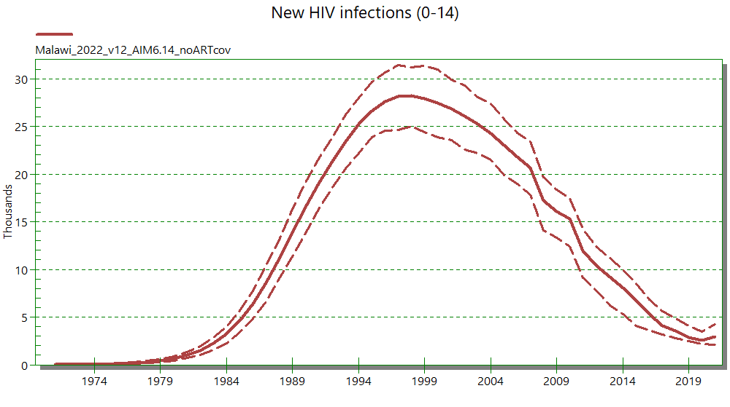
Result: New child infections by year
It is also possible to input nosocomial infections.

Slide 15
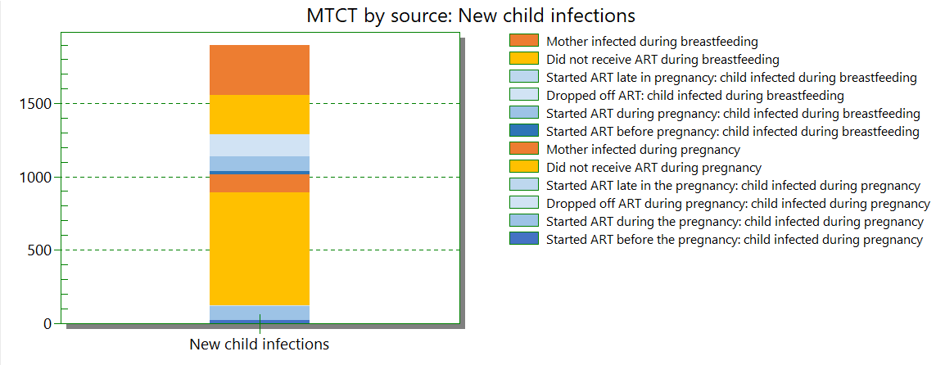
Sources of new child infections
Postnatal
Prenatal

Slide 16
Children newly infected are distributed by CD4% category
>30
60%
26-30
12%
New infections
-Perinatal
-0-6 months post-natal
-7-12 months post-natal
-12+ months post-natal
21-25
10%
16-20
9%
11-15
5%
Distribution of new infections is based on Dunn D. CD4 distributions in HIV Paediatric Prognostics Markers Collaborative Study and Cross Continents Collaboration for Kids. Presented to the October 2009 meeting of the UNAIDS Reference Group on Estimates Modeling and Projections, Geneva.
5-10
3%
<5
1%

Slide 17
HIV+ children are tracked by age, CD4 category and treatment status
μ = off-ART mortality rate
α = on-ART mortality rate
c = rate of ART initiation
δ = rate of ART discontinuation
λ = rate of progression to next lower CD4 category
CLHIV under 5 years old on ART by CD4 % category
CLHIV under 5 years old and not on ART by CD4 % category
CLHIV 5-14 years old and not on ART by CD4 count category
CLHIV 5-14 years old on ART by CD4 count category at initiation
_{c1}
_{c'1}
_{α1}
>30
>30
>1000
_{µ’1}
_{δ'1}
>1000
_{α’1}
_{δ1}
_{µ1}
_{c2}
λ₁
λ'₁
_{c’2}
_{α2}
26-30
26-30
750-999
_{μ'2}
_{δ’2}
750-999
_{α'2}
_{δ2}
_{µ2}
λ₂
λ’₂
_{c3}
_{c’3}
_{α3}
21-25
21-25
500-749
_{µ’3}
_{δ’3}
500-749
_{α’3}
_{δ3}
_{µ3}
λ₃
λ’₃
_{c’4}
16-20
_{c4}
350-499
_{α'4}
_{α4}
16-20
_{µ4}
350-499
_{μ'4}
_{δ’4}
_{δ4}
λ₄
λ’₄
_{c’5}
11-15
_{c5}
11-15
200-349
200-349
_{α5}
_{µ5}
_{µ’5}
_{δ’5}
_{α’5}
_{δ5}
λ₅
λ’₅
_{c’6}
5-10
_{c6}
5-10
<200
_{δ’6}
<200
_{α6}
_{δ6}
_{µ6}
_{μ'6}
_{α'6}
λ₆
<5
_{c7}
<5
_{α7}
_{µ7}
_{δ7}

Slide 18
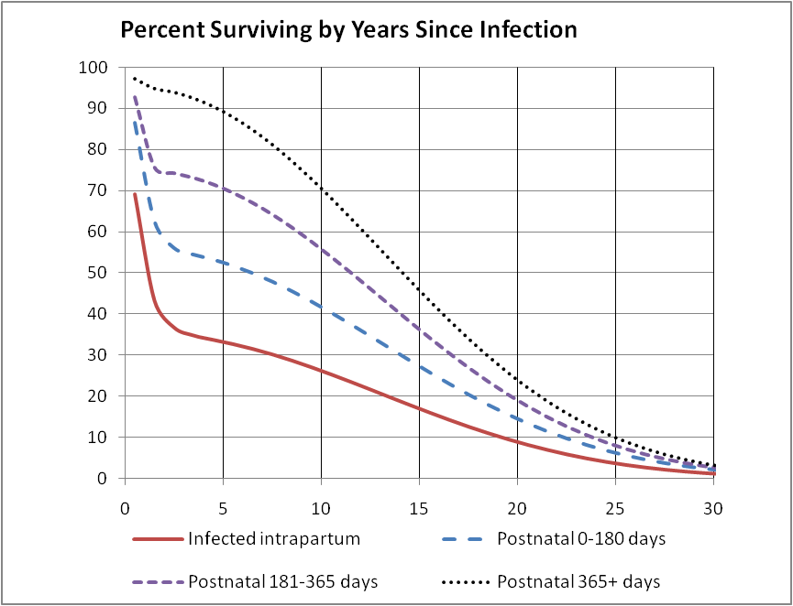
Survival of HIV+ not on ART depends on timing of infection
Marston M, Becquet R. Net survival of children HIV-infected perinatally and through breastfeeding: a pooled analysis of individual data from resource-constrained settings, December 2010.

Slide 19
Pediatric ART initiations are distributed by age according to patterns from the IeDEA Consortium
Data from IeDEA Consortium

Slide 20
Annual Mortality on ART by age of child (Example: on ART 12+ months, East Africa pattern)
Age (years)
Age (years)
Patterns estimated by IeDEA Consortium by age, duration on treatment and region

Slide 21
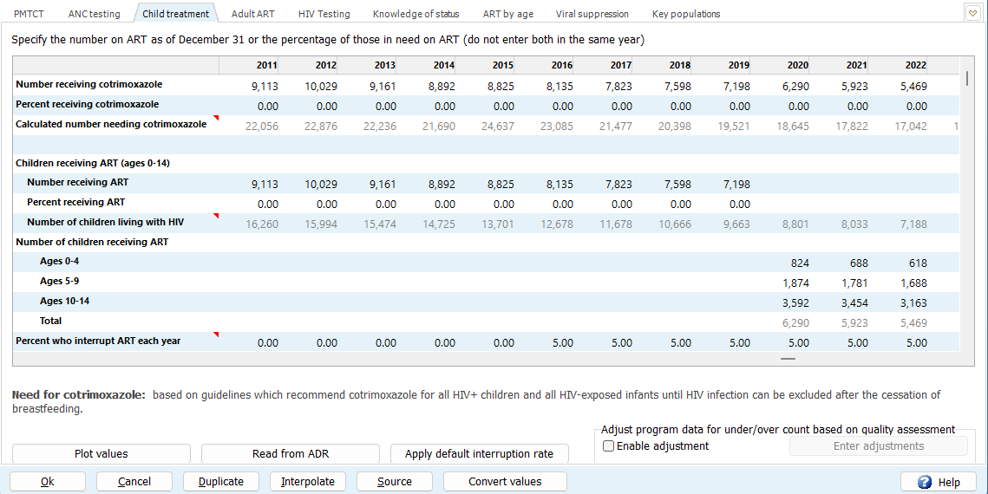
ART Dynamics
Please enter treatment interruption rates for all years with children on ART
From a reliable national or nationally representative program data, if available
Default rate of 5% per year – use new button in Child Treatment editor ‘Apply default interruption rate’
Treatment interruption entries do not affect numbers of children on ART (set by program data), but do refine:
the percentage of children in the first year of treatment and their age and CD4 distribution
Spectrum’s (new!) calculation of child Knowledge-of-Status.

Slide 22
CLHIV previously on treatment: new Validation chart

Slide 23
Knowledge of status among children
If good program data on KOS among children are not available, KOS may be estimated as children on ART plus CLHIV previously on treatment. A new button in the KOS editor ‘Apply child defaultsCalculate child Knowledge of Status’ will apply this approximation automatically.

Slide 24
Key Spectrum Outputs
Age groupings
Children: 0-14 years
Children < 1 years
Children < 2 years
Children 1-4 years
Young people 15-24 years (AGYW)
Adolescents 10-19 years
Indicators
Number of HIV+ children
New infections
AIDS deaths
HEU children
Mother-to-child transmission
Number of HIV+ pregnant women
PMTCT coverage
Peri-partum transmission rate
Transmission rate at 36 months of age
Number of new child infections
Treatment
Number needing cotrimoxazole
Cotrimoxazole coverage
Number eligible for treatment
Treatment coverage
Number on treatment by age and weight

Slide 25
HIV Prevalence 0-14 years: Spectrum estimates compare well to PHIA

Slide 26
Today, most HIV+ children are >5 years and were infected between 2008 and 2018. Since they do not have regular contact with the health system, they may be hard to find

