Slide 1


Program and surveillance data collation & data quality review
Anna Yakusik, Eline Korenromp
UNAIDS, Data for Impact
Webinar ‘EPP & CSAVR for Concentrated epidemics’
25 January 2024
Notes:
Presenter is : of [office/duty station] in UNAIDS
I will cover program and surveillance data needs, and quality review using the AIDS Impact Module in Spectrum for concentrated HIV epidemic settings.

Slide 2
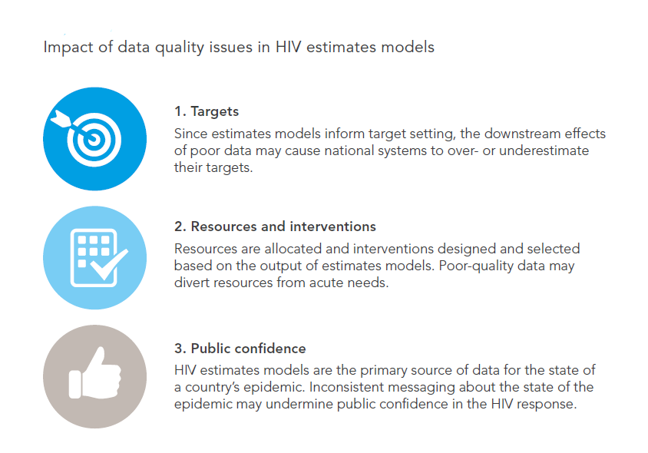
Purpose of estimation and projection models
Notes:
2
Mathematical models, like the AIDS Impact Module (AIM) in Spectrum software, provide vital insights as nationally representative exact counts are unachievable in most settings.
Developed by UNAIDS and Avenir Health, the module utilizes HIV surveillance, surveys, and program data alongside demographics to project key HIV estimates, including people living with HIV, new infections, AIDS-related mortality and treatment coverage.

Slide 3
Under- or Over-estimating
  Incidence and/or prevalence
  PMTCT or ART coverage
  New Infections, PLHIV & AIDS-related deaths
Leads to:
  Focusing on the wrong places, wrong interventions, wrong resource allocation
  Waste of resources and staff time
  Wrong decisions “Barking up the wrong tree”
If you get it “wrong”
Notes:
3
Data quality issues in HIV estimation modules can distort epidemic projections, affecting resource allocation and program planning.
Inaccurate data may lead to underestimation or overestimation of HIV burden, hindering effective response strategies and potentially exacerbating the epidemic's impact on public health.

Slide 4
Requirements for publishing an
incidence trend from EPP or CSAVR
EPP:
All major key populations covered
Each key population estimated based on:
A national population size estimate
An estimate of the % male in each population
An estimate of duration spent in population
(e.g., years in sex work)
At least 3 prevalence data points over time,
the most recent of which
no older than 4 years (i.e. from 2019 or later)
CSAVR:
8 years of HIV/AIDS deaths data and 8 years of Case diagnoses (within 1990-2023)
  Vital Registration of Causes of Deaths classified by IHME as medium or good-quality (groups 2A and 2B)
Spectrum file covering the full ‘de facto’ population: all residents including non-nationals.
Notes:
4
See Guide to update a Spectrum HIV estimation (Word document, on https://hivtools.unaids.org/hiv-estimates-training-material-en/):
Decision tree Figure 1

Slide 5
New HIV case diagnoses: input to
CSAVR & ECDC incidence models
Serve to inform:
HIV incidence – esp. for recent years,
when deaths, lagged behind infection and diagnosis, are less informative.
Progress in Knowledge of HIV serostatus
Include new/first-time diagnoses among:
all residents (full De Facto population)
regardless of nationality.
immigrants -- excepting any deported (not immigrating) at diagnosis
Do not include repeat diagnoses.
Immigrants entering with prior diagnosis (known positives)
– include not in CSAVR; do include them in
AIM > HIV+ immigrants
& as PLHIV Knowing their SeroStatus
Notes:
5
CSAVR allows for the incorporation of various inputs to generate adult estimates. The inputs for this model are:
New, first-time HIV diagnoses
AIDS-related deaths from vital registration systems
Optionally New HIV diagnoses by CD4 cell count category
All three inputs are specific to adults aged 15 years and older. You will enter the total and if possible disaggregations by sex and age.
New case diagnoses data to enter to CSAVR should:
Include all first-time diagnoses reports to the national surveillance system, whether HIV or AIDS, and for all residents – whether national or non-national, so also including immigrants with a first-time HIV diagnosis. In contrast, immigrants who had been diagnosed abroad (previously positive) already before immigration should be entered not in CSAVR, but in AIM Incidence > HIV+ immigrants.
When entering or revising new diagnoses, update any older entries that may have been revised due to delays in notifications or missing reports from specific regions or facilities.
If complete counts are not yet available for a year, leave the data for that year blank. Do not enter 0: CSAVR would read that as if there had been 0 diagnoses (or deaths) that year.

Slide 6
AIDS deaths: Which data are good to fit CSAVR?
UNAIDS recommends CSAVR for countries with medium or good quality and completeness of Cause of Deaths data.
Guided by IHME quality score* :
2A. High quality Vital Registration data
2B. Some usable Vital Registration data (mixture of quality)
2C. No useable-quality HIV-specific mortality data used by IHME → do not fit CSAVR.
1A/B: IHME used prevalence data to estimate incidence & mortality; regardless of (mixed-quality) VR data.
Based on:
Completeness of death registration – minimum threshold
Contribution of garbage and ill-defined causes of deaths – maximum threshold
For years with AIDS death reports incomplete:
Use IHME data, adjusted (up) for AIDS deaths misclassified under other causes
& supplement with original (unadjusted) Vital Registration data
for recent years (i.e., post-2019).
* IHME country groups: Section 2.3 of the supplementary material (page 5) and depicted in Figure S1 on page 6 of: https://www.thelancet.com/cms/10.1016/S2352-3018(21)00152-1/attachment/7371c03e-887f-4e26-a718-bae190b81c2f/mmc1.pdf
Notes:
https://www.thelancet.com/journals/lancet/article/PIIS0140-6736(17)32152-9/fulltext
The IHME created a star rating system for the overall quality of cause of death data for each location each year.
This system represents VR completeness, percentage of deaths coded to causes that cannot be true underlying causes of death (garbage codes), detail of the cause list and age groups, and time periods covered.
6
Using CSAVR requires good quality, complete entries of AIDS-related deaths among adults 15 years and above.
An indication of the quality and completeness of cause-of-death reporting is provided by the Institute for Health Metrics (IHME), alongside their Global Burden of Disease (GBD) analysis in 2019: 2A denotes high-quality cause of death data, 2B reasonable quality.
a 2C classification in the IHME's 2019 GBD indicate poor completeness and/or quality of Vital Registration. Countries in this group should not input death data (neither country-reported nor IHME-adjusted) into CSAVR and probably instead use the EPP model.

Slide 7
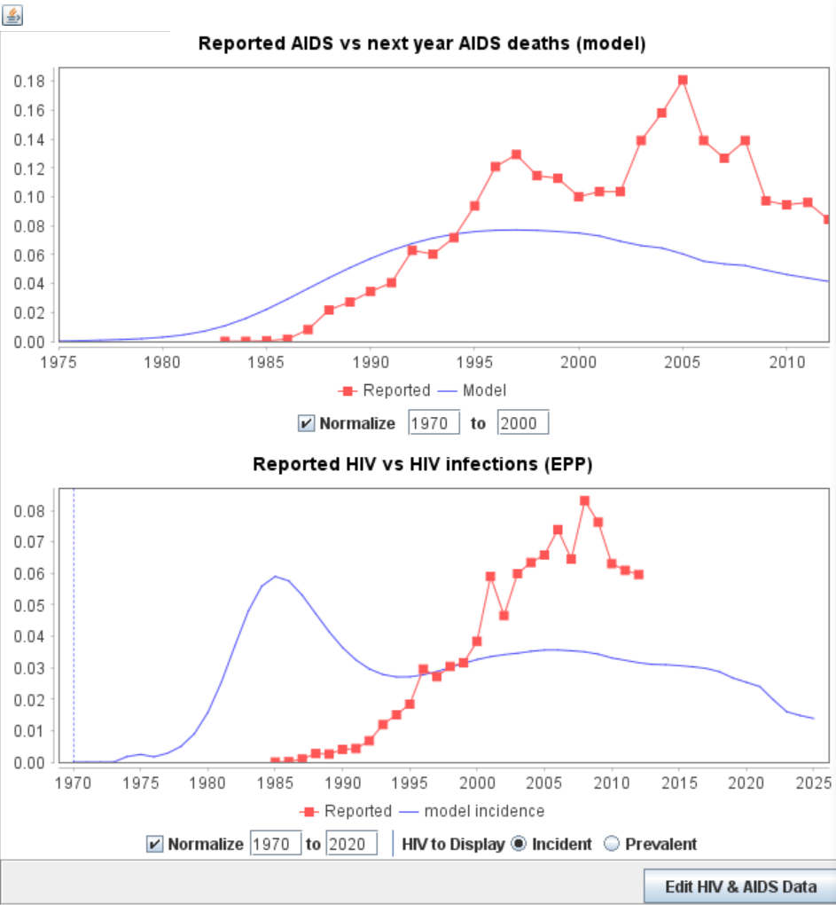
HIV and/or AIDS diagnoses: validate the initial epidemic rise estimated by EPP
EPP > Curve fit > Fitting results > Data Check > Edit HIV and AIDS data
AIDS diagnoses (pre-ART era) a proxy of AIDS deaths (with a ≈1-year lag)
HIV diagnoses expected to follow New infections.
Caveats:
Lags in diagnosis vary by country,
group
and year.
Completeness – and timeliness
– of case reporting varies over time.
Mixed AIDS and HIV diagnoses?
Sometimes combined, other times not.
→ Assess for broad compatibility
(not exact match).
Notes:
7
The EPP model, in contrast to CSAVR; fits adult prevalence and incidence to prevalence data from sentinel surveillance and surveys. But EPP can still also use HIV and AIDS Case diagnoses, as part of its validation. After doing your EPP data entry and fitting, under ‘Fitting Results’ go to Data check, and compare the EPP-estimated initial rise in the epidemic against your national case diagnoses. Case diagnoses of HIV are expected to follow (withn some lag and allowance for under-reporting) the new infections. AIDS case diagnoses are a proxy for imminent deaths from AIDS, that is, in the era before ART was available, most people diagnosed with AIDS would die within a year. In the example shown (from Peru), the rise in AIDS case diagnoses (the red dots in the lower graph) suggest that the EPP estimate (the blue line) was too early. In such cases, you may want to try an alternative curve in EPP (e.g. R-Hybrid instead of EPP-Classic) for one or more subpopulations, to improve the fit.

Slide 8
EPP: ‘validate’ initial epidemic rise across sub-populations
EPP > Curve fit > Fitting results
Example (Jamaica, 2023 round):
All sub-populations were fitted
with EPP-Classic
Implausible order of rise in incidence:
Remaining males and females took off before MSM
Notes:
Another validation recommended in EPP is to look at the estimated rise in incidence, across all sub-ppulations. Typically, HIV will have spread among key populations, before the general population.
In this example, from Jamaica in an earlier estimation round, EPP estimated that incidence rose among among lower-risk men and women (called ‘Remaining’ men and women) before it rose among MSM. This pattern is implausible or at least atypical. It should also spur your examination of the respective curves, and your possible adjustment of one or more of them, to ensure a plausible sequence of epidemic spread across the subpopulations. Again, trying the R-Hybrid curve instead of EPP-Classic may help avoid a too abrupt early estimated rise in prevalence and incidence, resulting in more plausible and coherent patterns.

Slide 9
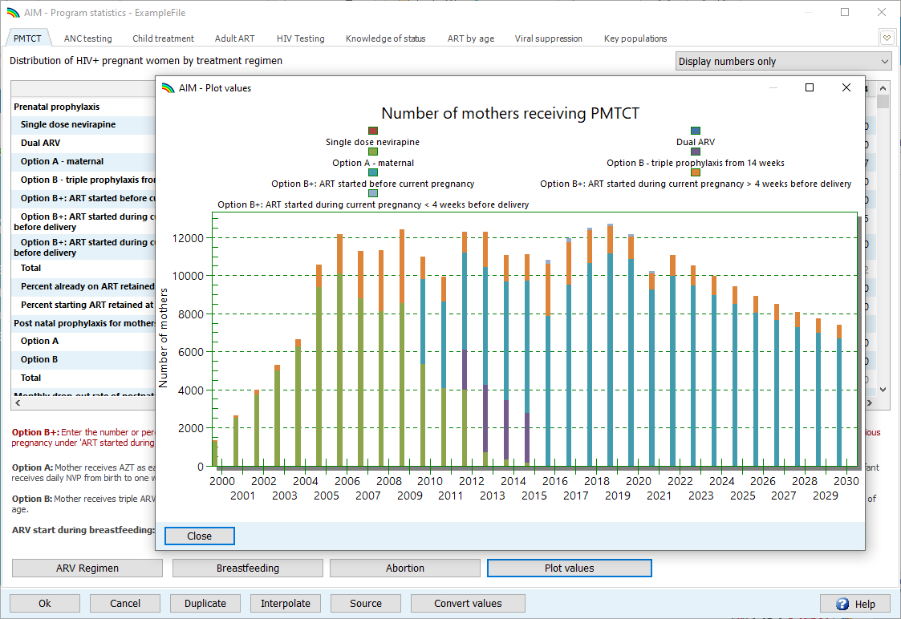
‘Plot’ program PMTCT & ART data, to spot and correct any unexplained year-on-year fluctuations in entries
Notes:
8
When you enter PMTCT and ART data, before existing the Program Statistics editor, PLOT the data, to identify and (if needed) correct any unexplained year-on-year fluctuations in entries. This check helps to ensure accurate and consistent data, before you proceed to fitting your Spectrum estimate to them.

Slide 10
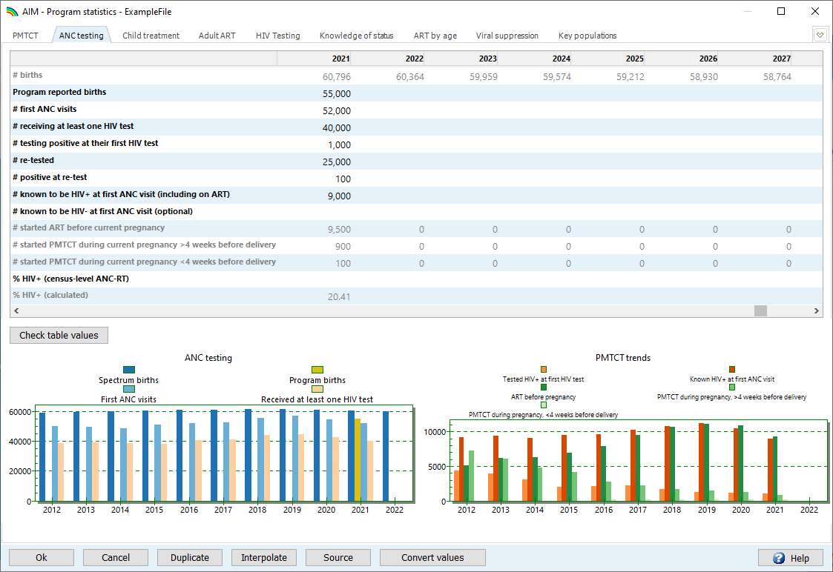
HIV tests in Antenatal Care (ANC)
Graphs to validate consistency across ANC indicators
Notes:
9
In the ANC testing tab, enter numbers of HIV tests conducted among pregnant women in Antenatal Care (ANC) for all years available.
Also specify numbers of women diagnosed as HIV-positive at their first ANC visit, as well as women entering ANC and already known (through a prior diagnoses) as being HIV-infected. Both groups count into the numerator as well as denominator of the prevalence of HIV among pregnant women.
Check and ensure consistency with PMTCT data. We expect that numbers newly diagnosed are equal to, or above, numbers who started PMTCT DURING the current pregnancy. Similarly, we expect that numbers already known as HIV positive are at least equal to numbers you entered in the PMTCT sheet as having started ART already before the current pregnancy.
If the data entry for these 3 indicators (HIV tests, new positives and known positives) is complete Spectrum will calculate the prevalence among ANC women, in a row at the bottom here. This prevalence is what you should enter in EPP for Remaining Women, in the top row ‘Census-level ANC Routine Testing’. Most countries will use the same to fit EPP for Remaining Men.
Whether you use EPP or CSAVR; the observed ANC prevalence calculated here from your data can be used to adjust Spectrum’s estimated prevalence among pregnant women, the denominator for the need for PMTCT, Mother-to-Child transmission events and so (cumulatively over next years) numbers of child infections and children living with HIV.
This is done under Advanced Options, HIV-related Fertility, fitting a local adjustment factor. The default fertility among HIV-infected women is informed by global default patterns, reflecting the effects of HIV on fertility by age, CD4 count, and treatment status relative to uninfected women. Through the Fertility Local Adjustment you can adapt the Spectrum-estimated prevalence in pregnant women to your ANC testing data – if you believe they accurately reflect the national prevalence. Please use ANC testing data for the fertility adjustment cautiously, though. For years that ANC testing was selective, incomplete and not representative, for example due to test stock-outs or incomplete ANC attendance, do not use the apparent prevalence to fit Spectrum’s fertility too. If there are no ANC testing data at all to adjust or validate Spectrum’s estimates for pregnant women and MTCT, you may refrain from estimation MTCT and child outcomes altogether, or UNAIDS may recommend to not publish those.
Lastly in this editor, you may optionally also enter program-reported births. Comparing these to Spectrum-calculated births informs about the coverage of ANC and the completeness of ANC data.
.

Slide 11
Routine ANC testing data:
Use only good-quality, representative data/years for fitting EPP and fertility
Routine testing data can be challenging, sometimes difficult to discern trends from reporting artefacts
Initial guidance on ANC sentinel surveillance suggested focus on high burden ANC sites
HIV testing at ANC scaled-up as HIV testing at ANC was rolled out, then stabilized → early years not nationally representative.
Managing individual level reporting difficult, especially before electronic reporting systems are available
Before using ANC-RT data:
Include women already known to be positive (but not re-tested)
in both numerator (HIV+) and denominator (sample size).
Count all first tests (max. one per pregnancy)
– including first tests at labor or delivery
Fit only years of data that are complete, or representative nation-wide.
Watch for sharp increases or decreases; prevalence trends should be stable
Watch for: false positives, changes in testing algorithms, stockouts and their impacts, and rates of refusal.
Review household survey data on the % of women not attending ANC and their characteristics, to understand biases.
Notes:
10
Before using routine ANC prevalence data in EPP or for fertility fitting, ensure criteria are met: stable prevalence trends, inclusion of known HIV-positive women, timeliness, exclusion of repeat tests, consideration of testing quality, and stock-outs. If any criteria are unmet, refrain from using the data.

Slide 12
Useful validation is comparison of Spectrum-estimated births with program-reported births, ANC visits and number tested
Notes:
11
Still within the ANC testing tab of Program Statistics, use the graph at bottom-left to validate your entries – before choosing which years of data are good enough to include in EPP and fertility fitting.
Possible inconsistencies to examine, explain or adjust are:
If program-reported births are far off the Spectrum-estimated births
If you counted many more first ANC visits than program-reported births – then the ANC visits may have been over-stated and so the prevalence in ANC under-stated

Slide 13
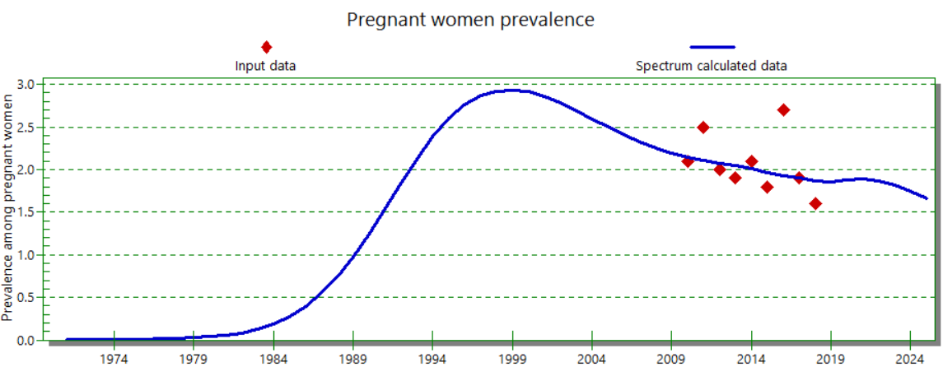
Advanced Options > HIV-related Fertility > Fit a Local Adjustment Factor, to fit Spectrum’s prevalence in pregnant women (driving PMTCT and pediatric estimates) to prevalence measured in routine ANC testing
An extreme fitted Fertility Local Adjustment Factor (LAF), below <0.5 or above >2.5, may indicate problems with ANC prevalence data – or with the overall adult women’s (EPP or CSAVR) estimate.
In those cases, review representativeness of ANC prevalence data, consider restricting the LAF to 0.5-2.5, or consider other ways to validate MTCT and child estimates, and PMTCTD and child ART coverage.
Fertility Local adjustment factor (LAF): fitted to 1.21
Notes:
12

Slide 14
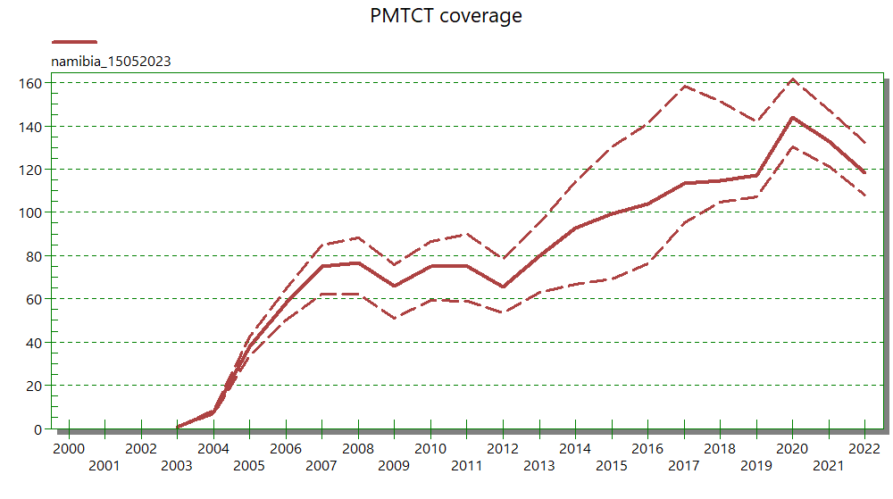
PMTCT coverage >100% signals a problem
Estimated coverage exceeding 100% in any year indicates a problem – especially if for recent years
(post-2015).
Check to see if:
births were under-estimated?
the Fertility Local Adjustment Factor was fitted to reproduce ANC prevalence well?
Pregnant women receiving ART were double-counted?
Notes:
13
An estimated coverage of PMTCT or ART exceeds 100% in any group (women, men or children) indicates a problem, with either the data or the epidemic estimation for that group. Especially so if this is the case for multiple and recent years.
In this example, for PMTCT, you should check to see if births were under-estimated,
if the local adjustment factor was fitted or set to reproduce national ANC prevalence well
And, if numbers of women receiving ARVs for PMTCT were double-counted..

Slide 15
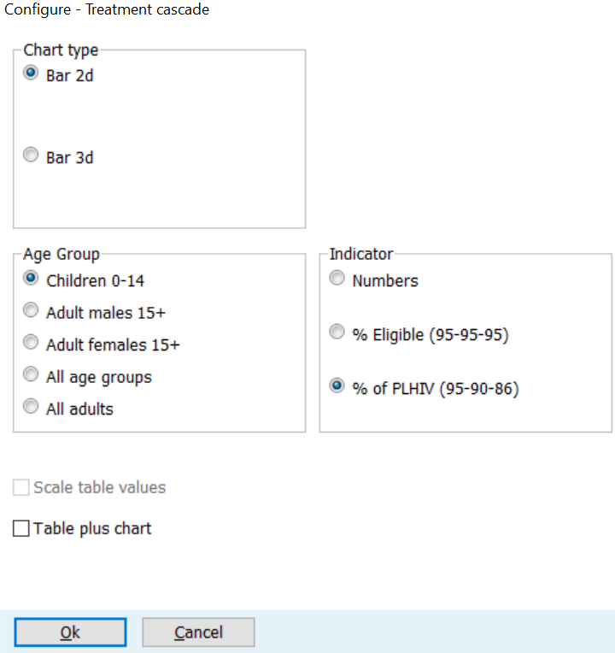
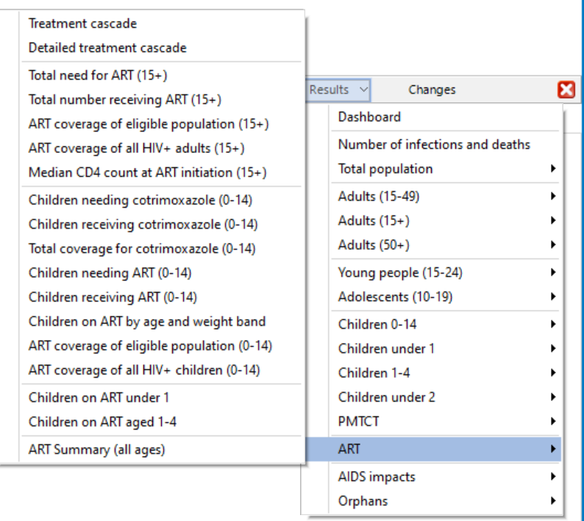
95-95-95 Testing & Treatment Cascade:
Spectrum Estimation and Data Quality Review (I)
Whenever you change program data on PLHIV Knowing their serostatus, ART or VL Suppression or the (CSAVR/EPP/AEM/ECDC) incidence estimate, review the cascades again
-- in turn for Men, Women and (if applicable) Children
Notes:
14
Once you have finalized your data entries and the CSAVR or EPP curve fitting, and set the sex pattern in incidence (Incidence Rate Ratios), proceed to review Results. Under Treatment cascade, review the estimated progress towards the 95-95-95 targets (i.e. 95% of PLHIV knowing their status, 95% of those on ART and 95% of those on ART being Virally Suppressed, in turn for adult men, adult women and children, over the period 2010 to 2023
You may evaluate the patterns in three ways:
1. As numbers of PLHIV
2. As % of those eligible, i.e. the 95-95-95 targets
3. As % of all PLHIV, i.e. the population-level testing and treatment cascade.

Slide 16
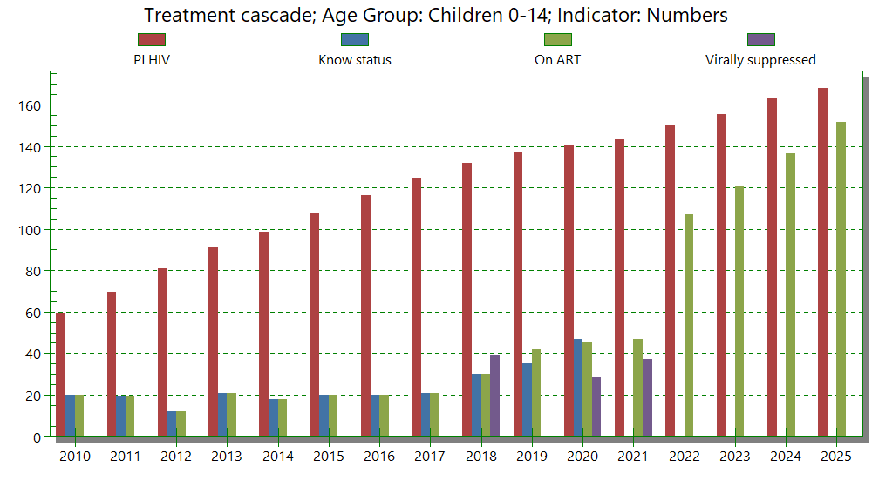
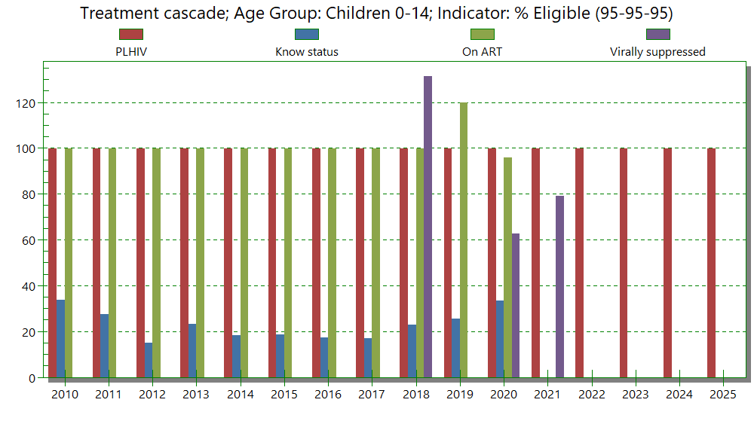
95-95-95 Cascade: Spectrum estimation & Data Quality Review (II)
Is the number of people in each bar of the cascade
smaller than the previous bar?
  Adult men, adult women and children in turn
  All years 2010-2023.
  If Knowing-Status >> ART, why such a gap?
  Was Knowing-Status over-stated,
  were deaths not subtracted?
Does coverage not exceed 100% any year?
Are there any large sudden increases or drops
year-on-year, that are not explained?
Coherence in ART coverage between:
  adult women overall,
  pregnant women entering ANC/PMTCT
  children
Scrutinize ART (and PMTCT) data,
but also the M/F/child PLHIV denominator estimate.
Notes:
15
Here you see the cascade as numbers, and as % of those eligible.
In numbers, verify and ensure that each step has fewer individuals than the preceding step.
In % of those eligible, no result for any group and year should exceed 100%.
Errors, such as more people on treatment than diagnosed, must be rectified. Large increases or declines in the cascade should be explained, comparing current estimates with previous years. Understanding the disparities between the 90-90-90 targets and the cascade is crucial. To ensure accuracy, key reviews include validating data sources, cross-referencing with reliable systems, and conducting quality assurance checks. This ensures reliable HIV data tracking and treatment progression.

Slide 17
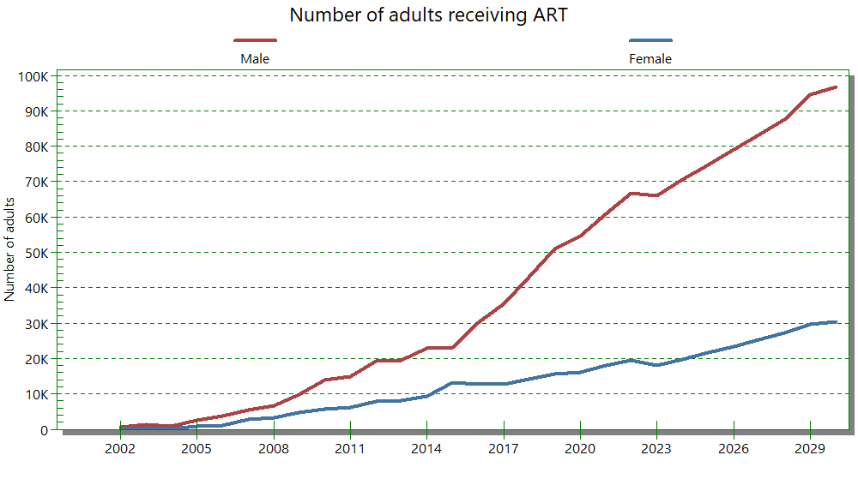
Refining and validating adult ART data and estimated coverage
Program Statistics editor
‘Plot’ the historic time trend in ART scale-up, to detect any data entry errors and unexplained fluctuations
Adjust program-reported ART numbers by a factor informed by a national Data Quality Audit
AIM Results
Treatment cascade. ART should be below Spectrum-estimated PLHIV
  for all years
  for men and women and (if applicable) children in turn.
Validation
Numbers of adults (and if applicable children) newly starting ART: Spectrum’s allocation versus program data
Numbers (currently) on ART by age: Spectrum’s allocation versus program data
Notes:
16
Adult ART is a driver of your overall epidemic estimate, since ART reduces mortality, and also infectivity and new infections.
Here a recap of the various steps and options you have to validate adult ART data.
In Program Statistics, visualize i.e. ‘Plot’ the year-on-year trend in ART scale-up. Identifying and explain or correct any sudden jumps or drops.
If you did a national Data Quality Audit, you may adjust national ART numbers according to its results. (IN the 2023 round, for example Morocco and Panama used this option – see next slide).
In Results, through ART coverage graphs and the Treatment Cascade, ensure that ART numbers never exceed the Spectrum-estimated PLHIV.
Under Validation, you may compare adults starting ART as well as the cohort currently (staying) on ART, between Spectrum's allocation and your program data.
High-burden countries with one or more national household sero-survey can also compare ART coverage with coverage measured in a survey.

Slide 18
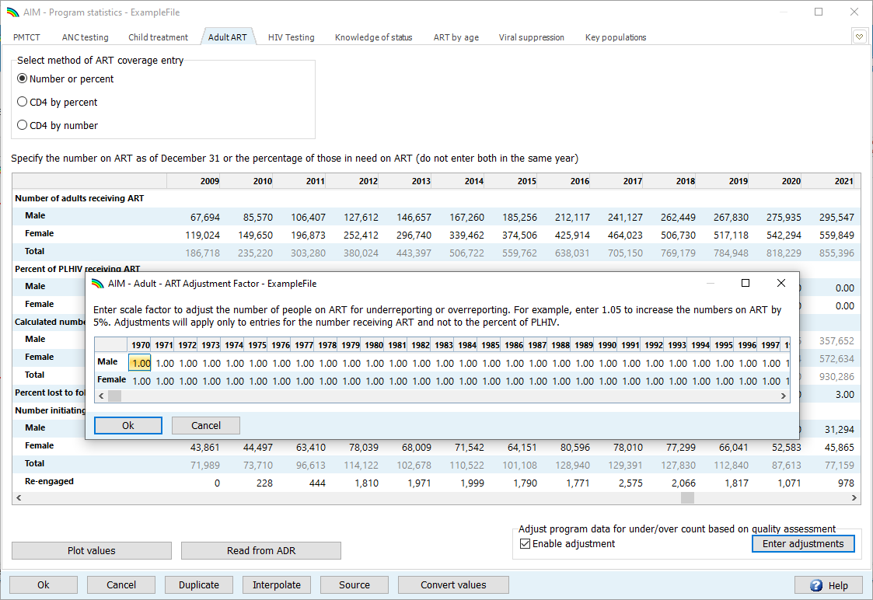
Adult ART numbers: adjust based on Data Quality Audit
You can adjust program-recorded numbers of adults on ART directly– or through an annual adjustment factor based on a national or representative Data Quality Audit.
Using the adjustment factor (for the year of DQA and optionally for years surrounding) makes your adjustments transparent.

Slide 19
What if final, full-year 2023 data are still pending?
In Jan-Feb., you may not have final program, HIV testing and surveillance data for the full year of 2023 yet.
The ‘final’ 2024 Spectrum estimate will have to wait for those,
and then refit (EPP, CSAVR, AEM or ECDC model, then AIM).
Meanwhile, you have these options for a draft Spectrum file:
ART, PMTCT:
  Leave or update 2023 as an expected % target, in line with 2022.
  As interim placeholder, put 2022 numbers for 2023.
  Enter 2023 first part-of-year data
  Do NOT leave adult ART blank! Since ART reduces HIV transmission & incidence
Prevalence-type of data (routine ANC tests & positives,
for EPP and – optional – fertility & MTCT & pediatric estimates):
  Enter the data available, e.g. the first 6 of 9 months
  – and document this in ‘Source’ field, as provisional.
New diagnoses and AIDS deaths, for CSAVR: Leave 2023 values blank.
In the Excel, please enter ALL data types even if only part of the year,
for DQA purposes
(e.g., test positivity rates corresponding to annual new diagnoses, for CSAVR)
Notes:
17
In January-February, you may not yet have the final program and surveillance data for the full year of 2023.
Your final 2024 Spectrum estimation can be fitted and completed only after that.
But meanwhile, you can proceed and do and review draft model fits, to already advance as much as possible.
What you should put into Spectrum instead of missing data varies by indicator:
For ART and PMTCT numbers: Options include setting 2023 as a target percentage based on 2022 numbers, or inputting partial-year 2023 data. DO not put 0 or else Spectrum would estimate a jump in new infections!
For prevalence-type data, like routine ANC testing data inputted to EPP and the fertility fitter, you may enter the prevalence based in the first half (or three quarters) of the year.
In CSAVR, for New diagnoses and AIDS deaths: Leave 2023 values BLANK.
All data types, even partial-year, can be entered in Excel, for Data Quality review purposes.
No matter your temporary solution, documenting the provisional status in your Data Excel file and within Spectrum in the 'Source' fields in AIM and EPP.

Slide 20
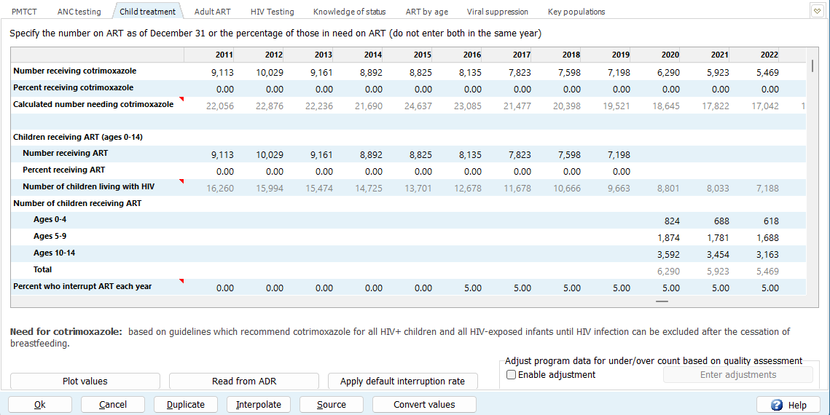
ART Dynamics
Please enter treatment interruption rates for all years with children on ART
  From a reliable national or nationally representative program data, if available
  Default rate of 5% per year – use new button in Child Treatment editor ‘Apply default interruption rate’
Treatment interruption entries do not affect numbers of children on ART (set by program data), but do refine:
  the percentage of children in the first year of treatment and their age and CD4 distribution
  Spectrum’s (new!) calculation of child Knowledge-of-Status.

Slide 21
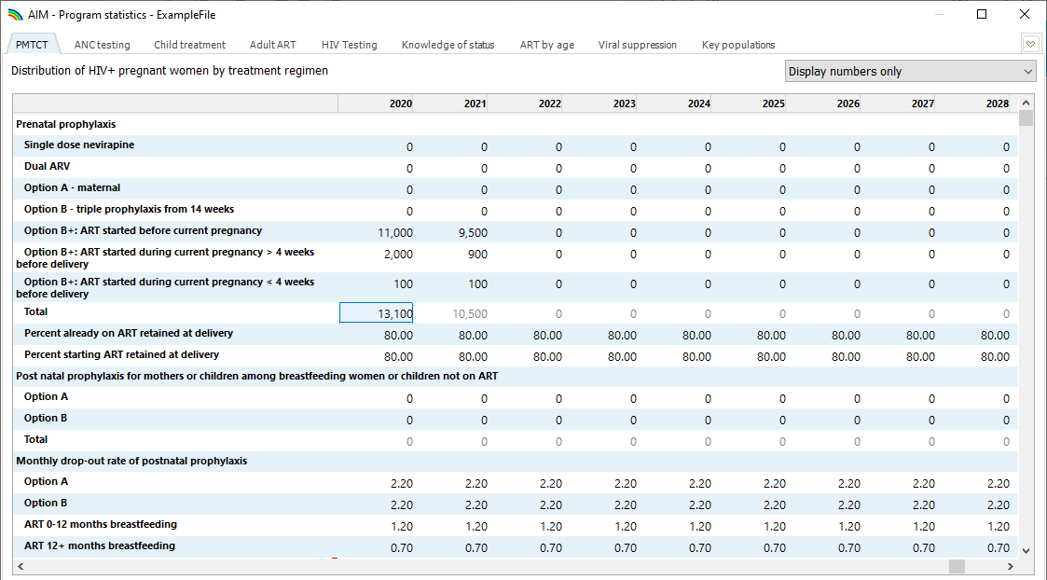
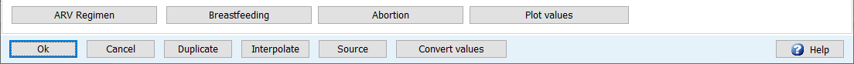
PMTCT
1
2
Display numbers
Add prenatal data for 2022
Check retention at delivery
Check monthly drop-out from ARVs during breastfeeding
Plot values
3
4
5

